Slide 1
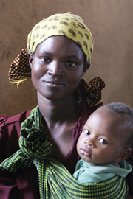
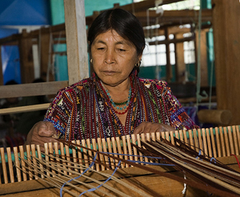
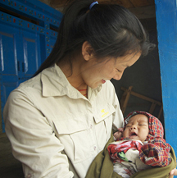
Tanzania Nursing Scholarship Program
Featured program for June 2014

Slide 2
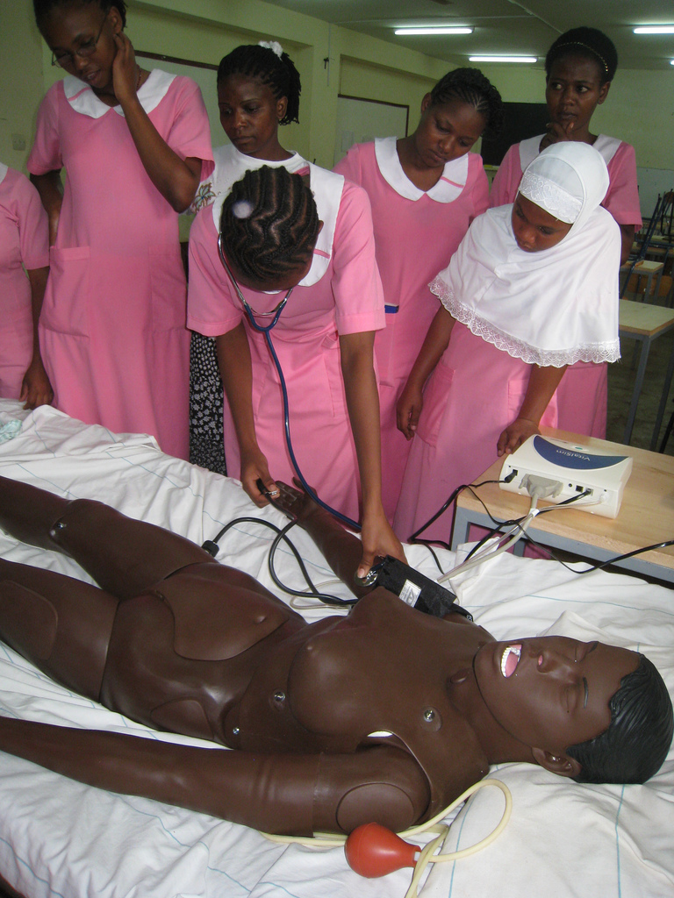
What are we supporting?
The Tanzania Nursing Scholarship Program (TNSP) sponsors and promotes young women in Tanzania to achieve dual diplomas as registered nurses/midwives.
Dining for Women’s grant will provide scholarships for 25 young Tanzanian women to complete their second and third years of nursing school.

Slide 3
Life Challenges of Women and Girls
The nursing scholarship students are from small, rural villages, and often come from single-family homes or are orphans.
Poor, rural girls face the greatest disparity in access to education: for every 100 urban boys completing primary school in Tanzania, only 53 poor rural girls do.
Although primary school is tuition free, the poorest households still struggle to pay for uniforms, books, and fees.
Insistence on girls fulfilling their traditional role in society, early marriage, and pregnancy also increase girls’ dropout rates.
The country is challenged by a severe shortage of health care professionals. According to the World Bank, Tanzania has only two nurses for every 10,000 people.
3

Slide 4
The Program
Students who meet admission requirements and are selected for placement are assigned to a slot at one of the government nursing schools.
School staff meets the student for the first time at the beginning of the new school year. At the end of the first year of nursing studies the nursing school’s staff is aware of each student’s academic progress and financial need.
Scholarship candidates are identified with the assistance of school staff. A member of the TNSP board or their in-country student coordinator reviews documentation, questions staff and conducts an interview with the student candidates.
In the course of this process they explain the sponsorship program to the student candidates. TNSP representatives sometimes visit students’ families, when they live within a day’s travel.

Slide 5
Program Budget
DFW’s grant to the Tanzania Nursing Scholarship Program is $35,000 over a two year period (will vary from budget total due to exchange rate)
DFW’s grant will directly impact the 25 young women who earn dual diplomas in nursing and midwifery.
The broadest impact will be an increase in the availability of healthcare in rural communities across the country.
Tanzania Nursing Scholarship Program | Year 1 | Year 2 | Year 3
Commitment | 9/1/2014 - 8/31/2015 | 9/1/2015 - 8/31/2016 | 9/1/2017 - 8/31/2018 | Total
Number of students selected for sponsorship (DFW Grant) | 13 | 12 | 0 | 25
Commitment cost (per student) | $ 1,396.69 | $ 1,396.69 |  | N/A
Incurred Cost Total | $ 18,156.94 | $ 16,760.25 |  | $ 34,917.20
Cash Outlay (Students selected Year 1) | $ 9,749.17 | $ 8,407.77 |  | $ 18,156.94
Cash Outlay (Students selected Year 2) |  | $ 8,999.24 | $ 7,761.02 | $ 16,760.25
Total Cash Outlay |  |  |  | $ 34,917.20

Slide 6
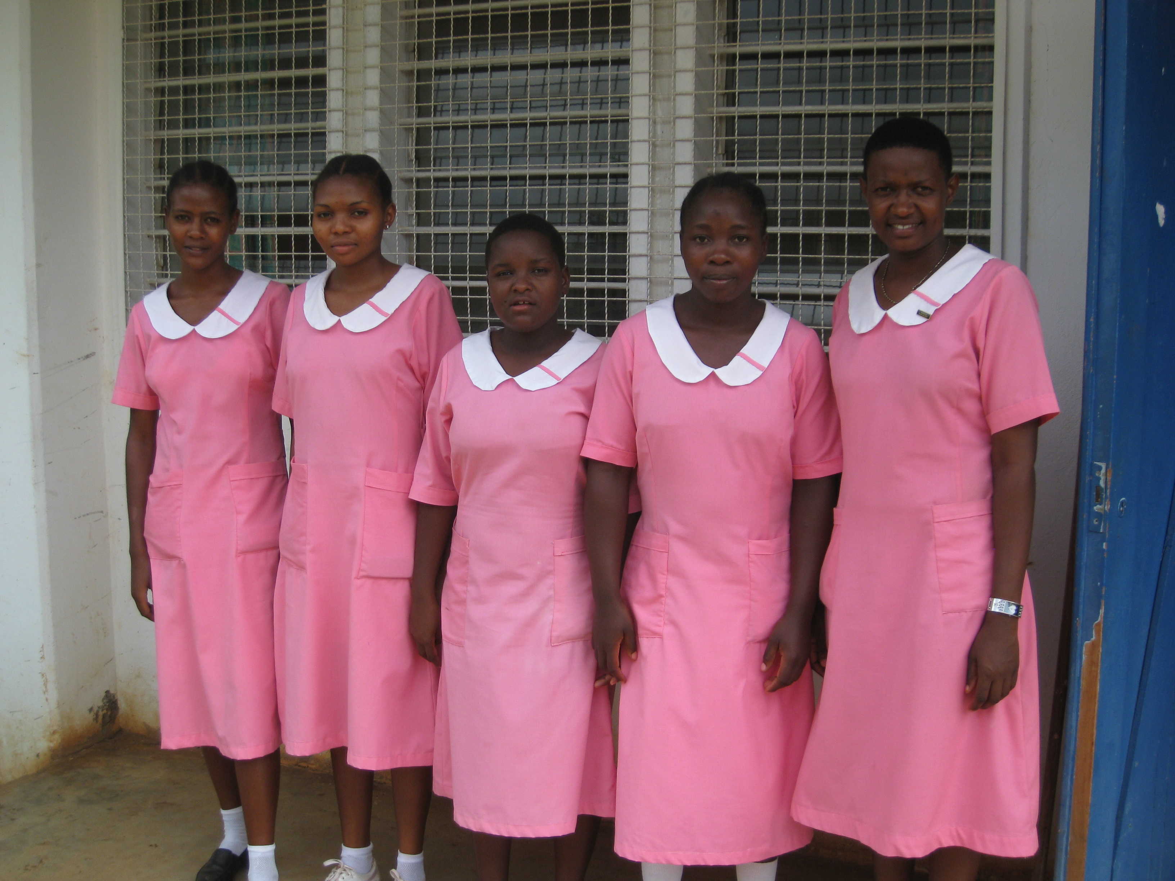
Why we Love this Program
We love the fact that professional degrees in nursing and midwifery will bring 25 bright, young students dignity, self-reliance and increased
esteem in the eyes of their
families and communities.
2013 Graduates
We love that their training will bring vital medical care to the people of Tanzania.

Slide 7
Evidence of Success
At present, 100 percent of the students sponsored by TNSP have graduated and passed examinations on schedule.
In addition, 17 students will be taking (or have taken) their national examination this year.
TNSP obtains grades for the students they sponsor. Although they expect students to maintain passing grades, the organization does not expect all students to be high achievers. This is due to the varied quality of the schools the sponsored students have experienced and their English language skills (classes are taught in English).
TNSP maintains communications during the school year with the principal of each of the schools. They require each student to submit a monthly progress report.

Slide 8
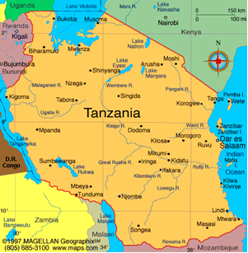
About the Organization
The Tanzania Nursing Scholarship Program was created by three nurses who believed they could increase the availability of medical care in Tanzania by sponsoring individual students through nursing school.
Located in East Africa, Tanzania shares borders with 7 neighboring countries and the Indian Ocean to the East.
45 percent of the population is under the age of 14.
Infant mortality: 43.7/1,000 live births (US 6.3)
The 2010 literacy rate was 79% for men and 67% for women

Slide 9
Questions for Discussion
Care to share your thoughts?
Why might the scholarship program not fund the young women’s first year of nursing school?
In what ways do access to healthcare and access to education impact one another?
What are some factors that contribute to the low quantity of healthcare workers in rural areas?

