Slide 2
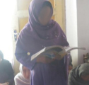
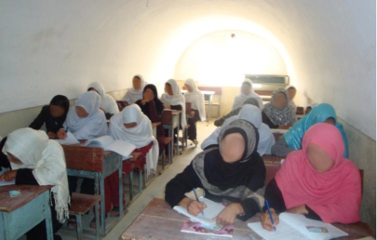
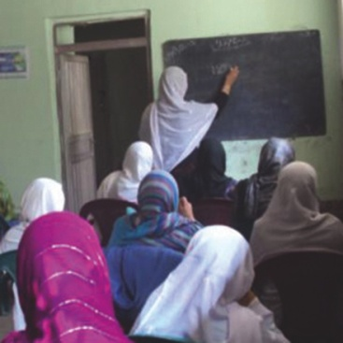
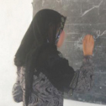
Educating Children and Empowering Women Growing the Future of Afghanistan’s Next Generation
John Bortner, President, Board of Directors

Slide 3
What We Do
Afghan Friends Network (AFN) delivers sustainable programs in education and cultural exchange that promote self-sufficiency and empower Afghans, in particular women and girls
Through education AFN empowers the current and future generations of Afghans
Founded in 2002 to extend a hand of friendship to Afghans who had already been through 22 years of war and were still suffering with continued unrest
— Co-founders Carol Ruth Silver and Humaira Ghilzai knew the support was imperative
AFN has low overhead as an all-volunteer, grass-roots organization
Funds raised go directly to programs in Afghanistan
— AFN provides support directly to the people who need it most in Afghanistan
Afghan locals in Ghazni define and execute the projects based on real needs
— AFN helps locals achieve their dreams
AFN board sets a high standard for fiscal responsibility and program excellence
— Financial checks and balances with professional book keeping firm
— Ongoing program reviews

Slide 4
Why Afghanistan?
Afghanistan has been ravaged by 33 years of war
Women and children have suffered the most during the turmoil
In the past decade, the country is still lacking basic essentials based on US State Department guidelines
Security, basic education, adequate healthcare, clean water, and basic infrastructure
40% of Afghans live below the poverty line
Female literacy is at a mere 16%; male literacy is only moderately higher at 34%
8 out of 10 Afghan females lack access to education
AFN focuses on regional educational programs that promote self sufficiency
AFN empowers Afghans to raise above the horrifying statistics

Slide 5
We Focus on Underserved Communities
AFN projects are in Ghazni Province
Afghanistan’s 2nd largest province, 60 miles southwest of Kabul
Historically Ghazni has had little support from the international community
According to NATO forces, Ghazni is the second most dangerous province in Afghanistan but also a very important province right in the center of Afghanistan
Most aid goes to Kabul or other famous cities; AFN can make a difference in Ghazni with our support
We work with Ghazni locals and have the support of the community
Ghazni Province residents have advocated for improved education for both girls and boys.
AFN has established strong ties with local leaders, educators and NATO forces in Ghazni which enables us to effectively execute projects.

Slide 6
“Education is the most powerful weapon which you can use to change the world.” ― Nelson Mandela
There is deep desire among Afghans to become educated, especially among girls
Many Afghan fathers, who have spoken to our board, want their daughters to be educated
In the 33 years of war, the Afghan education system has suffered from lack of funding, administrators, competent teachers, and security
In the past decade, more than 4.5 million children have re-entered school, 40% of which are girls
The Afghan government is not able to keep up with the demand
— School hours are reduced by 40%; school days are divided into 2 to 3 shifts
— Teacher to student ratio is 1: 90
AFN works with local educators to improve education opportunities

Slide 7
AFN Educational Programs
Khurasan Learning Centers
Provides math, science, English, and college prep courses for 7th-12th graders
Combined, our learning centers annually serve nearly 500 girls and 250 boys
Women’s Literacy Classes
Designed to help women—especially widows—learn reading, writing, basic math
They create handicrafts which generate funds that are used to buy rice, flour, oil, sugar, and other household items that support their families
80 women participate each year in the program held at two locations
Scholarship Program
University education is just a dream for most Afghan youth
AFN provides scholarship to achieve these dreams
We currently have 16 girls and 4 boys receiving the financial support they need to attend university to reach their goal of becoming educated and successful

Slide 8
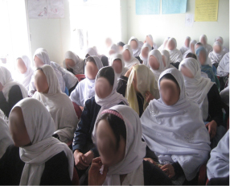
Khurasan Learning Centers for Girls
In 2006, the year before the first KLC opened, only one girl in our district of Ghazni was accepted to university
In 2011, all 84 senior girls from the KLC passed the university entrance exam
KLC centers are open 6 days a week, year round
Learning centers are well established and are supported by the community
Teachers donate personal time
Community members donate resources
Parents help with fixing the roof or buying extra wood for heaters
Dedicated to their education, some girls walk up to 1.5 hours each way to get to our centers

Slide 9
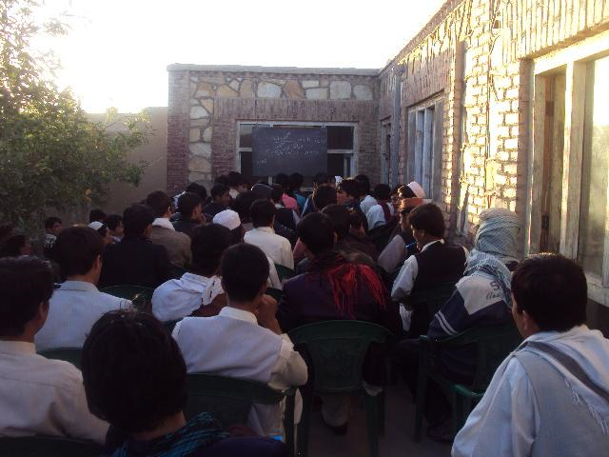
Khurasan Learning Centers for Boys
Why Boys?
Parents of the girls who attend the KLC, asked us to create a learning center for boys too
In a nation with 40% of the populations under the age of 14, boys can’t be ignored
AFN is one of the few organizations who is also helping Afghan boys
Established in April 2010, the boys learning center was immediately filled to capacity
In 2011, all 35 senior boys from the KLC passed the university entrance exams
“Only educated men with jobs and self-esteem will rise to support their women and girls.” Humaira Ghilzai, AFN Co-founder

Slide 10
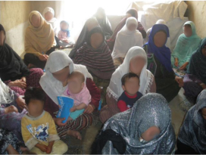
Women’s Literacy Class
The mothers of our students asked us to provide literacy classes so they could gain basic reading and writing skills
At an age around 35, they finally learn to write their names, read, and do basic math
Literacy classes are for three years to cover grades 1-3; over 160 women have participated
Women create handicrafts which are sold in the market; they receive basic household items with the pooled profits
Participants asked to learn about women’s rights
The classes are a community where women can gather, talk, and support each other
Participants gain self esteem, confidence, and hope
“When the women first come, they are quiet. Some of them are depressed. After a few weeks, I see them laughing and talking. It makes me happy.”
Fatema, Director, KLC

Slide 11
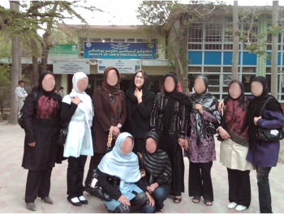
AFN Scholarship Recipients The Future of Afghanistan
$450 a year allows the brightest and neediest students to attend university
In 2011, two of our first scholarship recipients graduated from university
Both Monisa and Fahima have returned to their communities and are working as a nurse and a midwife
Monisa now earns $300 a month; more than her father
AFN representative in Kabul meets with scholarship recipients each quarter to check on their progress and learn about their coursework

Slide 12
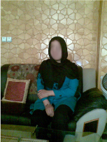
Touching the Community
Educating entire families such as Sameera, her sisters and her mother who attends the literacy program
Putting money back into the Afghan community
Providing salaries for almost 25 teachers, administrators, and other workers; and the rental of three buildings and the purchase of school supplies
Bringing the community together around their desire for education and a better future
KLC attendees inspire their families and communities to empower themselves through education

Slide 13
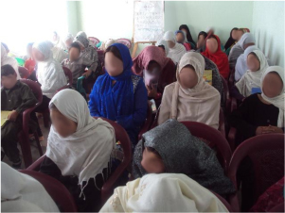
AFN is Making a Difference
Provided 1,500 women, girls and boys access to education
Helped financially support 22 university students
Afghan Ministry of Education wants to use the KLC model in other provinces

Slide 14
The AFN Board is Active in the United States and in Afghanistan
AFN educates our community in the United States in various ways including on Afghan culture, the current situation, and Afghanistan’s history
Speaking engagements and support for talks at The Commonwealth Club, local schools and universities, community organizations, and at our own events
Support of cultural events, author talks, and museum exhibitions
AFN board members visit Afghanistan, the KLCs, and students and teachers every year

Slide 15
The Future
Expand programs in a way that is scalable and sustainable
Increase the number of scholarship recipients each year
Identify additional programs to supplement the current KLC model
Work closely with the community leaders to identify the most needed educational opportunities
Continue outreach locally on Afghan culture and issues

Slide 16
“When you Educate a Women, you Create a Nation.” ― Hafez Ibrahim, Egyptian poet
Each dollar goes a long way in Afghanistan…
— $200 pays the salaries of 2 teachers for one month
— $210 pays to heat 2 KLC locations during the cold winters
— $450 sends one KLC graduate to university for 1 year
— $500 pays to educate 8 girls at the KLC for one year
— $1000 pays the rent of one KLC location for 3 months.
…. and in this giving, we gain so much.

Slide 17
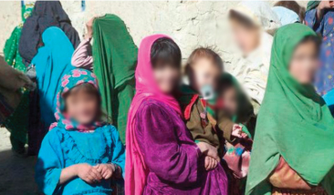
Our students are the seeds that will grow the future of Afghanistan’s next generation

Slide 18
Thank You
Afghan Friends Network thanks Dining for Women for all you do to empower women and girls globally and for supporting us as we work to educate the girls and women of Afghanistan

