Slide 1
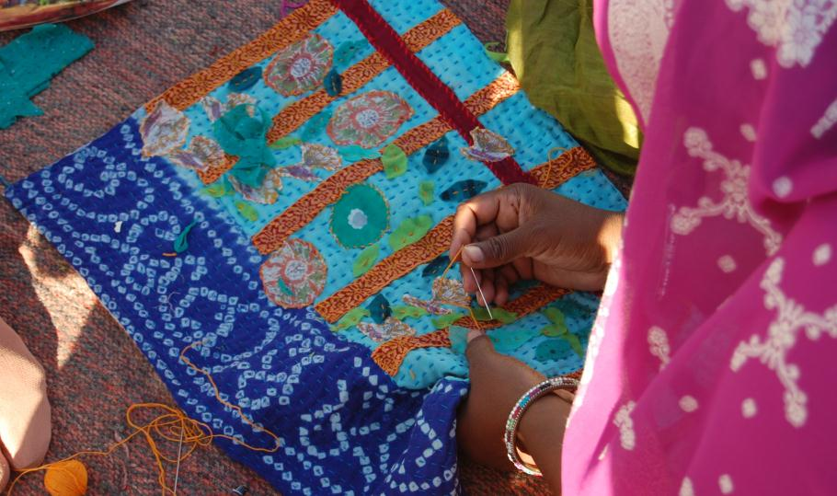
designing change, stitch by stitch

Slide 2
mission:
Anchal merges design, business, and education to empower marginalized and exploited women living in India.

Slide 3
anchal:
In Hindi, anchal refers to the edge of a sari used to provide comfort and protection for loved ones.

Slide 4
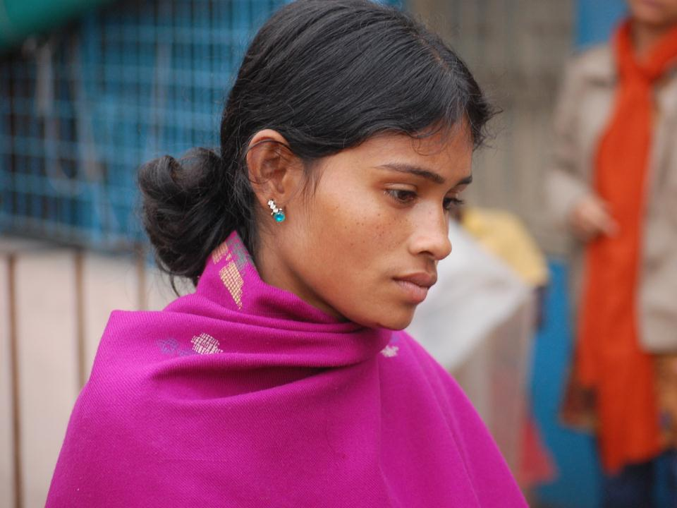

Slide 5
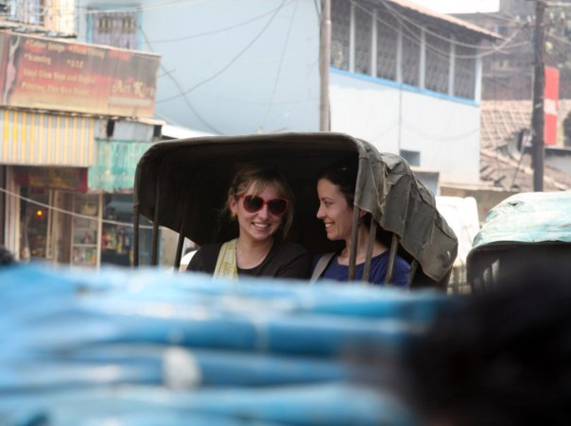
history

Slide 6
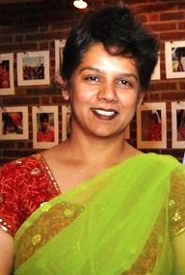
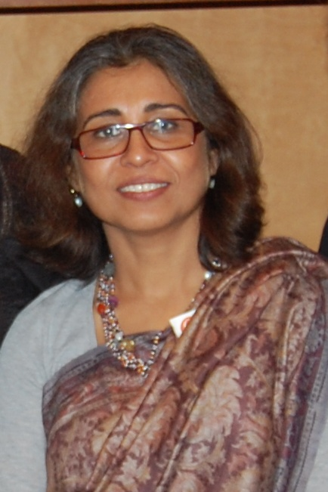
Vatsalya – Ajmer, India
jaimala gupta, executive director
New Light – Kolkata, India
urmi basu, executive director
partnerships

Slide 7
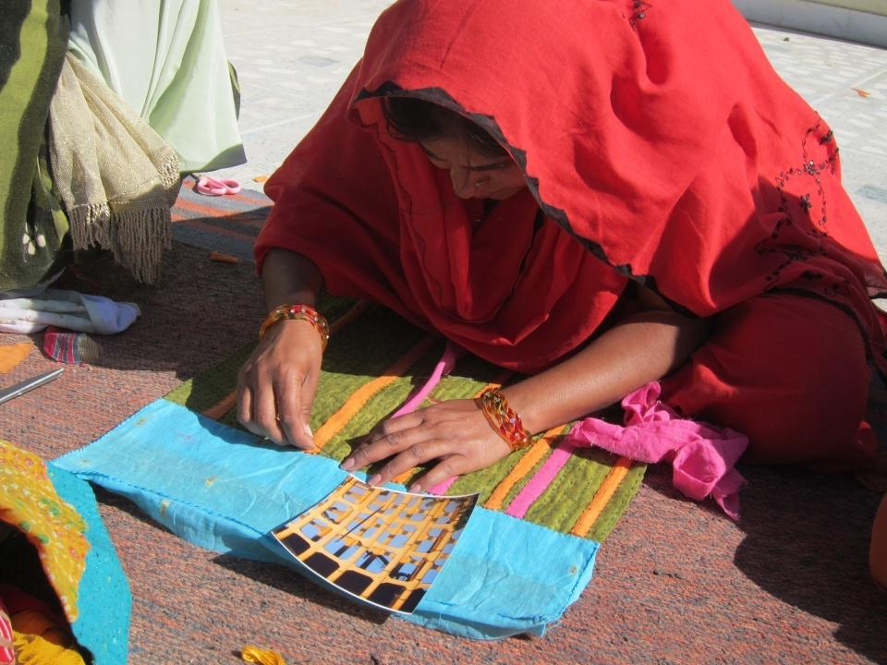
design

Slide 8
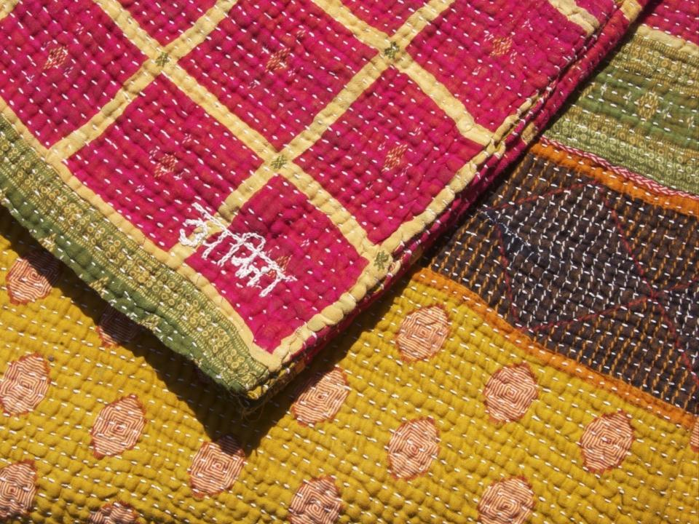
social enterprise

Slide 9
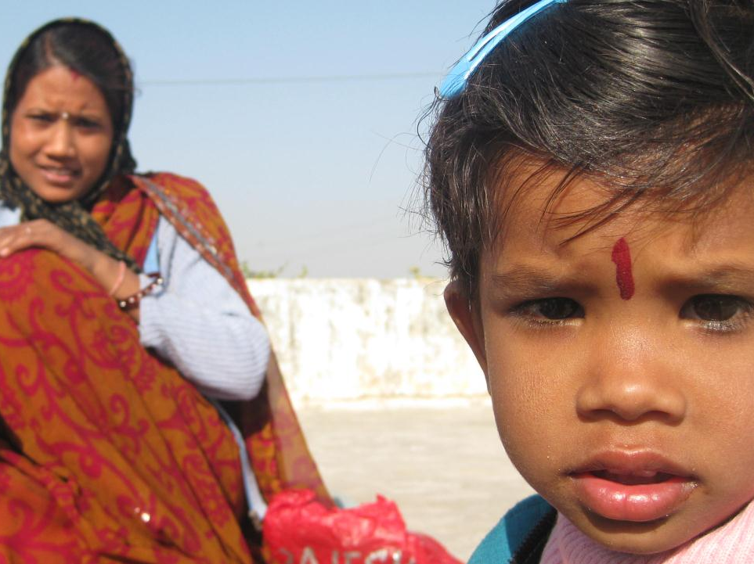
impact

Slide 10
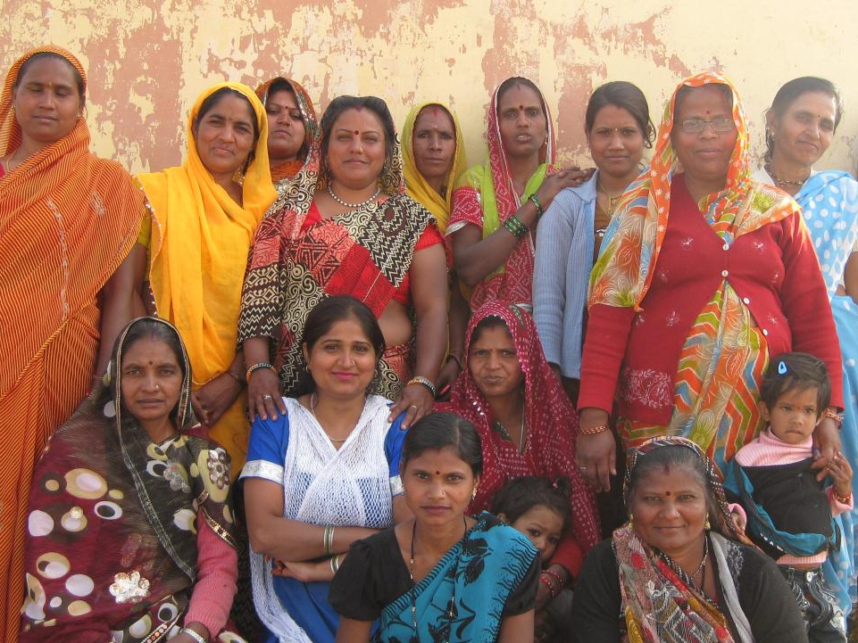
need

Slide 11
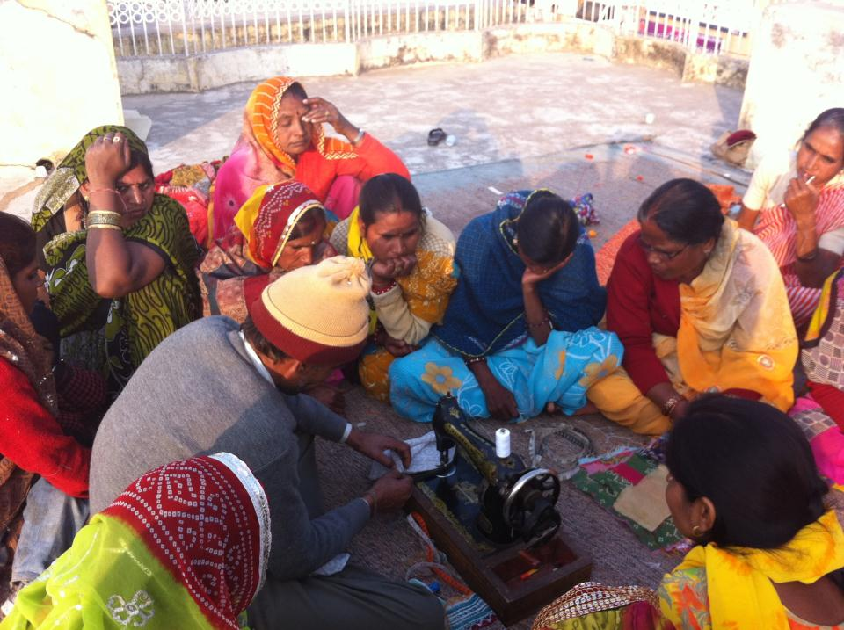
program

Slide 12
budget:
Training new artisans (30 from waiting list)
$90 artisan sponsorship (1 month)
$440 design training for 30 women (1 session)
Educational workshops
$24 financial planning for 50 women (1 workshop)
$32 health education for 50 women (1 workshop)
$45 holistic healing for 50 women (1 workshop)
Infrastructure
$300 new workshop space (1 month)
$366 new sewing machines and tools

Slide 13
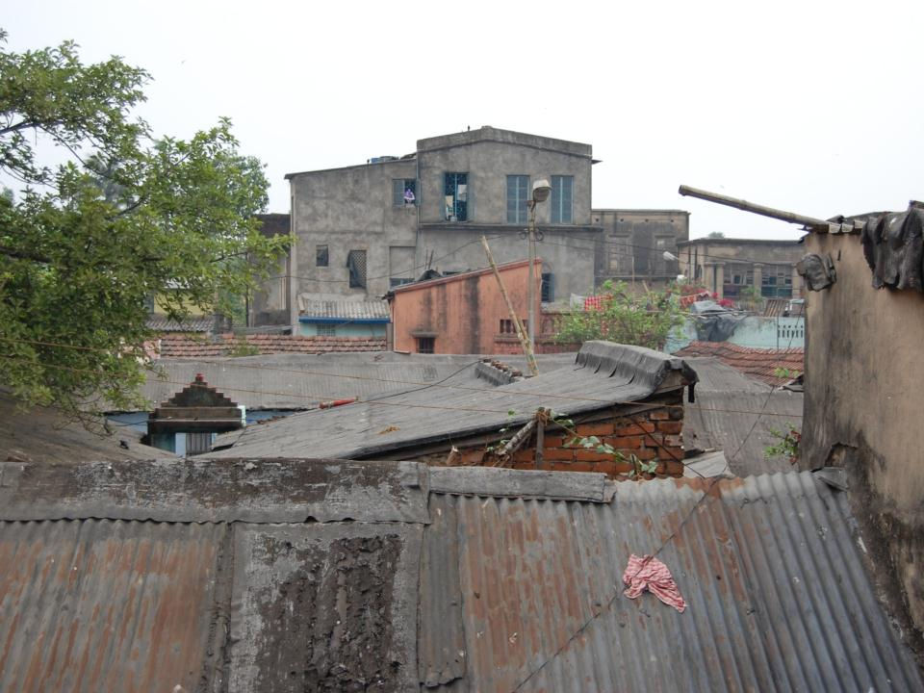
un’s mdg

Slide 14
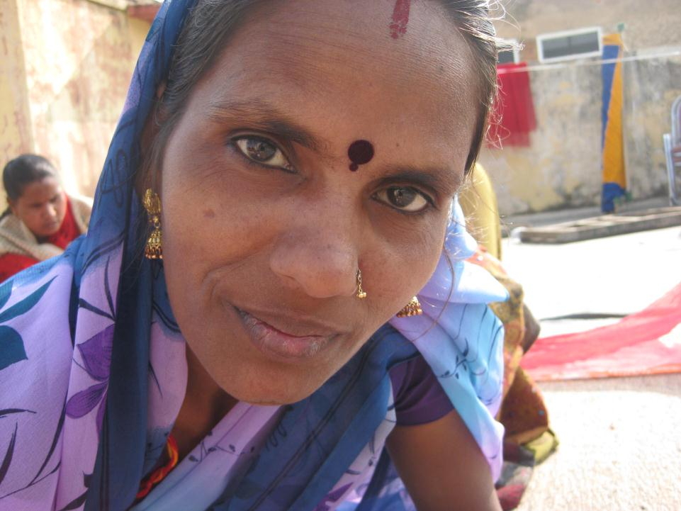
future

Slide 15
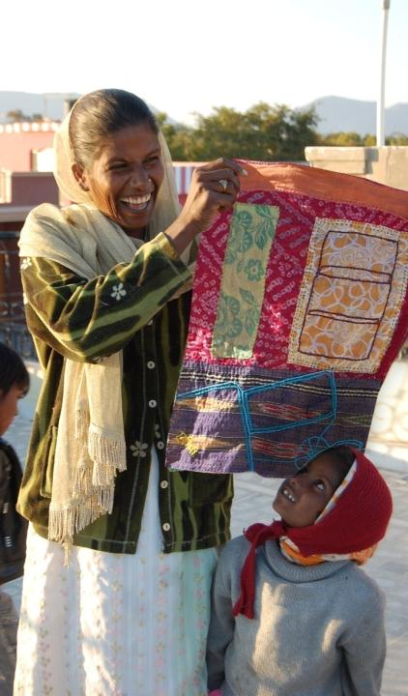
thank you
Dining for Women
www.anchalproject.org

