Slide 1
Welcome to…
Women as Peace Partners
Presented by:
Tanya E. Henderson, Public Policy Director,
Women’s Action for New Directions (WAND)

Slide 2
Women as Peace Partners: UN SCR 1325; the U.S. National Action Plan on Women, Peace and Security; …and Onward
By Tanya Henderson
Public Policy Director, WAND
Notes:
Good Afternoon! My name is Tanya Henderson, I am the new WPS Public Policy Director for WAND. The policy area of Women, Peace and Security is rapidly growing around the globe, and over the past year, the U.S, has taken huge steps to ensuring that women are equal partners in all aspects of peace-building and conflict resolution. So I am so happy to have you all here today to discuss this critically important topic to establishing sustainable and just peace.
Before we begin, however, I would like to note that today is the 11th Anniversary of 9/11…..

Slide 3
Women, Peace and Security: “The goal is as simple as it is profound:
To empower half the world’s population as equal partners in preventing conflict and building peace in countries threatened and affected by war, violence and insecurity.
Achieving this goal is critical to our national and global security.”
The U.S. National Action Plan on Women, Peace, and Security

Slide 4
Today
1. Overview: UN SCR 1325 and Women,Peace and Security Agenda (WPS).
2. U.S. implementation of Women, Peace and Security policies: (U.S. National Action Plan)
3. WAND’s WPS Program
4. What can you do? Action items.

Slide 5
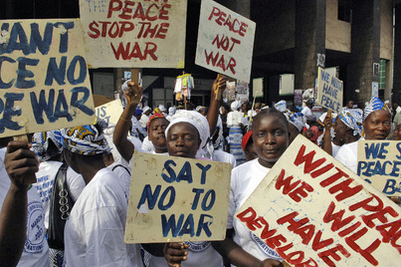
UN SECURITY COUNCIL RESOULTION 1325
Adopted unanimously in October 2000, UN Security Council Resolution 1325 on Women, Peace and Security is a landmark commitment to women in conflict that seeks to:
Repair the lack of equal participation of women in peace and post-conflict negotiations across the world
Safeguard women and children wherever conflict erupts
Resolution 1325 makes it clear that women’s participation and security is critical for international peace and security
It also provides a groundbreaking policy and practical framework for women’s participation in peacebuilding
Notes:
Women, Peace and Security or “WPS” is an international policy agenda that promotes the equal participation of women in preventing conflict and securing peace, and protects women and girls from gender based violence, particularly sexual violence, during war and crisis.

Slide 6
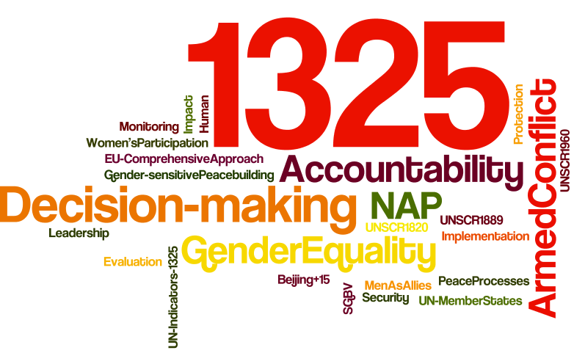
UN SCR 1325 and WPS Agenda
SCR 1325 plus subsequent resolutions 1820, 1888, 1889, and 1960 make up the Women, Peace and Security agenda (WPS).
Follow up resolutions address sexual violence, women and conflict, and women’s participation in government and peace processes.
Resolution 1325 requires UN member states to develop National Action Plans (NAPs) that provide for women’s participation in peace and conflict decision-making; the protection of women and girls; and gender training.
Countries are more peaceful and prosperous when women are accorded full and equal rights and opportunity.”
Former Sec. of State Clinton
Notes:
The WPS Agenda is rooted in United Nations Security Council Resolution 1325 enacted in 2000 (UN SCR1325), and its 4 follow-up resolutions (1820, 1888, 1889, and 1960) which collectively seek to address the disproportionate impact of modern warfare on women and girls and the necessity of substantively including women, representing half the population, in all efforts to promote peace and security.
In the 1990’s, with the fall of the Soviet Union and an end to the Cold War, the nature of war began to shift. The rise in violent intra-state conflict concerning ethnic and religious identities, control of natural resources, and economic and political power resulted in systematic acts of terror against civilian populations from Bosnia to Rwanda and Latin America to Liberia.
For women, the impact of this changing nature of warfare was devastatingly similar across all conflicts. According to statistics compiled by the World YWCA, 90percent of current war casualties are civilians, the majority of whom are women and children. Sexual violence, abduction for sexual slavery and for fighting, and forced displacement emerged as strategic new tactics of war.
Yet, within these same conflicts women were also emerging as critical actors of peace, mobilizing communities across religious and ethnic divides and using their social roles and networks to mitigate violence and mediate peace.

Slide 7
Women War and Peace Produced by Abigail Disney, Pamela Hogan, and Gini Reticker http://www.pbs.org/wnet/women-war-and-peace/features/women-war-peace-series-preview/

Slide 8
WPS applies to all aspects of peace-building and conflict prevention:
Notes:
Therefore the Goal: Full and equal participation of women in all peace and security matters means that…

Slide 9
From peace negotiations …
Somali women emerged as crucial peace-builders during the period of civil war (Aug. 2012).
accessed at /www.insightonconflict.org
Notes:
to elections to demobilization, disarmament, transitional justice systems and reintegration

Slide 10
Peace agreements…
Representatives sign pledges to promote justice and fight against impunity in Congo (Dec, 2011)
accessed at www.enoughproject.org

Slide 11
And support operations…
Indian women in peacekeeping forces contribute to post conflict reconstruction.
accessed at http://news4u.co.in
Notes:
Stressing that greater participation of women in post conflict reconstruction is the “sine qua non” for lasting peace and security, India has called for more deployment of females in peacekeeping forces.

Slide 12
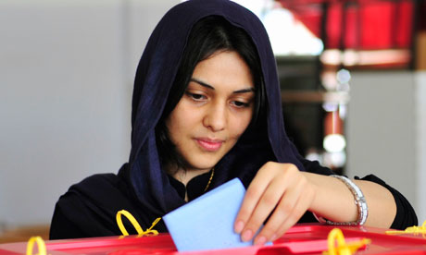
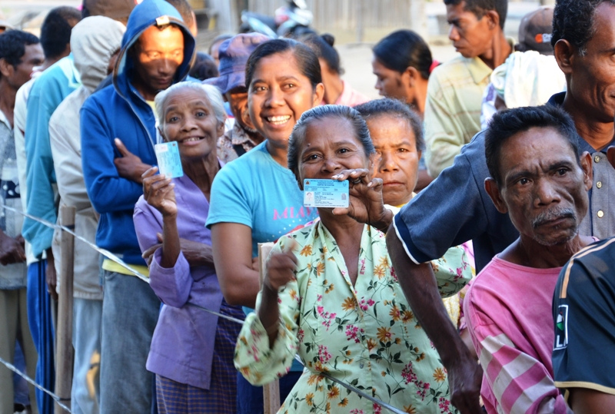
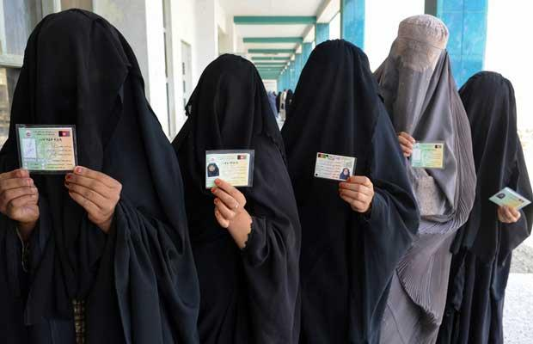
…To elections

Slide 13
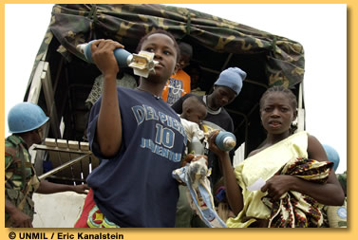
Demobilization…
Women fighters turning in mortar shells during Liberia's disarmament and demobilization process.
Accessed at www.un.org

Slide 14
To disarmament…
Secretary Clinton at the Conference on Disarmament in Geneva. (Feb. 28, 2011)

Slide 15
Transitional justice systems…
Transitional Justice Training Workshop in Yemen (April 2012).
accessed at www.womenpress.org

Slide 16
And reintegration.
Parliamentarians, Farida Hamidi and Frishta Amini, delegates from Nimroz Province in Southwest Afghanistan.
accessed at /www.ndi.org
Notes:
Nimroz is the only province represented by two women and the only place in Afghanistan, and one of the few places in the world, where a woman was elected outside of a quota system that reserves a certain number of legislative seats for women.

Slide 17
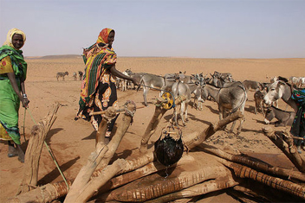
Reconstruction...
Woman drawing water from a well in Darfur.
accessed at www.policyinnovations.org

Slide 18
Why does SCR 1325 and WPS matter so much?
There are roughly 40 active conflicts in the world, today.
More than ½ of all peace agreements fail within the first 10 years.
Women are grossly underrepresented in peace and conflict negotiations.
Of the 40 conflicts in the last decade, 31 represent repeated cycles of violence with a disproportionate impact on women and children.
Notes:
Despite the crucial role women were playing to prevent and resolve conflict, they continued to be systematically marginalized during most peace negotiations. In the last two decades, women were less than 8% of the participants in key peace negotiations and less than 3% of the signatories of the resulting accords. Only 16 percent of agreements during this period mentioned women at all. Interestingly, in the 1990’s 50% of negotiated peace agreements didn’t make it to their 5th Anniversary, and of the 39 conflicts in the last decade, 31 represent repeated cycles of violence with a disproportionate impact on women and children.

Slide 19
And…
Sexual and gender based violence (SGBV) against women and girls has been deployed as a deliberate tool of war – often with impunity ( no prosecution or justice).
Forced displacement associated with conflict exposes refugees, particularly women and girls, to additional risks of violence and exploitation.
Evidence shows that increased violence against women can be an early indicator of impending conflict.
Frequently, women hold critical knowledge about impending or escalating conflict, but are overlooked or unable to report their concerns safely. **
Notes:
**For example:
In Kosovo, women observed the growth of arms caches, but had no one to whom they could report their concerns. Similarly, women in Sierra Leone knew of plans to attack UN peacekeepers, but threats to their personal safety prevented them from relaying that information.

Slide 20
And…
There is a correlation between return to violent conflict and lack of healthcare, economic opportunity, and education for women.
Women carry much of the burden of rebuilding communities in post-conflict settings.
When included as meaningful participants women expand the scope of discussion to include the broader set of critical priorities required for just and lasting peace.**
Notes:
**For example,
In Northern Ireland, women negotiators secured commitments in the 1998 Good Friday Agreement to involve young people and victims of violence in reconciliation; to accelerate the release and reintegration of political prisoners; and to ensure an integrated education system and integrated housing.
In the 1990s, Guatemalan women involved in negotiations to end a 36-year civil war secured important protections for labor and indigenous rights as well as guarantees of a balance in civilian and military power. They also enshrined commitments to women’s equal rights and participation in the peace accords.
Darfurian women, who provided gender expertise to African Union-mediated talks in 2005, shined a spotlight on the need to provide protection for the vulnerable and displaced and highlighted a wide range of critical gender concerns related to land rights and physical security. These women inserted critical issues into the talks that negotiators had previously ignored.

Slide 21
How does UN Security Resolution1325 and the Women, Peace, and Security apply to the U.S.?

Slide 22
U.S. and the WPS Agenda
Under its Presidency of UN Security Council, the U.S. introduced 3 out of the 4 follow up resolutions. (SCR 1820, 1888, 1960).
WPS has had Bi-Partisan political support.
In 2000, the UN Security Council passed Resolution 1325 with the backing of a Democratic administration.
In 2008, a Republican administration sponsored the follow-up UNSCR1820 recognizing rape as a tactic of war and threat to peace and security.
U.S. is a major stakeholder in peace processes.
Notes:
Resolution 1820? Passed in 2008, Resolution 1820 recognizes that conflict-related sexual violence is a tactic of warfare, and calls for the training of troops on preventing and responding to sexual violence, deployment of more women to peace operations, and enforcement of zero-tolerance policies for peacekeepers with regards to acts of sexual exploitation or abuse.
Resolution 1888? Passed in 2009, Resolution 1888 strengthens the implementation of Resolution 1820 by calling for leadership to address conflict-related sexual violence, deployment of teams (military and gender experts) to critical conflict areas, and improved monitoring and reporting on conflict trends and perpetrators.
Resolution 1960? Passed in December 2010, Resolution 1960 calls for an end to sexual violence in armed conflict, particularly against women and girls, and provides measures aimed at ending impunity for perpetrators of sexual violence, including through sanctions and reporting measures.
The United States , As a major donor to conflict affected countries, as a contributor of armed forces, and as a mediator and stakeholder in international peace and conflict negotiations, the U.S. holds a leadership role under SCR1325.
**Resolution 1889? Passed in 2009, Resolution 1889 addresses obstacles to women’s participation in peace processes and calls for development of global indicators to track the implementation of Resolution 1325, and improvement of international and national responses to the needs of women in conflict and post-conflict settings.

Slide 23
On October 26, 2010, at the 10th Anniversary of UN Security Council Resolution 1325, Secretary of State Hillary Rodham Clinton announced the United States commitment to developing a National Action Plan on Women, Peace, and Security (U.S. NAP).
Recognizing….

Slide 24
“ The only way to reduce the number of conflicts around the world, to eliminate rape as a weapon of war, to combat the culture of impunity for sexual violence, to build sustainable peace– is to draw on the full contributions of both men and women in every aspect of peacemaking, peacekeeping and peace building.”
U.S. Secretary of State, Hilary Rodham Clinton

Slide 25
On December 19, 2011, President Obama issued an executive order directing the implementation of the United States’ first-ever National Action Plan on Women, Peace, and Security.
Joining 35 other countries around the world committed to advancing the goals of UNSCR 1325 and Women Peace and Security.
Notes:
There are now 42 countries in the world that have a National Action Plan

Slide 26
Statement of National Policy on WPS:
The engagement and protection of women as agents of peace and stability will be central to the United States’ efforts to promote security, prevent, respond to, and resolve conflict, and rebuild societies.
In executing this policy, the U.S. will be guided by the principle of inclusion, seeking out the views and participation of a wide variety of stakeholders—women and girls, men and boys, and members of marginalized groups.
The U.S. will ensure that the WPS agenda is coordinated among all relevant govt. department and agencies, and integrated into relevant U.S. foreign policy initiatives and engagement with international partners.
U.S. governmental agencies will be accountable for the implementation of the NAP.
U.S. NAP on WPS 2011
Notes:
The engagement and protection of women as agents of peace and stability will be central to the United States’ efforts to promote security, prevent, respond to, and resolve conflict, and rebuild societies.
1. By building on the goals for gender integration described in the United States National Security Strategy and the Quadrennial Diplomacy and Development Review, the United States’ efforts on Women, Peace, and Security will complement and enhance existing initiatives to advance gender equality and women’s empowerment, ensure respect for human rights, and address the needs of vulnerable populations in crisis and conflict environments.
2. Marginialized groups identified in the NAP include: youth, ethnic, racial or religious minorities, persons with disabilities, displaced persons and indigenous peoples, lesbian, gay, bisexual and transgender (LGBT) individuals, and people from all socioeconomic strata.

Slide 27
U.S. NAP on WPS: Objectives and Framework
National Integration
and Institutionalization
of a Gender Responsive
Approach
Participation
in Peace Processes and
Decision-Making
Protection from Violence
Conflict Prevention
Access to Relief and Recovery
Notes:
A. National Integration and Institutionalization: Outcomes include:
Establish policy frameworks to achieve gender equality and empowerment in ALL diplomatic, development and defense work
Through gender sensitivity trainings, enhance staff capacity for applying gender responsive approach at ALL levels.
Establish mechanisms for accountability and implementation of gender-related policies.
Establish processes to evaluate and learn from WPS initiatives.
B. Participation: Outcomes include:
More women are effectively engaged in peace negotiations, security initiatives, conflict prevention, peace-building (including formal and informal processes) and decision making during all phases of conflict prevention and resolution, and transition.
Laws, policies and practices in partner nations promote and strengthen gender equality at national and local levels.
C. Protection From Violence: Outcomes include:
Risks of sexual and gender based violence (SGBV) in conflict-affected environments are decreased through the increased capacity of individuals, communities, and protection actors (peace-keeping forces, security personnel, ect.) to address the threats and vulnerability associated with SGBV.
Laws, policies, and transitional justice and accountability mechanisms are implemented to combat exploitation, abuse, discrimination and violence against women and girls at national and local levels.
Interventions are improved to prevent and protect human trafficking victims and survivors, in conflict-affected areas.
4. Men and boys are better protected from SGBV, and are mobilized as partners in the prevention of SGBV.
D. Conflict Prevention: Outcomes include:
Conflict early warning systems; (i.) include gender specific data; (ii.) are responsive to SGBV; and (iii.) women actively participate in early warning preparedness and response initiatives.
Women and girls participate in economic recovery, and have increased access to healthcare and education services.
E. Access to Relief and Recovery: Outcomes include:
Gender and protection issues are explicitly and systematically integrated and evaluated as part of response to crisis and disaster.
Relief and recovery assistance includes enhanced measures to prevent and respond to SGBV in conflict and post-conflict affected environments.
Reintegration and early recovery programs address the distinct needs of women and men.

Slide 28
The Women, Peace, and Security Act of 2013.
Within the next few months Congress will re-introduce the WPS Act.
A BILL
To ensure that the United States promotes women's meaningful inclusion and participation in mediation and negotiation processes undertaken in order to prevent, mitigate, or resolve violent conflict and implements the United States National Action Plan on Women, Peace, and Security.
Be it enacted by the Senate and House of Representatives of the United States of America in Congress assembled,
Notes:
Making U.S. NAP and WPS Policy into law would be necessary to ensure that “The engagement and protection of women as agents of peace and stability remain central to the United States’ efforts to promote security, prevent, respond to, and resolve conflict, and rebuild societies.
Without implementing laws in place, a change in administration or even a change in the role of Secretary of State, could result in superficial commitments from Govt. agencies to adhere to the policies and practices outlined in the NAP

Slide 29
Grass Tops
How does WAND’s work advance the Women, Peace and Security Agenda?
Grass Roots
Notes:
WAND believes that in order to advance sustainable and concrete change and “paradigm shifts”, activism must be engaged at both a grass roots level (civil society, mobilized NGO’s direct service actors), and at “grass tops level” where policy and decision makers are advocating for the needs of the base.

Slide 30
WAND’s Women, Peace, and Security (WPS) Program leverages the work and resources of WAND, our grassroots organization and WiLL our network of nearly 700 women state and federal legislators to ensure that women are at the tables of power where decisions are made concerning U.S. engagement on matters of peace and security.

Slide 31
The goals of WAND’s WPS work are:
Strengthen and promote the role of women as agents of change in political life, conflict prevention, and peace-building,
Ensure effective implementation of the U.S. WPS Agenda as directed by the United States’ National Action Plan on Women, Peace, and Security, (NAP) and its accompanying Executive Orders.

Slide 32
WAND’s WPS Program 5 Project Areas include:
U.S. NAP on Women, Peace and Security
WAND/EastWest Institute Partnership: Advancing Women’s Global Leadership;
Promoting Women’s Security and Rights in Afghanistan
WPS Clearing House: Tool-Kits and Policy Resources
UN and SCR 1325

Slide 33
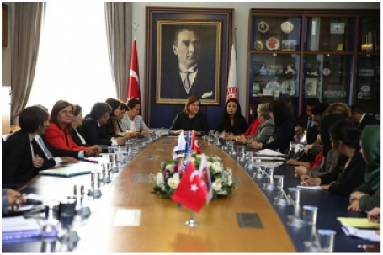
Advancing Global Women Leaders Project: Ankara, Turkey May 2013
Notes:
Last month, through a joint program of Women’s Actions for New Directions (WAND) and the EastWest Institute’s (EWI) Parliamentarian Network for Conflict Prevention, women political leaders from the west and the east came together as a coalition of global women political leaders committed to advancing peace : 16 women from the U.S. Afghanistan, Pakistan, Morroco, Tunisia, and Turkey met gathered in Ankara, Turkey to participate in a peer-to-peer exchange focused on dialogue, information sharing, and capacity building. The purpose of this ongoing exchange program is to strengthen and promote the role of women as agents of change in political life, conflict prevention, and peace-building in the U.S. and around the world. Among the women, powerful stories were shared, policy goals were identified, and concrete outcomes were realized .
Outcomes include:
All participants filled out a 15 page skills assessment identifying needs and areas of weakness in political leadership and capacity for the purpose of future training.
Commitment to develop a 2-year strategic plan for the coalition.
Identified key policy goals:
Protection of Afghan women following the 2014 withdrawal of U.S. troops.
Develop a Legislation Exchange between women Parliamentarains – specifically those drafting legislation within Sharia legal systems.
Most significantly was the heart-to-heart dialogue and understanding that was forged among the women. Exemplifying the importance of women in resolving conflict and building sustainable peace, former Pakistani Parliamentarian, Bushra Gohar, told the story of a 2009 incident in the Swat Valley region, where, Grain Chowk, one of the busiest community squares was renamed by the shopkeepers Khooni Chowk (bloody square) because each day residents found four to five dead bodies, hung from poles or trees, butchered by the Taliban. When the local provincial government organized a peace Jirga to address the violence, women political leaders were asked not to attend to avoid objections from religious leaders and Taliban supporters. In response, the women leaders convened their own peace Jirga and demanded women’s participation in the decision making process and sought “an independent humanitarian commission to analyze the extent of devastation as a result of militancy and military operations in Swat” and recommended adequate compensation to the victims of violence. Over 600 women from throughout the Province participated in the Jirga despite death threats and threats of violence. The event was widely highlighted in the local newspapers and electronic media. Political leaders took notice of women’s demands and the Women’s Parliamentary Caucus brought a resolution on the Swat Peace Process in the National Assembly which was passed unanimously.

Slide 34
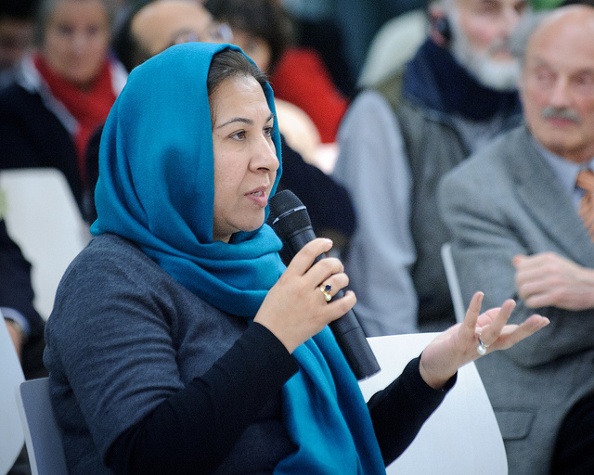
Priority Policy Goal: Protect the Rights of Afghan Women
Notes:
WAND aims to comprehensively address the critical work needed to promote women’s security and rights in Afghanistan specifically following the expedited withdrawal of U.S. and international security forces.
The goals of WAND’s work to promote women’s security and rights in Afghanistan are:
Strengthen the role of women as agents of change in political life, conflict prevention, and peace-building in Afghanistan
Safeguard ongoing support and protection of the political, economic, and social gains made by Afghan women since the U.S. intervention in 2002
Ensure effective implementation of the United States’ National Action Plan on Women, Peace, and Security in all policies and programs relevant to U.S. / Afghan relations
Promote application of United Nations Security Council Resolution 1325 in Afghanistan
Identify and seek to build support for a comprehensive peace-building transition strategy in Afghanistan, with an emphasis on the impact on women, based on: (1) gradual demilitarization, (2) political reconciliation (3) an interim peacekeeping force, (4) sustained support for community-based development and human rights, and (5) a UN-managed diplomatic compact among neighboring states.
Promoting Women’s Security and Rights in Afghanistan Project:
Dialogue, Information Exchange, and Trainings through Technology:
WAND will use technology to hold
“face-to-face” dialogues between women lawmakers in the U.S. and women political leaders in conflict affected regions to nurture ongoing friendships and information exchange. Additionally, WAND will provide educational opportunities for activists, funders and community leaders through webinars, conference calls and other virtual tools, to broaden awareness and understanding of relevant WPS issues.
WPS Clearing House - Toolkits and Policy Resources:
WAND will partner with leading research and policy institutions that work on WPS policy issues to disseminate critical research and data and create usable resources (toolkits) for congressional and administration leaders and WPS advocates.
WAND/EastWest Institute (EWI) Partnership: Advancing Women’s Global Leadership: Through 2013-2014, WAND will partner with EWI’s Parliamentarian Network for Conflict Prevention and/or other similar situated NGO’s to host 2 peer-to-peer exchanges, one in the U.S. and one in the Western / Central Asian region, between U.S. women legislators (10-12) and women Parliamentarians from Afghanistan (5-7), Pakistan (2-3), and the larger MENA region(3-4) for the purposes of: Increasing the skills and leadership capacity of Afghan women Parliamentarians on matters of peace and security, including implementation of SCR1325; women and human rights; and democracy and governance.
Expanding the network of global women political leaders who are fully informed and committed to promoting Afghan women’s security and rights within their own countries and governments.
Developing advocacy goals for the group in relation to promoting and protecting the rights of women in Afghanistan.

Slide 35
“Women At the Tables of Power”:
Notes:
The U.S. women political leaders and women Parliamentarians will convene again in September 2013 as part of the WAND/WiLL “Women At the Tables of Power” Biennial Conference. There they will participate in skill building trainings, develop a five-year strategic plan for their coalition of global women political leaders advancing peace, and bring their powerful message and political asks to the U.S. Congress. For the women who participated in the Turkey exchange, many just articulated the great power and comfort in knowing that they were not alone in their pursuit of a safe and more peaceful world for all people.

Slide 36
What can you do?
As a concerned citizen, what can you do to advance the Women, Peace and Security Agenda ?
Call or write your Representatives and tell them to support the WPS Act of 2013 to make the U.S. National Action Plan law!
Call or write your Representatives and tell them that we must protect and promote Afghan women rights following the expedited withdrawal of U.S. troops from Afghanistan!
Support women’s organizations that strengthen and promote the role of women as leaders and agents of change in political life, conflict prevention, and peace-building. Give to the grassroots and to the grass-tops!
Thank You!!

Slide 37
Please contact us for more information:
Tanya Henderson, Public Policy Director
WAND National Office
691 Massachusetts Ave Arlington, MA 02476 | 781-643-6740
thenderson@wand.org
WAND Washington, DC
322 4th St. NE Washington, DC 20002 | 202-544-5055
WAND Atlanta
250 Georgia Ave. Ste 202 Atlanta, GA 30312 | 404-524-5999
www.wand.org www.willwand.org

