Slide 1
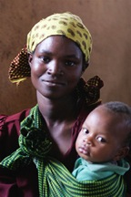
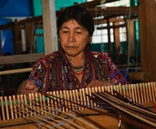
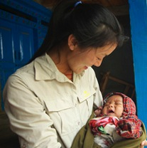
Bond Street Theatre Creative Arts Prison Program
Featured program for August 2014

Slide 2
What are we supporting?
DFW will support Bond Street Theater’s Creative Arts Prison Program, which uses theater-based techniques to encourage self-expression, build self-esteem, promote healing and provide life skills to ease re-entry into society.
The $41, 125 grant pays for:
Wages and fees for U.S. and local artists, equipment, travel, training material and supplies
Training Afghan female actors to implement programs for women in prison
Conduct 136 workshops impacting women and girls in Herat Women’s Prison, Herat Juvenile Correction Center, and Herat women’s shelters

Slide 3
Life Challenges of Women and Girls
Afghan laws protecting women’s rights are often ignored when women are accused of violating social and religious norms
Zina crimes are violations of social and religious norms
Crimes can include running away from an abusive marriage, fleeing domestic violence, or being a victim of rape or sexual abuse
They are often tried outside the Afghan judicial system in tribal court where women’s rights are ignored
Women generally have no knowledge of their rights
They accept their fates and do not try to fight back
They are ill prepared financially to hire a lawyer, and their families will not help them
Children of convicted women live in the prison with their mothers
Women give birth in prison. Children stay with their mothers until they reach the age of eight.
Juvenile girls stay in Juvenile Correction Centers
Girls convicted of moral crimes are also incarcerated with no regard for their rights.
Many are in danger of abuse or death if they return to their homes.
3
August 2014

Slide 4
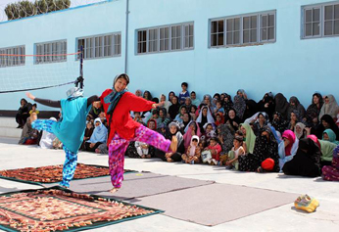
The Program
Introduces theater-based programming in the rehabilitative process for incarcerated Afghan women and girls to help them learn skills that will ease their re-entry into society
Train the women of arts partner Simorgh Theatre of Herat in theatre-based practices for incarcerated women
Conduct 136 workshops throughout the year at the Herat Women’s Prison, the Herat Juvenile Correction Center and women’s shelters in Herat
Improve the life skills of incarcerated women by developing communication, critical thinking, and problem-solving skills
Build self-confidence and motivation
Provide creative and healing activities for incarcerated women to enjoy with their children
Train staff in the prison environment to ensure an ongoing and adaptable program
The program will directly aid more than 500 women and girls.

Slide 5
Program Budget
DFW’s grant to Bond Street Theatre is $41,125
Line Item | # | Unit | $ per | Total
US Project Director - US based planning and reporting | 100 | hrs | $30 | $3,000
2 US Artist-Educators - US based planning and reports | 20 | hrs | $20 | $400
2 US Artist-Educators in Afghanistan | 3 | weeks | $2,200 | $6,600
Fringe benefit at 15% |  |  |  | $1,500
Subtotal Salaries, Wages, and Benefits |  |  |  | $11,500
International Air for 2 US Artists | 2 | tkts | $2,200 | $4,400
In country Air Kabul to Herat Round Trip | 2 | tkts | $350 | $700
Visas | 2 | visas | $160 | $320
International Travel & Health Insurance | 2 | people | $250 | $500
Ground travel - taxi, hired car - US artists | 17 | days | $50 | $850
Ground travel - local Afghans for full project | 108 | days | $20 | $2,160
Per Diem US Artist-Educator #1 | 21 | days | $90 | $1,890
Per Diem US Artist-Educator #2 | 22 | days | $90 | $1,890
Subtotal Travel/ Per diem |  |  |  | $12,710
Video / Photo equipment rental, footage archiving |  |  |  | $500
Printing of workshop materials, Training Manual, DVDs | 15 | manual | $45 | $675
Theatrical and workshop supplies: costumes, masks, crafts |  |  |  | $450
Subtotal Equipment & Supplies |  |  |  | $1,625
Project Director Fee |  |  |  | $2,500
Afghan Artist-Educator #1 | 88 | classes | $50 | $4,400
Afghan Artist-Educator #2 | 64 | classes | $50 | $3,200
Performance Fees: 4 shows with 4 actors | 16 | shows |  | $2,000
Security / Escort fees |  |  |  | $790
Subtotal Contractual Fees |  |  |  | $12,890
Local phone service, internet, other communication (documentation) |  |  |  | $700
Rehearsal studio rental | 10 | days | $50 | $500
Afghan Studio Rental | 10 | months | $50 | $500
Liability Insurance(15% of $1300 annual cost) |  |  |  | $200
Emergency Program Expenses |  |  |  | $500
Subtotal Other Direct Costs |  |  |  | $2,400
Grand Total |  |  |  | $41,125

Slide 6
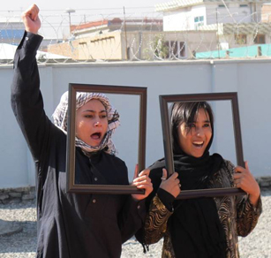
Why we Love this Program
Bond Street Theatre’s award-winning method is unique in that it utilizes targeted programming based on the needs of the group. The population served and their experiences are unique and foreign to the general American public.
A population with complex needs and challenges
Use of creative arts to rehabilitate
Innovative methods based on educational success
A great potential for educating DFW members on the population and how creative arts can be used to serve its needs
The program is designed to be continued as part of the inmate rehabilitation process long after DFW funding for the program ends

Slide 7
Voices of the Women
“ We learned to talk simply to people and ask them about their problems and also ask them their solutions This helps them to analyze things themselves.” -- Sakina, Herat
“ We can create drama about people’s problems and convince them that not allowing their daughters to go to school is damaging. And that beating their wives creates misery. This is useful for people to gain awareness.” Safina, Nangarhar
7

Slide 8
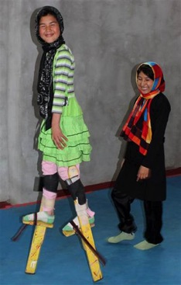
About the Organization
Bond Street Theatre was founded in 1976 by a group of physically skilled, socially concerned actors dedicated to innovative theatre led by Joanna Sherman and Patrick Sciarratta
Trained extensively in the physical and gestural arts of many traditions to develop a theatrical language that communicates across cultural borders
Complements striking theatrical forms like acrobatics, masks, stilts, etc. with gestures, rituals, symbols puppetry, music, and performance styles from many cultures
Today works internationally in collaboration with local theatre arts groups and initiating community-based arts projects
Committed to peace and projects for education healing and empowerment in critical areas.
Ensures sustainability by training local trainers in these techniques

Slide 9
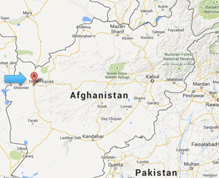
Where they Work
Afghanistan is a mountainous land-locked country in central Asia known formally as the Islamic Republic of Afghanistan with a history and culture that goes back 5,000 years
Theater and all of the arts were decimated by eight years of strict Taliban law. Most children under 10 haven’t seen a performance of any kind
Excessive violence and instability has created a population with disrupted coping skills, compounded by inconsistent schooling, work, recreation and voice in civic affairs
“Children under the age of 10 probably haven’t seen a performance of any kind, nor a painting, nor seen a dance.” Joanna Sherman, Founder, Bond Street Theatre

Slide 10
Questions for Discussion
Care to share your thoughts?
Why do you think women’s rights are not protected by the Afghan judicial system in spite of laws that require equal treatment?
Women who are incarcerated have no home to return to and no skills to help them return effectively to society. Why do you think women are so unprepared for life outside of prison?
How do you think theater arts can help these women develop better skills to help them return to society more successfully?

