Slide 1
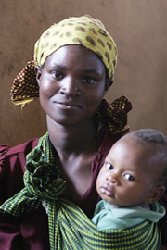
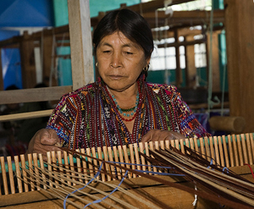
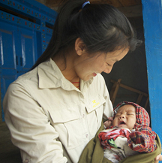
Gardens for Health International - Bumbogo Health Center and Community Outreach Program
Featured program for November 2014

Slide 2
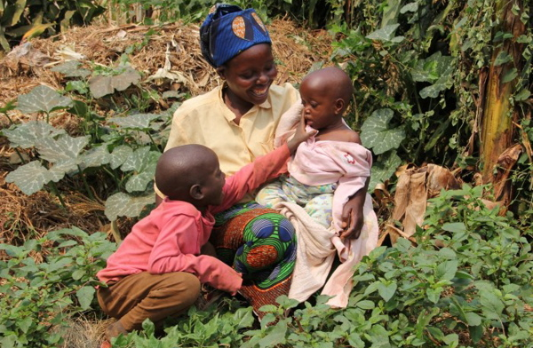
Introducing the Program
Gardens for Health International offers an integrated holistic program to attack widespread malnutrition in rural Rwandan children by empowering mothers - giving them knowledge, tools and skills to feed their children nutritious food.
A partnership program with Bumbogo Health Center in Gasabo District, Rwanda
“The doctor of the future will no longer treat the human frame with drugs, but rather will cure and prevent disease with nutrition.” ~ Thomas Edison

Slide 3
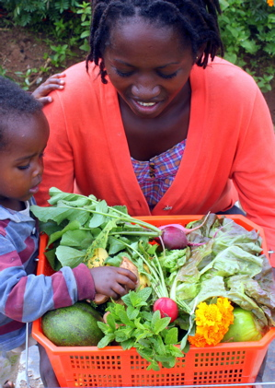
What are we supporting?
A program that targets mothers of children clinically diagnosed with malnutrition, educates them on nutrition, and gives them the tools and skills to successfully grow the right foods to feed their families for continued good health.
The $43,867 grant pays for:
Salaries of two field educators and two monitoring and evaluation agents
Partial salaries for the district supervisor and a driver
All program costs for the Bumbogo outreach program ($300 per family)
50 percent of salary of the farm manager and the teacher for the farm employment program
Full costs of material for both the empowerment training and early childhood education

Slide 4
Life Challenges of Women and Girls
Malnutrition is responsible for the deaths of more than 3.5 million children globally each year.
According to the World Health Organization, the world is facing an acute food and nutrition crisis that could affect up to 450 million children worldwide by 2025 if we do not address chronic malnutrition.
More than one third of malnutrition related deaths are among children under five.
Malnutrition is the single most important risk factor in the common diseases that lead to child mortality
Chronic malnutrition can disrupt mental and physical development, often permanently
Malnourished children are less likely to attend school
Malnourished children who go to school are less likely to succeed
As working adults, they are likely to earn less than their peers
People who are malnourished have shorter life spans
4

Slide 5
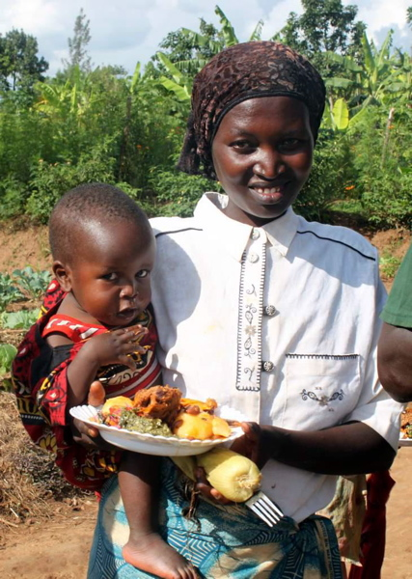
The Program
GHI partners with the Bumbogo Health Center to diagnose malnourished children and enroll their mothers in nutrition education programs. GHI delivers seeds and livestock, and teaches women to grow nutritious foods to feed their families.
Activities include:
Community awareness campaigns
Enrollment by clinical staff
Garden plot design
Seed and livestock distribution
Health training
Agricultural training
Farm work program
Monitoring & evaluation
The outreach program will serve 120 families including 600 children, and the farm worker program will benefit up to 2,000 women and their families

Slide 6
Program Budget
DFW’s grant to Gardens for Health International is $43,867
Personnel Expenses (Bumbogo)
Field Educators (2) | @ $2,028 | $4,056
M&E Agents (2) | @ $1,248 | $2,496
Field Supervisor (25%) |  | $1,276
Driver (25%) |  | $1,438
Total Personnel Expenses |  | $9,266
Program Expenses (GHI)
Seeds |  | $4,500
Livestock |  | $2,700
Training materials |  | $1,200
Cooking Demonstrations |  | $780
Home Visits |  | $1,500
Community Health Worker Training |  | $3,456
Car fuel and maintenance |  | $3,216
Communications |  | $240
Staff training |  | $2,075
Program supervision |  | $4,440
M&E |  | $1,848
Total Program Expenses |  | $25,955
Farm Employment Program Expenses (partial)
Farm Manager (50%)
Teacher
Educational Materials
Total Farm Employment Expenses |  | $8,646
Total Cost of Bumbogo HC Outreach Support Program |  | $43,867

Slide 7
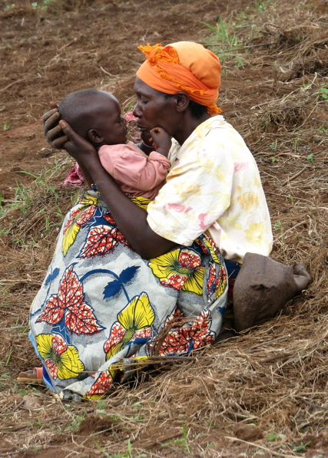
Why we Love this Program
Gardens for Health International works to address the root causes of malnutrition to create lasting, sustained improvements in family health
The GHI model targets mothers as change agents to break the cycle of malnutrition
Mothers learn why and how to feed their families nutritious food and break the cycle of malnutrition
Involvement of the regional health center integrates health with nutrition and wellness
The GHI demonstration farm serves as a model as well as source of learning and income for the mothers

Slide 8
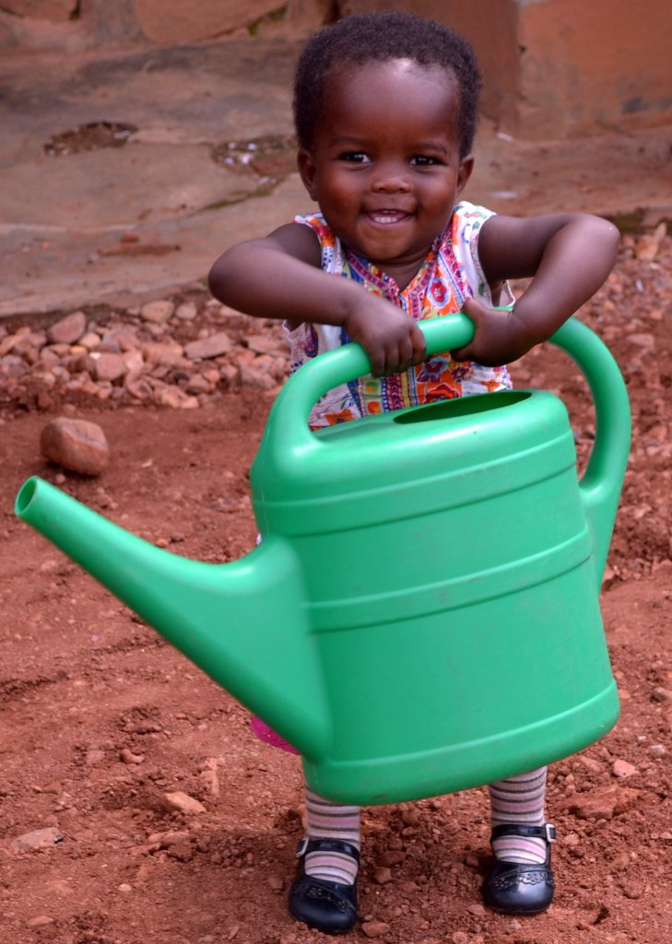
Voices of the Women
Naomi Musabyimana
“When I was seventeen years old, I met a young man who promised me a better life with his support, but after I got pregnant, he abandoned me to avoid the risk of being imprisoned because I was not of age.
So I resorted to working in a field, making just enough to support me and the child I was carrying. I even delivered my child when I was on the field. At first my daughter, Aline, was malnourished, and got food aid from the local health center. But I started working with Gardens for Health when she was an infant, and now she is healthy and no longer malnourished.
I am grateful to be a trainer with Gardens for Health. Through training other women, I feel now I can make a change in my community.
Before I believed my life was about cooking only, but now I believe there is more to it, and because of this I am able to contribute to the wellbeing of Rwandan women.
In our culture, a woman is the pillar of a good home, and by educating her you are enriching the family as well as the community.”
Naomi and Aline
8

Slide 9
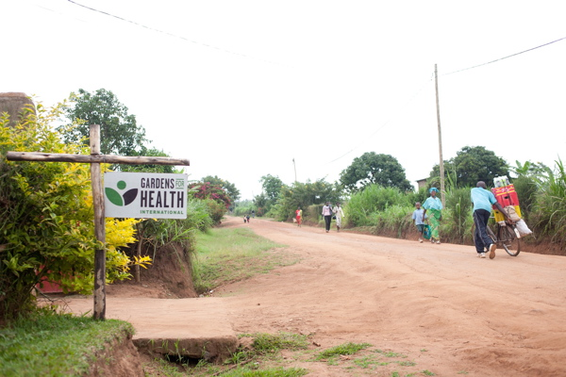
About the Organization
Gardens for Health International was established in 2008 by then college students, Julie Carney, Emma Clippinger, and Emily Morell, to use agriculture as a key driver of better health outcomes in Rwanda.
GHI partners with eight health centers in two Rwandan regions to integrate agriculture and comprehensive health education into the clinical treatment of malnutrition.
GHI advocates for policies and programs that include agriculture in the treatment of malnutrition.
GHI provides technical assistance to partners interested in adapting our model and methodology for their communities, including coffee farmers and community health workers.

Slide 10
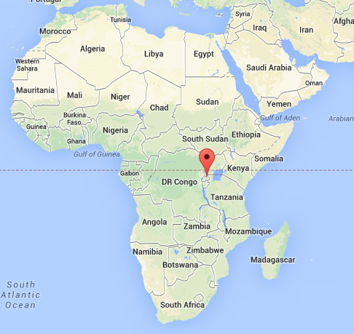
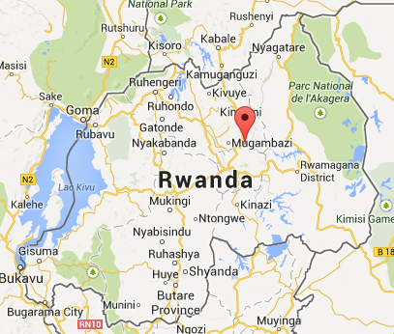
Where they Work.
Rwanda is a small land-locked country located in East Africa
In spite of its small size, it has the highest population density on the continent.
Rwanda still suffers as a result of the mass genocide of half its population and the loss of a large part of its male population
Although the economy in its cities is improving dramatically, poverty in rural villages (80 percent of the population) is widespread
Rwandan women are responsible for feeding their families. The average woman has more than four children.

Slide 11
Share Your Thoughts
Why do you think babies and young children are suffering from malnutrition in farming communities of Rwanda?
Emergency food aid is available from many sources. Why does GHI believe that it’s not enough to solve the malnutrition problem?
How is partnership with regional health centers a critical element of GHI’s service model?
What are ways in which GHI empowers the women it serves?

