Slide 1
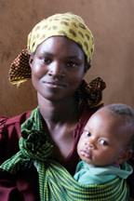
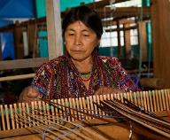
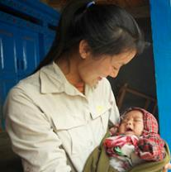
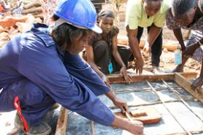
SHE28 Campaign, Rwanda: Puberty Education & Menstrual Hygiene Management Education
Featured program for February 2015
Sustainable Health Enterprises (SHE)

Slide 2
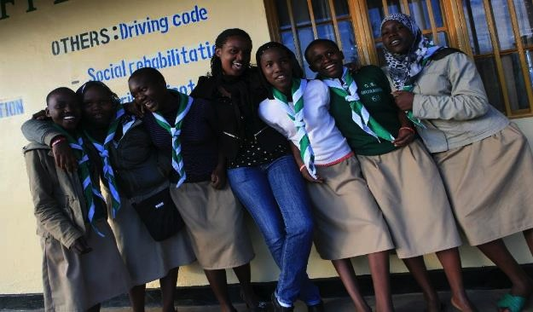
Introducing SHE: Sustainable Health Enterprises
A Rwandan girl or woman misses up to 50 days of school or work every year due to her menstrual cycle. Lack of affordable pads and understanding of her own body causes her to lose 5 years of productive time in her lifetime.
”For every fresh stage in our lives we need a fresh education, and there is no stage for which so little educational preparation is made as that which follows the reproductive period.” - Havelock Ellis

Slide 3
What are we supporting?
The DFW grant of $44,947 over 1 year will be used to support the Health and Hygiene administrator, provide training and materials for 50 teachers to educate students about menstrual hygiene education and supply them with ecofriendly sanitary pads
Manufacture and distribution of pads
Distribution cost (truck rental for delivery to schools)
Supply chain cost (purchase of fiber)
Fiber transportation cost
Produce puberty education and MHM manuals
15 Teacher manuals
55 Student/teacher manuals
8,000 Student booklets
Translation, printing, and photocopying
Teacher training
Training hall rental
Training supplies for trainer and 50 teachers
Trainee transport
50 MHM product supplies and posters of reproductive system
Support Health and Hygiene Manager
Salary for 1 year
Stipends for interns
Travel costs for teacher/school technical assistance and monitoring and evaluation visits
DFW’s grant will pay for all the program and personnel costs of the project including pad manufacture.

Slide 4
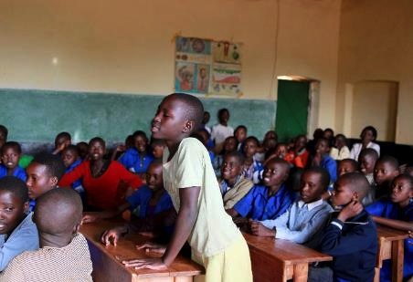
Life Challenges of Rwandan Girls and Women
Rwandan girls and women miss as many as 50 days of school and work every year because of lack of affordable sanitary pads and understanding of their reproductive health
Talk of menstruation is taboo, even between mother and daughter
Poor rural girls cannot afford pads and make do with ineffective rags, bark, and mud
Disposal options limited; toilet facilities unsafe, unclean, and lacking in privacy
Boys left out of conversation tend to tease, shaming and humiliating girls
Girls and women are denied their rights to health, education, gender equality, sanitation and dignity .
4

Slide 5
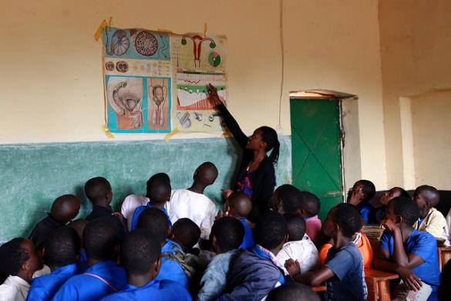
The Program
Train 50 select teachers to deliver puberty and menstrual health management training in after-school programs at 10 schools to girls, boys, parents and other teachers, and update and print training manuals for teachers and students

Slide 6
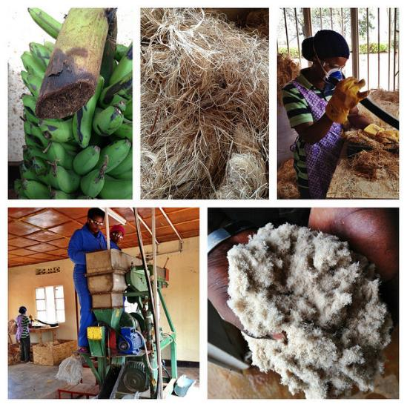
The Program
Manufacture and distribute 180,000 sanitary pads to 10 schools to increase access to affordable pads for 3,000 girls.
DFW grant pays for the raw materials and shipping costs

Slide 7
The Budget
How the $44,947 will be spent during the project year

Slide 8
Voices of the Women
8

Slide 9
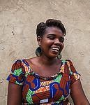
Voices of the Women
9

Slide 10
Evidence of Success
The DFW grant funded program builds on these successes of SHE
Trained Community Health Workers (CHW) in menstrual education and equipped them with sales management skills for the sale of go! Pads to jump start micro-enterprises
2012 - SHE signed up two banana cooperatives (mostly women) to supply raw banana fiber material for pad production
2013 - conducted menstrual hygiene awareness campaigns in eight schools reaching 996 students with community partner
2013 - SHE built a community production facility for the manufacture of go! pads by women

Slide 11
About the Organization
SHE was founded in 2009 by Elizabeth Scharpf when she learned of the loss of productivity by African women who missed work because of their menstrual cycle.
Scharpf spent two years researching and testing locally available, inexpensive raw materials for eco-friendly pads
The result was affordable go! pads made from banana fiber manufactured in a SHE cooperative facility staffed mostly by women
Charity in the form of money or donated sanitary pads is not enough to break the cycle of menstrual discrimination and its effects on girls and women.

Slide 12
Where they Work.
Kyonza District is in the Eastern Province of Rwanda, a densely-populated and landlocked developing country in the south east of Africa.

Slide 13
Share Your Thoughts
How do you think the holistic approach of SHE28 addresses education and empowerment of both girls and women?
How do you think the SHE model of empowerment through access and education compares with the standard charitable model of donation of sanitary pads?
Why do you think the education of parents, teachers and boys advances the success and effectiveness of the SHE28 MHM program?

