Slide 1
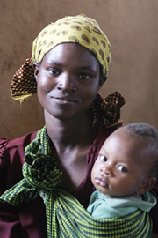
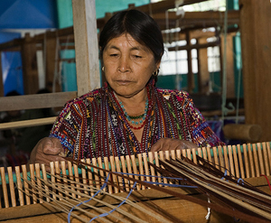
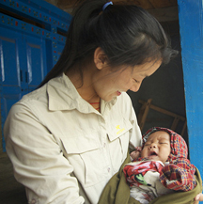
Well Women in Northern Haiti
Featured program for April 2015
MamaBaby Haiti

Slide 2
Where in the world
The project is located in Cap Haitian in northern Haiti in the communities of Vaudreuil, Pipoville and Morne Rouge.

Slide 3
Introducing MamaBaby Haiti
The Well Women in Northern Haiti (WWINH) program will provide cervical cancer and sexually transmitted infection education, screening and treatment as well as family planning services to women in northern Haiti.

Slide 4
What are we supporting?
The DFW grant of $44,996 over 1 year will be used to pay for staff support, training, patient screening and education, and medical and training supplies
Staff
Support new Health Educator to promote WWINH programs and services
Support Program director/ midwife
Support part-time midwife
Train Health care workers
Learn about sexually transmitted infections, cervical cancer and family planning
Clinical screening of patients for sexually transmitted infections and cervical cancer
Learn to perform VIA and cryotherapy for cervical cancer screening and treatment
Insertion of birth control (Jadelle and Implanon) devices
Patient care and education
Screen patients weekly
Conduct educational programs on sexually transmitted infections, cervical cancer and family planning
Distribute birth control weekly
Medical and educational supplies
Basic medical and testing supplies (gloves, alcohol swabs, urine cups, exam table paper, vinegar, pH paper, potassium hydroxide, slides) BP cuffs, stethoscopes, thermometers, speculums
Non-electric sterilizer
Medications
Antibiotics
Injectable and implanted hormonal contraceptives

Slide 5
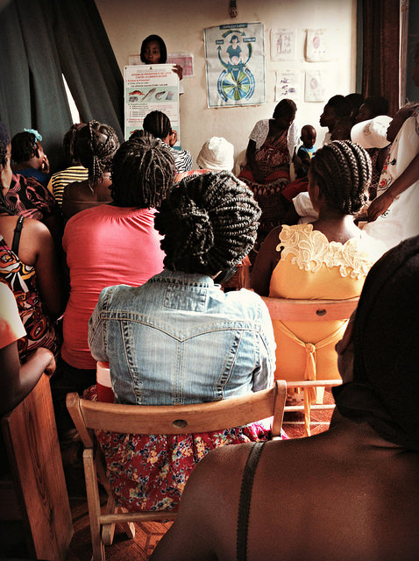
Life Challenges of Haitian Women
Lack of knowledge and services about reproductive health and wellness among Haitian women results in one of highest reported rates of cervical cancer in the world.
Rate of cervical cancer 50 percent higher than in the US
High incidence of sexually transmitted infections among tested women
Women misinformed about sexually transmitted infections leading to no treatment and complications
Well-woman health care services not available in this area
The demand for family planning services outweighs ability to provide them
Haitian women suffer the consequences of poorly financed and staffed government clinics.
5

Slide 6
The Program
Education, screening, early treatment and health referrals to increase the prevention, identification and treatment of pre-cancerous cervical cells and STIs in two clinic sites
Train health care workers on VIA/cryotherapy
Educate health care workers on STIs and family planning
Weekly education class and screening for patients
Hire/ train new health care educator
Clinically train health care workers in VIA/cryotherapy
Weekly distribution of birth control
Educate health care workers on STIs and family planning
Weeklong clinic to screen patients
Community promotion of program and recruitment of patients
6 Health Care Workers
500 patients recruited /week
500 patients recruited /week
360 patients screened/ week
500 patients recruited /week
360 patients screened/ week

Slide 7
The Budget
How the $44,946 will be spent during the project year.
Education and Teaching Aids | DFW grant
Posters, translation of materials, medical record cards (4,000) | $360
Staff Training
Training on VIA/Cryogun and placement for birth control implants | $5,600
Staffing
Full-time project director/midwife, full-time health educator and part-time supporting midwife | $10,560
Medical Equipment and Supplies
General medical supplies, sterilizer, speculums, cryogun and nitrous oxide gas, rapid test kits, lancets and syringes | $14,488
Medications
Antibiotics, contraceptives, condoms | $14,028
Project Total | $44,996

Slide 8
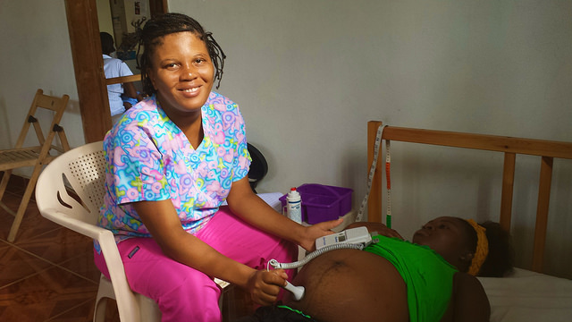
About the Organization
MamaBaby Haiti maintains a clean, safe, freestanding birth center and health clinic in Northern Haiti
Education on prenatal health and nutrition, hygiene, childbirth education, breastfeeding, contraception methods and sustainable living for women and families
Prenatal, birth, postpartum and pediatric care by trained midwives
Collaborate with other health service providers to offer complete health services
Fully staffed by Haitians
Founded by American midwives following the earthquake in 2010
Helping to better the lives of Haitians one person, one village at a time.

Slide 9
Share Your Thoughts
Why is MamaBaby Haiti offering cervical cancer and sexually transmitted infection screening and treatment along with their pre- and post-natal services?
How do you think education increase the impact of access to health care?
How do you think this project impacts future generations in Haiti?

