Slide 1
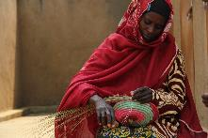
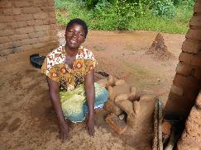
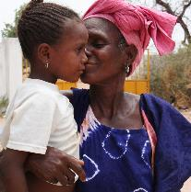
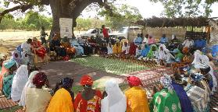
Leadership Academy for women entrepreneurs
Featured program for June 2015
Indego Africa

Slide 2
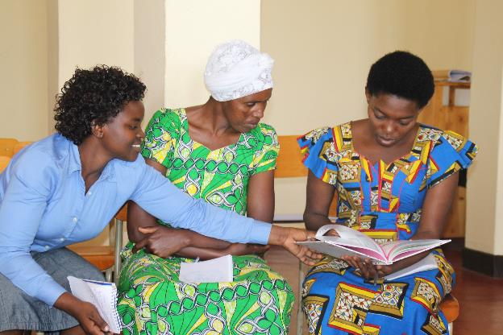
Introducing Indego Africa
Indego Africa’s Leadership Academy provides emerging artisan leaders with the advanced business training they need to flourish as independent businesswomen and drive development in their communities.

Slide 3
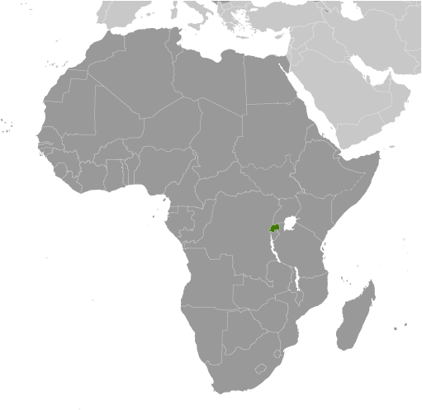
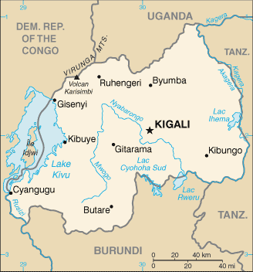
Where in the world
The project is located in Kigali, Rwanda.

Slide 4
What are we supporting?
The DFW grant of $40,000 over 2 years will be used to pay for :
Over the 2-year period project outputs include:
100 artisans will participate in and graduate from the Leadership Academy
Up to 16 separate artisans will serve as Teaching Fellows and up to 8 will serve as Program Assistants
1,102 aggregate hours of class time (348 hours per cohort)
18 - 21 mentoring or networking events (6 -7 per cohort)
20 - 22 special projects and assignments completed (5 -7 per cohort)
75 assessments (including pre-assessment, mid-term, final and homework) (25 per cohort)
66 class reports prepared by Teaching Fellows (22 per cohort)
18 monthly progress reports prepared by Program Coordinator (6 per cohort)

Slide 5
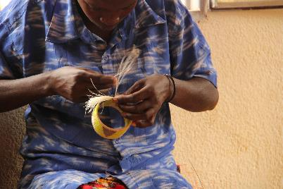
Life Challenges of Rwandan Women
2014 marked the 20th commemoration of the Rwandan genocide when over 800,000 people died over 100 days of unimaginable violence.
Following the genocide, women comprised 70 percent of Rwanda’s remaining population. These women were left to rebuild the country, yet many of them remained trapped in cycles of poverty, lacking the education and resources to lift themselves out.
When Indego Africa began, the majority of its artisan partners had their educations interrupted by the genocide and without markets in which to deploy their artisan skills, they were making less than $1 per day.
Women have begun to emerge as powerful leaders, entrepreneurs and community changers. However, in order to sustain this momentum, it is crucial that women receive advanced training to further develop their business and leadership skills.

Slide 6
The Budget
How Dining for Women’s grant of $40,000 over two years will be used:
 | Summary of costs | Year 1 Year 2 |  | Combined
1 | Leadership Training (teaching fellows, program coordinator, meal and transportation stipend) | $20,750 | $23,000 | $43,750
2 | Facility, equipment and supplies (facility rental, teaching equipment and supplies) | $3,800 | $2,500 | $6,300
3 | Events and initiatives (mentorship and networking series, graduation ceremony) | $500 | $600 | $1,100
4 | Supervisory (Rwanda Country Director [allocation]) and other (printing, communications) | $1,950 | $1,700 | $3,650
5 | Total costs | $27,000 | $27,800 | $54,800
8 | Dining for Women Grant | $20,000 | $20,000 | $40,000
9 | Total donations secured and self-funded | $7,000 | $7,800 | $14,800

Slide 7
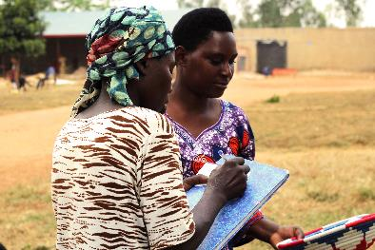
About the Organization
Indego Africa was incorporated in Oct. 2006 by Matthew Mitro and his father, Tom Mitro. Tom worked for Chevron in Africa during the mid 1970s-1990s, and Matt grew up living with his family in Nigeria and Angola. The Mitro family observed the entrepreneurial spirit of African female artisans. They also observed the women’s difficulties in scratching together a living without access to markets to sell their goods or educational opportunities to help them run their businesses more efficiently. Matt left his career as an attorney and founded Indego Africa in order to address these issues of access and opportunity. Indego Africa pools 100 percent of its profits from product sales with grants and donations to fund job skills training programs for its artisan partners in business management, technology, entrepreneurship and literacy.

Slide 8
Share Your Thoughts
How do you think graduates of The Leadership Academy can use their training to mentor others?
How do you think the artisan cooperatives benefit women entrepreneurs, aside from the ability to sell their products?
In the aftermath of genocide, how do you think women have been able to emerge as leaders in Rwanda?

