Slide 1
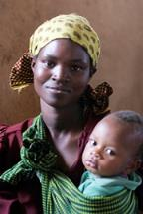
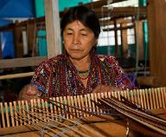
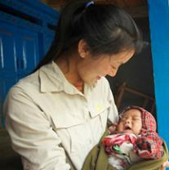
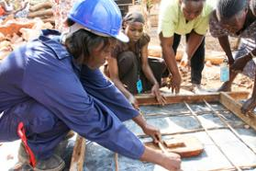
Grandmother Project Grandmother Leaders: a resource to improve the lives of adolescent girls
Featured program for March 2015

Slide 2
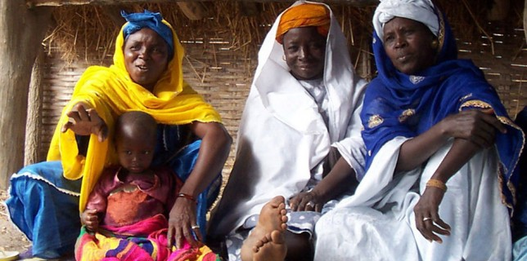
Introducing the Grandmother Project
In rural Senegal, young and adolescent girls face constraints related to female genital mutilation (FGM), early or forced marriage (EFM) and teen pregnancy that hinder their opportunities for formal education and possibilities for more equality. In this project, the women who have conducted these practices become change agents to stop them.
”In Africa, when an elder dies, it is a library burning down.” - Amadou Hampati Ba

Slide 3
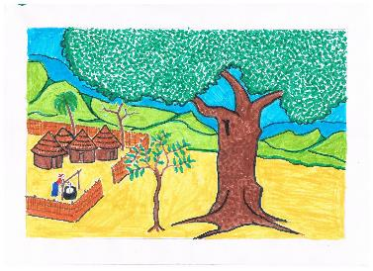
What are we supporting?
The one year DFW grant of $45,000 will be used to prepare grandmothers to facilitate change and promote improved adolescent girls’ health and well-being
Develop new training material for grandmother leadership on girls health & well-being
Eight-day train-the-trainer session led by experts to teach leadership training skills to five village “animatrices” (grandmother leaders) and two teacher representatives
“Under the tree” sessions with grandmother leaders in 30 villages (300 women) to teach them to be effective leaders in and champions for adolescent girls’ health and well-being issues
A small plant can only develop when it is under the shade of a large tree.
-- Local proverb
Documentation and evaluation of the effectiveness of the training program
A “lessons learned” report delivered at a general meeting to village elders, grandmother leaders, and other interested local participants
DFW’s grant will pay for 88 percent of the program and personnel costs of the project.

Slide 4
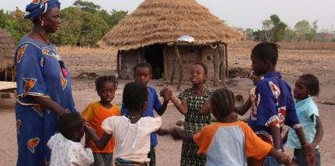
Life Challenges of Women and Girls
Although banned, FGM and EFM are practiced in many rural areas of Senegal, and schooling in French and western influences through media create serious problems for village life and the lives of young girls.
“The changing economy, new roads and television brought new ideas to remote villages. Revealing clothing, Rasta hairdos and postures copied from Mexican telenovelas started competing with traditional dress and decorum. Thousands of new classrooms, where lessons are taught in French, widened the gap between generations. By going off to school – instead of working and marrying young – teenage girls became more exposed to the dangers of flirtation and pregnancy out of wedlock.”
Flore de Preneuf
4

Slide 5
The Program
The Grandmother as Leaders program consists of five main activities:
Activity 1: Design and develop leadership exercises and materials to train experienced grandmother leaders (animatrices) with limited literacy to conduct leadership sessions
Activity 2: Train experienced animatrices to lead groups and teach other grandmothers to be leaders and advocates for adolescent girl health and safety issues in an 8-day workshop
Activity 3: Animatrices conduct “Under the tree” leadership sessions for grandmother leaders in 30 villages in the region over 6 months. Participants are assessed prior to training.
Activity 4: Document and evaluate the trainings and their effect in a report.
Activity 5: Share the results and lessons learned with local officials and organizations in a 1-day workshop.
Rather than give the message that traditional practices are harmful, GMP uses problem-solving and consensus-building to help communities find their own solutions

Slide 6
Program Budget
DFW’s grant to GMP is $44,500. It covers development, implementation and evaluation of leadership training programs for grandmother leaders in 30 villages
Grandmother Project Budget
Activity |  | Total | DFW
Activity 1: Under the Tree exercise development |  | $6,350 | $5,350
 | Professional fees for methodology expert, researcher, gender & leadership expert, and artist; printing & binding exercises
Activity 2: Training the trainers workshop |  | $10,400 | $10,400
 | Training room rental, food & lodging, travel, transportation, catering, fees and salaries for methodology expert, experienced facilitator, local coordinator; per diem for 5 animatrices, 2 female teachers
Activity 3: Under the Tree sessions in 30 villages |  | $21,640 | $21,640
 | Professional fees for experienced facilitator, travel, food & lodging; per diem for 5 animatrices plus food & lodging; transport; snacks; offfice supplies and phone expenses
Activity 4: Documentation & evaluation |  | $8,560 | $5,560
 | Professional fees for community expert and methodology expert; travel, food & lodging; documentation assistant, translations
Actiity 5: Meeting to Report results |  | $1,550 | $1,550
 | Graphic design & printing; meeting room, catering, local transporation; journalist fee, radio coverage, and website update
General Expenses and Supplies |  | $2,080 | $0
 | Total Cost | $50,580 | $44,500

Slide 7
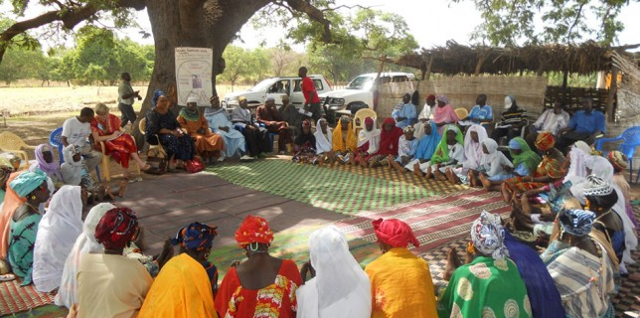
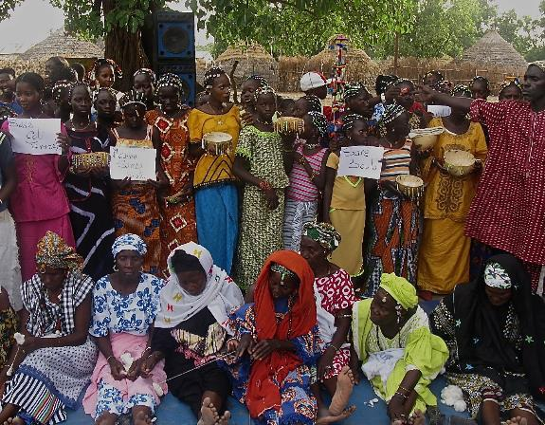
Under the Tree (“L’arbe de palbre”)
“The Palaver Tree is a place in a village where you go to start long and intense discussions, but also tell a story, organize a city or even talk about lighter things.”

Slide 8
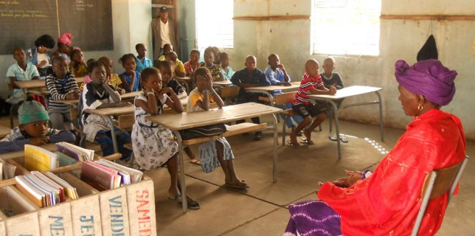
Why we Love this Program
We love grandmothers as agents of change. We love the opportunity to empower these elder women to connect three generations to discuss and find indigenous solutions to cultural based challenges faced by young girls and adolescents in the community.

Slide 9
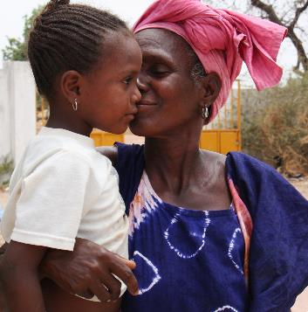
Voices of the Women
“ When you’re an older person, you are seen as the last resort if there’s a problem within the community. That’s why, sometimes, women ask us about problems understanding the restless behavior of a daughter, they ask us about arguments between neighbors and problems connected to the health of a pregnant woman and of children .”
“A young woman always needs advice from older women like ourselves. Women still ask the advice of certain grandmothers, even if they’re not leaders, because of their experience. They ask for advice about their health, and that of their children.”
9

Slide 10
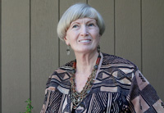
About the Organization
GMP is a learning organization that continually build its knowledge base related to community interventions using grandmothers as key players.
Judi Aubel – anthropologist, adult educator, health educator – founded the Grandmother Project in 2005 with Australian journalist Elizabeth Mealy.
A process of continuous and participatory learning
Inclusive of all relevant players - development workers, community leaders and groups, adolescents and grandmothers
In all past projects, GMP found that involving grandmothers contributed to positive change and better results.

Slide 11
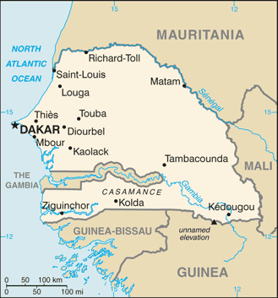
Where they Work.
Senegal is a poverty-stricken but democratic nation in West Africa.
One of Africa’s model democracies
Stable economy
Established multi-party system
Tradition of civilian rule
History of active government participation even as a colony

Slide 12
Share Your Thoughts
What are some of the benefits of using grandmothers as change agents?
How does the project take advantage of local culture and customs while at the same time challenging them?
How important do you think it is to involve village elders and other influential men in the community in discussions about harmful practices targeted at adolescent girls?

