Slide 1
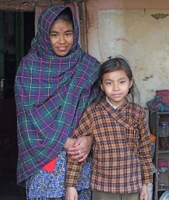
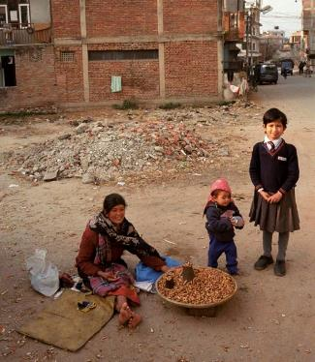
Be Part of Her Dream
Featured program for April 2016
Hands in Outreach

Slide 2
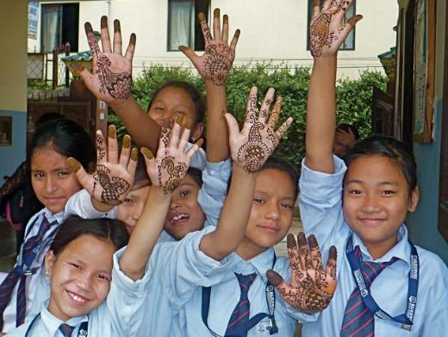
Introducing Hands in Outreach
Hands in Outreach is a small, educational sponsorship program for poor, inner-city girls in Nepal. With a family oriented approach, HIO guides and empowers girls to become strong, self-reliant adults. The organization builds lasting relationships with families, children and affiliate schools, encouraging girls to remain in school, thus avoiding early marriage and a life of low-wage, menial jobs.

Slide 3
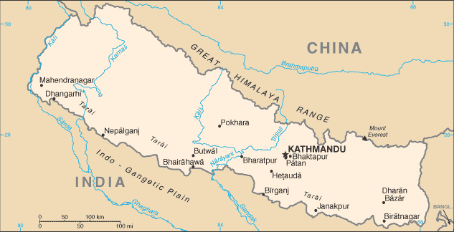
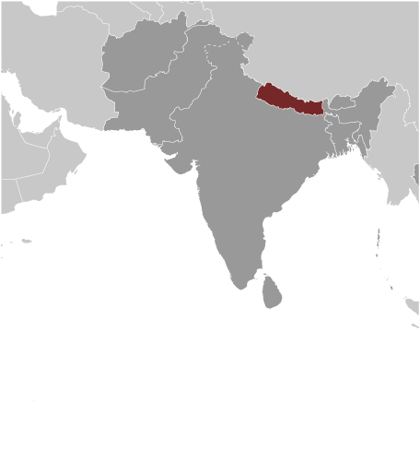
Where in the world?
Hands in Outreach operates in Kathmandu, Nepal, a landlocked country between China and India. The country has a population of roughly 27 million. It was ranked 145 out of 187 on the United Nations Development Programme’s 2014 Human Development Index and is one of the 31 countries classified by the World Bank as a “low-income” country.
Nepal is a patriarchal country and has traditionally been one of the worst in the world for gender equality. It ranked overall 112 out of 142 in the Gender Gap Index 2014, according to the World Economic Forum.

Slide 4
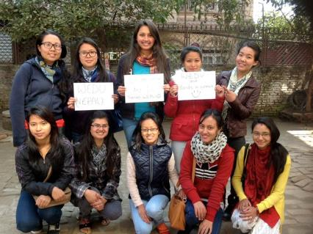
What are we supporting?
Hands in Outreach empowers women and their daughters through education in financials and literacy, gaining citizenship documents and beginning savings accounts.
Hands in Outreach works with women from the most poverty stricken underclasses. In effect, for the first time in their lives, these women will have the opportunity to move out of the entrapment of extreme poverty and have the ability to make autonomous choices in their lives and to gain the skills necessary to empower and move forward with their lives and pass this benefit along to their daughters.

Slide 5
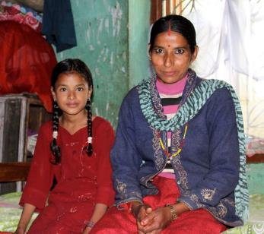
Life Challenges of Women in Nepal
HIO serves girls ages 4 – 25 living in extreme poverty in Kathmandu. They live in urban poverty, usually without running water or power, sharing one room with the family. Without the assistance of HIO these girls will repeat the cycle of extreme poverty, illiteracy and dependence endured by their mothers.
Under these conditions they are more likely to marry young, have children early, have poor health, and perform low paid, low skilled menial work that does not give them the opportunity to escape from the poverty trap. This situation leaves them vulnerable and at much greater risk of exploitation in domestic and sexual servitude, domestic violence and human trafficking.

Slide 6
Budget
How Dining for Women’s grant of $44,290 will be used over two years:
Item |  | Total
Monthly cash transfers | $20 per month each for 24 months to 54 women | $25,920
Software licenses | $50 each for 54 women | $2,700
In-country project coordinator | $100 per month 24 months | $2,400
Teachers for classes | Two teachers for two years | $2,800
Travel to villages for paperwork | $40 each for 54 women | $2,160
School supplies | $40 each for 54 women | $2,160
Bonus at completion of Year 1 | $50 each for 54 women | $2,700
Lawyer’s fees for citizenship work |  | $750
Health check-ups | $50 each for 54 women | $2,700
TOTAL EXPENSES |  | $44,290

Slide 7
About the Organization
Hands in Outreach was founded in 1985 by Donald Wilcox and Louise Todd Cope. The organization received non-profit status in 1987. In 2000, it began to shift away from having sponsored girls in boarding situations at our affiliate schools. Now, 99 percent of sponsored girls are day students, allowing the staff complete access to the home for frequent visits. This vital access allows HIO to monitor the home conditions and provide back-up medical or financial support when necessary, as well as the unique ability to serve as mentors for the girls.

Slide 8
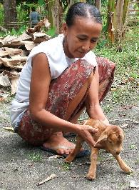
April 2016 Sustained Program: Health in Harmony
Health in Harmony’s Women Catalysts for Conservation program addresses gender inequality in rural Indonesia, where women have fewer employment opportunities, possess fewer assets and participate less in leadership roles. It also improves environmental sustainability and food security.
The project’s main goal is to help women achieve their potential as catalysts for rainforest conservation, by creating opportunities for local women to lead and drive forward conservation and health activities that benefit their broader communities.
HIH plans to accomplish this through complementary initiatives that train women to fill positions of leadership or highly-specialized technical jobs; establishing organic vegetable gardens that reduce household expenditures on food and dependence on forest resource extraction; providing alternatives for logging families by engaging wives in starting small businesses that will help their husbands make the transition to new livelihoods; and Goats-for-Widows: establishing goat herds that serve as an economic safety net to improve widows’ economic independence.

Slide 9
Share Your Thoughts
How do you think tying cash transfers to literacy classes will make a difference in the lives of women in Nepal?
How do you think having daughters as literacy partners for their mothers will impact the program?
What could the long term effects be of empowering women in a patriarchal culture?

