Slide 1
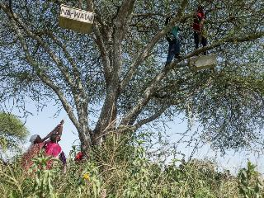
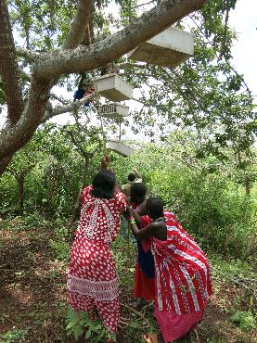
Women’s Entrepreneurship and Empowerment Initiative
Featured program for May 2016
African People and Wildlife Fund

Slide 2
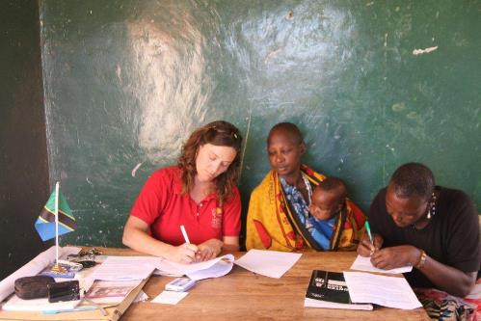
Introducing African People and Wildlife Fund
APW builds the capacity of rural Africans to engage in environmental conservation and sustainable livelihood strategies that promote the dual objectives of biodiversity conservation and poverty alleviation. The organization emphasizes the importance of place-based and community-led initiatives that support the collective management of natural resources for the mutual benefit of people and wildlife.

Slide 3
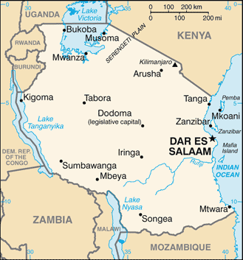
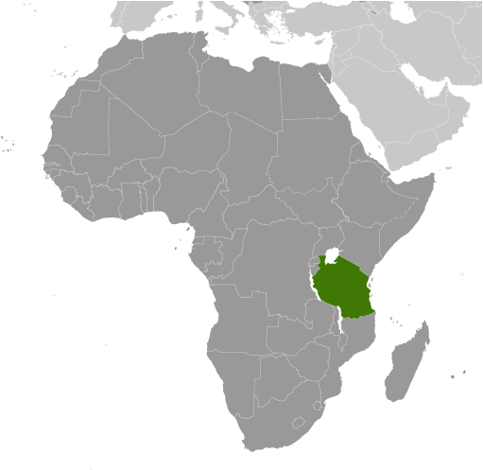
Where in the world?
APW works across Northern Tanzania in 19 Maasai communities, an unfenced landscape which is home to Tanzania’s most threatened population of African lion. Tanzania is located in Eastern Africa, bordering the Indian Ocean, between Kenya and Mozambique. The country is slightly larger than twice the size of California. Environmental issues are of critical importance, including soil degradation, deforestation, desertification destruction of coral reefs, recent droughts and wildlife threatened by illegal hunting and trade, especially for ivory.

Slide 4
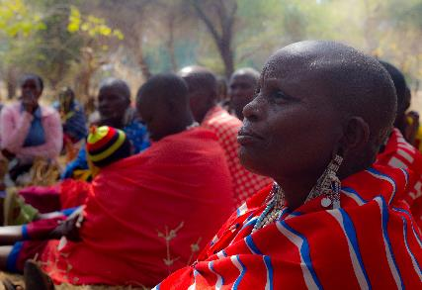
What are we supporting?
APW empowers Maasai women to protect their natural resources for themselves and for future generations, through entrepreneurship and environmentally-friendly small business development, including beekeeping.
Women will attend entrepreneurship seminars and learn about environmentally friendly business opportunities. Seminar participants can apply for business grants that will improve household income, put business skills into practice and improve environmental measures. Grantees receive continued training to support their business and are required to organize and participate in impactful conservation projects within their communities.

Slide 5
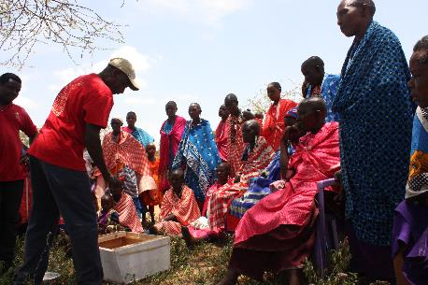
Life Challenges of Women in Tanzania
APW works across Northern Tanzania in 19 Maasai communities. Women represent 80 percent of the population and are the principal managers of natural resources. The gross annual income is approximately $900 USD. The Maasai culture is based on a traditional patriarchy where women have no rights to the land, water or the livestock of their families. Wives are sometimes said to be less important to a man than his cattle.
As a result, Maasai women are among the poorest and most marginalized groups in Tanzanian society, with girls’ access to education often restricted by their responsibility to perform household chores. However, if a woman generates her own income, she is allowed to keep and use it however she wishes.

Slide 6
Budget
How Dining for Women’s grant of $47,500 will be used:
Item |  | Total
Microfund grants | $500 each | $10,000
Personnel and labor | Community Development Program Officer, Education Program Officer, Beekeeping Program and Extension Officers, Community Trainer | $24,450
Vehicle costs | Fuel and maintenance | $1,800
Entrepreneurship Seminars | Nine seminars, including transportation for hundreds of women to reach seminar, educational materials, food and fuel | $6,750
Continuing training for business development | Hive management, honey harvesting, marketing, etc. | $4,500
TOTAL EXPENSES |  | $47,500

Slide 7
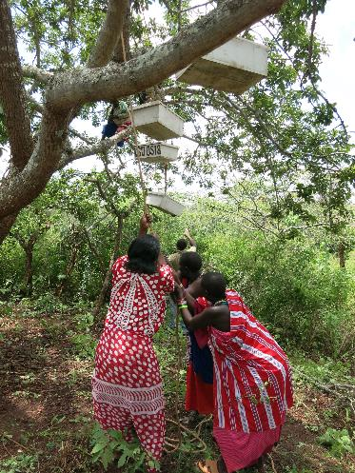
About the Organization
APW was co-founded in 2005 by Dr. Laly Lichtenfeld and Charles Trout to transform the practice of community-based conservation in Africa. By empowering rural Africans to manage and derive significant benefits from their own natural resources, APW has successfully created conservation programs and solutions that mutually benefit people and wildlife in Tanzania. Reflecting its grassroots approach, APW made history in Tanzania in 2006 by becoming the first non-profit to receive a donation of land from Maasai communities. The organization built the Noloholo Environmental Center on 10 acres of land to serve as Northern Tanzania’s first rural environmental center.

Slide 8
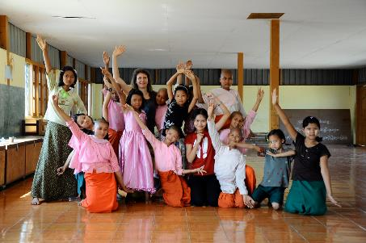
May 2016 Sustained Program: Girl Determined
Girl Determined works to promote girls’ rights in all forums, particularly for the most vulnerable, by organizing Colorful Girls Circles, training facilitators, creating curriculum, bringing girls together and exposing the reality of girls’ lives in Burma. Sustained funding will allow the organization to scale up through further development of a model in which communities manage weekly implementation of their core Colorful Girls Circles projects. Girl Determined will provide training, oversight and quality control and an increased focus on girls’ rights advocacy.

Slide 9
Share Your Thoughts
How do you think empowering women with their own income can impact their children?
What might the long term impact be of including women in making decisions about the use of natural resources?
How might beekeeping serve to have an impact on women, their families and the community?

