Slide 1
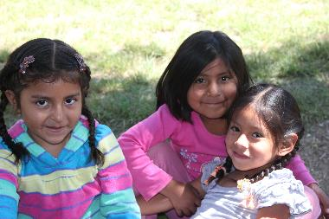
Centro Una Brisa de Esperanza (CUBE)
Featured grantee for September 2016
A Breeze of Hope

Slide 2
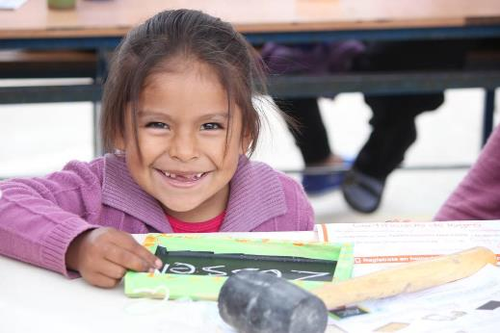
Introducing A Breeze of Hope Foundation
The mission of A Breeze of Hope is to restore the lives of those who have suffered childhood sexual violence by providing them free, holistic support; to eradicate sexual violence through transdisciplinary prevention strategies; and to promote healthy, comprehensive childhood development.

Slide 3
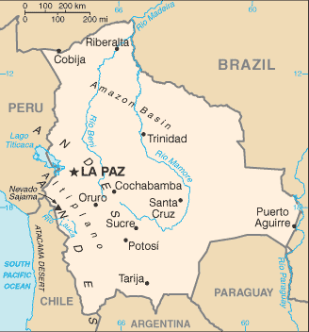
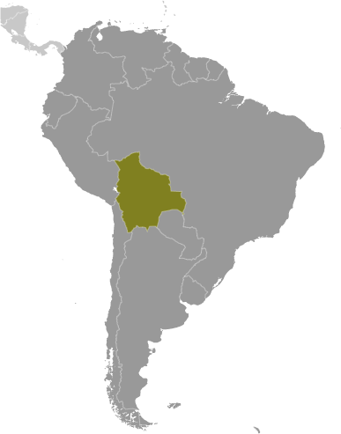
Where in the world?
A Breeze of Hope’s service area is the country of Bolivia, in the Department Cochabamba, where they work in cities/provinces of Cochabamba City, Tiquipaya, Quillacollo, Sacaba, Valle Alto, Chapare, and the rural province of Morochata.

Slide 4
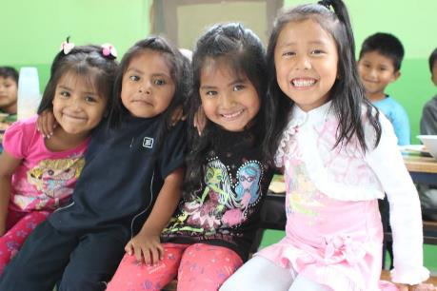
What are we supporting?
The Centro Una Brisa de Esperanza (CUBE) project will create a new interdisciplinary team at A Breeze of Hope’s center that will provide 70 girl victims of sexual violence with a safe and comfortable environment in which they can rebuild their lives and dreams and develop the skills they need to live successful, economically independent lives.

Slide 5
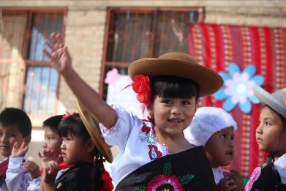
Life Challenges of Women in Bolivia
Bolivia’s cultural machismo is an aggressively male dominant construction of gender that presupposes male supremacy and normalizes males’ use of violence, manipulation and harassment against females to establish and maintain dominance and control. This culture leads to lower education and restricted access to employment opportunities for women, as well as violence.
September 2016

Slide 6
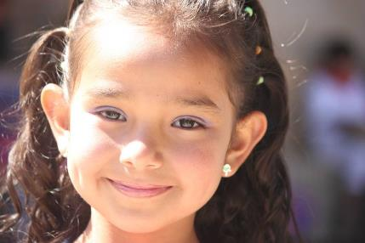
How Prevalent is Violence Against Women in Bolivia?
In 2003 and 2004, 88 percent of Bolivian women stated that they had suffered from some kind of violence. In 2009, 1 in 3 girls reported having suffered sexual violence before age 18.

Slide 7
Budget
How Dining for Women’s grant of $50,000 will be used over one year:
Item |  | One-Year Total
Psychologist | For psychotherapeutic self-esteem building activities for 70 girls for one year | $12,000
Group therapy facilitator and vocational therapy facilitator | For self-esteem and economic independence activities for 70 girls for one year | $19,000
Full-time attorney | Legal advocacy support for 45 girls for one year | $15,000
Project materials and transportation | Professional advocacy materials, group therapy supplies, vocational therapy supplies, transportation for 70 girls | $4,000
TOTAL EXPENSES |  | $50,000

Slide 8
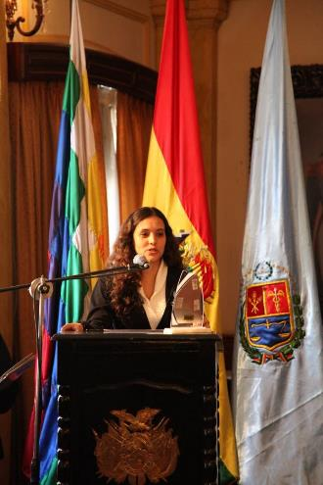
About the Featured Grantee
A Breeze of Hope Foundation was founded in 2003 by Dr. Brisa De Angulo when she was just 17 years old. As a young girl, Brisa was raped and tortured by an adult member of her extended family. When she sought help, police, prosecutors, and judges blamed her for everything that had happened – because she was both a girl and a child and in Bolivia culture woman and children are always at fault.

Slide 9
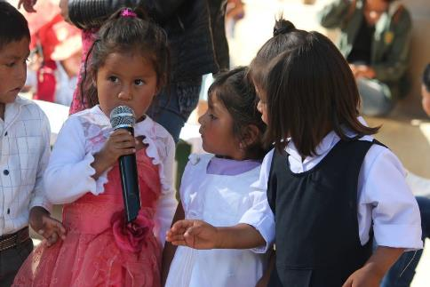
About the Featured Grantee
After living this nightmare, Brisa founded Centrol Una Brisade Esperanza (CUBE) — Bolivia’s first and only support center for child victims of sexual violence, to provide other girls the help she never found. To date, the center has provided over 1,450 children with life changing support and protection.
September 2016

Slide 10
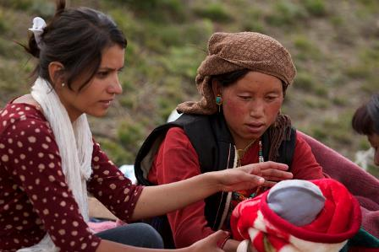
September 2016 Sustained Program: One Heart World-Wide
One Heart World-Wide's mission is to decrease maternal and newborn mortality and morbidity in remote rural areas of the world. The sustained grant of $20,000 per year in 2015 – 2017 trains community outreach providers to increase access to safe births in two remote rural areas of Nepal. Community Health Workers are trained to be the first responders for maternal and child health. The grant will fund stipends for the 600 Female Community Health Volunteers. This includes both the original training and a refresher training the following year.
Direct Reach: 600 workers to
be trained
Indirect Reach: 24,645 women
and girls could be served

Slide 11
Share Your Thoughts
How do you think empowering victims of sexual assault can change the cultural bais against women?
How are legal advocacy efforts empowering Bolivian women?
What role does education have in stopping the cycle of domestic violence in Bolivia?

