Slide 1
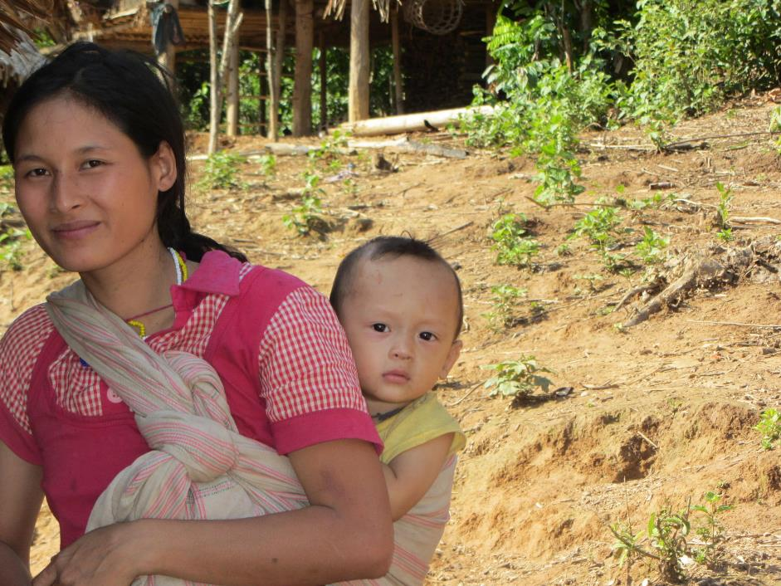
September 2017 Featured Grantee:
Burma Humanitarian Mission (BHM)
Myanmar

Slide 2
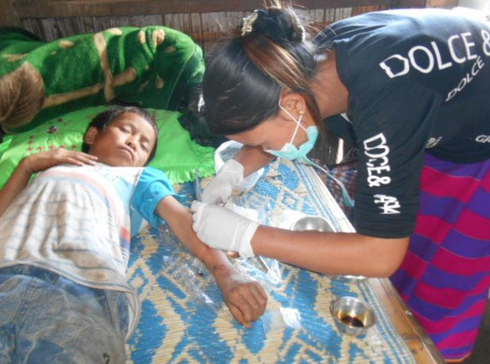
Introducing Burma Humanitarian Mission
Burma Humanitarian Mission (BHM) supports community-based, predominantly women-led backpack medics who administer village healthcare services and grassroots education programs to the displaced people of Myanmar.
HEADLINE GOES HERE
Text goes here
Text goes here
Text goes here
Text goes here

Slide 3
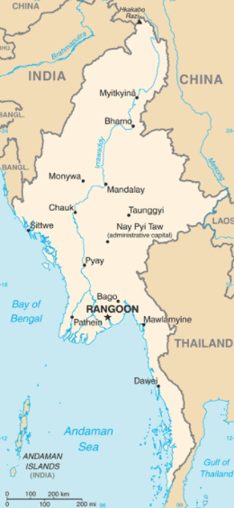
Where in the world?
Myanmar is a country of 59 million people in southeastern Asia, bordering Bangladesh, China, India, Laos and Thailand. It is about the size of Texas, and characterized by tropical climate and lowlands in the central area ringed by steep, rugged highlands.
Myanmar is rich in jade, gems, oil, natural gas and other mineral resources. The income gap is among the widest in the world, since the majority of the economy is controlled by supporters of the former military government.

Slide 4
What are we supporting?
DFW’s two-year grant of $47,276 funds 1.44 million doses of medicine and 80,000 individual medical supply items for the backpack medics. As a result of the DFW grant, 180 women will have the opportunity to serve as backpack medics – breaking gender and cultural stereotypes to be leaders in their villages and communities, developing critical skills, and reducing poverty and suffering. In addition, the predominantly women-led backpack medic teams will dramatically reduce infant and maternal mortality rates.
Direct Impact: Year 1: 26,644, Year 2: 26,644
Indirect Impact: Year 1: 75,000, Year 2: 75,000

Slide 5
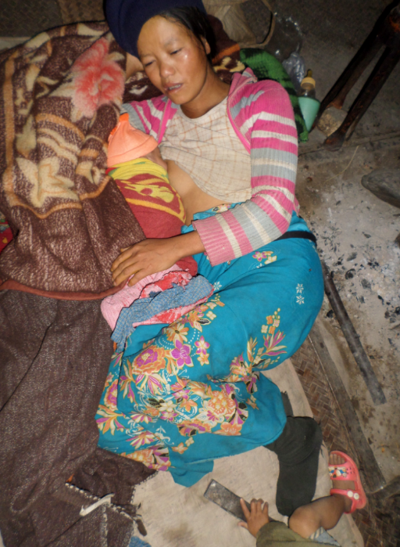
Life Challenges of the Women Served
For 60 years, Myanmar’s ethnic minorities have struggled to maintain their freedom, culture and identity.
Violent military oppression includes extrajudicial killings, forced labor and sexual violence.
Families live in isolated villages or camps, with illness, disease and malnutrition and no access to medical care. and morbidity.
HEADLINE GOES HERE
Text goes here
Text goes here
Text goes here
Text goes here

Slide 6
Budget
How DFW’s grant of $47,276 over two years will be used:
Item | Description | Cost
Medications for 12 teams, year 1 | 743,760 units of medicine per year (oral and injection) | $19,944
Medical Supplies for 12 teams, year 1 | 40,150 units of supply items (gloves, needles, bandages, stethoscopes, thermometers, etc.) | $3,694
Medications for 12 teams, year 2 | 743,760 units of medicine per year (oral and injection) | $19,944
Medical Supplies for 12 teams, year 2 | 40,150 units of supply items (gloves, needles, bandages, stethoscopes, thermometers, etc.) | $3,694
TOTAL EXPENSES |  | $47,276
HEADLINE GOES HERE
Text goes here
Text goes here
Text goes here
Text goes here

Slide 7
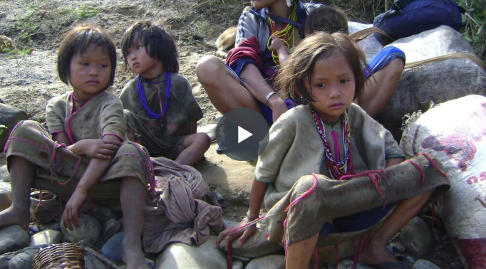
About the Featured Grantee
BHM was founded in 1999 by a group of friends who visited the Thai-Myanmar border and witnessed the suffering and displacement of the ethnic minorities. Today, BHM works with partner organizations to serve over 50,000 villagers with medical care and support education efforts that touch over 500,000 lives annually. BHM also provides educational opportunities for youth. BMH’s approach is extremely cost efficient, with an average of $1.10 per person treated.
HEADLINE GOES HERE
Text goes here
Text goes here
Text goes here
Text goes here

Slide 8
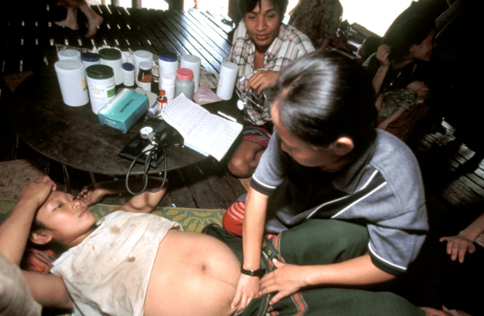
About the Featured Grantee
BHM’s partnership with Backpack Health Worker Team changes and saves lives. In 2016, BHM supported 14 backpack teams, with impressive results:
Cared for 30,481 people
Delivered 841,088
doses of medicine
Treated 13,435 patients
Delivered 436 babies
Reduced the incidence of malaria from 3.7/100 to 0.41/1,000 people
Saved an average of 48 people for each team
HEADLINE GOES HERE
Text goes here
Text goes here
Text goes here
Text goes here

Slide 9
Share Your Thoughts
Why are backpack medics a more effective solution to healthcare than conventional clinics?
How will young daughters benefit from seeing their mothers as backpack medics?
How do you think having backpack medics as role models and community leaders will impact future generations?
HEADLINE GOES HERE
Text goes here
Text goes here
Text goes here
Text goes here

Slide 10
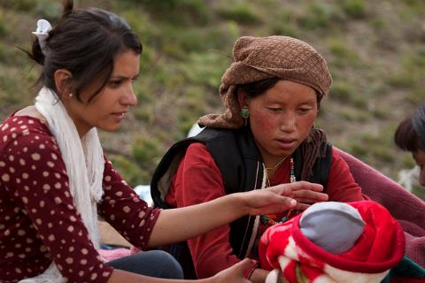
September’s Sustained Grantee:
One Heart World-Wide
One Heart World-Wide's mission is to decrease maternal and newborn mortality and morbidity in remote rural areas of the world. DFW’s sustained funding of $20,000 per year for three years supports training 600 community outreach providers to increase access to safe births in two remote rural areas of Nepal.
Direct Impact: 600 workers to be trained
Indirect Impact: 24,645 women and girls could be served.
HEADLINE GOES HERE
Text goes here
Text goes here
Text goes here
Text goes here

