Slide 1
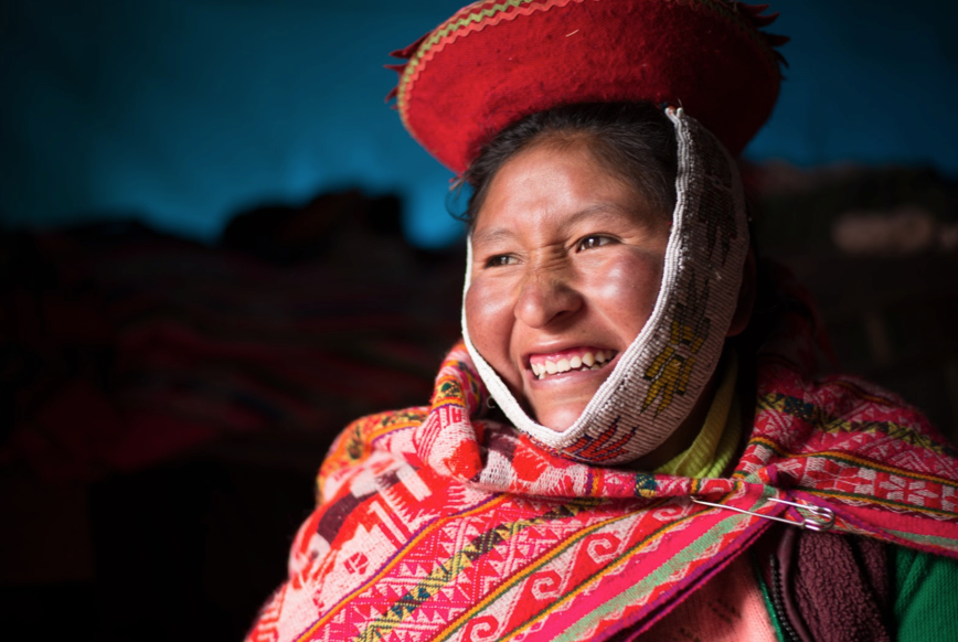
February 2018 Featured Grantee
Sacred Valley Health
Peru

Slide 2
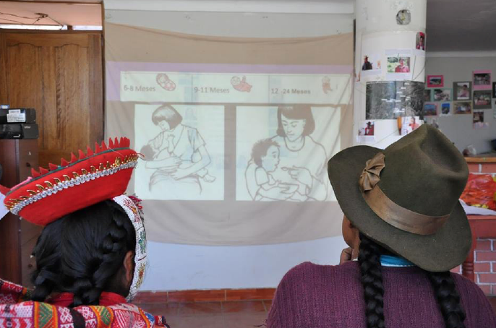
Introducing Sacred Valley Health
Sacred Valley Health helps alleviate malnutrition in Peru by disseminating targeted nutrition education via specialized Community Health Workers.
HEADLINE GOES HERE
Text goes here
Text goes here
Text goes here
Text goes here

Slide 3
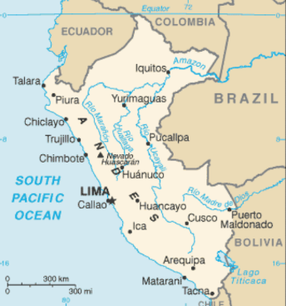
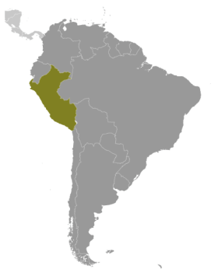
Where in the world?
Sacred Valley Health is based in Ollantaytambo, Peru, located between the Incan capital of Cusco and Machu Picchu. The service area focuses on the 30 rural communities in the Ollantaytambo District, which, make up approximately 70 percent of the District’s nearly 10,000 inhabitants. Peru, population 31 million, is approximately twice the size of Texas, and varies from tropical in the east to dry desert in the west and temperate to frigid cold in the Andes.

Slide 4
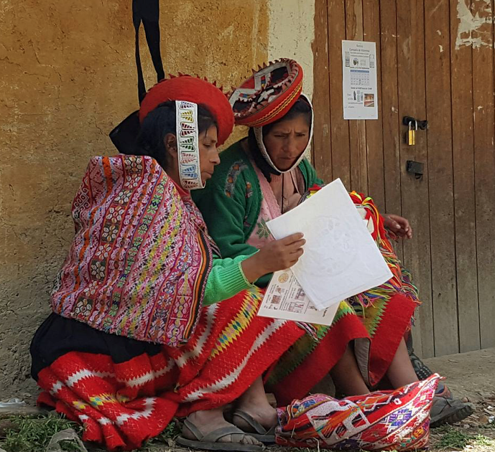
What are we supporting?
DFW’s two-year grant of $44,087.70 covers
training, transportation,
Community Health Worker incentives,
and staffing to enhance nutrition and health.
Direct Impact: 38
Indirect Impact: 2,000

Slide 5
Life Challenges of the Women Served
18 percent of children in the Cusco region are malnourished.
Over half exhibit stunted growth, are underweight, or both.
In the same communities, 55 percent of children under 5 are anemic, and many experience chronic illness, learning delays, and developmental problems.
Malnutrition is a problem in this area due to geographic isolation, limited access to nutrient-rich foods, and extreme altitude.
Parents are unaware of the importance of a balanced diet and there is little training on how to grow a wider selection of food at high-altitude.
HEADLINE GOES HERE
Text goes here
Text goes here
Text goes here
Text goes here

Slide 6
Budget
How DFW’s two-year grant of $44,087.70 will be used:
Item |  |  | Total
Training materials | Binders, printing, supplies, meals, |  | $5,108.80
Transportation | In-office trainings and reviews, community reviews, AASD Sustainable Agriculture visits |  | $17,995.50
CHW Incentives | Food incentives for CHWs and in-office trainings |  | $3,236.40
Staffing | M&E Coordinator
 | Peruvian Project Manager
 | SVH Director of Operations
 | Community Coordination Volunteers
 | Quechua-speaking Nutrition Docentes
 | Program Coordinator Intern
 |  |  | $17,747
TOTAL EXPENSES |  |  | $44,087.70
HEADLINE GOES HERE
Text goes here
Text goes here
Text goes here
Text goes here

Slide 7
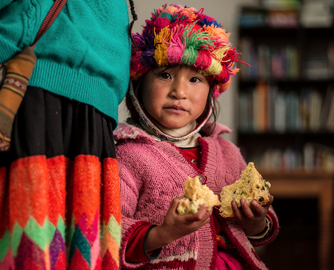
About the
Featured Grantee
SVH uses a “train the trainer” model in 14 rural communities in Peru. Community Health Workers are trained in disease prevention, health promotion, and first-aid skills. The curriculum uses a low-literacy format as most members have limited reading and writing ability. The areas of focus are respiratory disease, parasitic diarrheal disease, and malnutrition. In addition to providing health education and nutrition screening (height, weight, and anemia testing), SVH distributes multivitamins to children from six-months-old to five years of age as well as to pregnant and lactating women.
HEADLINE GOES HERE
Text goes here
Text goes here
Text goes here
Text goes here

Slide 8
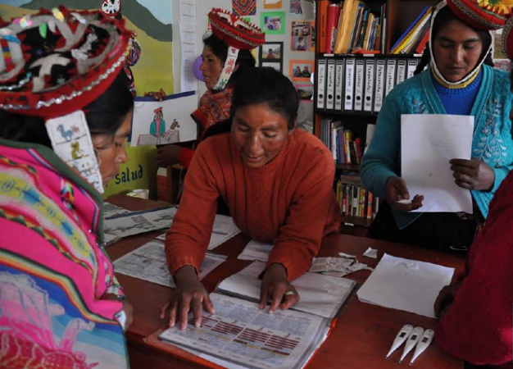
About the Featured Grantee
SVH’s vision is to:
assure access to quality health care;
create partnerships with government and NGOs to maximize access to resources;
have at least one trained promotora de salud (Community Health Worker) in every community,
see that each promotora serves as a community health advocate and agent of change.
HEADLINE GOES HERE
Text goes here
Text goes here
Text goes here
Text goes here

Slide 9
Share Your Thoughts
Why do you think the “train the trainer” model is key to SVH’s success?
In addition to enhanced health, what other benefits do you think children will see and feel?
How do you think this project will change the current health system?
HEADLINE GOES HERE
Text goes here
Text goes here
Text goes here
Text goes here

Slide 10
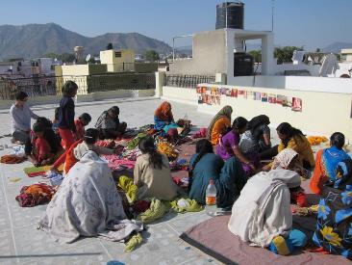
February’s Sustained Grantee:
Starfish
Starfish empowers young women in Guatemala through education and mentorship to become leaders in their community.
DFW’s sustained grant of $20,000 per year in 2016 – 2018 supports the creation of Guatemala’s first all-girl middle school to prepare high-aptitude, first-generation “everything” girls to be competitive at a local, national, and international level. The school is unique due to its ability to combine rigorous academics with an equally intentional focus on the elements of culture and community, thus ensuring the empowerment of each girl within and outside of her indigenous culture.
Direct Reach: 2,500 girls
HEADLINE GOES HERE
Text goes here
Text goes here
Text goes here
Text goes here

