Slide 1
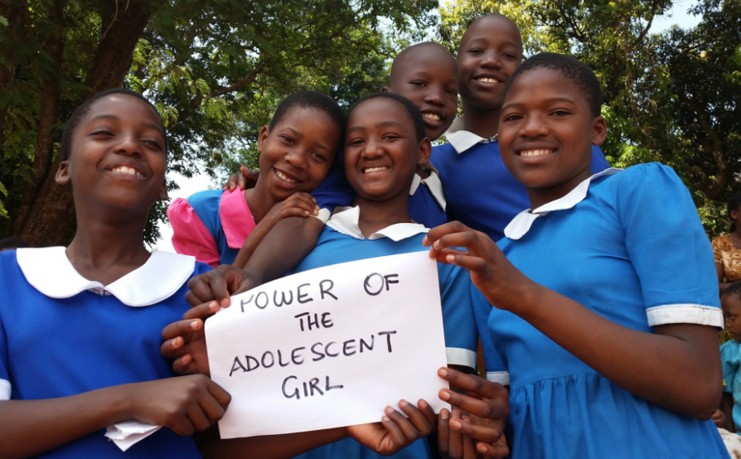
December 2017 Featured Grantee:
AGE Africa
Malawi

Slide 2
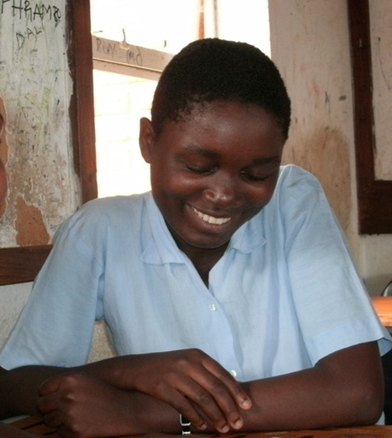
Introducing Advancing Girls’ Education (AGE) Africa
AGE Africa’s mission is to provide life-changing opportunities for young women in Malawi through targeted initiatives.
HEADLINE GOES HERE
Text goes here
Text goes here
Text goes here
Text goes here

Slide 3
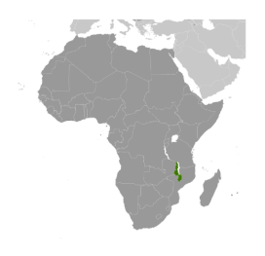
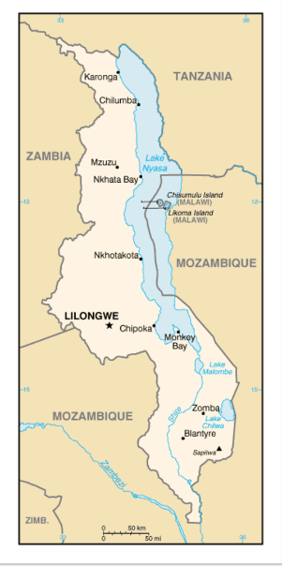
Where in the world?
Malawi is among the world’s most densely populated and least developed countries:
6th poorest nation in the world
About the size of Pennsylvania
Population 17 million
Often called the “warm heart of Africa” because the people are so kind and welcoming
Nearly 90 % live in rural areas, often on $1 per day

Slide 4
What are we supporting?
DFW’s grant of $50,000 supports AGE Africa’s CHATS (Creating Healthy Approaches to Success) program. “Girls’ clubs” provide a 3-year, weekly after-school program for adolescent girls that builds their core life skills and helps them continue their educations. The curriculum features sexual and reproductive health education, leadership training and career guidance, self-advocacy, gender-based violence awareness and prevention, entrepreneurship, problem solving, and access to higher education.
Direct Impact: 480 adolescent girls
Indirect Impact: 4,800 family and community members

Slide 5
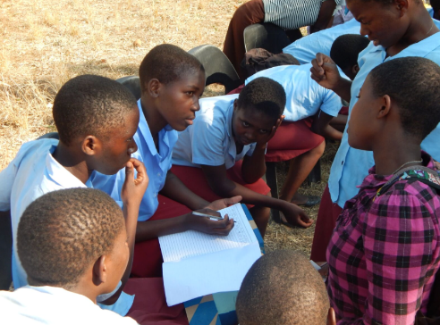
Life Challenges of the Women Served
Adolescent girls in Malawi face systemic poverty, lack of family and community support, limited educational opportunities, lack of voice, and adverse social attitudes. These vulnerabilities constrain them economically and socially and often result in risky sexual practices that contribute to poor long-term reproductive and health outcomes.
HEADLINE GOES HERE
Text goes here
Text goes here
Text goes here
Text goes here

Slide 6
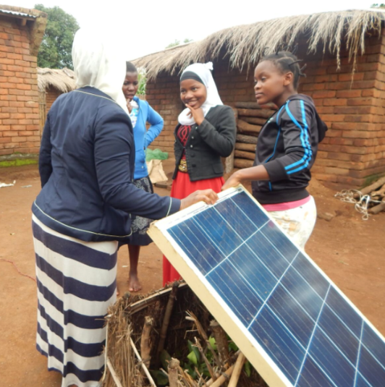
Life Challenges of the Women Served
Twice as many boys in school, six times as many in rural areas
Only 6% of girls graduate high school
Less than 1% go on to higher education
Over half of all girls drop out before age 18 to marry or due to early pregnancy or cost of schooling
12% are married before age 15
19% of women 15 - 49 die while giving birth
HEADLINE GOES HERE
Text goes here
Text goes here
Text goes here
Text goes here

Slide 7
Budget:
How DFW’s one-year grant of $50,000 will be used
Item | Detail | Budget | Total
Project Expenses | CHATS faculty advisor, alumnae mentors, community engagement meetings, girls’ training, materials, guest speakers, portion of district officer, refreshments for CHATS meetings, printing of manual, staff travel to school, communications for mentors | $26,010
Monitoring and Evaluation | Portion of monitoring officer and program & learning manager, surveys, pre- and post-test, focus group discussions | $11,225
Administration | Portion of cost for country director, finance and administration officer, and rents | $12,765
 | TOTAL BUDGET |  | $50,000
HEADLINE GOES HERE
Text goes here
Text goes here
Text goes here
Text goes here

Slide 8
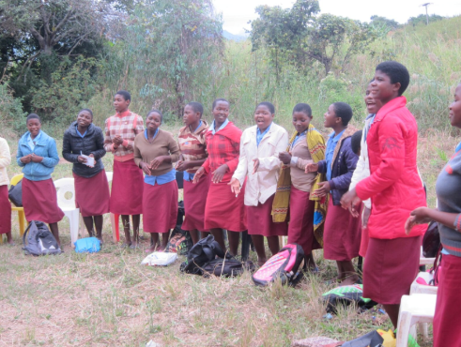
About the Featured Grantee
AGE Africa was founded by Xanthe Ackerman in 2005. A scholarship was established for girls whose families could not afford the school fees. AGE Africa quickly learned that a scholarship was not enough to keep girls from dropping out or failing out of school.
In 2009, an AGE Africa study confirms what prevents girls from finishing school: pressure to marry, early pregnancy, and serious knowledge gaps about the value of an education and post-secondary opportunities
HEADLINE GOES HERE
Text goes here
Text goes here
Text goes here
Text goes here

Slide 9
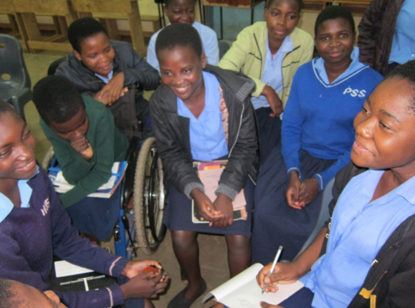
About the Featured Grantee
2011: team of Malawian women helps AGE Africa develop Create Healthy Approaches to Success (CHATS).
2014: Based on overwhelming success, CHATS Girls’ Clubs are replicated and expanded, currently serving 1,200 adolescents in 24 schools.
Today: 95% of participants complete all four years of secondary school, and 50% qualify for higher education.
Goal: reach 12,000 girls and 85 schools by 2019.
HEADLINE GOES HERE
Text goes here
Text goes here
Text goes here
Text goes here

Slide 10
Share Your Thoughts
Why is an education focused entirely on reading, writing, and arithmetic not enough for Malawi girls?
How might these girls begin to alter cultural norms?
How do you think the CHATS program can benefit younger siblings?
HEADLINE GOES HERE
Text goes here
Text goes here
Text goes here
Text goes here

Slide 11
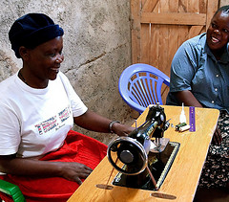
The mission of Shining Hope for Communities
is to combat intergenerational cycles
of poverty and gender inequality by linking
tuition-free schools for girls to essential social services in Kenya’s Kibera slum through a holistic, community-driven approach. DFW’s sustained funding of $20,000 per year for three years supports the Mother and Child Health Program incentives aimed to counteract the high child morbidity and mortality rates by encouraging mothers to seek regular prenatal, postnatal, and child welfare services to ensure positive health outcomes for themselves and their children.
Direct Impact: 2,469
December’s Sustained Grantee:
Shining Hope for Communities
HEADLINE GOES HERE
Text goes here
Text goes here
Text goes here
Text goes here

