Slide 1
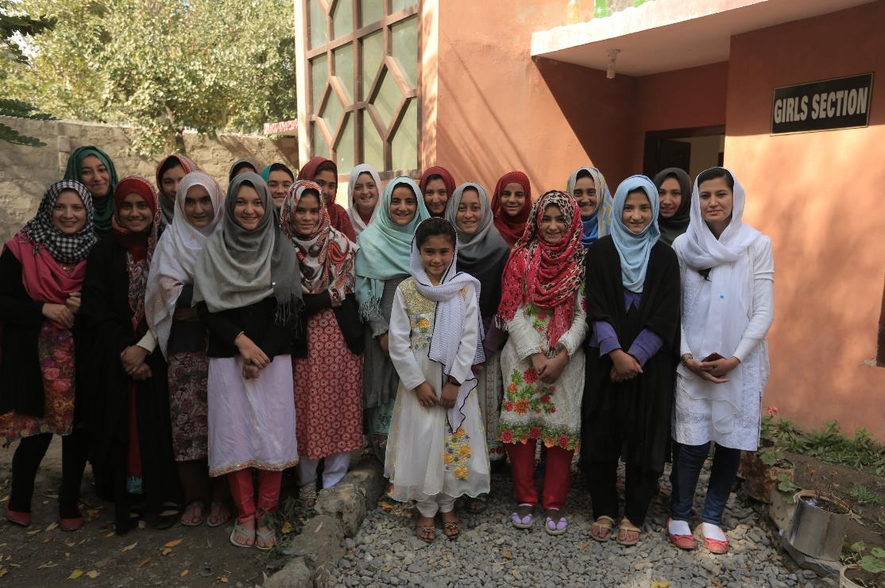
July Featured Grantee
Iqra Fund
Basha Valley, Pakistan

Slide 2
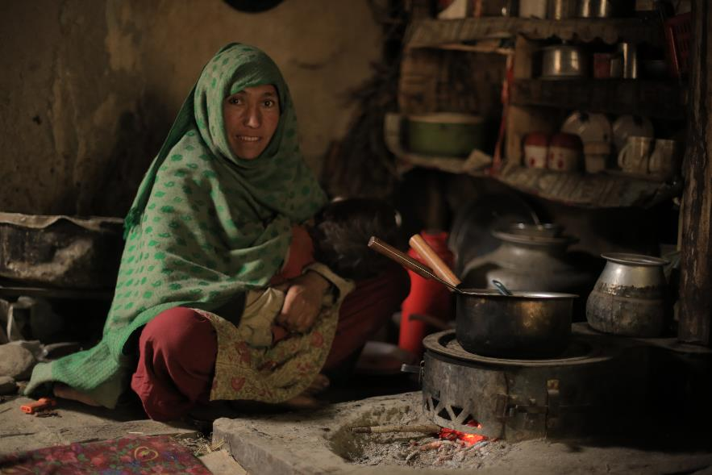
Introducing Iqra Fund
HEADLINE GOES HERE
Text goes here
Text goes here
Text goes here
Text goes here
Iqra Fund provides access to quality, sustainable education, especially for girls, in the remote tribal areas of Pakistan.

Slide 3
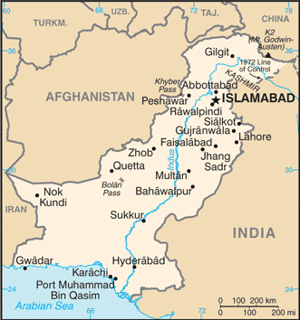
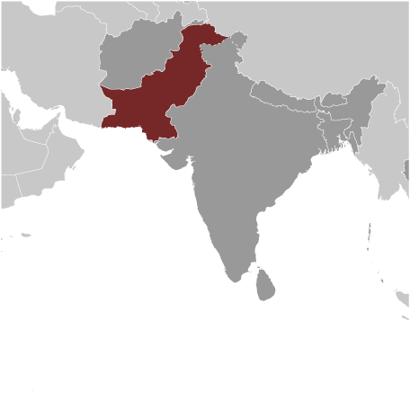
Where in the world?
Pakistan’s population is about 208 million.
The median age is 24.1 years, and the average life expectancy is 68.4.
The literacy rate in Pakistan is 57.9%, with 69.5% of males and 45.8% of females being literate.
Pakistan has the second highest number of girls out-of-school of any country in the world.
The tribes living in remote northern Pakistan have lived in much the same way for thousands of years. They are close-knit conservative Islamic communities with traditional customs and almost no income.

Slide 4
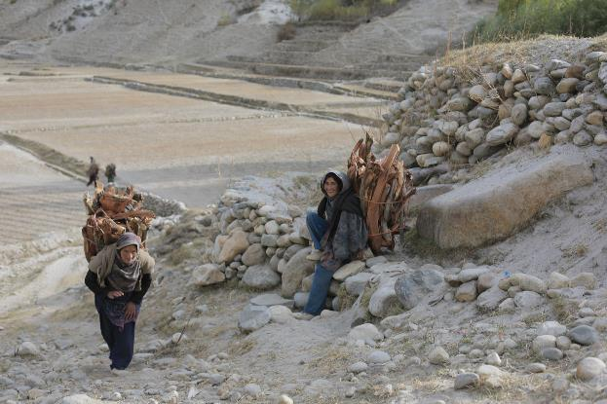
Life Challenges of the Women Served
HEADLINE GOES HERE
Text goes here
Text goes here
Text goes here
Text goes here
The valleys where Iqra Fund works are cut off from the rest of the country by the Karakoram Range, which has some of the world’s highest peaks. Communities are further isolated by poverty, politics, and religion. Nationally, 25 million children are out of school - half the country’s school-age population. In Gilgit-Baltistan, 16.9% of girls get married before age 15; 52.4 % before 18.

Slide 5
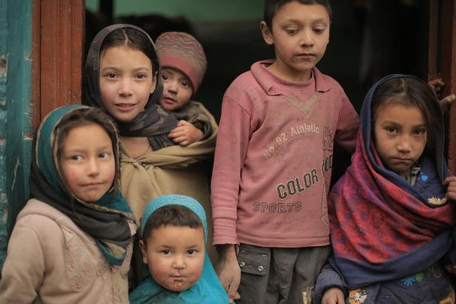
What are we supporting?
This project establishes a girls’ middle school program in Pakistan’s isolated Basha Valley by funding teachers, providing uniforms, books and supplies for the girls, and engaging the mothers in leadership workshops. It will provide for 66 girls transitioning to middle school, as well as salaries for 10 teachers who will serve 284 additional girls entering middle school in the next two years.
Direct Impact: 276; Indirect Impact: 150,000

Slide 6
Budget
DFW’s grant of $42,398.40 supports:
Item | Description | Cost
Monitoring and Evaluation | Baseline survey and staff orientation, end line assessment and project closing | $600
Providing Access to Quality Education for Girls | Initial meetings with community leaders, uniforms, books and school supplies, mid-year and end-year meetings with leaders, wages for 10 teachers for 12 months | $21,268.40
Women Leadership Activities | Six Mother Support Group workshops, supplies for the workshops, refreshments, travel and food for staff | $5,640
Project Operational and Personnel Cost | Transportation and vehicle costs, salaries for Female Project Manager, Female Social Mobilizer and Female Field Officer | $14,600
Visibility | Communication to regional leadership, banners and standees for community events and workshop venues | $290
TOTAL EXPENSES |  | $42,398.40
HEADLINE GOES HERE
Text goes here
Text goes here
Text goes here
Text goes here

Slide 7
About the Featured Grantee
Genevieve Walsh founded Iqra Fund in 2011, following a doctorate focused on educational development in Pakistan.
Through her dissertation, Walsh knew Iqra Fund needed a model that worked for the community.
Iqra Fund focuses on quality educational programming and community investment. Today, 92% of girls in participating villages attend Iqra Fund schools.
HEADLINE GOES HERE
Text goes here
Text goes here
Text goes here
Text goes here

Slide 8
Share Your Thoughts
How do you think Mother Support Groups address the patriarchal community?
How do you think the education of girls affects the community’s economy?
How do you think this program will have global impact?
HEADLINE GOES HERE
Text goes here
Text goes here
Text goes here
Text goes here

Slide 9
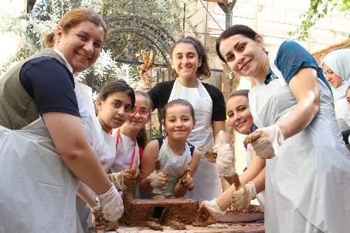
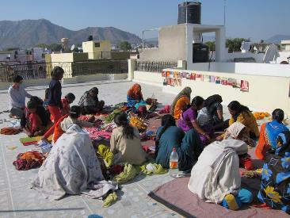
July’s Sustained Grantee:
Collateral Repair Project
Resilience Beyond Displacement: Education and Empowerment for Refugee Women and Girls in Jordan
HEADLINE GOES HERE
Expands CRP’s holistic support model to refugees from Iraq, Syria, Sudan, and Yemen with more focused programing
Aims to educate and empower women and girls through targeted training and educational activities along with opportunities for advocacy and leadership
Provides technical and vocational skills training to women and gender-based violence prevention and awareness training to both women and men in the refugee communities.
Direct Impact: 3,885 women and girls; Indirect Impact: 25,605 family members
Text goes here
Text goes here
Text goes here
Text goes here

