Slide 1
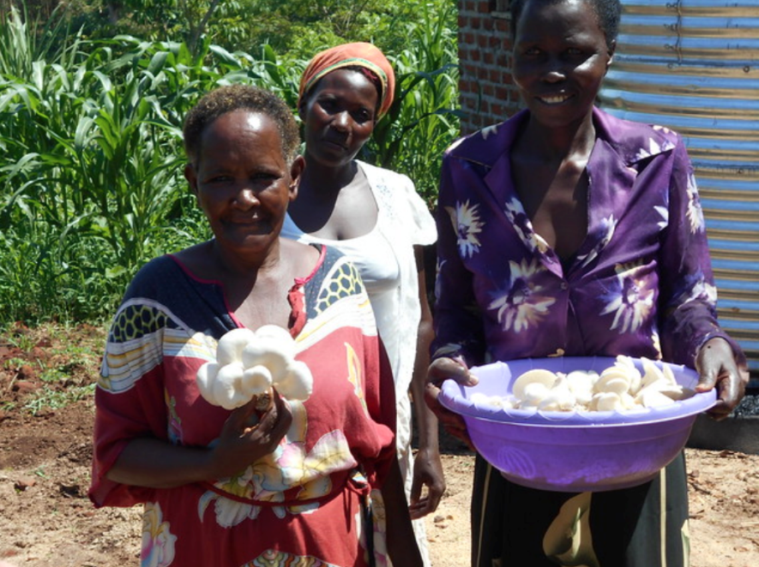
April 2020 Featured Grantee
Africa Development Promise
Uganda

Slide 2
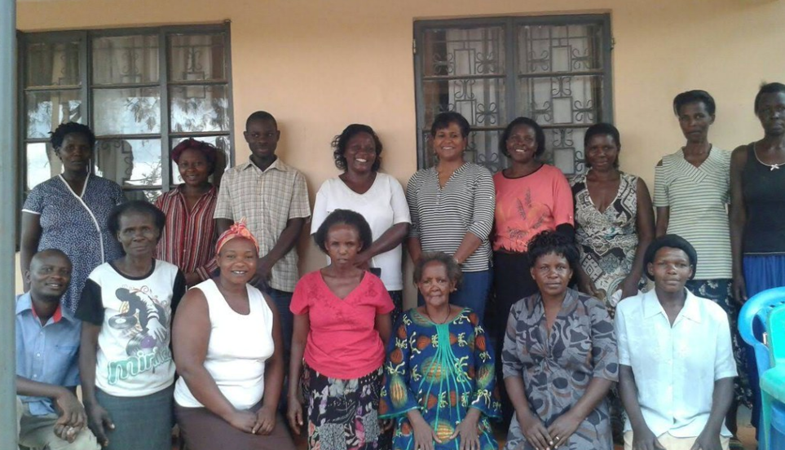
Introducing Africa Development Promise
HEADLINE GOES HERE
Text goes here
Text goes here
Text goes here
Text goes here
Africa Development Promise drives collective action of rural entrepreneurial women to advance sustainable business and economic independence in African communities.

Slide 3
Where in the world?
Uganda: 43 million and growing fast
5.8 children average per woman
Many ethnic groups
75% live in urban areas
Home to refugees from surrounding areas
Lake Victoria is world’s largest tropical lake and second largest freshwater lake
Climate is tropical, prone to droughts, floods, earthquakes, landslides, hailstorms
Government is corrupt and poorly managed

Slide 4
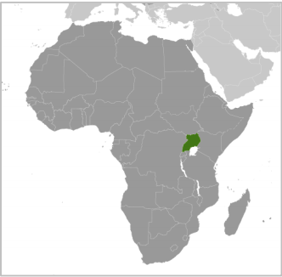
Where in the world?

Slide 5
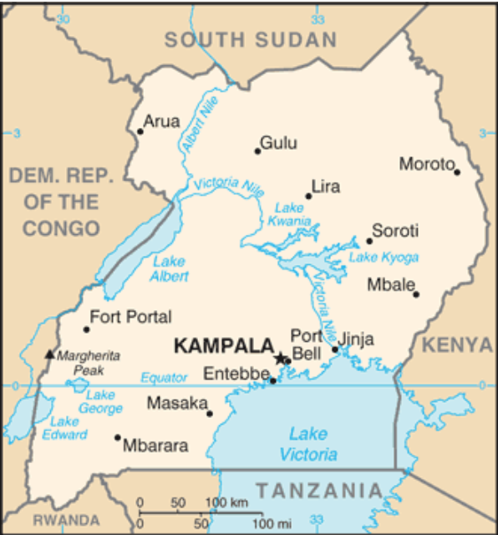
Where in the world?

Slide 6
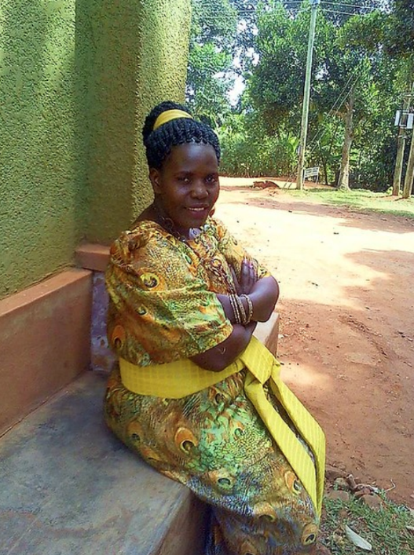
Life Challenges of the Women Served
Opportunity for economic engagement is nearly nonexistent
Rural women are poorest of the poor
Little access to healthcare, education, water, sanitation
HEADLINE GOES HERE
Text goes here
Text goes here
Text goes here
Text goes here

Slide 7
Life Challenges of the Women Served
70% of women practice agriculture, but it is only rain-fed and subsistence farming; they do not have access to services and equipment
Government focuses on cash crops typically farmed by men: coffee, cotton, tea, tobacco
Deeply entrenched gender inequality
Women are less educated and paid less than men, and have little control over childbearing
HEADLINE GOES HERE
Text goes here
Text goes here
Text goes here
Text goes here

Slide 8
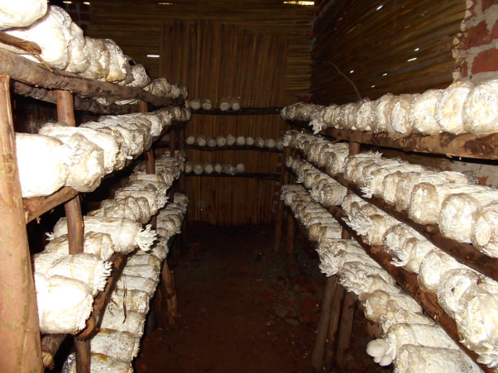
About the Featured Grantee
Africa Development Promise delivers programs that:
Strengthen cooperative governance and management
Build technical skills
Provide farm inputs and infrastructure support
Build local and regional networks
HEADLINE GOES HERE
Text goes here
Text goes here
Text goes here
Text goes here

Slide 9
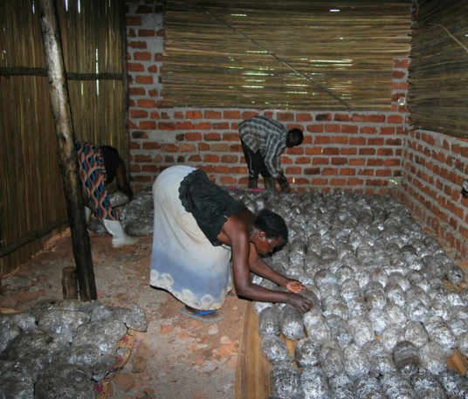
What are we supporting?
Mushroom growing cooperative will add 50-60 new women who otherwise could not afford to join.
These “outgrowers” receive training, tools, and infrastructure support.
They are expected to double the average household income to $150 per month.
The cooperative increases mushroom sales.
Direct Impact: 90
Indirect Impact: 530

Slide 10
Budget
DFW’s grant of $45,000 will fund:
Item | Detail | Total
Outreach and recruitment | Radio announcements, flyers, community meetings, interviews | $ 1,915
Training | Technical training (mushroom cultivation, maintenance, operations), financial management training and refresher, group management (overseeing outgrowers), cooperative marketing skills | $16,850
Equipment | Rainwater catchment tanks, mushroom growing structure, trays, concrete base, expansion of irrigation system, solar dryer | $18,334
Monitoring and evaluation | Mid-year and end-of-year | $2,000
Transportation and Uganda staff support | Infrastructure transport, bus rental to training center, weekly field visits, | $5,901
Total |  | $ 45,000
HEADLINE GOES HERE
Text goes here
Text goes here
Text goes here
Text goes here

Slide 11
Share Your Thoughts
How do you think the outgrower model could work for other endeavors?
What skills are women learning other than growing mushrooms?
Why do you think partnerships are key to the success of the program?
HEADLINE GOES HERE
Text goes here
Text goes here
Text goes here
Text goes here

Slide 12
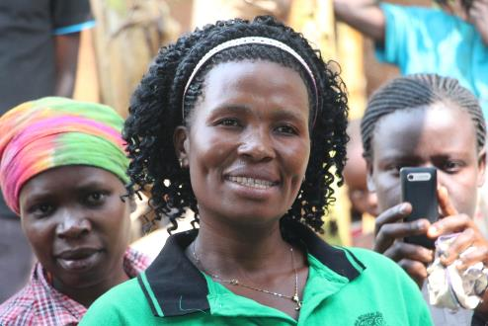
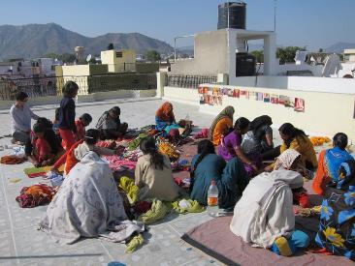
April’s Sustained Grantee:
Women’s Microfinance Initiative
Empowering Village Women Through Business Ownership (Uganda)
HEADLINE GOES HERE
Expand financial access for rural village women who are considered “un-bankable” through a two-year cycle of four consecutive, 6-month term loans of up to $250
Training, support, and education to ensure the women succeed in their business and can successfully repay these loans.
Includes WMI’s regular loan program, a jumbo loan program for alumni who are experienced businesswomen, construction/solar and technology upgrades.
Direct Impact: 1,360; Indirect Impact: 13,600 – 25,000
Text goes here
Text goes here
Text goes here
Text goes here

