Slide 1
March 2021 Featured Grantee
Women Advocacy Project
Zimbabwe

Slide 2
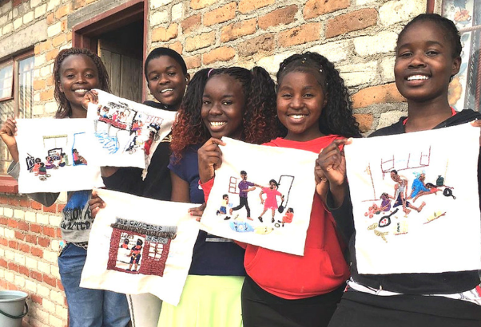
Introducing Women Advocacy Project
HEADLINE GOES HERE
Text goes here
Text goes here
Text goes here
Text goes here
Women Advocacy Project (WAP) seeks to abolish child marriage, promote women and girls’ rights, and work toward women’s economic empowerment.
WAP was founded in 2012 by group of Zimbabwean women
WAP organizes advocacy campaigns, trainings, workshops

Slide 3
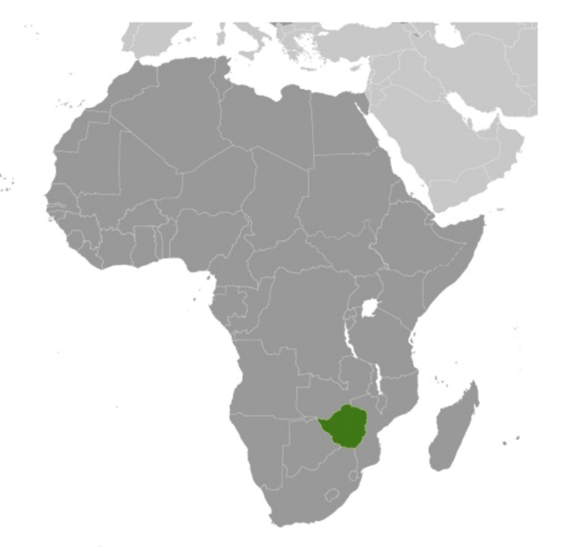
Where in the world?
Zimbabwe

Slide 4
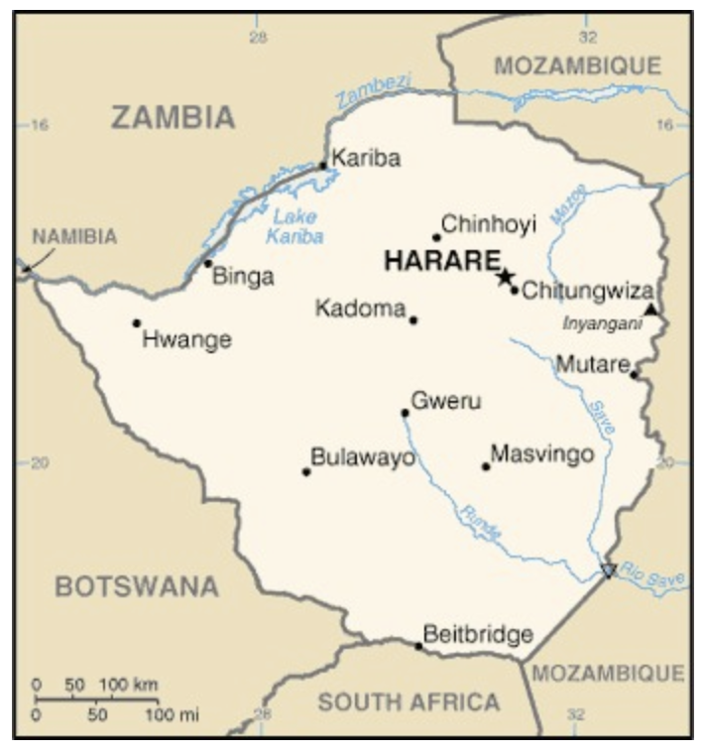
Where in Zimbabwe?

Slide 5
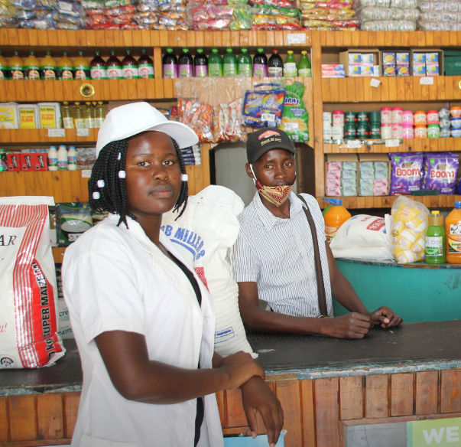
Zimbabwe
Is a poor, landlocked country in southern Africa
Population of 14.5 million
90% unemployment rate
72% live in chronic poverty
Women experience hardship, sexual and gender-based violence
30 years under President Mugabe was politically repressive, resulted in numerous reports of human rights violations
One quarter of the population fled to South Africa, Botswana

Slide 6
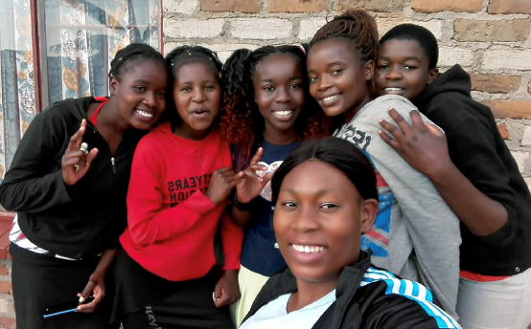
Life Challenges of the Women Served
HEADLINE GOES HERE
Text goes here
Text goes here
Text goes here
Text goes here
Financial pressure forces families to take daughters out of school and marry them off to wealthier men
Many girls turn to prostitution
One third of girls marry before age 18
500,000 teenagers become pregnant every year
19% of pregnancies are the result of child marriages
48% of adolescent pregnancies are unplanned

Slide 7
What are we supporting?
Producing & Selling Soap
to Empower Zimbabwean Girls
Training for producing and sales, money management, education about child marriage
Girls and mothers will earn an income by producing and selling all-purpose (“Clean Girl”) soap
With the pandemic, the market for soap has expanded
Family income is expected to rise by 50%
Child marriages will decrease when families see the value of daughters’ entrepreneurship
Year 1 - Direct impact: 160 Indirect impact: 400
Year 2 - Direct impact: 160 Indirect impact: 400

Slide 8
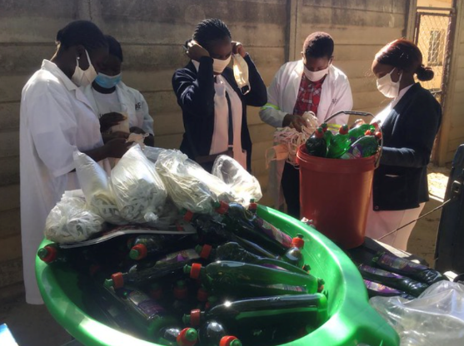
What are we supporting?
Girls who participate in this program become more productive, efficient and experienced as they undergo more training.
Girls acquire confidence and new skills through selling, including expression, marketing, and leadership.
No girls who have attended WAP's clubs or participated in prior soap training have married early.

Slide 9
Budget
DFW’s grant of $31,960 will fund:
Item | Description | Total
Raw Materials | Raw materials for making soap, including sulphonic acid, coarse salt, soda ash, and more | $15,900
Production and safety equipment, packaging | Electronic mixing machines, bottles, labels, boots, gloves, coats | $8,060
Personnel | Executive Director, Ambassadors’ stipend, Club Coordinators | $6,200
Fuel | Monthly fuel for WAP staff field visits | $1,800
TOTAL EXPENSES |  | $31,960
HEADLINE GOES HERE
Text goes here
Text goes here
Text goes here
Text goes here

Slide 10
Share Your Thoughts
Why is soap a good product to introduce the concepts of production, marketing, and sales?
How might this program benefit gender equality?
How do you think this program could be replicated for other products or services?
HEADLINE GOES HERE
Text goes here
Text goes here
Text goes here
Text goes here

Slide 11
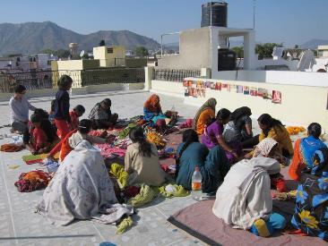
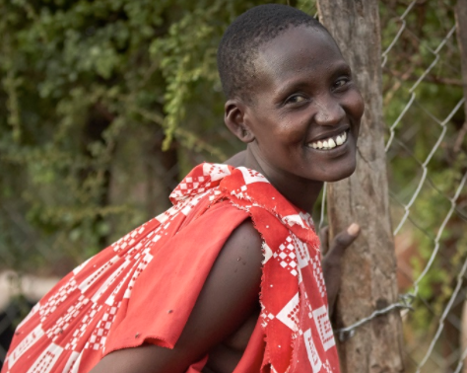
Sustained Grantee: African People & Wildlife
Women and Girls in Conservation –
Driving Economic and Environmental
Sustainability in Northern Tanzania
Elevates women and girls’ involvement
in conservation
Living Walls ensure human and
livestock security
Allows women time to pursue business opportunities to better family’s livelihood
Entrepreneurship seminars, micro-grants, and business training build economic and conservation opportunities in the community
Direct Impact: 1,128; Indirect Impact: 21,710
HEADLINE GOES HERE
Text goes here
Text goes here
Text goes here
Text goes here

