Slide 1
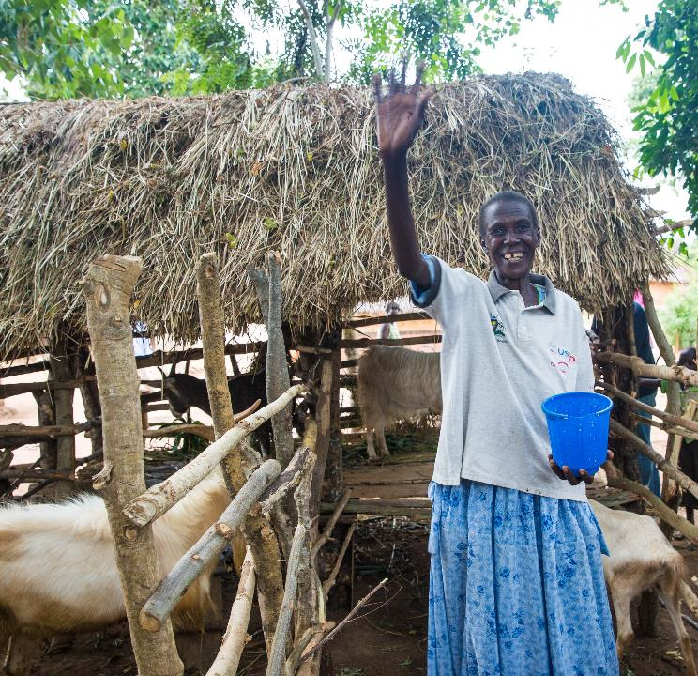
TERREWODE
May 2021 Featured Project

Slide 2
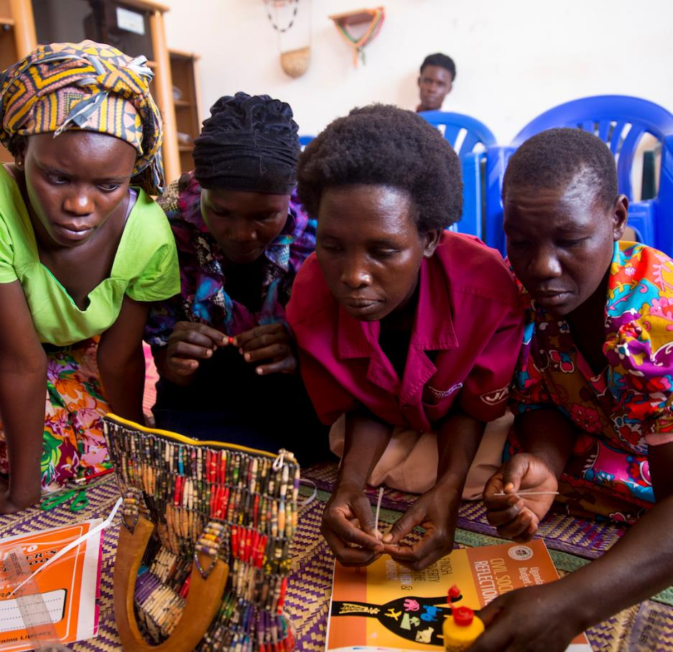
Introducing TERREWODE
Reintegration Program for Obstetric Fistula Survivors, Uganda
TERREWODE’s mission is to build community capacity to eliminate obstetric fistula and systematically empower women and girls to meaningfully participate in the development process.
Obstetric fistula is a debilitating childbirth injury that results in uncontrollable incontinence of urine and/or feces that is caused by prolonged, obstructed labor and delayed access to quality emergency obstetric care.

Slide 3
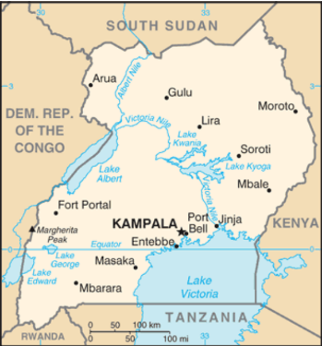
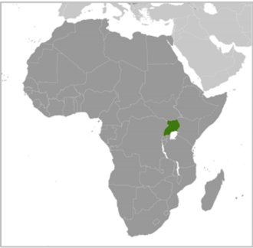
Uganda
Uganda has one of the highest rates of obstetric fistula in the world, with an estimated140,000-200,000 women currently suffering from fistula and an additional 1,900 new cases annually.
Often, the fetus dies during the prolonged labor.
The social consequences of obstetric fistula are extreme – odor from incontinence leads to discrimination, shaming, isolation, high rates of divorce and abandonment, and higher rates of gender-based violence.

Slide 4
Life Challenges
Uganda struggles with severe health worker shortages, with only nine physicians and 65 nurses or midwives per 100,000 people.
Most of the health workforce is concentrated in urban areas. When rural women need emergency obstetric care, especially a caesarian delivery, they often experience long delays – sometimes days.
The high rate of obstetric fistula and maternal mortality can be directly attributed to delays in receiving quality care.

Slide 5
Life Challenges
Women experience workforce discrimination and increased costs in health and hygiene needs, loneliness, anger, low self-esteem, bitterness, depression, and suicidal thoughts.
Many women report lingering psychosocial distress, ongoing depression, family discord, and economic difficulties even after successful surgical treatment of fistula.
Women who experienced withdrawal of support, abandonment, and abuse, often struggle to reintegrate. This is more pronounced for extremely impoverished women and women who continue to experience physical co-morbidities from fistula, such as stress incontinence, secondary infertility, sexual disfunction, or pain.
Young women and girls are particularly at-risk for ongoing reintegration difficulties. Almost half report ongoing health issues, a third desired additional personal or family counseling, and virtually all struggle economically.

Slide 6
The Project
TERREWODE’s Reintegration Program for Obstetric Fistula Survivors (RPOFS) addresses the lingering psycho-social, mental health, economic, and ongoing health needs of women who have suffered obstetric fistula.
The program will be implemented in Soroti, Uganda, at the newly opened TERREWODE Women’s Community Hospital, with fistula survivors from eastern, central, and northern Uganda.
The main goal is to provide the comprehensive care women need to fully heal from the trauma of obstetric fistula and successfully reintegrate into communities. It begins with a holistic, two-week reintegration program.

Slide 7
The Project
The program includes psychosocial counseling (including family and marital counseling), health, nutrition, and safe motherhood education, family planning education and services, social reintegration support, and tools for economic empowerment. For many, this the first time they truly understand why they experienced fistula and how to prevent it in future pregnancies.
Women and girls gain health and sexual reproductive health knowledge, process and heal from psychological wounds, and gain practical income generating skills and financial literacy.
Solidarity Groups and Music, Drama, and Dance groups provide ongoing support and mentorship, including financial support, to help lift women out of poverty.

Slide 8
Budget
Item | Description | Cost
Obstetric Fistula Reintegration Program | Participant meals | $20,000
Obstetric Fistula Reintegration Program | Participant transportation | $7,300
Obstetric Fistula Reintegration Program | Reintegration training materials, reintegration MDD training costumes, expert and trainer facilitation, exposure visits and community linkages study tours | $5,200
Patient costs | Toiletries, toothbrush, soap, medicines, personal effects (pads, underwear) | $2,500
Total |  | $35,000

Slide 9
About TERREWODE
The Association for Rehabilitation and Re-orientation of Women for Development (TERREWODE) is a Uganda-based non-governmental organization founded in 1999 by Alice Emasu and two grassroot women leaders in Soroti District of eastern Uganda. It was the first to break the silence that surrounded obstetric fistula in Uganda, bringing national attention and resources to address the issue. No other organizations in Uganda provide a comprehensive reintegration program for fistula survivors.
Since its founding, it has supported treatment and reintegration services to more than 5,000 women and girls suffering from fistula.
Construction on TERREWODE Women’s Community Hospital (TWCH) began in March 2018 and was completed in April 2019. Patient treatment began in August 2019. TWCH is the first and only dedicated fistula treatment hospital in Uganda and one of three in all of Africa.

Slide 10
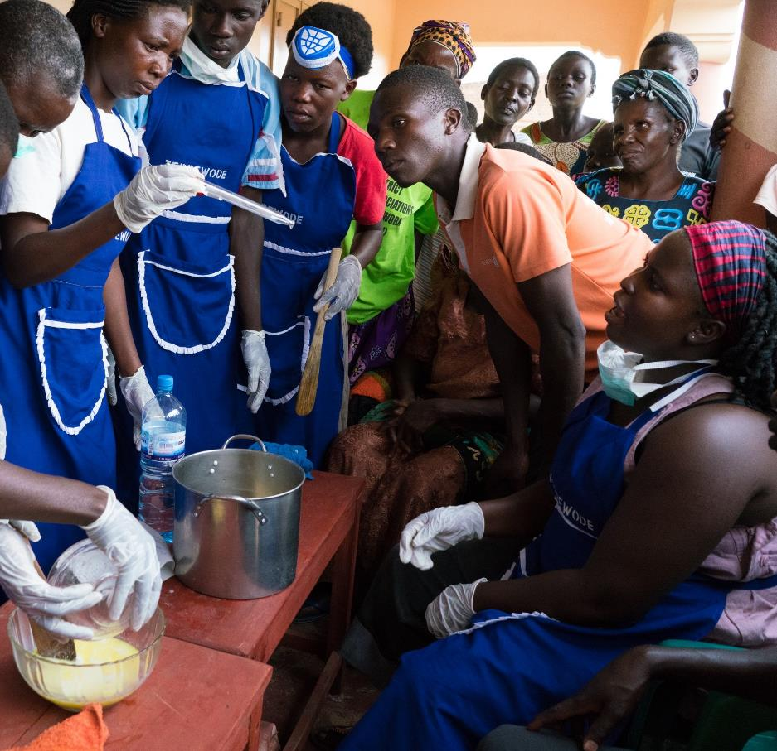
Share your thoughts
How do society's attitudes toward women affect the health care available to women?
Why do you think child marriage persists and is even increasing during the pandemic?
Why do you think obstetric fistula in considered a solvable scourge?
Why is it critical that support extend beyond the two-week program?

Slide 11
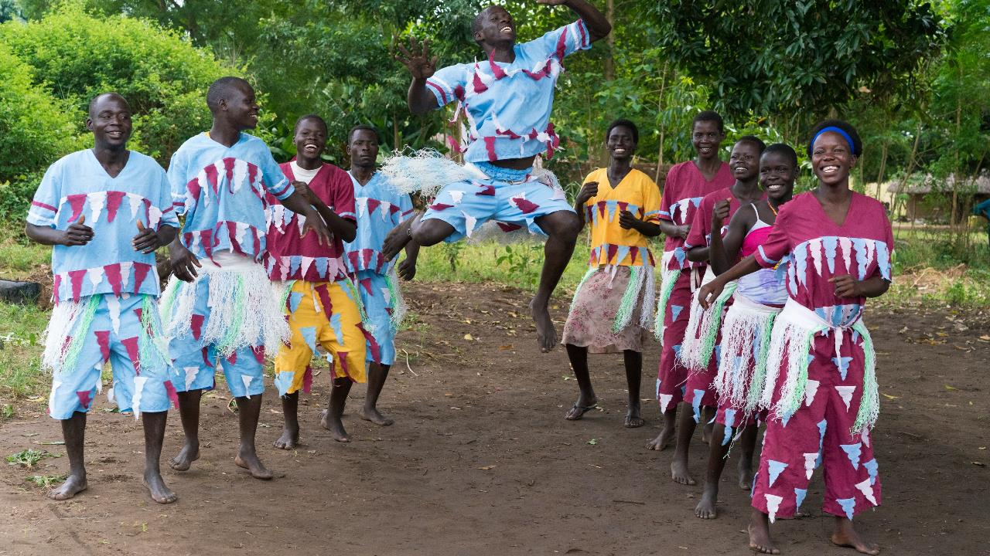

Slide 12
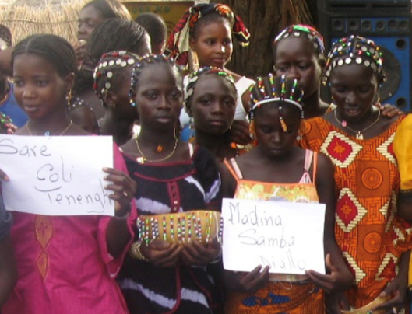
Grandmother Project
May 2021 Sustained Grantee Strengthening Communication Between Generations of Girls and Women to Promote Girls’ Holistic Development (Senegal)
This project expands and strengthens GMP’s Girls’ Holistic Development Program to promote girls’ education and decrease child marriage, FGM/C (Female Genital Mutilation/Cutting), and teenage pregnancy.
A community assets approach builds social infrastructure and strengthens the resilience communities need to solve problems.

Slide 13
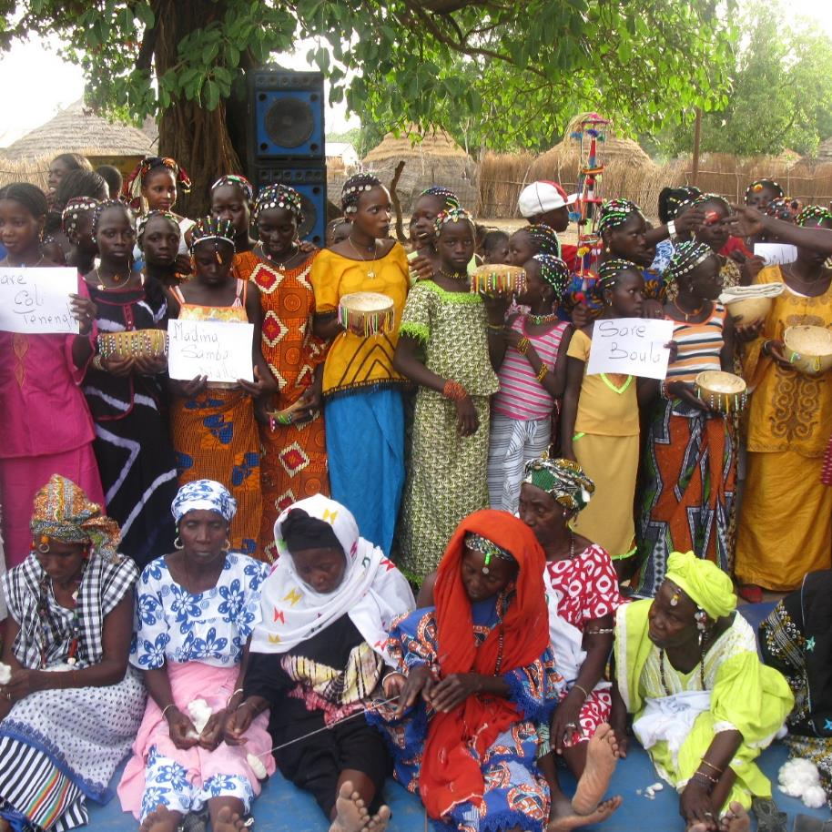
Grandmother Project
GMP will convene a series of All Women Intergenerational Forums with girls, mothers, grandmothers, and female teachers to discuss topics of importance to girls’ well-being and education.
These open and in-depth discussions strengthen and reinforce the grandmothers’ roles as culturally designated advisors and advocates for girls and contribute to community-wide dialogue for changing social norms.
Direct Impact: 495; Indirect Impact: 1,800

