Slide 1
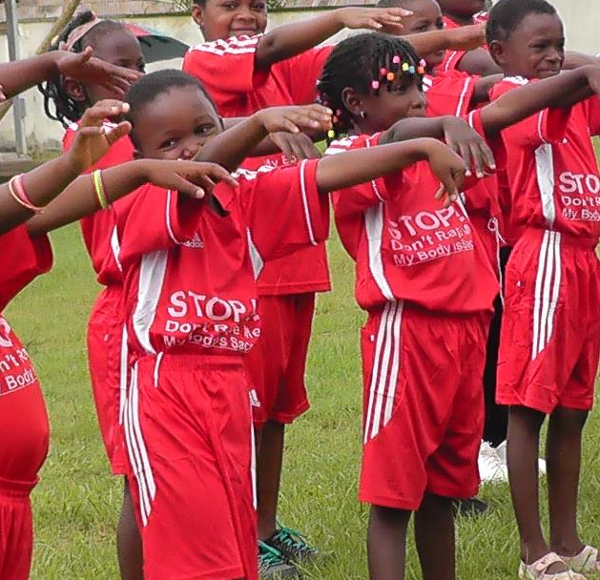
Global Pearls, Inc.
July 2021 Featured Project

Slide 2
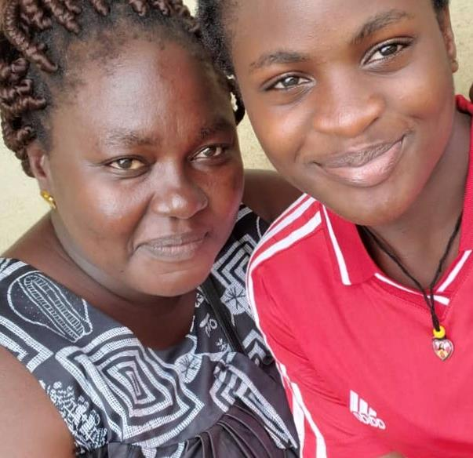
Introducing Global Pearls
Child Rape Prevention Camps
Global Pearls' mission is to reduce suffering and foster hope among marginalized populations in developing countries by empowering changemakers from within.
Cameroon has a high incidence of gender-based violence (GBV, but the COVID-19 pandemic and socio-political Anglophone crisis (ongoing civil war) have caused it to skyrocket. Children are particularly vulnerable.

Slide 3
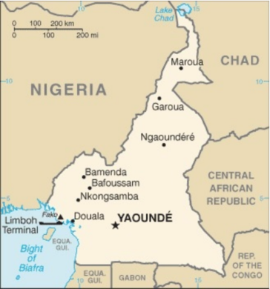
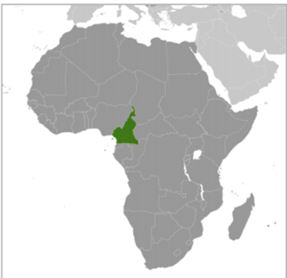
Cameroon
Cameroon has an ethnically diverse population of 28.5 million, among the most urban in western Africa. Over 40% are under 15 years old. Fewer than 20% use contraception. HIV/AIDS is a serious health issue.
Poverty has increased, especially in rural areas. Food insecurity exists due to natural disasters and a lack of infrastructure, as well as government corruption and mismanagement.
Gender inequality is part of the social fabric – in the economy, education, healthcare, and employment. While 39% live below the poverty line, the rate is 51.5% for women.

Slide 4
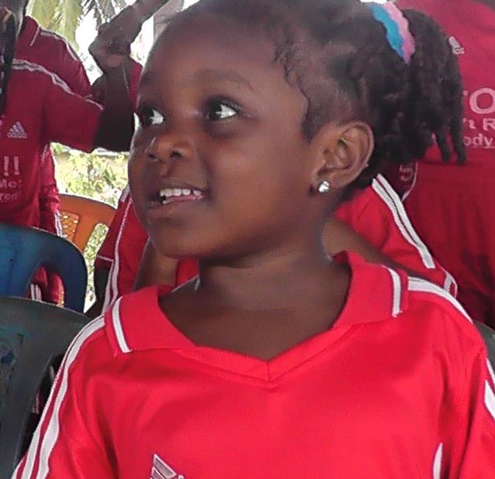
Life Challenges
GBV, including child rape, is commonplace in Cameroon. The child victims do not understand what is happening or know how to protect themselves. They are left with feelings of intense shame and fear that can cause problems in school and in future relationships of all kinds.
Watchdog organizations estimate that 40% of children in Cameroon have been sexually abused. Most women and girls do not report rape or abuse even to their parents, let alone to the authorities.

Slide 5
Life Challenges
51% of women ages 15 to 49 in Cameroon have experienced intimate partner physical and/or sexual violence, 33 percent within the previous year. These numbers are likely understated, because it is extremely rare for a woman to report her experience of rape and physical abuse – particularly when she is a child.
In the Oroko culture, men believe and openly state that women will not understand that they are loved if they are not beaten, so a man must beat his wife to demonstrate his love.
The Anglophone crisis (civil war) displaced 400,000 people; many are now sharing cramped houses. These Internally Displaced Persons (IDPs) had only known agriculture and struggle to survive. Many young girls have resorted to prostitution. Parents are often away from the home for long hours struggling to earn an income, leaving children vulnerable to abuse.

Slide 6
The Project
Global Pearls, in collaboration with its partner, Rescue Women Cameroon (REWOCAM), is addressing GBV, particularly child rape, in Kumba, Cameroon. This project focuses on building leadership skills, knowledge, healing, and confidence of young girls. By expanding the project to the larger community, this project seeks to propel women and girls as leaders who bring about cultural change to their schools and communities.
The primary objectives are to:
protect girls from rape by teaching them how to avoid dangerous situations and what to do if they are faced with a potential rape
bring healing to rape victims by removing their shame
extend the message to the broader community and begin to transform the culture by discussing rape and calling it the crime that it is.

Slide 7
The Project
400 children ages 5 to 15 will attend GP's Child Rape Camps. These child ambassadors will learn how to advocate for other children who have been raped or are in danger. GP will use/revive traditional African sports and games to create a fun environment, develop trust and team spirit, and put the children in a relaxed state of mind that fosters learning and sharing.
500 children will attend Girls Against Rape clubs at secondary schools. These clubs extend the lessons to more children, develop an ongoing supportive social group, and create powerful girl leaders who will stand against rape and GBV.
Each camp will have a media budget for TV and radio exposure. This created serious excitement in the pilot program. Talking openly in the community about this taboo subject and the legal rights of women is creating a real stir.

Slide 8
Budget
Item | Description | Cost
Child Rape Camps | Rental of sports arena and hall for 8 week-long camps over two years, plus two nutritious meals per day | $14,400
Sports Attire & Prizes | Signature red sports attire identifies the girls as GAR camp participants | $6,800
Trainers | Sports trainers and trainers in Gender Based Violence and Sexual and Reproductive Health and Rights | $4,800
GAR Clubs | Girls Against Rape clubs in 10 schools for 2 years to spread the teachings to a wider group of children | $4,000
TOTAL |  | $30,000

Slide 9
About Global Pearls
Global Pearls seeks to accomplish international development work by empowering locals. GP selects outstanding individuals from impoverished communities who are resourceful, well-connected, and passionate about improving life for marginalized populations in their communities. They mentor and help develop them to dramatically increase their impact. Together, they are creating a collective movement that uses media and gatherings to unite their voices.
GP has 12 partners in eight countries. Since the goal is to empower local partners to pursue their own passions and not impose particular projects on them, GP's projects are quite varied. Projects range from education to agriculture, maternal mortality to job creation. GP always focuses on the most marginalized populations that are outside the reach of other aid organizations.

Slide 10
About Global Pearls
Global Pearls was established in 2016 by three women – Lisa Robinson-Spader, LeeMin Chong, and Arlene Say Soto. These women believed there was a better, more effective way to accomplish international development work: by empowering outstanding locals from the outset.
REWOCAM, GP's implementing partner, was founded in 2013 by Nakinti Nofuru and other dynamic, solutions-oriented Cameroonian women who were fed up with the deeply ingrained culture of violence against women.
Their passion is to address the many forms of injustices that are perpetrated against Cameroonian women by creating a collective movement that uses media and gatherings to unite their voices

Slide 11
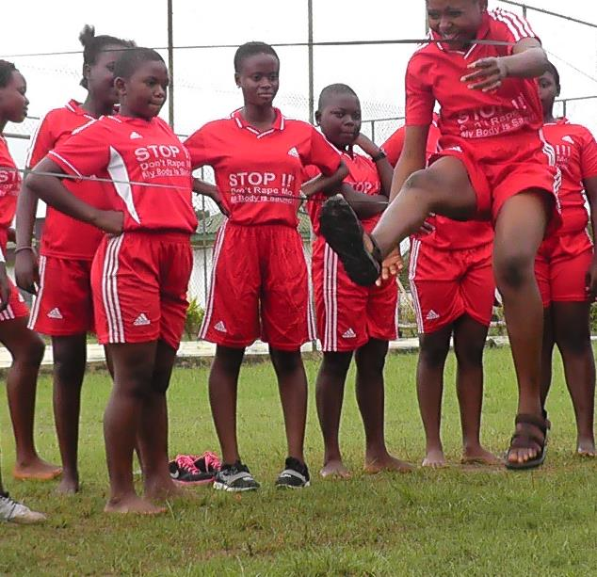
Share your thoughts
1. How might male-female relationships change after a woman has been able to share her story of GBV?
2. Why do you think there was overwhelming demand for this program, even from boys?
3. How and why do you think a community comes to accept rape and GBV as "normal”?

Slide 12
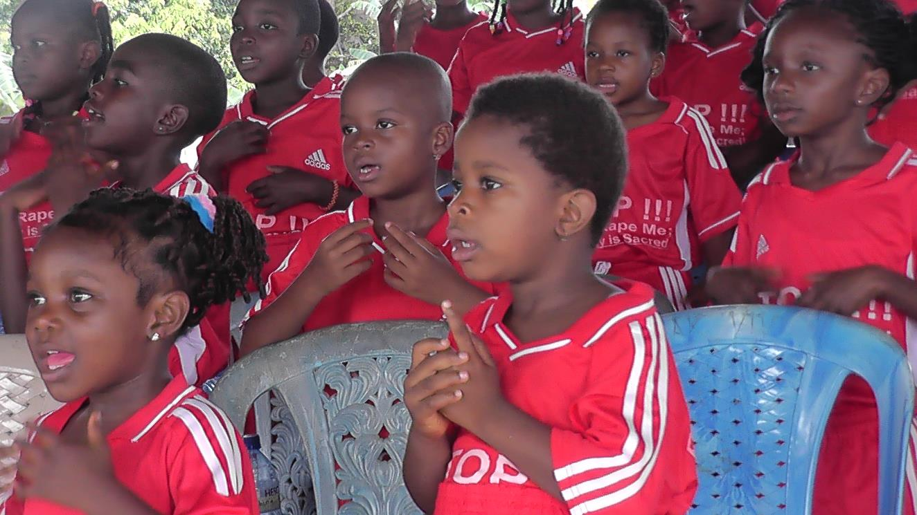

Slide 13
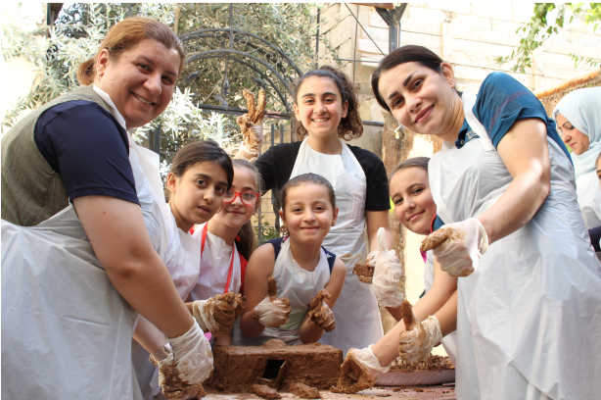
Collateral Repair Project
July 2021 Sustained Grantee
Resilience Beyond Displacement: Education and Empowerment for Refugee Women and Girls in Jordan
This project is based on the understanding that refugees must first have their basic needs met in order to heal from trauma and build a better life.
It provides refugee families with basic needs, such as food vouchers, medical assistance, winter needs, education and skill-building, community-building, and programs to help them heal from trauma.

Slide 14
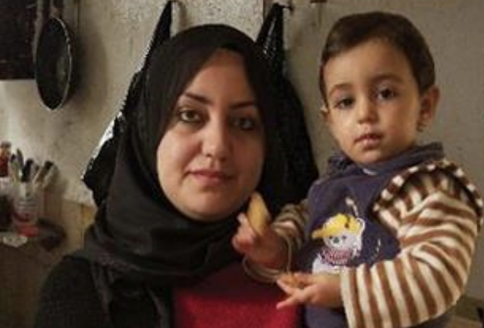
Collateral Repair Project
CRP is expanding its support model to refugees from Iraq, Syria, Sudan, and Yemen. CRP educates and empowers women and girls through targeted training and educational activities along with opportunities for advocacy and leadership.
Technical and vocational skills training is provided to increase the resilience of refugee women and offer them more opportunities for income generation. GBV prevention and awareness training is also offered to both women and men in the refugee communities.
Direct Impact: 3,885 women and girls; Indirect Impact: 25,605 family members

