Slide 1
March 2022 Featured Project
Healing the wounds of torture survivors

Slide 2
Important note
In February and March 2022, our Featured Projects focus on the mental health needs of survivors of gender-based violence, each using a different approach to treatment and recovery. Gender-based violence is one of the most prevalent issues faced by women and girls around the world, and it can have lifelong repercussions for survivors.
The topics raised by these projects may be difficult for some Together Women Rise members to discuss. Please consider your own well-being before engaging in this content.
Notes:
Important content warning for members.

Slide 3
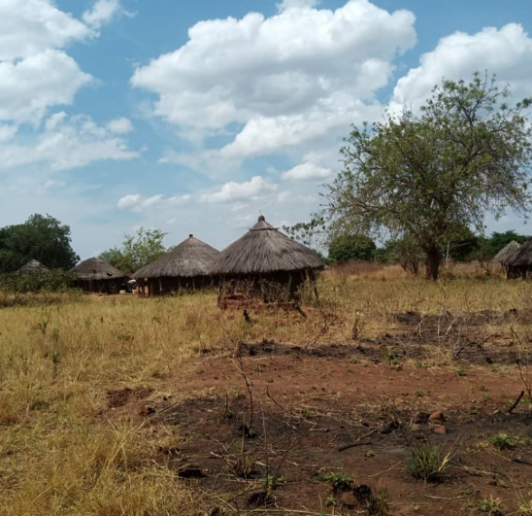
Introducing The Center for Victims of Torture
Mental Health Counseling for Women and Girls in Uganda
Works to end torture and heal the wounds of torture
for individuals and families from refugee and local communities
with focus in Uganda on rehabilitative care of women and girls kidnapped and trafficked as child soldiers or sex slaves of male combatants
Notes:
Purpose: The goal of the CVT Uganda program is two-fold, providing mental health services to torture and trauma survivors, as well as developing the capacity of mental health practitioners, particularly women and the broader community. CVT aims to improve the quality of life for women and help them pursue their own goals and create lasting change in their lives.

Slide 4
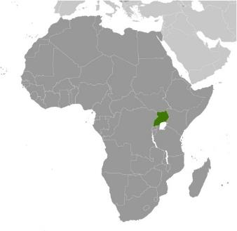
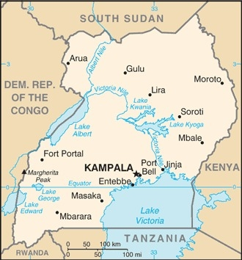
About Uganda
Population 44.7 million
Located in East-Central Africa
One of the youngest and most rapidly growing populations in the world
Literacy rate is 82.7% for men and 70.8% for women
Women on average -- less-educated, less paid employment, little say in childbearing decisions
Notes:
Uganda is located in East-Central Africa, west of Kenya, east of the Democratic Republic of the Congo, in an area slightly more than two times the size of Pennsylvania. The Democratic Republic of Congo, Kenya, Rwanda, South Sudan, and Tanzania border it. The population of Uganda is 44,712,143.
Uganda’s total fertility rate is among the world’s highest at 5.8 children per woman. Except in urban areas, actual fertility exceeds women’s desired fertility by one or two children, which is indicative of the widespread unmet need for contraception, lack of government support for family planning, and a cultural preference for large families. Gender inequities also make fertility reduction difficult; women on average are less-educated, participate less in paid employment, and often have little say in decisions over childbearing and their own reproductive health.

Slide 5
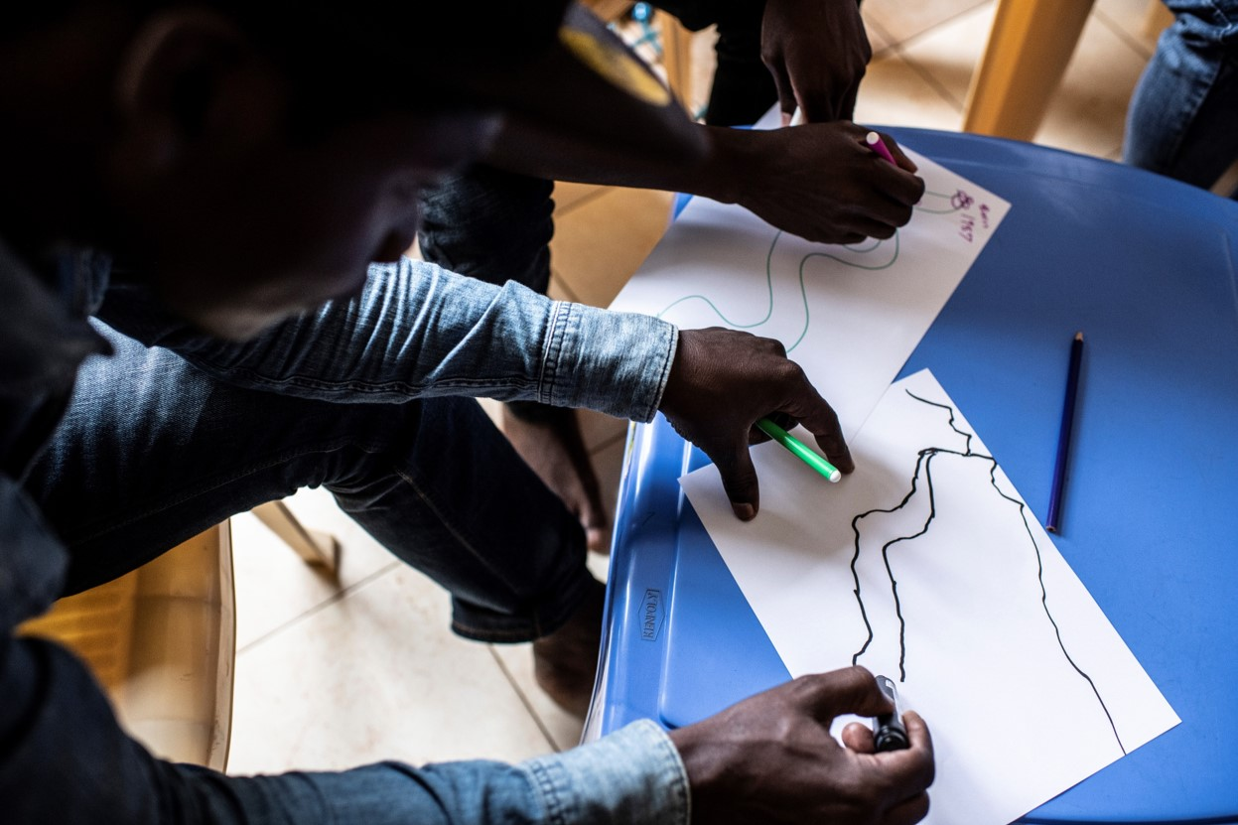
Life Challenges
For women in Uganda
Recovering from nearly 20 years of conflict including widespread torture and human rights violations
Health, societal, and financial challenges are barriers to accessing social services and opportunities
Notes:
Uganda hosts nearly 1.5 million refugees fleeing from neighboring humanitarian emergencies, and it is also still recovering from nearly 20 years of conflict between the government and the Lord’s Resistance Army (LRA) – whose leaders stand accused and have been convicted by the International Criminal Court (ICC) of widespread torture and human rights violations. Therefore, Uganda is striving to provide opportunities and basic social services to its citizens and refugees, but health and financial challenges continue to be barriers while accessing such services.

Slide 6
Life Challenges
Thousands of baby girls were kidnapped, trafficked, and forced to be child soldiers, or used as sex slaves for male combatants
During captivity, many women contracted HIV and delivered children born of rape
Women feel immense shame, lack access to resources, have limited education, experience trauma symptoms, and may face rejection from community
They were victims of violence and also forced to perpetrate violence
Notes:
The LRA conflict was particularly troublesome for women and children, as thousands of baby girls were kidnapped from their families, trafficked, and forced to be child soldiers, or used as sex slaves for male combatants. During captivity, many women contracted HIV and delivered children born of rape. Women returning home after capture feel immense shame and self-blame, are unable to access resources, have limited education, and experience trauma symptoms from growing up and living amidst violence. In addition, they may face rejection and blame from their families and communities.
Women survivors (70 percent of CVT clients) of the LRA conflict are different from other trauma survivors, as they were victims of violence and also forced to perpetuate it. Children were forced to kill their parents, men forced to rape their sisters, and children abducted and forced to be LRA soldiers.

Slide 7
The Project
The goal is two-fold:
Improve the mental health of torture and war trauma survivors through individual and group mental health counseling
Strengthen the capacity of Ugandan mental health care providers to understand, identify, support, and treat survivors of torture and trauma
Beneficiaries include Ugandan women survivors of torture and trauma, and Ugandan and international organizations providing mental health services to Ugandan and refugee communities
340 direct beneficiaries (160 women per year, 20 total counselors) and 2,000 indirect beneficiaries
Notes:
CVT aims to improve the quality of life for women survivors of torture in Uganda and help them pursue their own goals and create lasting change in their lives. Among CVT clients, 92% experience a medium-to-high severity of depression and PTSD at the start of services.
CVT’s specialized mental health services support and empower women to live self-sufficient lives in the following ways: 1) through counseling, women improve their functioning significantly, allowing women to take steps to better care for themselves and their families; 2) women are referred for medical and livelihood services thereby improving their health and financial stability; and 3) counseling gives women the support of other women to know they are not alone, to be integrated back into the community, and to learn how to assert their needs as an individual. By reclaiming their dignity (a core objective of the CVT group model), they develop the strength to claim a new identity for themselves beyond what is prescribed for them by the cultural norms — resulting in increased sense of empowerment.

Slide 8
The Project
Components:
Mental health counseling provided by local counselors hired, trained, and supervised by CVT expert staff – group counseling, trauma recovery, reconnection to community, restoration of dignity
Medical and livelihood partnerships for services to improve health and financial stability
Programming for internally-hired CVT staff, Masters-level interns from Makerere University, and local counselors from partner organizations
Notes:
The majority of counseling services are provided through group counseling with 10-12 participants, lasting three months including a two-session intake and an individual check-in and mid-group cycle. Groups are formed according to age, gender, and similar trauma history. Individual treatment is available if necessary (e.g. a woman who experienced sexual assault or attempted suicide). Session topics include safety and trust, mind-body awareness, sharing difficult memories, grief/loss, reconnection to self, community and the future.
For capacity building programming, CVT delivers programming to three different populations of providers: 1) internally-hired CVT staff, 2) Master-level interns from Makerere University, and 3) local counselors from partner organization, some of whom participate in a diploma program accredited by Makerere University.

Slide 9
Budget
Item | Description | Cost
Field Staff | Associate Psychotherapist – Gulu (Shares supervision responsibilities, provides training to the national mental health staff, provides management and coordination of counseling activities directly related to the project) | $20,854
Field Staff | Psychosocial Counseling Supervisor (Assists senior clinical staff with onsite supervision and provides support in the development of training sessions and program direction) | $17,608
Field Benefits | Health insurance, life insurance, and taxes for the field staff | $11,538
TOTAL |  | $50,000
Notes:
Why We Love This Project
We love CVT's focus on the rehabilitative care of women and girls who were kidnapped and trafficked into becoming child soldiers or sex slaves of male combatants of the Lord's Resistance Army. CVT offers interdisciplinary, holistic, and broad-based healing care for the trauma and torture experienced by their beneficiaries. CVT is also training and building capacity of local mental health professionals to understand, identify, support, and treat survivors of torture and trauma in these communities for a long time to come.

Slide 10
About The Center for Victims of Torture
Founded in 1985, CVT was the first rehabilitation center for torture survivors in the United States; remains one of the largest organizations of its kind in the world
Work began in Minneapolis-St. Paul, Minnesota serving immigrants from war-torn countries
In 1999, launched its first international direct services program in West Africa
Today, international rehabilitation programs operate in Jordan, Ethiopia, Kenya, Iraq, and Uganda
Notes:
CVT was founded on the recommendation of Minnesota Governor Rudy Perpich in 1985. CVT was the first rehabilitation center for torture survivors in the United States, and it remains one of the largest organizations of its kind in the world. Their work began in the Minneapolis-St. Paul area of Minnesota serving immigrants from war-torn countries, and in 1999, CVT launched its first international direct services program in West Africa. Today, their international rehabilitation programs operate in Jordan, Ethiopia, Kenya, Iraq, and Uganda.

Slide 11
Share your thoughts
Why do you think capacity building for local mental health professionals is important for this project?
How do you think group counseling makes a difference in trauma recovery?
Why is it important for counseling and treatment to be culturally relevant?

