Slide 1
Transformation Partnerships
Fall 2021

Slide 2
Our Mission
Together Women Rise cultivates the collective power of community to achieve global gender equality
Our Vision
Together Women Rise envisions a world where every person has the same opportunities to thrive regardless of their gender or where they live

Slide 3
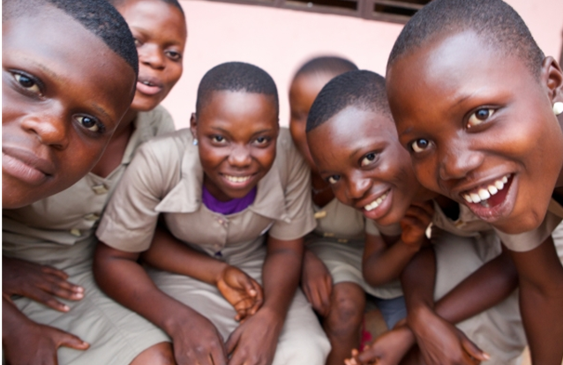
Core Strategies

Slide 4
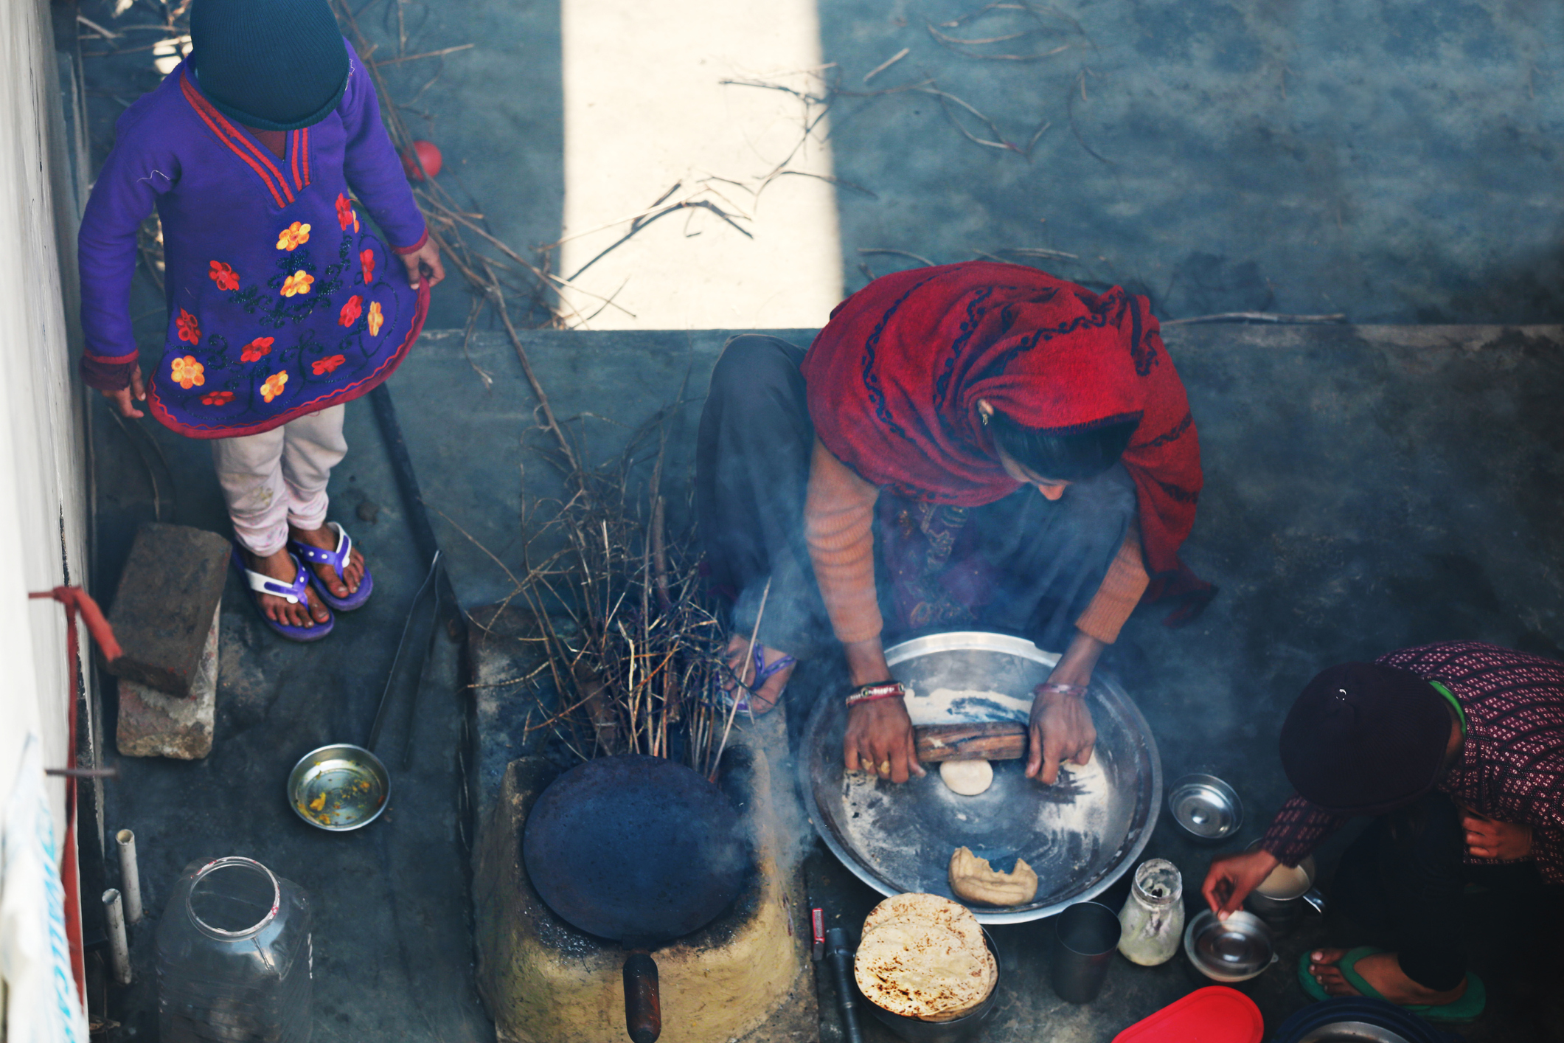
Grants Reimagining Committee
Connect grant making to issues and systems change
Form Partnerships with past grantees pursuing systems change
Elevate global gender equality and connect to “Learning” as a core strategy
Shift the historical power dynamic between grant maker and grantee
Notes:
Grants Reimagining Committee made up of Board members/GSC and staff convened for 20 months

Slide 5
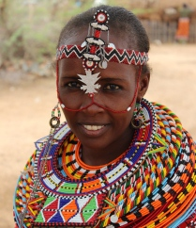
Key Recommendations
Featured grants continue unchanged
Evolution of Sustained and Partnership Grants into Transformation Partnerships
Focus on systems change within the most pressing gender inequality challenges
Utilize best practices in participatory grant-making
Forge partnerships with a small number of selected partners, with priority to past grantees
Focus on multi-year funding
Notes:
Continuum of grant making; following principles of multi-year funding for deeper impact at scale

Slide 6
Why Pursue Systems Change ?
The world is made up of patriarchal systems created by, for, and benefitting men.
Gender inequality and poverty are deeply linked; we cannot combat poverty without addressing gender inequality.
Our current approach to support services to help women does not specifically address root causes. A systemic approach focuses on laws, changing beliefs, and practices, so women have equal access to resources, decision-making power, and opportunity.
Notes:
GBV --Groups of women can be helped year after year without addressing underlying issues or helping the world for the next generation of women.

Slide 7
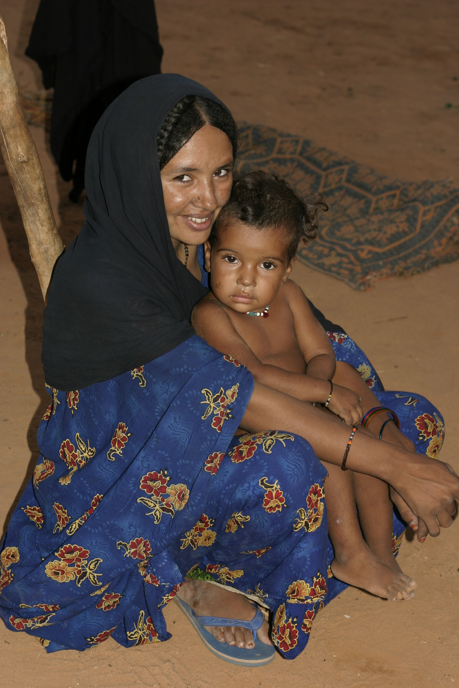
To Advance Global Gender Equality
RISE can make investments to support meaningful systems change.
The two biggest impact opportunities are:
Economic equality
Access to decision-making power
Two other meaningful areas of opportunity are:
Education
Ending gender-based violence

Slide 8
Examples of Systems Change
Support changes in labor, banking, land ownership and inheritance laws to give women equal opportunities.
Support media campaigns to demonstrate diverse roles for women and illustrate women’s rights.
Support implementation of teacher training and curriculum shifts to highlight gender concerns.
Notes:
Land rights
Women as role models
Schooling as a Socializing agent

Slide 9
Key Concepts of Participatory Grant Making
Forge trusting relationships
Shared control is fundamental
Respects partner (grantee’s) knowledge of problems and solutions
Offers flexibility in resources and time for efforts to adapt and grow
Incorporates local experts, peer grantees, and/or other non-RISE voices in decisions
Includes shared evaluation and monitoring
Requires ongoing time and investment from RISE staff and volunteers to maintain relationships
Notes:
Flexibility: Recognizes that efforts may have to adjust, change, calibrate over time to achieve long-term goals

Slide 10
Transformation Partnerships - Process
Transformation Partners will be selected by invitation, not application.
We will make $25k planning grants to a few organizations, and then larger multi-year larger grants for the most promising partnerships.
RISE staff and board will work collaboratively with Transformation Partners to plan and assess projects.
The underlying issues addressed will become part of RISE’s learning program for chapters and members.

Slide 11
Transformation Partnerships - Timeline
Research and Outreach
Selection of Partnerships
Partnerships Announced
Rolling process to be repeated as needed

Slide 12
Q and A

