Slide 1
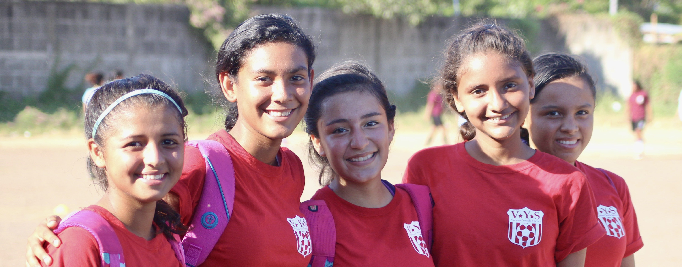
July 2022 Featured Project
Fostering education and leadership through sports

Slide 2
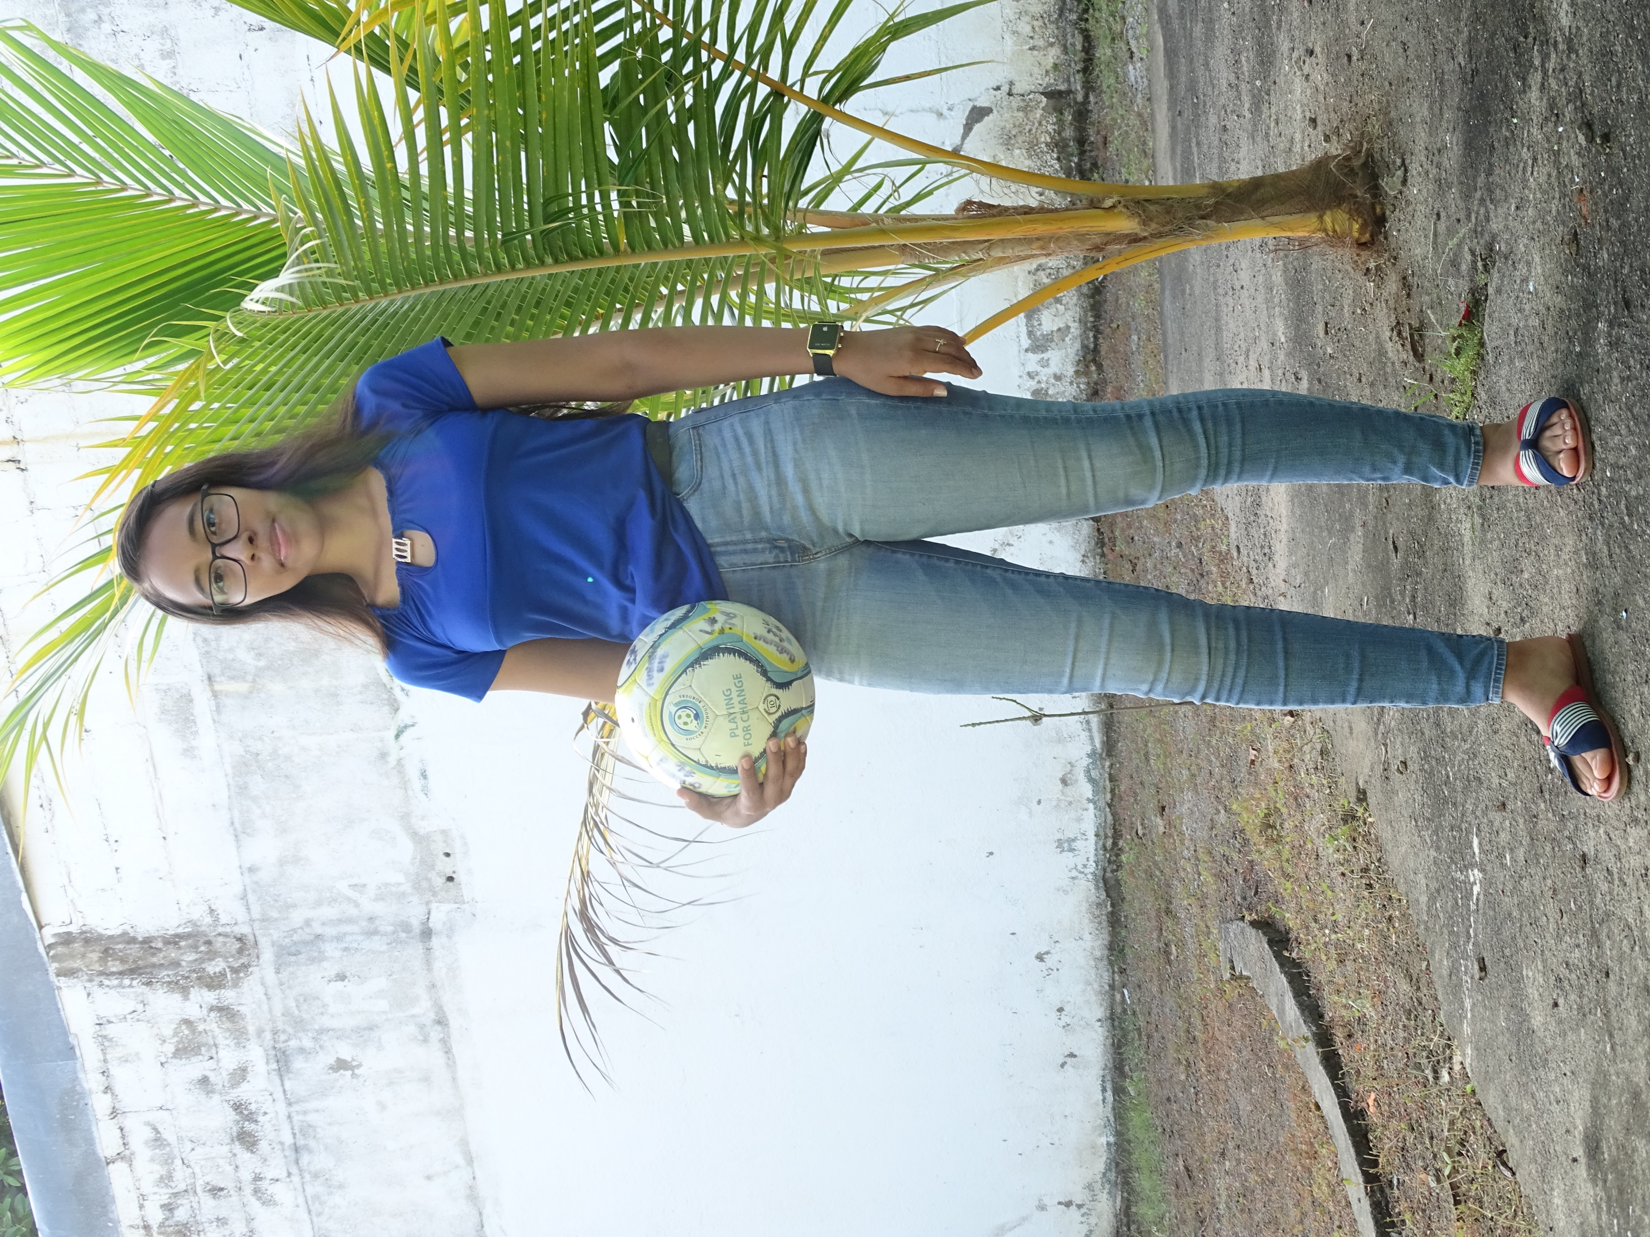
Introducing Soccer Without Borders
SWB Nicaragua Education & Leadership Program
Pairs sports and education to empower girls and promote leadership
Soccer used as vehicle for positive change
Gives underserved youth a toolkit to overcome obstacles to growth, inclusion, and personal success
Notes:
Soccer Without Borders’ mission is to use soccer as a vehicle for positive change, providing underserved youth with a toolkit to overcome obstacles to growth, inclusion, and personal success.
The goal of this project is to facilitate positive school outcomes through a system of financial, academic, and socio-emotional support that empowers girls to overcome barriers to success.

Slide 3
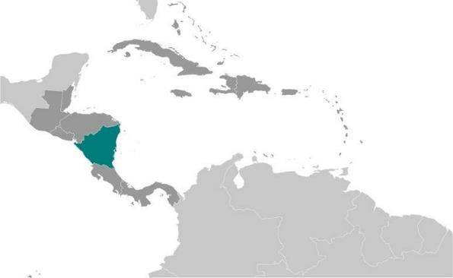
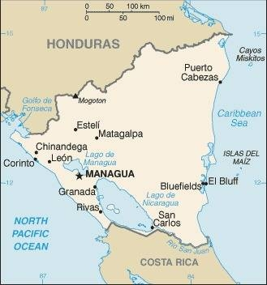
About Nicaragua
Population 6.3 million
Poorest country in Central America, second poorest in the Western Hemisphere
Widespread underemployment and poverty
Compounding crises: human rights abuses, pandemic, collapse of tourism
Highest rate of teen pregnancy in Latin America
Notes:
Nicaragua was settled as a Spanish colony from Panama in the early 16th century. Independence from Spain was declared in 1821 and the country became an independent republic in 1838. Violent opposition to governmental manipulation and corruption spread to all classes by 1978 and resulted in a short-lived civil war that brought a civic-military coalition, spearheaded by the Marxist Sandinista guerrillas led by Daniel Ortega Saavedra coming to power in 1979. Nicaraguan aid to leftist rebels in El Salvador prompted the US to sponsor anti-Sandinista contra guerrillas through much of the 1980s. After losing free and fair elections in 1990, 1996, and 2001, former Sandinista President Daniel Ortega was elected president in 2006, 2011, 2016, and most recently in 2021. Democratic institutions have weakened under the Ortega administration as the president has garnered full control over all branches of government, especially after cracking down on a nationwide pro-democracy protest movement in 2018.
Nicaragua is the poorest country in Central America and the second poorest in the Western Hemisphere and has widespread underemployment and poverty.

Slide 4
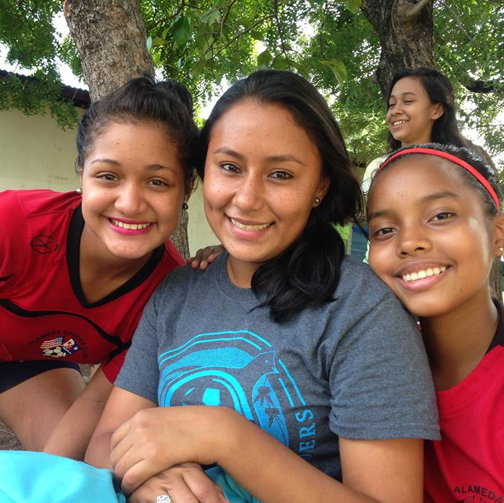
Life challenges for women in Nicaragua
Culture is rooted in machismo, girls face tremendous barriers to success
28 percent are pregnant by age 18, 52 percent do not complete primary school
Women
are more likely to be illiterate
are less likely to complete secondary education
have more domestic responsibilities
are less likely to have a bank account
lack workforce protections
Notes:
Nicaragua is in a state of compounding crises. A string of protests in 2018 led the country to the brink of Civil War. Economic sanctions due to human rights abuses, followed by the collapse of tourism have devastated the economy, and the pandemic has added another layer of isolation, uncertainty, and loss. In a culture rooted in machismo, girls in Nicaragua face tremendous barriers to success: 28 percent are pregnant by age 18 (the highest rate of teen pregnancy in Latin America) and 52 percent do not complete primary school. Due to these crises, many of the resources available for girls have diminished, leaving girls farther behind.
Prior to the 2018 crisis, Nicaragua was already the second poorest country in the Western Hemisphere and it continues to hold that position according to the World Population Review. It is estimated that 75 percent of the workforce participates in the informal economy, lacking access to benefits such as healthcare and social security. McKinsey research reports that women’s participation in the workforce could increase GDP in Latin America by $2.6 trillion, yet women are more likely to be illiterate, less likely to complete secondary education, have more domestic responsibilities, are less likely to have a bank account, and lack workforce protections.

Slide 5
The Project
Facilitates positive school outcomes through a system of financial, academic, and socio-emotional support
Provides scholarships (including all supplies and uniforms) with support and requirements to participate in school and SWB programming
Access to computers, printing, tutors, school supplies, and a safe space (youth center with open-air courtyard) after school for homework
YEAR 1 – DIRECT IMPACT: 275 GIRLS TOTAL (109 ON A DEEPER LEVEL THROUGH SCHOLARSHIPS); INDIRECT IMPACT: 1,100 FAMILY MEMBERS
YEAR 2 – DIRECT IMPACT: 300 GIRLS TOTAL (132 ON A DEEPER LEVEL THROUGH SCHOLARSHIPS); INDIRECT IMPACT: 1,200 FAMILY MEMBERS
Notes:
There are many factors that cause girls in Nicaragua to drop out of school, including domestic responsibilities in the home, a financial need to work in the market/informal economy, unplanned pregnancy, and a lack of visible pathways and encouragement for women to enter the workforce and pursue a career. Public school in Nicaragua is not free. There are required uniforms for school and gym class, required school supplies, and matriculation fees each year. Public schools are also overpopulated and under-staffed, meaning that quality education is more often found in private schools, which have even higher costs.
SWB Nicaragua addresses these barriers one by one, providing school scholarships (including all supplies and uniforms) to girls with support and requirements to participate actively in both school and SWB programming. SWB also provides access to computers, printing, tutors, school supplies, and a safe space after school every day for homework. While access to this space has been more limited during the COVID-19 pandemic, SWB’s youth center includes an open-air courtyard which has made it possible for masked activities to take place throughout the pandemic, with staggered times for different ages. Together, these resources ensure that a girl’s attendance at school is not only valuable to her future, but also a value-add to a family’s economic condition.

Slide 6
The Project
SWB Nicaragua includes four primary programs: the Team Program, the Education & Leadership Program (ELP), the School Outreach Program, and Camps & Trainings – operate in-school, after-school, and weekends 45 weeks per year.
ELP operates with Team Program to create a true “student-athlete” experience – additional academic support, educational workshops, leadership development, and school scholarships
No financial cost to participate – girls receive participation points, which can be exchanged for school supplies, uniforms, equipment, and school scholarships, so they contribute to their family’s financial stability
Notes:
SWB Nicaragua includes four primary programs: the Team Program, the Education & Leadership Program (ELP), the School Outreach Program, and Camps & Trainings. Together, these programs operate in-school, after-school, and weekend programming 45 weeks per year. The Team and ELP programs serve approximately 300 girls ages 5-20 each year.
The project focuses specifically on the SWB Nicaragua’s Education & Leadership Program (ELP). The main goal of the ELP is to facilitate positive school outcomes through a system of financial, academic, and socio-emotional support. The ELP offers material support for school uniforms and educational supplies to all SWB participants, as well as primary, secondary, and university scholarships to qualifying participants. The ELP operates hand-in-hand with the Team Program, creating a true “student-athlete” experience for participants through additional academic support, educational workshops, leadership development, and school scholarships. In a typical week, a participant will have three soccer practices or games, five days of available tutoring, one team-building activity, and an open invitation to the SWB youth center six days per week from 10 a.m. – 6 p.m. There is no financial cost to participate. In fact, girls who participate in the program receive participation points, which can be exchanged for school supplies and uniforms, equipment, as well as school scholarships, allowing them to contribute to their family’s financial stability.

Slide 7
Budget
Item | Description | Cost
Personnel | Includes a portion of salary and benefits for the Co-Director, Leadership Council Director and Advisor; Co-Director Finance and Operation Lead, Administrator; Education Program Senior Program Coordinator; Education Program Coordinator; other coaches and staff | $18,534
Materials, Fees, and Supplies | Covers a portion of costs for uniform sets required for school; school supplies; semester fees, matriculation fees, promotions to the next grade; university scholarships, technology, ink, printing | $15,825
Other Costs | A portion of fees for the Youth Center facility including utilities and internet; monitoring and evaluation, and administration | $7,141
TOTAL |  | $41,500
Notes:
Why We Love This Project
Soccer Without Borders' holistic approach to youth development is evidence-based and emphasizes the leadership abilities of the student-athlete. Using soccer as an entry point, impactful programs combat the machismo culture, build trust, and help girls reduce barriers to schooling and social capital with scholarships, financial support, mentoring, and community building. Coaches provide valuable guidance, encouraging teamwork and group effort in building healthy lifestyles, confidence, and competencies, with more girls completing high school and moving on to bigger things.

Slide 8
About Soccer Without Borders
Established in 2006, with mission to use soccer as a vehicle for positive change
Began its first year-round program in the USA in Oakland, California in 2007, and has directly implemented programs in 12 different countries and eight U.S. states
Holistic approach to school engagement has led to an academic advancement rate (passing from one grade to the next) of 92 percent
Nearly every girl in the program is playing on her first-ever sports team
Notes:
Soccer Without Borders (SWB) was born of a vision to support all young people to reach their inherent potential. Established in 2006, its mission is to use soccer as a vehicle for positive change, providing under-served youth with a toolkit to overcome obstacles to growth, inclusion, and personal success. SWB began its first year-round program in the USA in Oakland, California in 2007, and has directly implemented programs in 12 different countries and eight U.S. states. Currently, it operates year-round program hubs in Granada, Nicaragua; Kampala, Uganda; East Bay Area, California; Greeley, Colorado; Aurora, Colorado; Greater Boston, Massachusetts; and Greater Baltimore, Maryland. It has additional coach training programs in multiple regions in Nicaragua and Uganda as well as the Seattle, WA area, and virtual training programs serving organizations in Europe and Latin America.
SWB’s vision is a more inclusive and equitable world through soccer. Programs focus on reaching marginalized youth who might otherwise not have access to extracurricular development opportunities, living in underserved communities that do not have clear pathways and resources to bridge these gaps. In particular, SWB has focused on populations of youth that soccer is uniquely suited to reach, including newcomer refugee and immigrant youth, unaccompanied minors, and marginalized girls. Nearly every girl in the program is playing on her first-ever sports team.

Slide 9
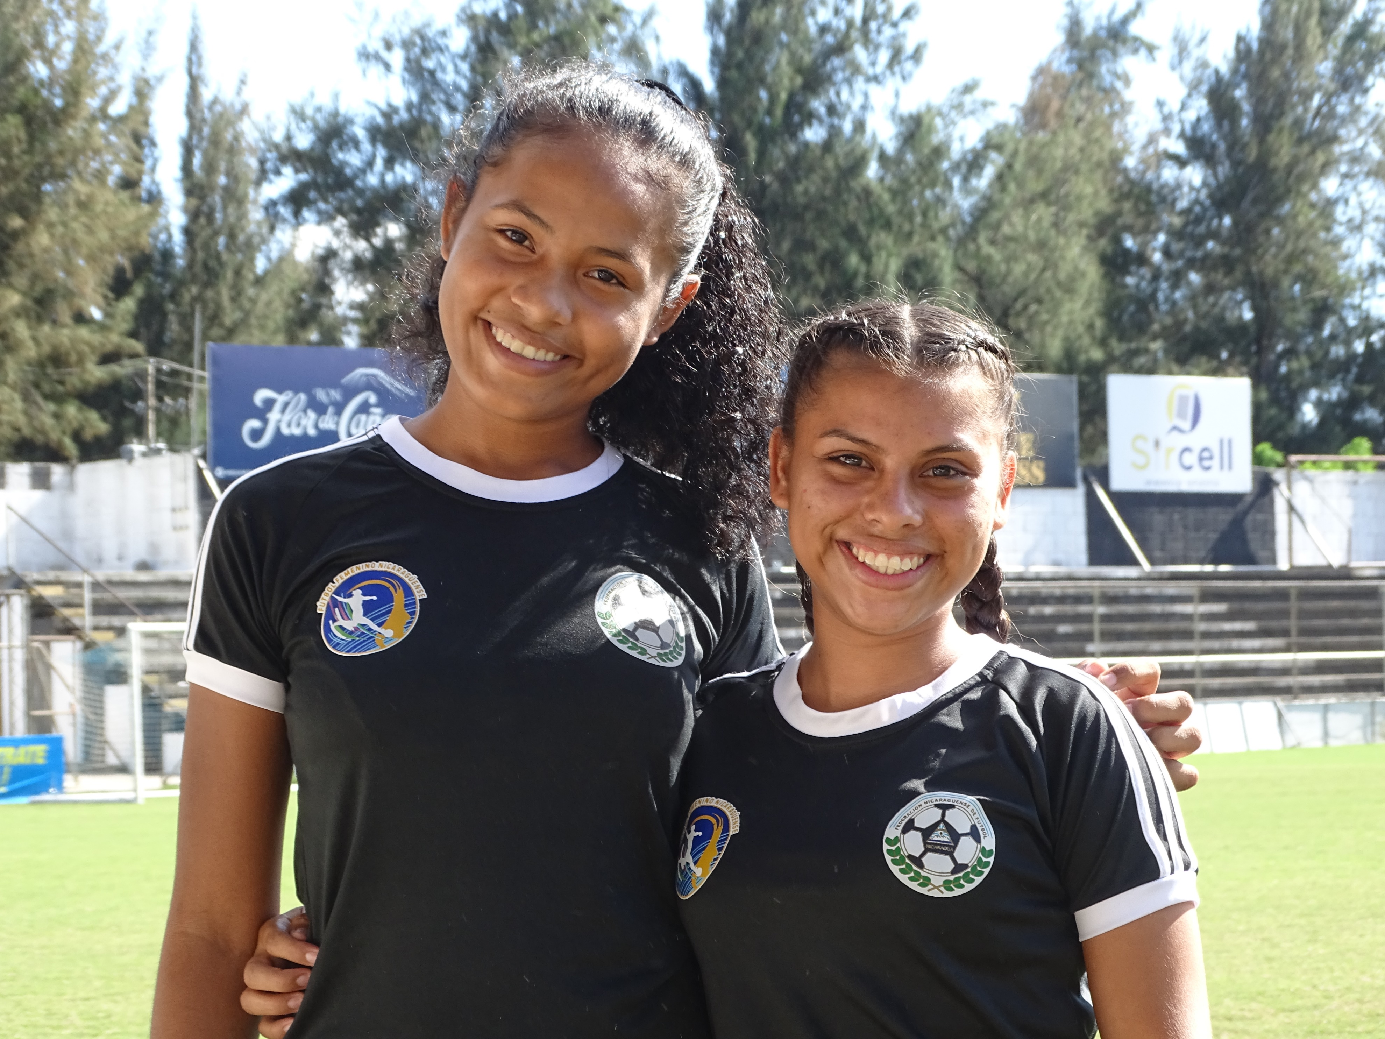
Share your thoughts
1. In a country with a machismo culture, how do you think girls’ participation in team sports can make an impact on all generations?
2. In the United States, sports are seen by some as a distraction from academics, and there is a perpetual debate about financial reward for college student-athletes. Do you think SWB’s program can reframe that to promote education through sports?
3. How do you think playing soccer can increase a girl’s agency – both physically and emotionally?
Notes:
Participants have reduced school absenteeism and increased social self-efficacy when compared to peers at the same school. They have gains in socio-emotional learning measured by the externally-validated High Impact Attribute youth survey.
Evidence shows that every year of schooling beyond fourth grade increases lifetime income by 10 percent, yet in Nicaragua nearly half of girls do not enroll in secondary school (seventh grade). At Soccer Without Borders Nicaragua, SWB has maintained a 92 percent academic advancement rate over the most recent three years, including into secondary school years.
According to Plan International, Nicaragua has the highest teen pregnancy rate in Latin America – 28 percent of girls are pregnant by age 18. This is a driver of limited educational and professional outcomes, and drastically shrinks a girl’s world and future options. Soccer Without Borders has consistently had less than 1 percent unplanned pregnancy rate in its teen programs.

Slide 10
Notes:
“It was a huge breather for me when my daughter was awarded a school scholarship three years ago. We receive the benefit of monthly tuition payments to the school, school supplies and uniforms. I have three more children to look after and am a single mother. Both my daughter and I have learned a lot in this time about soccer. She has become more physically fit, and her social relationships have strengthened – before she did not have many friends or people to share with – now she interacts with others more. From the scholarship program she has received support with school materials and with her learning and homework." – Karla, participant parent
“For parents, the impact has gone beyond having scholarships for their daughters. These days, parents are grateful for the support we provide to create a safe space for their daughters. Girls and young people need to be able to recreate and be distracted in the face of so much tension caused by the pandemic. It has not been easy to adapt to new school systems ... The girls are excited to receive scholarships, and they responded by having high attendance and participation in other [SWB Nicaragua] activities." – Veronica Balladares, SWB Nicaragua Program Co-Director

