Slide 1
December 2022 Featured Project
Holistic interventions in support of girls’ education in India

Slide 2
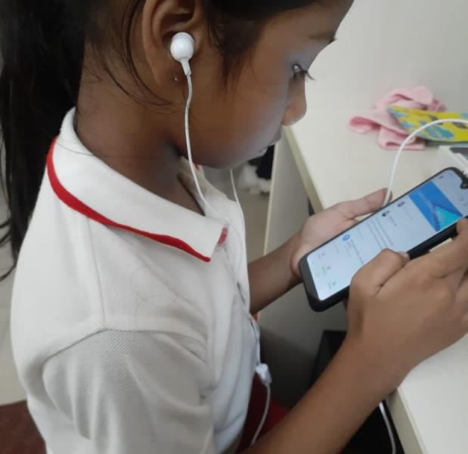
Introducing Ek Tara
School Support Project for Adolescent Girls
(Kolkata, West Bengal, India)
The mission of Ek Tara is to educate, engage, and empower girls and women from marginalized, urban, low-income settlements to become agents of change.
Notes:
School Support Project for Adolescent Girls (Kolkata, West Bengal, India)
The mission of Ek Tara is to educate, engage, and empower girls and women from marginalized, urban, low-income settlements to become agents of change.

Slide 3
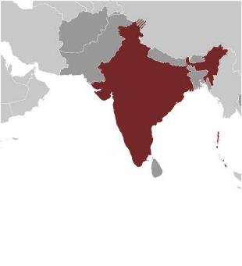
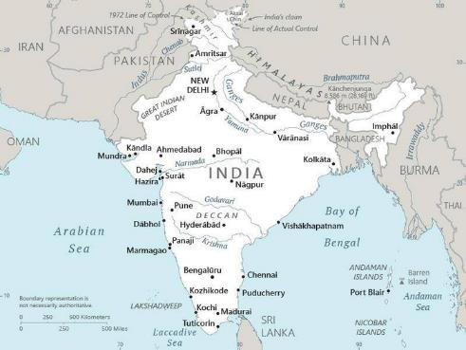
About India
Population of almost 1.4 billion; 360 million live in squalid conditions, among the most impoverished in the world
Low-income settlements are home to millions
Rampant discrimination against women and girls
Kolkata: second largest city in India and the primary business, commercial, and financial hub of East India
Notes:
With a population of almost 1.4 billion, India is the second most populated country on Earth and the largest South Asian economy, comprising a third of Asia and over 17 percent of humanity. Unfortunately, 360 million Indians – more than every US man, woman, and child – live in squalid conditions and are among the most impoverished in the world.
India’s low-income settlements are home to millions, yet a third are not even recognized by the government. Families crowd together in makeshift structures, drink scant and contaminated water, scrounge through waste dumps, and typically share unhygienic communal bathrooms that lack sewage systems. Twenty percent live far below the poverty line, often as domestic workers, daily wager laborers, rickshaw pullers, and other low-paying jobs. Discrimination against women and girls is rampant, corruption is entrenched, and there is an unequal distribution of quality education.
Ek Tara works predominantly in three municipal wards in Kolkata, West Bengal. There are thousands of low-income settlements in Kolkata, comprising the largest in Eastern India. Kolkata is the second largest city in India and it is the primary business, commercial, and financial hub of East India. West Bengal is home to historic architecture and famed art galleries, and it is also the seat of pronounced poverty and thousands of sex workers trapped in a life of abuse and slavery.

Slide 4
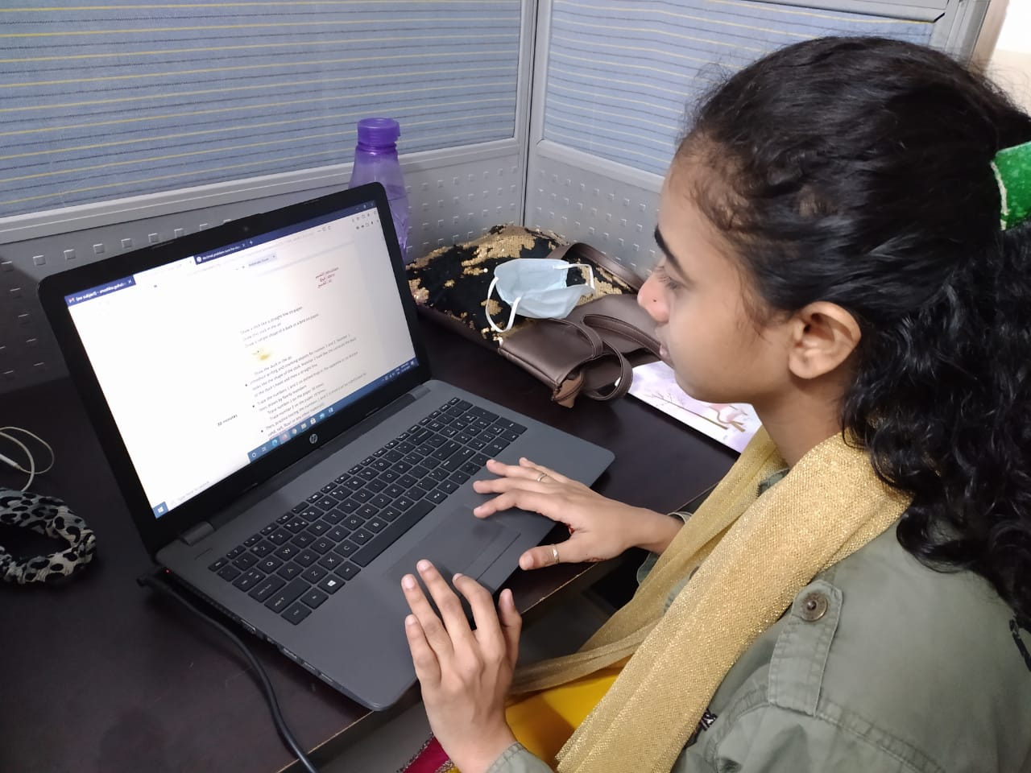
Life challenges for women in India
Girls in low-income settlements are relegated to the bottom of society with nearly no rights or choices
Challenges include early child marriage, poor health and hygiene conditions, class discrimination, general lack of safety
Girls lack quality, accessible schools, access to proper nutrition, and safe, clean spaces
Drop-out rate for girls as high as 57% in some areas
Girls are at risk for early pregnancy, trafficking, violence, and poverty
Notes:
Girls in the low-income settlements of East India are relegated to the bottom of society with nearly no rights or choices. They are from oppressed, marginalized communities, with oppression coming from within the family, the community, and the larger society. The parents of these girls lack financial resources or stability, working in the unorganized sector as daily wage earners, laborers, etc. Some typical challenges the community faces include early child marriage, poor health and hygiene conditions, class discrimination, and general lack of safety. Deep-rooted patriarchal mindsets and preferential treatment of boys inhibit the growth, development, and decision-making ability or opportunity of women and girls in the area. There is a lack of quality, accessible schools, as well as a lack of access to proper nutrition and safe, clean spaces.
India has more than 35 million children without access to school, of which 53 percent are girls. More than 1.6 million girls ages 11 – 14 were estimated to be out of school before the pandemic and this is likely to increase significantly due to the impact of the pandemic. Girls in this situation are at risk of early marriage, early pregnancy, trafficking, violence, and poverty. India also has a high drop-out rate for girls – as high as 57 percent in some areas.

Slide 5
The Project
Helps children from low-income settlements complete secondary level of education so they can enroll in college or vocational programs and ultimately get vocational jobs
Monitoring of regular attendance in school, academic performance, and non-academic engagement including health, hygiene, and meals
Enrollment in leading schools based on their academic competencies
Growth plan including access to co-curricular activities, leadership training, participation in events and activities to expand knowledge and worldview
Parental participation and capacity building
Notes:
Ek Tara’s School Support Project for Adolescent Girls helps children from low-income settlements complete their secondary level of education so they can enroll in college or vocational programs and ultimately get vocational jobs. This helps ensure a steady flow of income, which is directly linked to the position one holds in the family and the broader community. Through exposure to activities at Ek Tara, girls also acquire skills in critical thinking, effective communication, and decision-making, thereby reducing their reliance on male members of the household. Girls who gain an education and these intangible skills move toward greater gender equality and become change agents in their families and communities.
Major activities under the project include monitoring of regular attendance in school, academic performance, and non-academic engagement including health, hygiene, and meals. Ek Tara will enroll girls in leading schools based on their academic competencies and chart out a growth plan for them. This will include access to co-curricular activities, leadership training, participation in various events and activities that expand their knowledge and worldview and help them become more informed citizens, as well as parental participation, and capacity building.

Slide 6
The Project
Holistic program interventions begin early and include
social skills
academic skills
sports
creative arts
health and wellbeing
parental engagement
They are designed to build a supportive community invested in the long-term academic goals for girls, with follow-through on tertiary level education and job attainment.
Direct Impact: 80; Indirect Impact: 750
Notes:
Partnerships are an integral part of program delivery at Ek Tara, including working with five partner schools where the girls will be enrolled for their formal education. In addition, parents, other community members, and local civic bodies will also play an important role in the success of the project. For events and special activities, partnerships with individuals and organizations around the world will be formed.
All girls in this project were enrolled in Ek Tara’s Early Childhood Learning Center at the age of 3 after a rigorous three-month admission process to determine financial status as well as the family’s willingness to support their girls’ education. Girls completing primary education under Ek Tara’s care are enrolled in schools depending on their academic ability and parent participation. Ek Tara has multiple school partners affiliated with three different school certification boards. This helps each child find her right fit in completing school education.
Ek Tara's program interventions begin early and include social skills, academic skills, sports, creative arts, health and wellbeing, and parental engagement. These highly successful interventions are holistic, with very impressive outcomes. They are designed to build a supportive community invested in the long-term academic goals for girls, with follow-through on tertiary level education and job attainment.

Slide 7
Budget
Item | Description | Cost
School Fees | Monthly fees, registration, computer class fee, exam fees and other school costs | $17,550
Books | Textbooks, workbooks, copies, stationery items | $6,933
Transportation | Daily cost of transportation to and from school/cost of online education (either will be supported) | $10,240
Staff | Project coordinator, homework support teachers, co-curricular activity teachers (music, art, martial arts) | $10,400
Leadership Training | Monthly workshops for students (leadership development, including public speaking and problem solving) | $1,600
Health/Hygiene, Parent Capacity Building | Quarterly health checks, periodic health and hygiene kits, parent capacity building | $1,337
Administrative Costs | Portion of electricity, rent, and overhead | $1,138
TOTAL |  | $49,198
Notes:
A total of 80 children will be direct beneficiaries of the Together Women Rise project grant. Indirect beneficiaries include the families of the children enrolled, including 750 people from Kolkata’s low-income settlements. Upon completion of school, these children and their families will have means to lead a better quality of life. The expectation is that girls enrolled in this project will attend school regularly, complete secondary school, and be ready for a job linked to vocational training. In addition, the expectation is that these girls will also have good health indicators and parents who support them. Economic independence gained from employment enables these girls and their families to access quality services, which leads to better nutrition, hygiene, and health. Specific goals include:
• 100 percent will be promoted to the next class by the end of the year
• 80 percent will have strong attendance at school
• 100 percent will secure over 50 percent aggregate percentage for the year
• 20 percent will be among the top 10 scoring children in their class
• 100 percent will participate in at least two co-curricular activities
• 100 percent will participate in at least one intra-school program
• 100 percent will attend one external event
• 100 percent will complete at least class 12 and 80 percent will pursue higher education
• 50 percent will develop their leadership skills in the community and will understand the importance of educating others.
• 100 percent of the mothers will enroll in trainings for better parenting.

Slide 8
About Ek Tara
Founded in 2011 by Vinita Saraf and Namrata Sureka
Has reached more than 40,000 children in low-income settlements in partnership with approximately 70 organizations, schools, and individuals across India
Has worked with nearly 1,000 families and impacted the lives of more than 5,000 individuals through direct and indirect programs
In the past 10 years, 98 percent of girls have graduated from Ek Tara projects ranging from primary to secondary levels of education
Girls develop strong academic foundation leading them to secure positions in formal schools
Marked improvements noted in Foundational Literacy and Numeracy and overall classroom performance
Notes:
Ek Tara was founded in 2011 by Vinita Saraf and Namrata Sureka. The organization has reached more than 40,000 children in low-income settlements in partnership with approximately 70 organizations, schools, and individuals across the country.
Women and girls ages 3 – 30 from marginalized low-income settlements in Kolkata benefit directly from Ek Tara’s programs. They come from families that migrated from neighboring states to find employment, but are currently mostly unemployed. These families are engaged as daily wagers, live in bustees (densely populated low-income housing) with shared toilets, and on an average make an income of about Rs 1,000 to 1,500 per week ($14 to $20) to support a family of four to five members.
Ek Tara provides academic and non-academic programs for first generation students ages 3 – 18 from the largest and poorest low-income settlement of East India. Services include core academic interventions and support along with a host of development opportunities such as arts, crafts, sports, events and activities, library and more. Children enrolled in the projects are part of an all-encompassing program that includes parental engagement, daily meals, and access to physical and mental health support. Programs are delivered through two 30,000 square foot facilities – the Ek Tara Community Centre and Ek Tara Learning Centre located within the area of intervention.

Slide 9
Share your thoughts
1. How do you think this project can bolster gender equality in the community and beyond?
2. How do you think the value placed on keeping girls in school, along with associated parent capacity building, can make a generational impact on participating families?
3. Girls can get connected to Ek Tara as young as 3 years old. Do you think this approach evens the playing field for them more than intervening when they are adolescents? Why or why not?
Notes:
In 2020, during the first outbreak of the pandemic, Ek Tara successfully pivoted to meet the welfare needs of the communities it works in and distributed food and other essentials to more than 10,000 people across the city. During the second wave, Ek Tara continued to provide meals to more than 5,000 individuals.

Slide 10
Notes:
Voices
From Ek Tara students:
“I want to be a teacher when I grow up. My favorite subject is English.”
“The teachers are wonderful and I have a lot of friends here. I have learned a lot here at Ek Tara.”
“I enjoy library classes. I love the books in there because they are so colorful.”
“Today I completed my work on time because I wanted to help my friends with their work.”
“Me and my friends in art class will be taking part in the annual at exhibition in the coming year. I enjoy coming to Ek Tara.”

