Slide 1
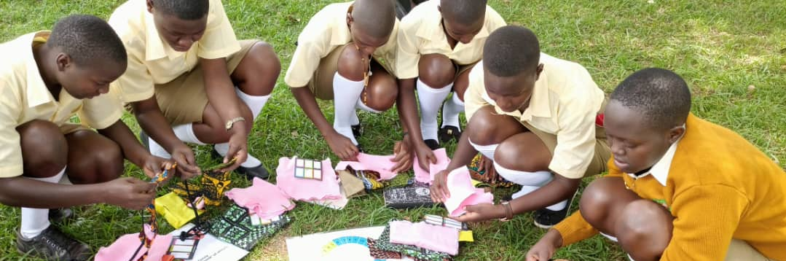
April 2023 Featured Project
Menstrual hygiene kits help girls in Sub-Saharan Africa succeed

Slide 2
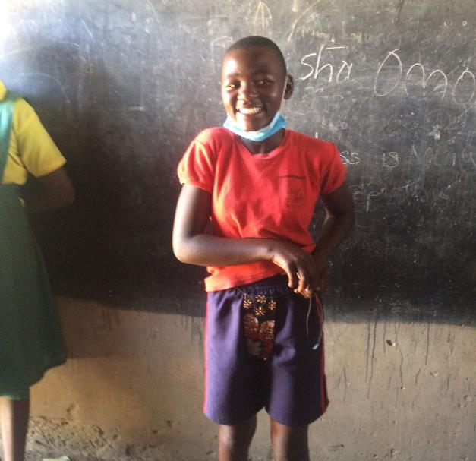
Introducing The MoonCatcher Project
Mission: to optimize girls’ lives worldwide by removing barriers related to menstruation
Serving Uganda, Malawi (including a vocational school for deaf students), and Kenya
Notes:
The mission of The MoonCatcher Project (MCP) is to optimize girls’ lives worldwide by removing barriers related to menstruation. MCP’s primary service areas are Uganda (Wakisa, Pallisa, Jinja, Kimenyede), Malawi (Mtunthama, Nkhata Bay – at a vocational school for deaf students, Malengmzoma /Chituka), and Kenya (Kisumu) and India (New Delhi).

Slide 3
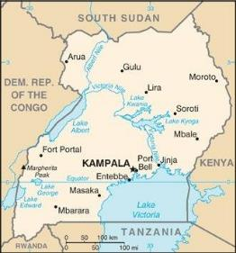
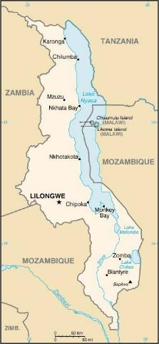
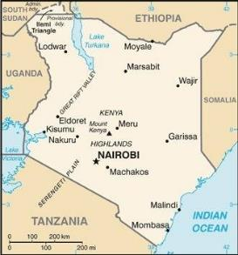
About Kenya, Malawi, and Uganda
At least 1 in 10 girls miss school because of their periods
Girls miss as much as 20% of the school year; many drop out
High rates of child marriage and fertility
1 in 5 women endure sexual or physical violence
Notes:
UNESCO has reported that one in 10 girls in Sub-Saharan Africa misses school due to their menstrual cycle. By some estimates, days missed can be much as 20 percent of a given school year. Many girls drop out of school altogether once they begin menstruating.
Child and early marriage is a serious problem, as are high adolescent birth rates. Although the fertility rate has declined, it is still the highest in the world. Gender inequality is rampant and reinforced by discriminatory laws. In many areas, women are not allowed to own or inherit land. Women take the brunt of (unpaid) domestic life, caring for children as well as aging family members.
Even when laws exist, exceptions are made at the expense of women and girls. For instance, many countries state the legal age for marriage is 18, yet child marriage occurs on a regular basis. In some countries, women are required by law to obey their husbands and cannot apply for a passport like a man. Although laws prohibiting domestic violence exist, one out of five women in the region has endured physical or sexual violence.

Slide 4
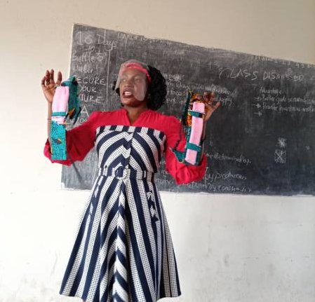
Life Challenges for Women and Girls Served
Menstrual hygiene products: unavailable or unaffordable
Misconceptions about menstruation: widespread
Culture of silence about menstruation: gender inequality, discriminatory social norms, cultural taboos, poverty, lack of basic services like toilets and sanitary products
Worse in rural areas
Notes:
For many low-income families around the world, menstrual hygiene products are unavailable or unaffordable. In addition, misconceptions regarding menstruation are widespread and there is a general culture of silence surrounding the topic. This is due to many factors, including gender inequality, discriminatory social norms, cultural taboos, poverty, and a lack of basic services like toilets and sanitary products. The situation is worse in rural areas and for girls who attend public schools.
Education is the most effective means of improving the lives of girls in the communities with the lowest financial resources (with family incomes averaging less than $2 per day), but menstruation can create a significant barrier to completing a girl’s education. Traditional menstrual hygiene products are a luxury many families simply cannot afford. Girls often drop out of school when they reach puberty. Early dropout rates for these girls are a worrisome trend that can lead to early marriage, childbearing at an early age, and a lack of financial independence.

Slide 5
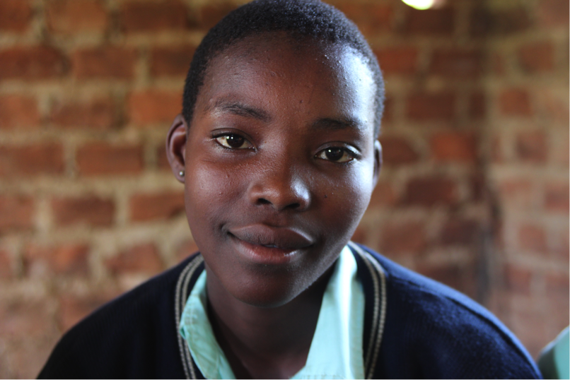
Sustaining Africa Projects
Sewing cooperatives produce and distribute 15,000 free MoonCatcher Menstrual Management Kits
Each kit includes:
carrier with waterproof barrier that expands as girl grows (no underwear needed)
3 washable absorbent pads
waterproof bag to store used pads
calendar to track cycles
visual instructions on caring for kit
Notes:
This project takes place in Malawi, Uganda, and Kenya, where MCP will work with local sewing cooperatives to produce and distribute 15,000 free MoonCatcher Menstrual Management Kits. By engaging these tailors, many of whom are women, MCP also financially empowers local women and bolsters their local economies. MCP will also work with regional schools to both distribute the kits and to provide reproductive health curriculum.
MoonBees (old fashioned sewing bees) cooperative members produce kits and are paid $1.50 per kit. Tailors are then free to use MCP equipment to earn additional income by taking in other sewing work. Once purchased, the equipment becomes the property of the cooperative members who are free to use it as they see fit.
Each MoonCatcher kit includes:
• a carrier with a waterproof barrier that ties around the waist and expands as a girl grows
• three washable absorbent pads
• a waterproof bag where used pads can be stored and then washed with a small amount of water
• a calendar to help girls to track their cycles
• and a care tag with visual instructions on caring for the kit.

Slide 6
The Project
Coordinators distribute kits and provide reproductive health curriculum to regional schools; curriculum also adapted for boys, too
Students learn to use and care for their kit, plot cycles, envision and articulate goals
Budget: $43,000 15,000 kits: sourced locally - fleece, shoelaces, cording, fabric (for carrier and drawstring bag), elastic, Velcro; Sent from US: calendar, Tyvek (donated), waterproof nylon
Direct Impact: 15,000 girls; Indirect Impact: 43 tailors, 3 coordinators, and local communities
Notes:
Coordinators distribute kits and provide reproductive health curriculum to regional schools. The schoolgirls are given the kits free of charge along with a menstrual management and reproductive health curriculum at the time of kit distribution. Coordinators provide an information session using MCP’s reproductive health curriculum. Students learn how to use and care for the kit, how to plot their cycles, and are given an opportunity to envision and articulate their goals. Schools are selected by coordinators, based on the income levels of families served. Low-income communities are the focus of distribution.
Although the curriculum is designed specifically for girls when they receive kits, MCP has adapted the curriculum for a male audience as well, and it is taught to boys in Uganda. MCP plans to begin using the boys’ curriculum in the other countries in 2023.

Slide 8
About The MoonCatcher Project
Created in 2011 to help keep girls in low-income communities from missing school due to their periods
Founder Ellie von Wellsheim designed a reusable, washable pad that can be worn without underwear (a luxury in many communities)
More than 100,000 kits have been manufactured by MCP tailors and volunteers and distributed around the world
Conversations with teachers led to developing reproductive health curriculum, originally taught to girls, now also educates boys regarding menstruation and reproductive health
Notes:
The MoonCatcher Project was created in 2011 to help keep girls in low income communities from missing school due to their menstrual periods. After attending a lecture and learning that girls in these communities used unsanitary items such as dung, plastic bags, old rags, or cloths to manage their periods, MCP's founder, Ellie von Wellsheim, designed a reusable, washable pad that can be worn without underwear (a luxury in many communities). This pad and its components make up the MoonCatcher kit.
So far, more than 100,000 kits have been manufactured by MCP tailors and volunteers and then distributed around the world.
In 2011, monthly MoonBees were established in U.S. locations for the purpose of creating the reusable menstrual pad kits. In 2014, in an effort to further support women and girls, the project evolved and established its first sewing cooperative in Uganda. This model was then replicated, creating a total of three other cooperatives in Uganda, three in Malawi, and one in Kenya. All of these cooperatives are funded by The MoonCatcher Project. In addition to the sewing cooperatives in Africa, MCP has a sewing center in India.

Slide 9
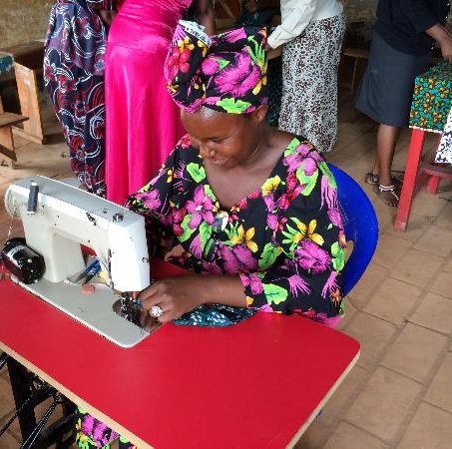
Discussion: Share Your Thoughts
How might family dynamics change when girls are no longer hindered by monthly periods?
What are the advantages of including curriculum specifically for boys?
How do you think this project promotes gender equality?

Slide 10
Notes:
Voices
From project participants in Uganda:
• “I come to school because I want to be a teacher and help the children of Uganda.”
• “I come to school to be able to participate in politics and make changes in our communities.”
• “I come to school in order to get a job and help my mom.”

