Slide 1
June 2023 Featured Project
Equipping girls in rural Honduras with secondary education, resources, and leadership skills

Slide 2
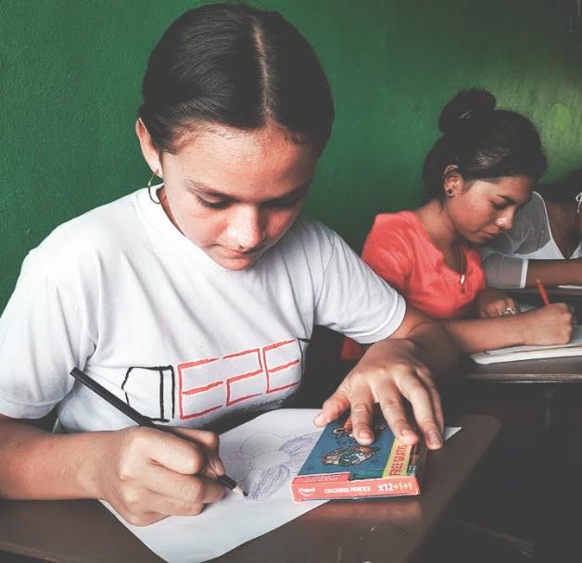
Introducing Educate2Envision
Mission: to equip rural youth in Latin America with the secondary education, resources, and leadership skills they need to build brighter futures and healthier communities
Elevates status of girls in rural Honduras
Notes:
The mission of Educate2Envision International (E2E) is to equip rural youth in Latin America with the secondary education, resources, and leadership skills they need to build brighter futures and healthier communities.

Slide 3
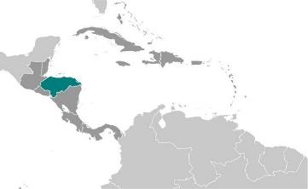
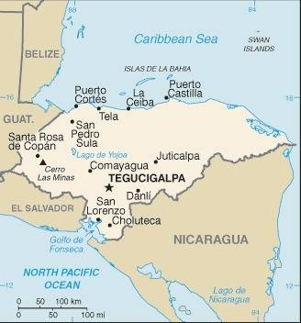
About Honduras
Gender inequality is the norm
Patriarchal society
Profound income inequality
20% in extreme poverty
High murder rate
Chronic corruption
Pandemic and hurricanes impacted economy considerably
Notes:
Gender inequality is the norm in Honduras, especially in rural areas. In this patriarchal society, the men usually make all the decisions. Despite legislation, many women face domestic violence and discrimination in the workplace.
Although Honduras has the second fastest growing economy in Central America, the COVID-19 pandemic and two hurricanes have impacted it considerably. It also faces major long-standing challenges, including profound income inequality. More than two-thirds of Hondurans live in poverty and 20 percent endure extreme poverty, living on less than $1.90 per day.
Chronic corruption pervades the political and justice systems and allows human rights violations to typically end in impunity. Gang activity is widespread and often includes extortion, violent street crime, rape, narcotics, and human trafficking. The murder rate is among the highest in the world. Those most at risk for violence include women, journalists, environmentalists, and those in the LGBTQ community.

Slide 4
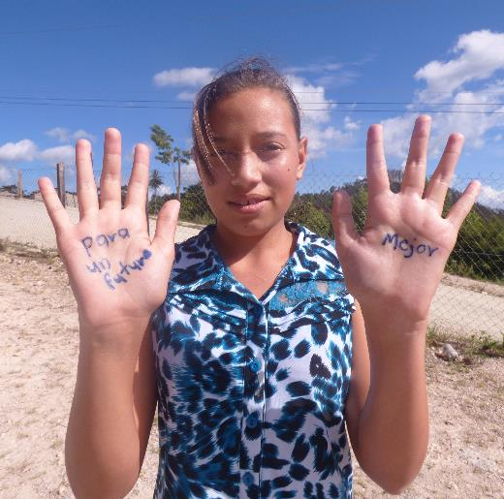
Life Challenges for Women Served
Rural Honduran girls: undervalued and undereducated
70 percent of rural Honduran girls are excluded from secondary education
Barriers: economic, geographic, and cultural
Secondary schools often an hour or more away
Some fathers see no value in educating girls
Notes:
Rural Honduran girls are undervalued and undereducated. They are denied the chance to participate in society beyond the confines of motherhood or as caretakers, with few female role models who have broken out of the mold.
Approximately 70 percent of rural Honduran girls are excluded from secondary education due to economic, geographic, and cultural barriers. The first two barriers are interrelated and speak to the lack of government investment in expanding education access to rural areas. Girls who choose to make the journey to the nearest secondary school increasingly face the risk of physical or sexual assault while walking to or from home.
The primary barrier stopping children from attending secondary school is the cost of getting there, as these schools are often located an hour or more away.

Slide 5
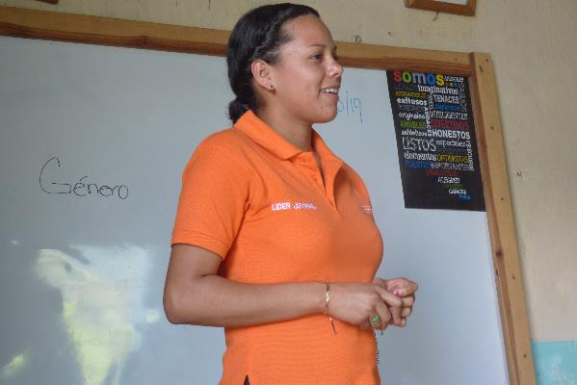
Increasing Agency and Education Access of Rural Honduran Girls
Tackles key issues:
Pervasive machismo culture
Lack of female role models who have achieved higher education or financial independence
Ill-equipped education system fails to connect girls to future income-generating opportunities
Notes:
This project allows E2E to elevate the status of girls in rural Honduras by improving their economic independence and enabling them to fully participate in the communities where they live. To achieve this, this project tackles key issues, including a pervasive machismo culture that undermines girls’ capacity to be leaders, a lack of female role models who have achieved higher education or financial independence, and an ill-equipped education system that fails to connect girls to future income-generating opportunities.

Slide 6
The Project
Built on three primary components:
Improving Secondary School Access: connect with mothers through mothers’ groups and family gardens
Promoting Girls Leadership and Empowerment: youth leadership is facilitated by Peer Trainers
Expanding Post-Secondary School Services: job training, guidance counseling, and a gender-sensitive space at youth center
Direct Impact: 125; Indirect Impact: 400
Notes:
Improving Secondary School Access: E2E creates access to secondary school in communities where it was previously nonexistent. For this to happen, it is essential that parents, especially mothers, see the value in providing girls this education. To help convince them, mothers will be invited to join mother support groups and to participate in E2E’s family garden program. Family gardens and women’s support groups have been shown to motivate mothers to put their girls in school and keep them enrolled through graduation.
Promoting Girls Leadership and Empowerment: Students receive training from grades 7 – 9 on designing and implementing low-cost, high-impact solutions that address local needs. Once students reach high school (grades 10 – 12) they are eligible for paid internships as the new trainers of the program.
Expanding Post-Secondary School Services: As students complete secondary school, E2E provides them additional guidance and taps their vast volunteer network of working professionals across Honduras to serve as mentors. E2E will provide 25 female graduates with additional skills and guidance on utilizing their education to achieve financial independence as young adults.

Slide 7
Budget
Item | Description | Cost
Personnel | Director of Education, Director of Curriculum & Instruction, Director of Field Programs, and Director of Monitoring and Evaluation Stipends paid to Peer Trainers for teaching leadership workshops after completing their certification Agronomist’s technical assistance to support mothers' vegetable garden initiative Transportation stipend youth tutors | $15,762
Supplies and Equipment | Leadership workshop training materials Community project materials and tools (projects by E2E leaders in their communities: $150 - $500 each, approximately 1 project per school per month) Garden materials and supplies E2E graduate toolkits (help graduates cover startup costs like business attire, laptop, or bus fare for job interviews, enrolling in training programs, or other job-related activities) | $25,238
Logistics and other costs | Staff transportation to supervise project and make regular visits to E2E school sites and youth center Student transportation (bus fare to youth center, as needed: travel to impart leadership trainings in neighboring communities, attend trade school classes, or travel to internship sites) (NIDO) Youth Center Internet Student cell phone credits (for students and youth leaders who need internet service to stay connected while in their communities) | $9,000
Total |  | $50,000

Slide 8
About Educate2Envision
Established in November 2010 by founder Katia Gomez
2011 - began establishing first E2E secondary school in Central Honduras
2012 - began integrating leadership training and youth-led community development as part of secondary school model
2016 - first NIDO (youth center) opened - serves as technology and coworking hub for youth leaders
2022 – second NIDO opened, adding more job skills training and mental health support
Notes:
Educate2Envision was legally established as a 501c3 nonprofit in November 2010 by founder Katia Gomez.
By 2011, E2E had begun the process of establishing its first secondary school located in Central Honduras – the same community that served as the inspiration for E2E after Katia visited as a college student in 2009.
In 2012, E2E began integrating leadership training and youth-led community development as a part of its secondary school model.
In 2016, the first NIDO (youth center) was opened to serve as the technology and coworking hub for youth leaders from surrounding rural villages.
The second NIDO opened in Southern Honduras in Summer 2022, and beyond the regular programming, it will provide more job skills training and mental health support.

Slide 9
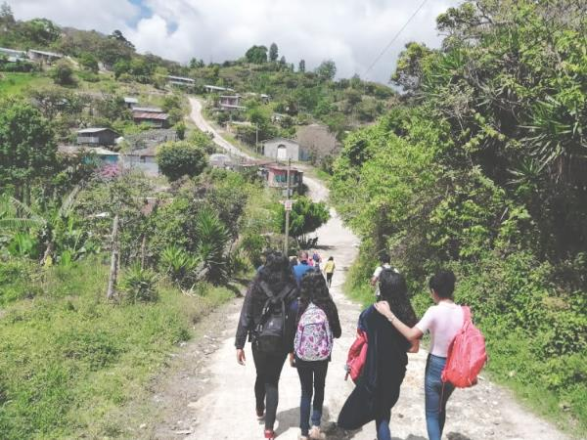
Discussion: Share Your Thoughts
Saby, an E2E 2019 graduate, currently a university student studying Business Administration, said “(E2E) has made me change the way I think.” What do you think this statement implies about the results of this project?
How do you think an E2E education varies from a traditional education?
How do you think this project advances gender equality?

Slide 10
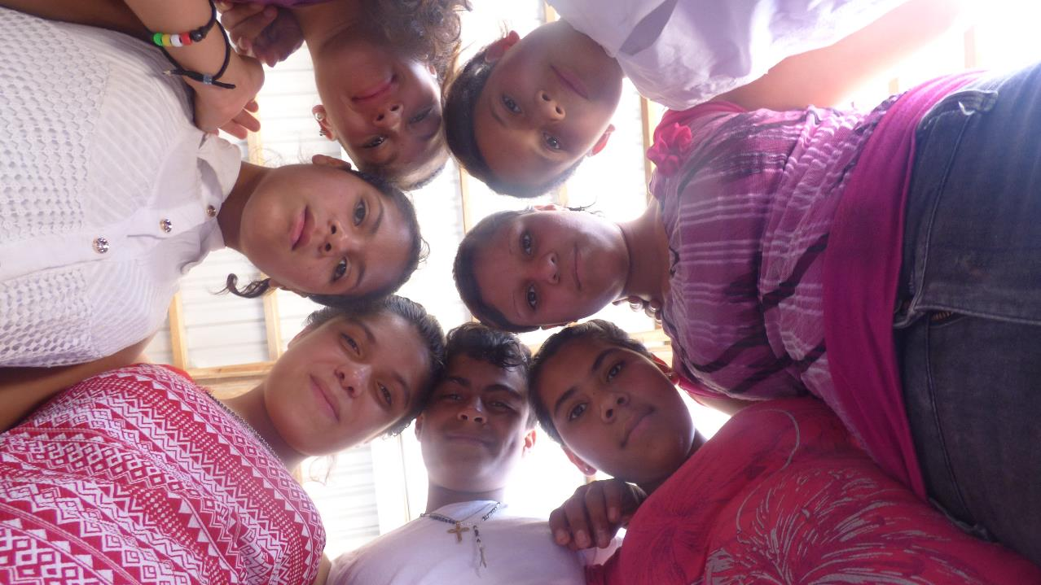
Notes:
Voices
“The greatest benefit I have received from E2E has been the ability to achieve my goal. Before E2E arrived in our community, we couldn’t study because we didn't have the money. We had our dreams but you can say we were trapped. But thanks to E2E we’ve been able to reach our dream of graduating and moving ahead.” – Alumna from Central Honduras currently completing her nursing assistant license
“Well, my life has changed a lot. It has made me change the way I think. I feel like with E2E my life is different now. I feel like I can achieve my dreams. Now I am a person with many values. E2E has taught me many things that I didn’t know — that I shouldn’t just settle with where I am but rather keep moving forward, that the wise isn’t the person who starts the journey but rather the person who finishes it. E2E has taught me to fight for what I want to have in my future. What most makes me happy is helping other students, to teach them what I have learned from E2E. Honestly, I am so happy for everything. – Saby, E2E Class of 2019, currently enrolled in university for Business Administration

