Slide 1
July 2023 Featured Project
Uniting and equipping young women for peace

Slide 2
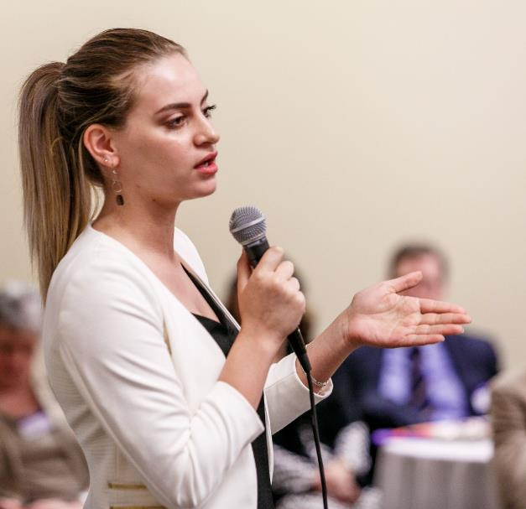
Introducing Tomorrow’s Women
Mission: to train young women from Palestine, Israel, and the United States to be strong, compassionate leaders who partner to resolve conflicts and inspire action that promotes equality, peace, and justice for all.
Notes:
Tomorrow’s Women trains young women from Palestine, Israel, and the United States to be strong, compassionate leaders who partner to resolve conflicts and inspire action that promotes equality, peace, and justice for all.

Slide 3
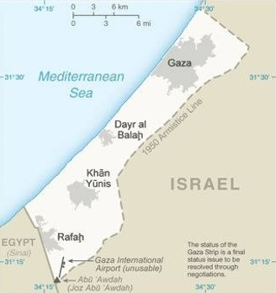
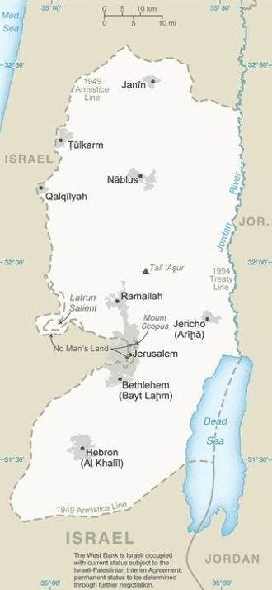
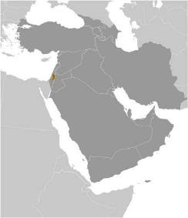
About the Palestinian Territories
Refers to the territories of the West Bank (including East Jerusalem) and the Gaza Strip, occupied or otherwise under the control of Israel since 1967
Magnitude of regional problems are severe
Conflict is long and intractable; women are especially impacted
40% of unmarried women have been physically abused by a household member
Notes:
The "Palestinian Territories" and "Occupied Palestinian Territories" refer to the territories of the West Bank (including East Jerusalem) and the Gaza Strip, which are occupied or otherwise under the control of Israel since 1967.
The Gaza Strip is a strip of land with a coastline at the Mediterranean Sea. The small self-governing Palestinian territory is bordered by Egypt (Rafah border crossing) and by Israel with 1.9 million Palestinian Arabs living in Gaza Strip (est. 2017). The West Bank is a landlocked, rugged territory in the Mediterranean Region, west of Jordan, surrounded on three sides by Israel. The territory has a population of 3 million people (est. 2017). About 500,000 Israeli settlers live in the West Bank (est. 2023).
The magnitude of the problems in this region are severe given the longevity and the intractability of the conflict, as well as the number of generations, particularly of women, it has affected. According to the Palestinian Central Bureau of Statistics, 40 percent of unmarried women have been physically abused by a member of their household.

Slide 4
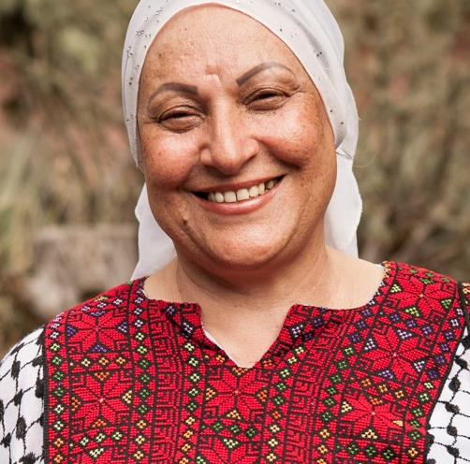
Life Challenges for Women Served
Barriers to young Palestinian female activism are many and severe
Pervasive and discriminatory patriarchal cultural traditions
Regular threat of violence
Living under occupation impacts well-being, security, and participation in public and private spheres
Blockades and restricted travel make connection and relationships difficult
Notes:
The barriers to young Palestinian female activism are as many as they are severe. The impact of conflict on women often builds on pre-existing situations of discrimination, including the delivery of basic services, access to healthcare and education. Women are forced to look for alternative sources of livelihood, with families in conflict zones often depending heavily on their contributions. Pervasive and discriminatory patriarchal cultural traditions also make gender equality a difficult issue to broach in society. They permeate all aspects of life for women, severely limiting their opportunities for civic engagement. Most significantly impacted are Palestinian young women from Gaza, Jerusalem, and the West Bank currently living under occupation, and Palestinian Israelis living in a deeply segregated system who are currently engaged in peacemaking, social entrepreneurship, and activism.
Living under occupation adds another layer of oppression that has a daily impact on women’s lives, well-being, and security, as well as their engagement and participation in the public and private spheres.

Slide 5
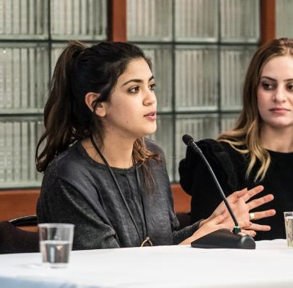
Beyond Wars and Walls: Palestinian Young Women Activists Unite
Serves young women ages 15 – 29 from all economic backgrounds
Builds a community of practice by and for young women peace activists from Gaza, Jerusalem, West Bank, and those living in Israel
Led by alumnae
Self-governed and ultimately self-sustained community of practice
Notes:
Fundamental to this project is TW’s Theory of Change:
• Young women in Israel, Palestine, and the U.S. will become collaborative leaders and equitable partners in conflict mitigation at all levels of society if they engage in clearly defined opportunities for peacebuilding.
• When young women seek out and are offered continuous relationship-based support, mentorship, and guidance, they are most likely to sustain the process and stay invested in its outcome.
• When young women learn how to share and promote their stories and solutions on relevant platforms and with key individuals across all sectors, they are more likely to be acknowledged and included in all places where decisions are made.
• As empowered leaders and decision-makers, these young women will drive positive change in their communities, resulting in a more equal, just, and peaceful society.

Slide 6
The Project
Primary components:
Retreats and workshops featuring emotional resilience and trauma healing sessions
Leadership workshops, survey taking, and listening sessions for the creation of a baseline of data for the group
Creation of a social media campaign (blogs and podcasts) to promote the circumstances facing young women activists in Gaza
Direct Impact: 120; Indirect Impact: 1,200+
Notes:
Through this project, young Palestinian peace activists will have greater hope, connectivity, and sisterhood in support of a unified Palestinian narrative. Specific outcomes include:
• Launch an ongoing and self-sustaining community of practice through gatherings and trainings in the West Bank and Gaza
• Increase emotional resiliency skills, trauma healing, confidence and sustained engagement in the field.
• Assist up to 100 women in starting projects in their communities, with the outcome that 50 percent of participants start peacemaking projects and strategic efforts in their communities or in partnership with their Israeli counterparts
• Gather qualitative and quantitative data through listening sessions and surveys from up to 100 participants, resulting in unique baseline data from this community needs assessment
• Conduct a professional analysis of findings, with the outcome of producing a published baseline of data for young Palestinian women activists
• Establish concrete support to affect change in their neighborhoods, communities, and in all of civil society through project support and leadership training
• Acknowledge and promote their contribution to the peacemaking field in the region through a community needs assessment.

Slide 7
Budget
Item | Description | Cost
Gaza | Staff (2 contracted Palestinian facilitators) Internet connectivity Cost for Face-to-Face gathering (listening session and survey; includes location, secure travel for girls, food, supplies) Where I Live Storytelling/Digital Activism (project coordination, podcast production, editing, promotion) | $6,945
West Bank | West Bank Palestinian Coordinator Alumnae Coordinator Stipends Weekend Retreats (3) (lodging, secure transportation, food, contracted Palestinian Dialogue Facilitator for 2 listening sessions) Emotional Resiliency training (movement, HeartMath, compassionate listening) Data monitoring and evaluation, assessment design/publication, community presentation | $31,580
Total |  | $38,525

Slide 8
About Tomorrow’s Women
Founded in 2003 by humanitarian Rachel Kaufman, artist Debra Sugerman, and activist Anael Harpaz
Proprietary model for Compassionate Dialogue
Flagship Young Leader Program: year-long, immersive leadership experience for young Israeli and Palestinian women
Newest initiatives: groundbreaking virtual Gaza Girls for greater inclusivity, and Advanced Leadership Initiative for change-making opportunities for Israeli and Palestinian young women to partner on projects and affect change on the ground
Notes:
Founded in 2003 after the second Intifada (uprising between the Palestinians in the West Bank and Gaza), Tomorrow’s Women (TW) trains young women ages 15 – 29 from Palestine, Israel, and the United States to be strong, compassionate leaders who partner to resolve conflicts and inspire action that promotes equality, peace, and justice for all.
The founders, humanitarian Rachel Kaufman, artist Debra Sugerman, and activist Anael Harpaz, believe in providing young women with a safe, neutral location, and an empathetic model to begin their trauma healing and the hard work of forming lasting connections and partnerships for change. TW’s proprietary model for Compassionate Dialogue draws from the work of The Compassionate Listening Project, founded by Leah Green and the late Quaker activist Gene Knudsen-Hoffman, from Marshall Rosenberg’s Nonviolent Communication, and from The Way of Council, developed and formalized by Jack Zimmerman. Its flagship Young Leader Program is a year-long, immersive leadership experience for young Israeli and Palestinian women based on transformational dialogue sessions and creative and therapeutic workshops that allow participants to share their personal experiences, practice compassionate listening, and build an understanding of their peers from the “other side.” This program concludes with intensive leadership seminars in Israel and Palestine about gender, dual narratives, grief, forgiveness, and activism, preparing participants to be the next generation of women peacemakers in the region.

Slide 9
Discussion: Share Your Thoughts
1. How do you think the participation of alumnae in design and implementation enhances the effectiveness of Tomorrow’s Women’s projects?
2. Discuss the significance of “Do No Harm” policies (which consider the impact of project activities on this region in conflict and the individual safety and security of participants) to the success of this project.
3. Given the longevity of occupation and the continued volatility in the region, how do you think Tomorrow’s Women and its partner organizations keep participants and staff engaged?

Slide 10
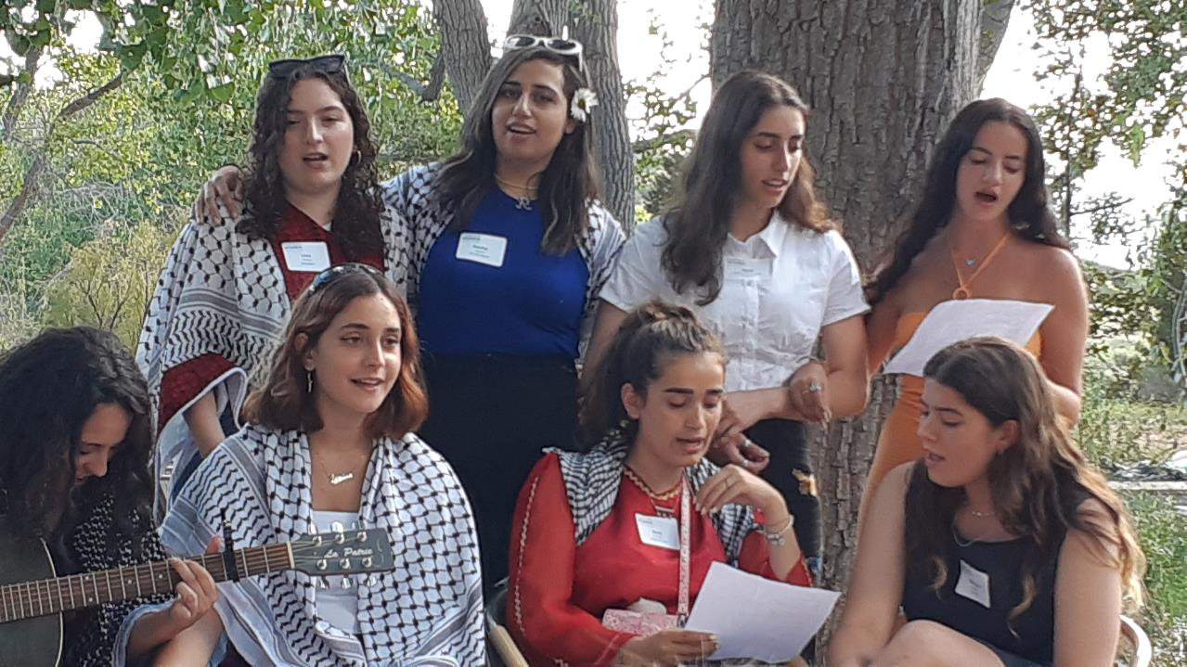
Notes:
Voices
“When I came to camp, the occupier became my roommate. I suddenly understood how meaningful and crucial this work is. After seven years in this organization, I use the tools I’ve learned to document the Israeli Knesset's activities and teach Arabic to Jewish Israelis. I no longer hate the Hebrew language and I often host Israelis in my home. Together we cook and dance. My focus as an activist is to minimize the gaps between the two nations and help each to understand and connect with the other.” – Aia Khalaily, alumna 2010
“More than even peace, I have gained an unbreakable sisterhood.” – Lana, alumna 2016
“The whole three weeks of memories (of camp) are always running through my head. I always think about our hard times together and the good times when we had fun with each other, and I miss these days. It’s been like a dream, and it ended too fast. I wish I could live the moments again with the same people with the same thoughts, the same situations. I felt free all the time just to say what I wanted without hesitating or feeling afraid. Those three weeks were the best three weeks in my life, and of course, the following two years were better for me with the seminars. I attended all of them to see my friends and to talk more without hesitating or judgment.” – Nora, alumna 2018

