Slide 1
August 2023 Featured Project
Addressing the noncommunicable disease crisis in India through nutrition education for girls

Slide 2
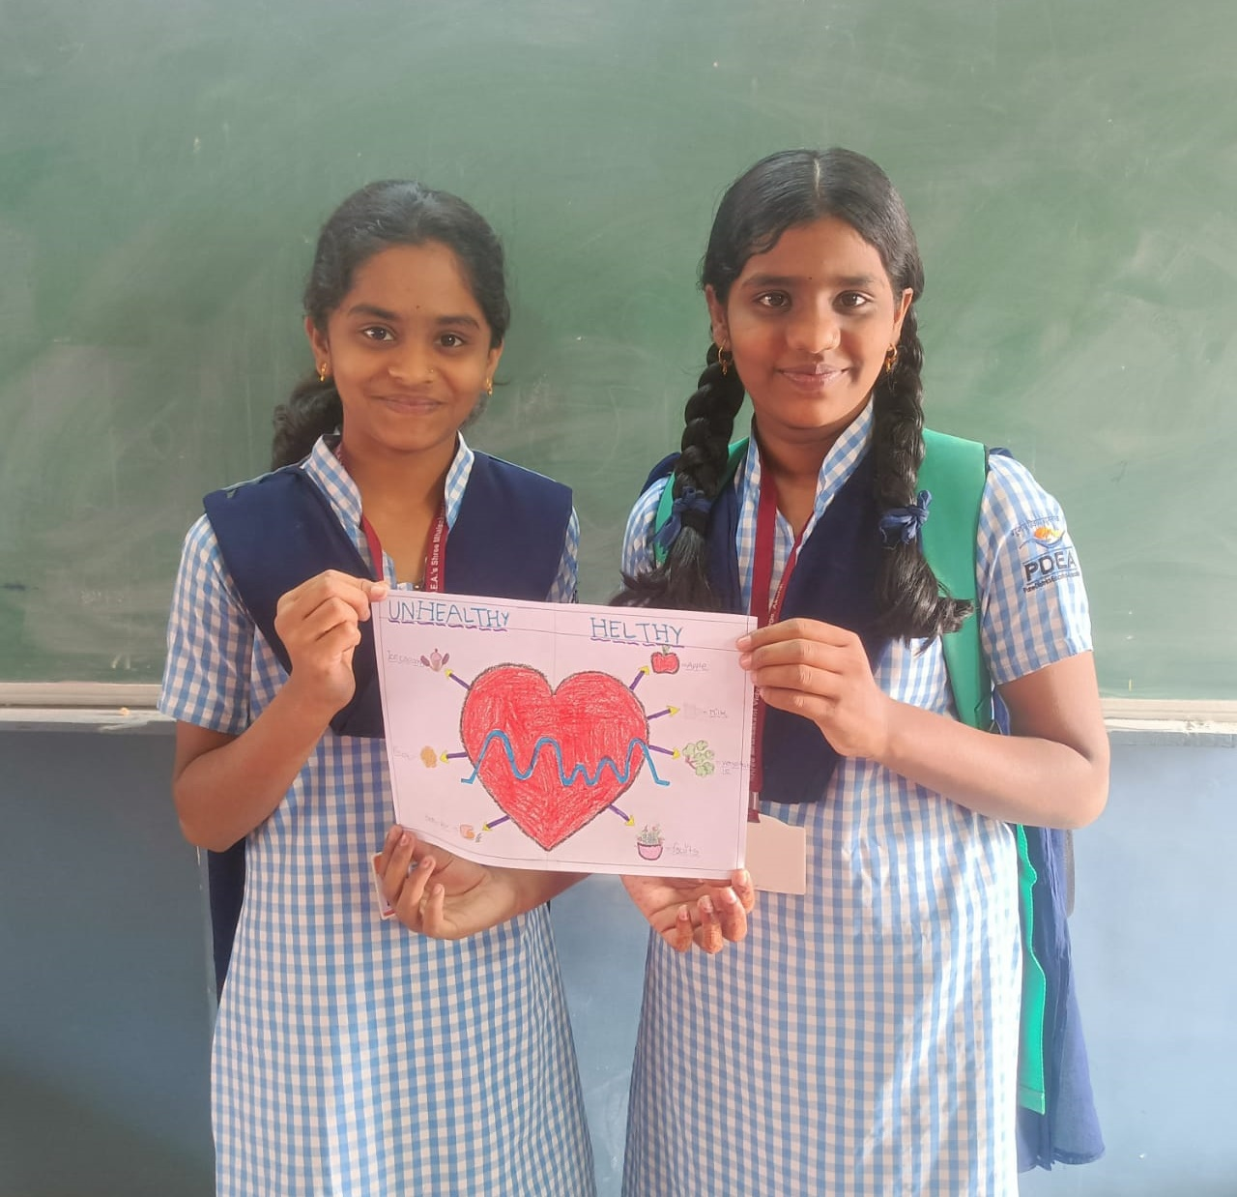
Introducing Arogya World
Mission: works to prevent noncommunicable diseases (NCDs) in India through health education and lifestyle change
Innovative, community-based doorstep health model delivering prevention programming outside of traditional healthcare systems
Notes:
Arogya World works to prevent noncommunicable diseases (NDCs) in India through health education and lifestyle change, leveraging technology and partnerships to help people lead healthier lives. It accomplishes this through an innovative, community-based doorstep health model, delivering prevention programming outside of traditional healthcare systems to reach people where they live, learn, and work.

Slide 3
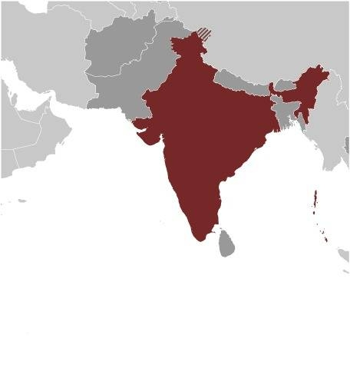
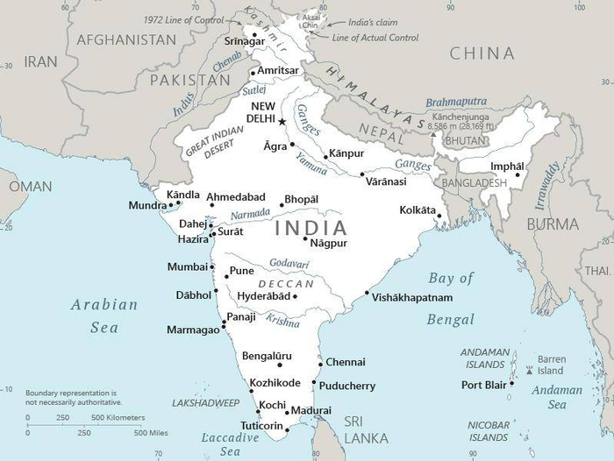
About India
Population of almost 1.4 billion
Second most populated country on Earth
360 million live in squalid conditions; among the most impoverished in the world
20% live far below the poverty line
Discrimination against women and girls is rampant, corruption entrenched, unequal distribution of quality education
Gujarat (project area) - about the size of Kansas but home to 71.5 million people versus 2.92 million in Kansas
Notes:
With a population of almost 1.4 billion, India is the second most populated country on Earth and the largest South Asian economy, comprising a third of Asia and over 17 percent of humanity. Unfortunately, 360 million Indians – more than every US man, woman, and child – live in squalid conditions and are among the most impoverished in the world.
India’s slums are home to millions, yet a third are not even recognized by the government. Families crowd together in makeshift structures, drink scant and contaminated water, scrounge through waste dumps, and typically share unhygienic communal bathrooms that lack sewage systems. Twenty percent live far below the poverty line, often as domestic workers, daily wager laborers, rickshaw pullers, and other low-paying jobs. Discrimination against women and girls is rampant, corruption is entrenched, and there is an unequal distribution of quality education.
Gujarat is on the west coast of India, bordered by Pakistan and other Indian states. It is about the size of Kansas but is home to 71.5 million people versus 2.92 million in Kansas. Seventy-two percent of the world’s processed diamonds and 80 percent of India’s diamond exports come from Gujarat.

Slide 4
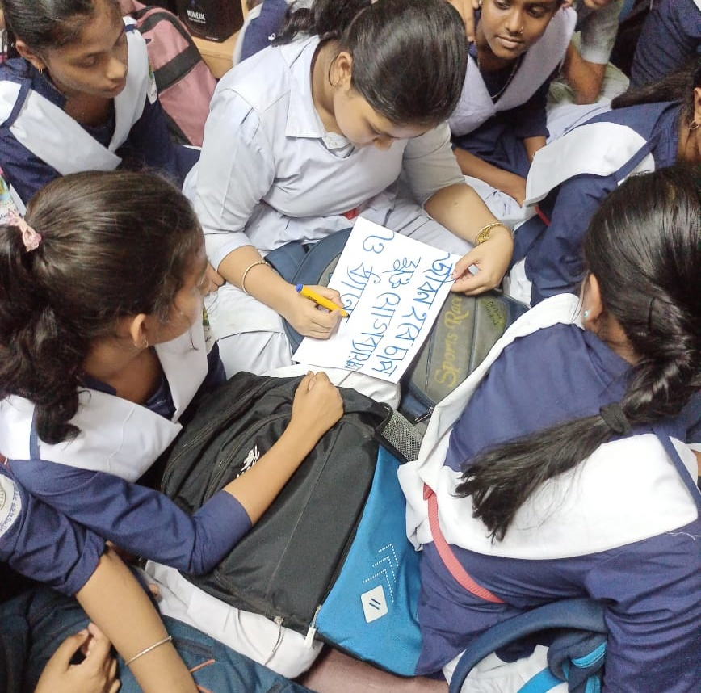
Life Challenges for Women Served
The Noncommunicable Disease (NCD) crisis in India is staggering
NCDs account for nearly 2/3 of deaths
Financial burden high in vulnerable communities - cost of healthcare, financial consequences are catastrophic
Adolescents experience triple burden of malnutrition: undernutrition, overweight, and hidden hunger caused by a lack of essential nutrients, especially rural girls
Notes:
The Noncommunicable Disease (NCD) crisis in India is one of the most significant health and development challenges of the century. The current incidence of NCD in India is staggering:
• NCDs account for nearly two-thirds of deaths.
• 77 million have diabetes and an equal number are estimated to be prediabetic.
• 75 percent of adults in metros like Delhi and Chennai are diabetic or prediabetic.
• 20 percent have a chronic disease.
• 10 percent have more than one chronic disease.
• One in three adults has high blood pressure.
• South Asians account for 60 percent of the world’s heart patients.
The NCD crisis greatly impacts one of the largest segments of India’s population: adolescents. Young people in India account for every fifth person or 280 million people. Adolescence is a nutritionally vulnerable time when rapid physical growth increases nutrient demands. Adolescents experience a triple burden of malnutrition: undernutrition, overweight, and hidden hunger caused by a lack of essential nutrients. The incidence of overweight and obesity is increasing, more than 10 percent of those ages 10 to 19 are prediabetic, and the rate of childhood diabetes has increased three-fold over the last 30 years.

Slide 5
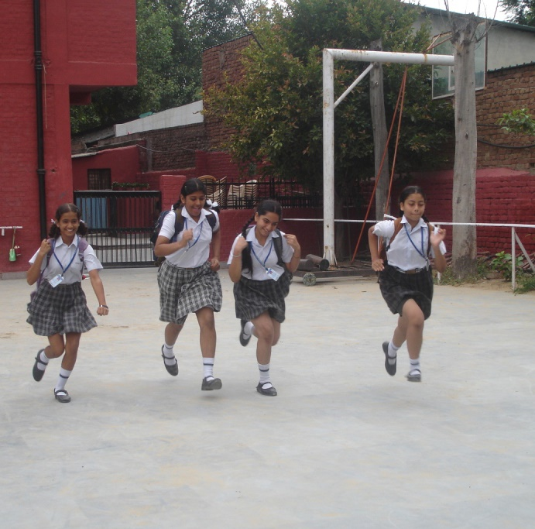
Rural Adolescent Girls Health and Nutrition Education
Tests effectiveness and impact of Rural MyThali, which translates India’s National Institute of Nutrition (NIN) guidelines into easy-to-follow picture format that is region-specific
Educates adolescents about basics of healthy living before lifestyle habits are set
Focus groups (girls and their mothers) assess food preferences/habits, locally available food and more
Notes:
This project takes place in Gujarat, India. It will test the effectiveness and impact of Rural MyThali, which translates India’s National Institute of Nutrition (NIN) guidelines into an easy-to-follow picture format that is region-specific. This will be integrated into Arogya World’s Healthy Schools health education program, which has been proven to work and has been deployed in 500,000 children around the country. In 2020, India’s top nutrition experts requested that AW integrate MyThali into the existing program and deliver it to large numbers of girls in school, but the work was delayed by the pandemic. This project will be the first opportunity to develop a formal integrated program for a nutrition tool in the school setting and test its effectiveness in adolescent girls, who most often are forgotten in the design of nutrition programs.

Slide 6
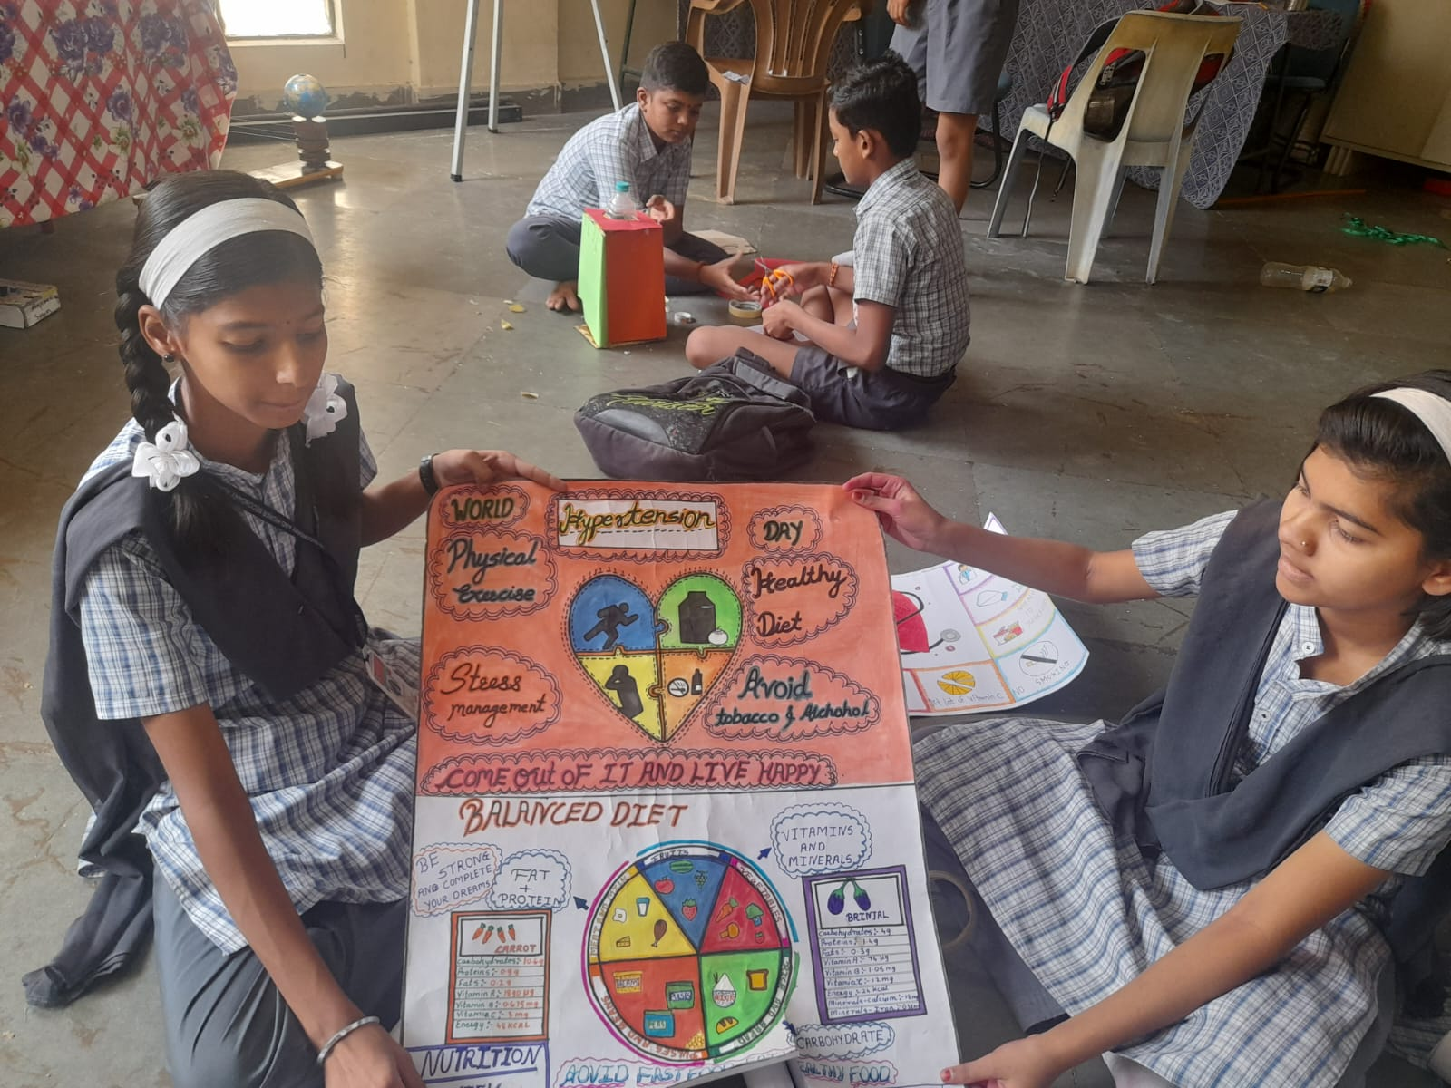
The Project
Project phases:
Formative Research – Dietary practices and dietary diversity, knowledge assessment
Development of Action Plan / MyThali activity calendar for 12 weeks – supports use of MyThali comic book on basics of Foods and Nutrition, plus additional region-specific, culturally relevant tools
Capacity building – Development and pretesting of intervention Tool Kit in vernacular language using regional meals (left for future use by schools)
Impact Evaluation – Assessing impact of intervention
Each Year of 2-Year Project – Direct Impact: 1,600 (800 Intervention); Indirect Impact: Approximately 8,000 Family Members
Notes:
The project unfolds in four phases:
Phase 1: Formative Research – By administering questionnaires to the girls, measuring health metrics, and gathering information from district authorities, data will be collected in participants including socio-demographic profile of school-going girls, assessment of knowledge about basic aspects of foods, nutrition and anemia, dietary practices and dietary diversity, information on interventions under various national or local programs and girls’ utilization of these services.
Phase 2: Development of Action Plan / MyThali activity calendar for 12 weeks – To support the use of MyThali comic book on basics of Foods and Nutrition, additional region-specific, culturally relevant tools will be developed, including counseling cards, traditional Indian “Toran” (similar to a garland) depicting the My Thali concept to be placed in strategic places at the school, activities such as rally, quiz, Snakes and Ladders game, and board games, the integrated MyThali + Healthy Schools program.

Slide 7
Budget
Item | Description | Cost
Project Management | Portion of direct cost to manage project, plus oversight | $10,000
Field Implementation | On-the-ground implementation and execution | $20,000
Materials Development | Encompasses the cost of altering current materials based on focus group input, translation, and printing | $3,000
Training | Training modules development and training sessions | $4,000
Impact Evaluation | Data collection, analysis, and reporting | $5,000
Travel | Travel for trainings, partner liaising, and project update | $3,000
Total |  | $45,000
Notes:
Phase 3: Capacity building – Development and pretesting of intervention Tool Kit in vernacular language using regional meals; Tool Kit will be used to implement the current project and will also be left behind so the schools can continue to use it in future years for fresh incoming seventh grade girls, two peer-educators will be identified per school, training of all implementers, activities will be implemented by the peer-educators and completed on time – the program will be provided to all students in the designated classroom (both boys and girls), sessions conducted by peer educators will be monitored through spot checking and observation checklist by designated monitors.
Phase 4 Impact Evaluation: The impact of the Healthy Schools + Rural MyThali intervention on the adolescent girls will be assessed based on knowledge, attitudes and behaviors including on physical activity, dietary practices, nutritional status, hemoglobin levels, dietary diversity and morbidity profile. Data collection will be done on the phones of field staff using a questionnaire adapted from Arogya World’s existing questionnaires. Hemoglobin levels for the girls (a subset) will be measured in the local primary health center. All these measurements will be carried out at two timepoints – baseline (before the start of the intervention) and endline (when the intervention ends).

Slide 8
About Arogya World
Established in 2010 by Dr. Nalini Saligram and three other founding board members, dedicated, passionate women with goal of making an impact on global health
Leverages strategic partnerships, existing networks, and technology for cost-effective, impactful programs including mDiabetes (diabetes prevention program), MyThali (builds awareness on healthy eating and nutrition) and more
Educated 6 million people on healthy living, aims to reach 50 million in next 5 years with evidence-based, user-centered programs with demonstrated impact
Notes:
Arogya World was established in 2010 by Dr. Nalini Saligram and three other founding board members, a group of dedicated, passionate women who had the shared goal of making an impact on global health. In 2012, Arogya World India Trust was established to further advance AW’s work in India. The two entities work in close partnership to deliver AW’s programs across India.
AW leverages strategic partnerships, existing networks, and technology for cost-effective and impactful programs that include:
• mDiabetes, a diabetes prevention program that sends preventive care messages directly to phones of users
• Healthy Schools, which teaches adolescents the basics of healthy living through age-appropriate games and activities
• Healthy Workplaces, which assesses and supports companies on doing more for the physical and mental health of employees, and
• MyThali, which builds awareness on healthy eating and nutrition.
AW has educated 6 million people on healthy living since its inception and aims to reach 50 million in the next five years. Its programs are evidence-based, user-centered, and have demonstrated impact.

Slide 9
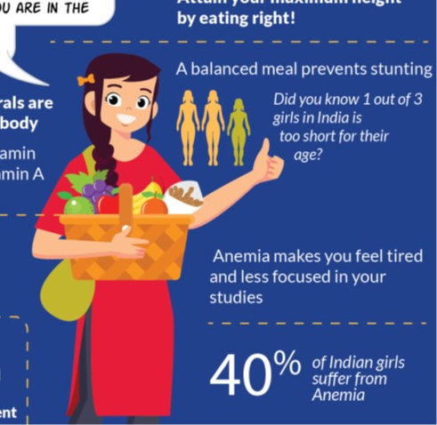
Discussion: Share Your Thoughts
1. Why is delivering programming where people “live, learn, and work” more effective than traditional methods?
2. How do you think a reduction in NCDs can affect gender equality?
3. What roadblocks might a girl experience when trying to introduce nutrition, exercise, and anti-tobacco changes to her family?

Slide 10
Notes:
Voices
“Before when I used to check the lunch boxes of all my friends in class, they used to get lot of junk and unhealthy food. After the awareness program by Hriday & Arogya World, they have started getting healthy foods for lunch.” – Peer Leader of Arogya Healthy, Schools Program, Delhi.
“These diseases have affected us badly because they (my parents) are sick, and there’s no money... the truth is I’m tired...but I have to take care of them.” – A woman who cares for her parents who suffer from NCDs
“I study in KGVB, Kadambu, RES, Bagalkot. Today people from Arogya World and Agastya Foundation came to our school to teach us about diabetes awareness and prevention. This workshop was very informative and we could later spread this useful information to our family members. For this, I would like to thank Arogya World and Agastya Foundation on behalf of my school and me.” – Student from the Healthy Schools Program

