Slide 1
September 2023 Featured Project
Leveraging technology to reach girls in remote locations and end FGM/C

Slide 2
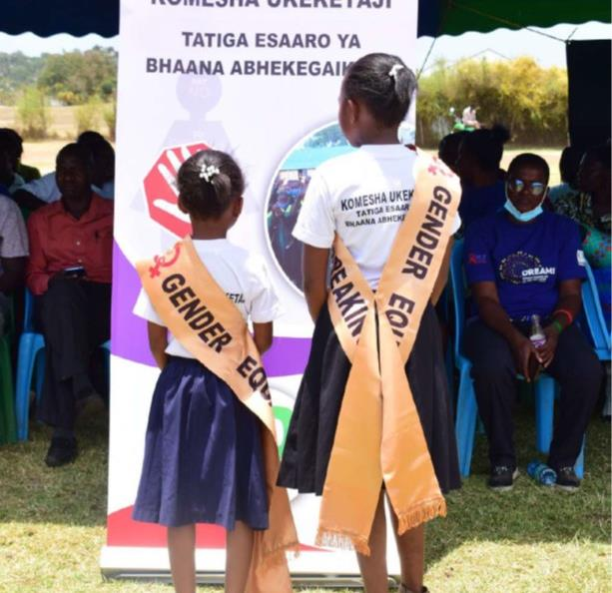
Introducing Last Mile 4D
Mission: mobilizes resources to ensure that girls and women everywhere, particularly in remote communities, can access information about their rights to health, safety, and freedom from gender-based violence
Notes:
The mission of Last Mile 4D (LM4D) is to mobilize resources to ensure that girls and women everywhere, particularly in remote communities, can access information about their rights to health, safety, and freedom from gender-based violence.

Slide 3
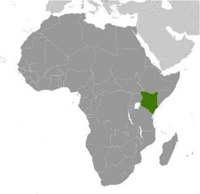
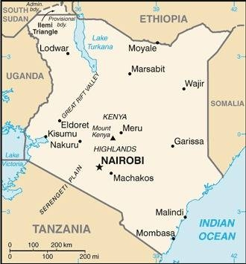
About Kenya
Population over 57 million
High fertility, early marriage - almost 40% of Kenyans are under age 15
Rapid population growth - high birth rate and declining mortality rate
Project is in Migori and West Pokot counties – hotbeds of FGM/C, characterized by diverse ethnic groups, norms, class structures, and educational outcomes among girls
Notes:
Kenya is in Eastern Africa, bordering the Indian Ocean, between Somalia and Tanzania. With a population of over 57 million, Kenya has experienced dramatic population growth since the mid-20th century as a result of its high birth rate and its declining mortality rate. Almost 40 percent of Kenyans are under the age of 15 (as of 2020) because of sustained high fertility, early marriage and childbearing, and an unmet need for family planning. Kenya’s persistent rapid population growth strains the labor market, social services, arable land, and natural resources.
Migori and West Pokot are two of Kenya’s 47 counties located in the western part of the country. Migori has an area of 2,586 square kilometers and a population of more than 1.1 million. West Pokot has an area of 8,418 square kilometers and a population of more than 620,000.

Slide 4
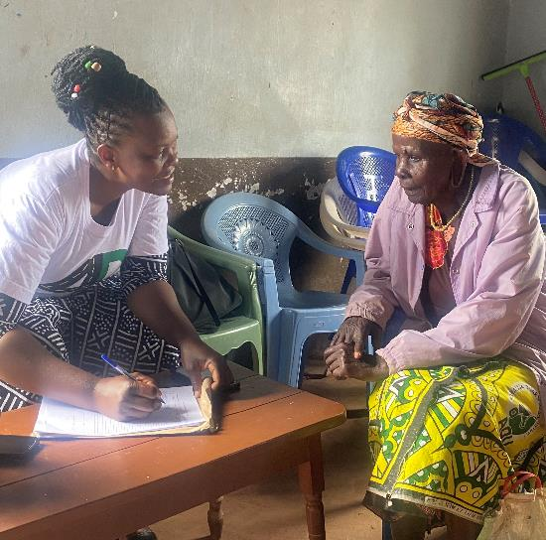
Life Challenges for Women Served
Female Genital Mutilation/Cutting (FGM/C/C) - national prevalence in Kenya of 21% among women and girls ages 15 – 49
FGM/C is illegal, done in secret and isolation
Can mean infections, hemorrhage, fistula, birth complications, sterility, and death
Girls are shunned if they refuse FGM/C or speak out against it
Notes:
Female Genital Mutilation/Cutting (FGM/C/C) has a national prevalence in Kenya of 21 percent among women and girls ages 15 – 49 years. This is an estimated 4 million women and girls. LM4D aims to prevent and eradicate FGM/C.
FGM/C is the intentional altering or injuring of the female genitals for non-medical reasons. Under international laws and treaties, FGM/C is illegal and is a violation of girls’ and women’s human rights. The World Health Organization (WHO) estimates that 200 million women have undergone FGM/C globally – one female every 10 seconds, or 3 million girls a year, from diverse religious backgrounds. FGM/C results in significant physical and psychological harm including infections, hemorrhage, fistula, birth complications, sterility, and death. FGM/C is more prevalent in rural areas with low socioeconomic opportunities and high rates of illiteracy. In many African communities, FGM/C is often a prerequisite to childhood marriage and is the leading cause of school dropout, reducing chances for socioeconomic improvement.
Despite FGM/C being illegal, families and relatives persevere “cutting” girls in secret and isolation. FGM/C is a silent crime, and no one speaks about it in practicing communities. The girls are shunned if they refuse FGM/C or speak out against it.
.

Slide 5
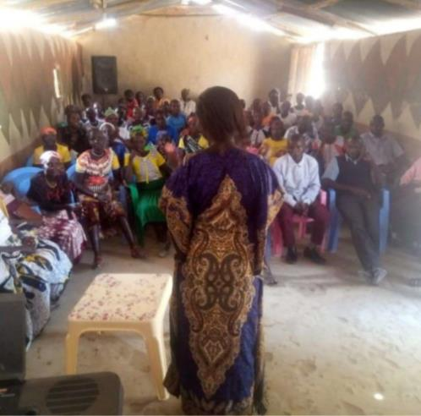
Ending Female Genital Mutilation - A Three Pillar Approach
Innovative early warning system provides real-time data via mobile, solar-powered technology – Vpack4Development (V4D)
Can intervene almost immediately to prevent FGM/C
Targets the most marginalized girls, ages 9 – 14 in remote hotbeds of FGM/C
Primary goal: stop FGM/C for 1,600 girls ages 9 – 14 in Migori and West Pokot
Notes:
V4D units offer a "high tech/high touch" solution that includes mobile technology (solar cells) and wireless laptops with online, real-time tech platform access with secure information. Girls at risk of FGM/C are recorded and an intervention identified in real time. The organization’s impressive pilot had no FGM/C identified during that time. The project also shelters girls during peak “cutting season” (December holidays) to help protect them. Men and boys are encouraged to become involved, and the organization partners with law enforcement – using multiple approaches to tackle the issue in an effort to effect long-term change.
LastMile4D (LM4D) is concerned about FGM/C and its effect on the lives of girls in remote areas of Kenya. It has invented an innovative early warning system that provides real-time data on the girls and therefore can intervene almost immediately to prevent FGM/C.
LM4D targets the most marginalized girls, ages 9 – 14 in remote hotbeds of FGM/C in Kenya. The primary goal of this project is to stop FGM/C for 1,600 girls ages 9 – 14 in the regions of Migori and West Pokot.

Slide 6
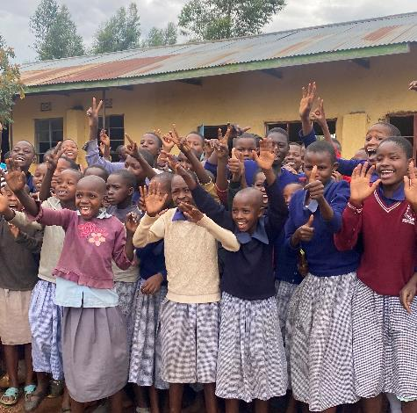
The Project
LM4D uses a “three pillar approach” to achieve goals:
1. Leverage technology to assess girls at risk of FGM/C
2. Deploy educational modules to sensitize girls, boys, and families against FGM/C
3. Engage authorities to enforce laws and protect girls by preventing FGM/C
Includes shelter for girls during cutting season (December holidays) when FGM/C risk is highest
Direct Impact: 1,600 girls, 400 boys; Indirect Impact: 3,000 family members
Notes:
LM4D uses a “three pillar approach” to achieve these goals:
1. Leverage technology to assess girls at risk of FGM/C
2. Deploy educational modules to sensitize girls, boys, and families against FGM/C
3. Engage authorities to enforce the laws and protect the girl child by preventing FGM/C.
LM4D intersects with target audiences to provide comprehensive strategies to prevent and eradicate FGM/C. The program activities outlined below are collaborations with different stakeholders to conduct activities and services designed to prevent and eradicate this practice.

Slide 7
Budget
Item | Description | Cost
Personnel | Field officer, supervisor, manager and monitor Evaluation consultant | $20,820
Safe Houses for Girls | Shelter, food, personal needs, and security for enrolled girls at-risk of FGM/C | $13,700
Community Meetings | 40 bi-monthly community meetings (20 meeting per county for one year) to raise awareness about the harms of FGM/C and engage community influencers, tribal chiefs, religious leaders, local government, and all other stakeholders | $6,400
Equipment and Communication | V4D units including solar backpacks and tablets loaded with platform, internet access Printing and copying (flyers, posters, and T-shirts for community meetings) Local teams’ communication needs Local transportation for field workers to meeting points | $7,080
Total |  | $48,000
Notes:
LM4D promotes women and girls’ self-sufficiency by designing, advocating, and implementing evidence-based strategies that reduce the systemic gender and economic inequalities perpetuated by FGM/C.
Stopping FGM/C for 1,600 girls will lead to higher graduation rates and more post-secondary opportunities, such as non-farm jobs that will benefit both the girls and their communities.
A key component to reach self-sufficiency is keeping the girls in school so they can reach their maximum economic capacity. Some girls choose to attend vocational programs and others opt to attend junior secondary education institutions and beyond. Both of these options foster economic and social empowerment. Through the process, the girls and community acquire skills that empower them to speak out against FGM/C, and join and lead the conversation about eliminating it. They become advocates and champions of eradicating FGM/C, attending county and national government anti-FGM/C activities and promoting decisions that support girls’ rights to health and safety.

Slide 8
About Last Mile 4D
Founded in 2014 by Mahnaz M. Harrison; focuses on women’s and girls’ rights to health and safety in rural or isolated communities
Bundles innovative technology – online platform and tablet in a solar powered backpack – Vpack4Development (V4D)
Goals of V4D:
eradicate FGM/C using innovative educational modules for field workers to create awareness about dire consequences of the practice
real-time monitoring by trained field workers to assess FGM/C risk and need for immediate interventions
crisis intervention hotlines to rescue and shelter girls at risk of FGM/C
Notes:
LM4D was founded in 2014 by Mahnaz M. Harrison. The organization achieves its milestones through an iterative process that focuses on women’s and girls’ rights to health and safety in rural or isolated communities.
LM4D bundles innovative technology that includes an online platform and a tablet in a solar powered backpack – Vpack4Development (V4D). The goal of V4D is to eradicate FGM/C using innovative educational modules for field workers to create awareness about the dire consequences of the practice; conducting periodic, real-time monitoring by trained field workers, to assess FGM/C risk and need for immediate interventions; and create crisis intervention hotlines to rescue and shelter girls at risk of FGM/C in a safe environment.

Slide 9
Discussion: Share Your Thoughts
1. How do you think the use of technology by LM4D can change the fight against FGM/C?
2. Discuss how silence within the community unwittingly condones FGM/C.
3. How do you think the elevation of girls’ voices influences the prevention of FGM/C?

Slide 10
Notes:
Voices
“The program has helped me to escape the harmful practice and effects of FGM…such as early pregnancy, early marriage, school dropout and psychological effects such, bleeding and death and diseases such as fistula. I have told my parents and siblings about the harmful effects of FGM. Now my parents have rejected FGM and will not take me or my siblings for FGM.”
– Student at Kubweye Primary School
“The program has made my parents not to spend money on the FGM ceremony. The funds which would have been used to conduct the FGM ceremony was used towards paying my school fees.”
– Student at Kubweye Primary School

