Slide 1
October 2023 Featured Project
Developing girls’ leadership and empowering them to change attitudes about their value and education

Slide 2
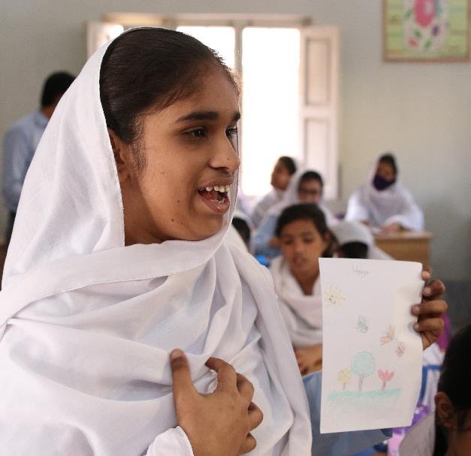
Introducing Girl Rising
Mission: Use the power of storytelling to change the way the world values girls
and their education
Increasing social emotional learning (SEL)
Addressing gender-based discrimination
Notes:
Girl Rising’s mission is to use the power of storytelling to change the way the world values girls and their education.

Slide 3
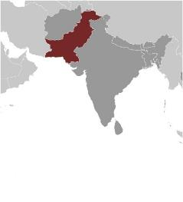
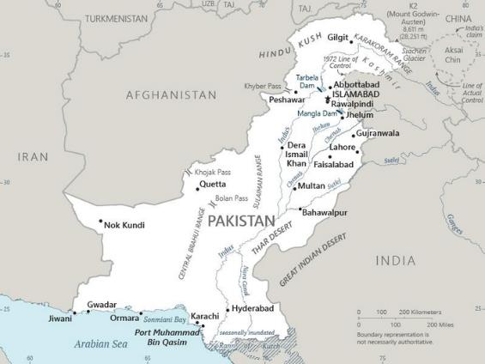
About Pakistan
Population nearly 248 million
Many internal and external conflicts
Intolerance of diversity and dissent
High level of insecurity and tension
Project location: underserved Khairpur district of Sindh, Pakistan
Human development lags in most of the region
Recent flooding challenged agriculture and health sectors
Notes:
This project takes place in the underserved Khairpur district of Sindh, Pakistan. Pakistan is located in Southern Asia and shares borders with Afghanistan, China, and India. The total population is nearly 248 million (2023 estimate.)
Pakistan faces many internal and external conflicts, including a fragile economy, extremism, and intolerance of diversity and dissent. Active militant groups contribute a high level of insecurity and tension. Recent flooding across the country caused significant damage and significantly challenged the country’s agriculture and health sectors. These floods showed Pakistan’s vulnerability to climate disasters as well as ongoing issues with governance and economic stability.
Half of Pakistanis work in agriculture, but the majority of the country’s GDP comes from services such as banking and information technology. As a result, many people are moving to urban areas in search of jobs. Human development lags in most of the region.

Slide 4
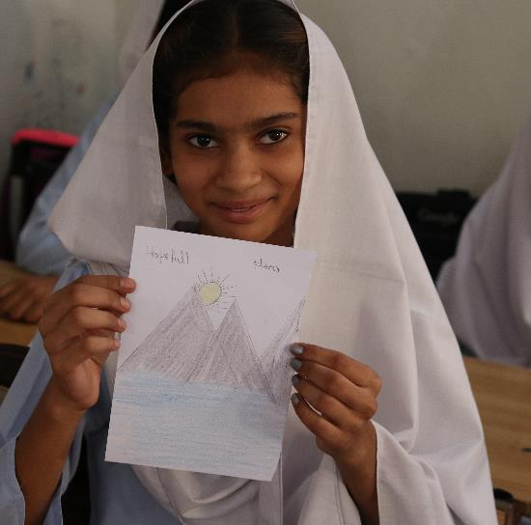
Life Challenges for Women Served
Adolescents, especially girls, lack access to quality education and social emotional learning (SEL)
Girls often taken out of school for marriage, labor, or to manage household chores and become caretakers
Girls often endure discriminatory gender norms, mental health problems, child marriage, violence
Schools often lack sanitation facilities for menstrual hygiene
Notes:
Adolescents in the underserved Khairpur district of Sindh, Pakistan, especially girls, lack access to quality education and social emotional learning (SEL). More than 10 million Pakistani girls are not in school, and boys outnumber girls at every stage of education. In Sindh, only 42 percent of girls attend school. By grade nine, only 13 percent are enrolled. During secondary schooling, a critical time to invest in girls’ life skills, girls are often taken out of school for marriage, labor, or to manage household chores and become caretakers.
Numerous political, economic, and socio-cultural factors lie at the heart of this problem: pervasive gender stereotypes, stereotypical approaches to education, and a lack of infrastructure, awareness of girls’ menstrual health and hygiene, and parental engagement. Even when girls are able to attend school, they often endure discriminatory gender norms, mental health problems, child marriage, and violence.
The lack of sanitation facilities at educational institutions and the pervasive silence around menstrual hygiene results in a high dropout rate of girls in secondary school as they start menstruating.
.

Slide 5
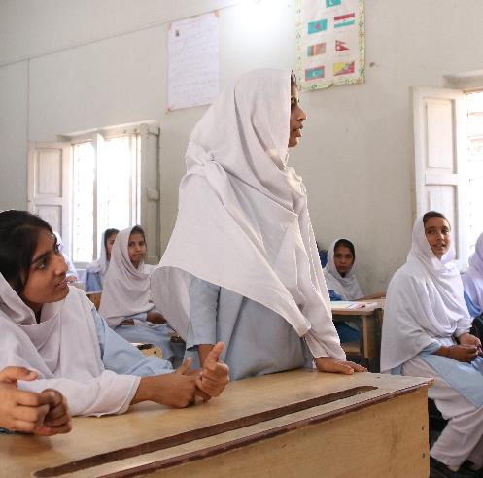
Kaavish – “effort” – Builds Girls’ Leadership
Kaavish (“effort”) program develops adolescents’ voice, agency and leadership skills through story-based curriculum focusing on SEL, mental health, gender stereotypes, and menstrual health
Two-year program: Engages with mothers and teachers to build safe spaces for adolescent girls
Year 1: Knowledge and skill building for adolescents
Year 2: Peer-led leadership model
Notes:
Girl Rising’s Kaavish (“effort”) program develops adolescents’ voice, agency and leadership skills through a story-based curriculum focusing on SEL, mental health, gender stereotypes, and menstrual health.
This two-year program takes place in Pakistan’s Khairpur district and engages with mothers and teachers to build safe spaces for adolescent girls.
The first year focuses on knowledge and skill building for adolescent girls, along with building gender responsive attitudes in teachers and mothers.
In the second year, girls develop leadership skills to lead community groups, youth clubs, and school-based interventions. A peer-led leadership model promotes self-sufficiency for women and girls. The project also engages with boys and men to create an environment in which girls can thrive.

Slide 6
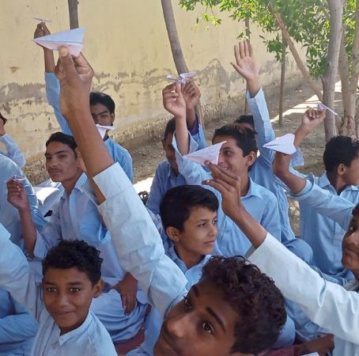
The Project
Key components:
Review of gender and SEL curriculum to incorporate themes of mental health and menstrual health and hygiene, stories of role models
Teachers trained to implement curriculum and mentor parents and other teachers
Select girls trained to become Girl Icons and lead peer-to-peer learning activities in youth clubs on SEL and academic issues – at school and in community
Parent and community engagement - mothers, Girl Icons, and master trainers form nexus of learning
Notes:
The key components of this program are:
Curriculum adaptation: A thorough review of Girl Rising Pakistan’s gender and SEL curriculum will be carried out to incorporate themes of mental health and menstrual health and hygiene.
Teacher training: Teachers from six government schools will be trained to implement the Girl Rising curriculum in their classrooms. In the second year, a select group of these teachers will be trained as master trainers and engage parents in facilitating the SEL of their girls at home.
Peer-led leadership model: A select group of girls will be trained to become Girl Icons and lead peer-to-peer learning activities on SEL and academic issues under the supervision of master trainers - at youth clubs formed in consultation with teachers, adolescents participating in the program, and their parents.
Parents and Community engagement: Mothers (fathers where possible) will be engaged in a series of sessions that will equip them with the appropriate strategies to facilitate their children’s SEL and understand the gender bias. These mothers, the Girl Icons, and master trainers will form a nexus of learning.

Slide 7
Budget
Item | Description | Cost
Personnel | Personnel to directly manage project on the ground in Pakistan, including portion of cost for Girl Rising’s country manager, HAMT’s executive director, training coordinator, field monitoring officers | $31,134
Program Costs | All program activities, including material development for teacher trainings, parent engagement, curriculum implementation, mentoring sessions and organizing exposure visits for Girl Icons | $7,560
Monitoring, Evaluation and Learning | Regular field monitoring visits, baseline and endline assessments in annual learning workshops with project staff and key partners including translation and printing of quantitative and qualitative tools, and more | $1,200
Administration and Logistics | In-country travel of project staff, external speakers to visit the project areas and speak with Girl Icons and/or participate in project activities, printing of curriculum, etc. | $3,580
Overhead | 15% of overhead costs | $6,521
Total |  | $49,995
Notes:
Girl Rising will work with Husn-e-Afroz Memorial Trust (HAMT), a women-led nonprofit organization that brings sustainable change in Khairpur by providing quality education to adolescents focusing on their socio-emotional development, engaging their families and the larger community to change discriminatory social norms.

Slide 8
About Girl Rising
Founded in 2010 as a documentary film and social action campaign company by Holly Gordon, Richard Robbins, Christina Lowery, and Tom Yellin
Creates: films, media content, and educational resources
Collaborates: with local schools, community-based organizations, and educational organizations – to provide educational resources, training and mentoring, measurement and evaluation training, expanding networks, and in some cases providing financial resources
Activates: storytelling and media content encourage change, inspiring everyone from parents to presidents to support girls’ education
Notes:
Girl Rising was founded in 2010 as a documentary film and social action campaign company by Holly Gordon, Richard Robbins, Christina Lowery, and Tom Yellin.
Girl Rising –
• Creates: films, media content, and educational resources.
• Collaborates: with local schools, community-based organizations, and educational organizations – to provide educational resources, training and mentoring, measurement and evaluation training, expanding networks, and in some cases providing financial resources.
• Activates: storytelling and media content encourage change, inspiring everyone from parents to presidents to support girls’ education.
Girl Rising reaches adolescents ages 11 to 16 primarily residing or studying in rural communities. This year programs are set to reach more than 8 million young people (70 percent girls and 30 percent boys). An estimated 80 percent of Girl Rising’s target population falls below the low income bracket, with some communities falling below the poverty line earning less than $1.90 per day.
This year, an estimated 30,000 educators will be reached through Girl Rising’s teacher training.

Slide 9
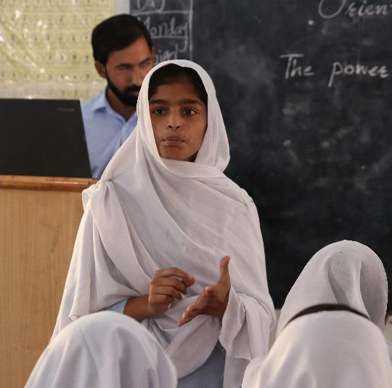
Discussion: Share Your Thoughts
1. Why do you think it is important that both teachers and parents are included?
2. Describe how this project has a built-in “ripple effect.”
3. How do you think the broader community, including boys, benefits from this program?

Slide 10
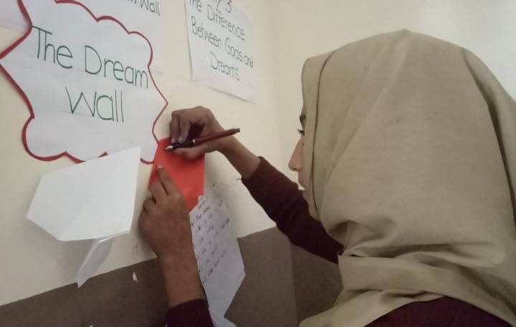
Notes:
Voices
“I am a student of Star School Paras Bari and belong to the small village of Mansehra. I learnt how to fulfill my dreams through the Girl Rising Program by watching numerous stories of courageous and brave girls in this program. I learnt about the strength of the dreams. I learnt how to achieve my goals with utmost commitment and make my parents proud. My dream is to become a teacher. My dream is to continue my studies. I was told that I should study til 8th but I want to study more as this program motivated me a lot. I talked to my parents regarding continuation of my studies and asked for permission. My teacher is my role model and I also want to become a teacher. I learnt about the difference between gender and sex and about the rights of individual from this program. I will study and fulfill my dreams.” – Eman, Participant of Girl Rising Program, Pakistan
“I used to remain shy in my class, I was not good in many subjects but when I appeared in sessions conducted by Girl Rising last year, I felt confident. It seemed very useful to me when I identified my strengths and cultivated a better understanding of ways to use these strengths to overcome challenges in my life.” – Moomal, class 8, Khairpur

