Slide 1
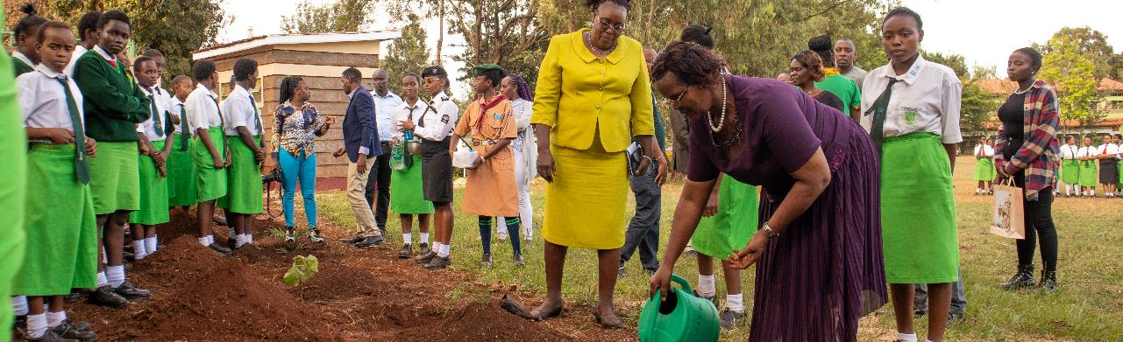
November 2023 Featured Projects
Legacy grants extend powerful partnerships for global gender equality

Slide 2
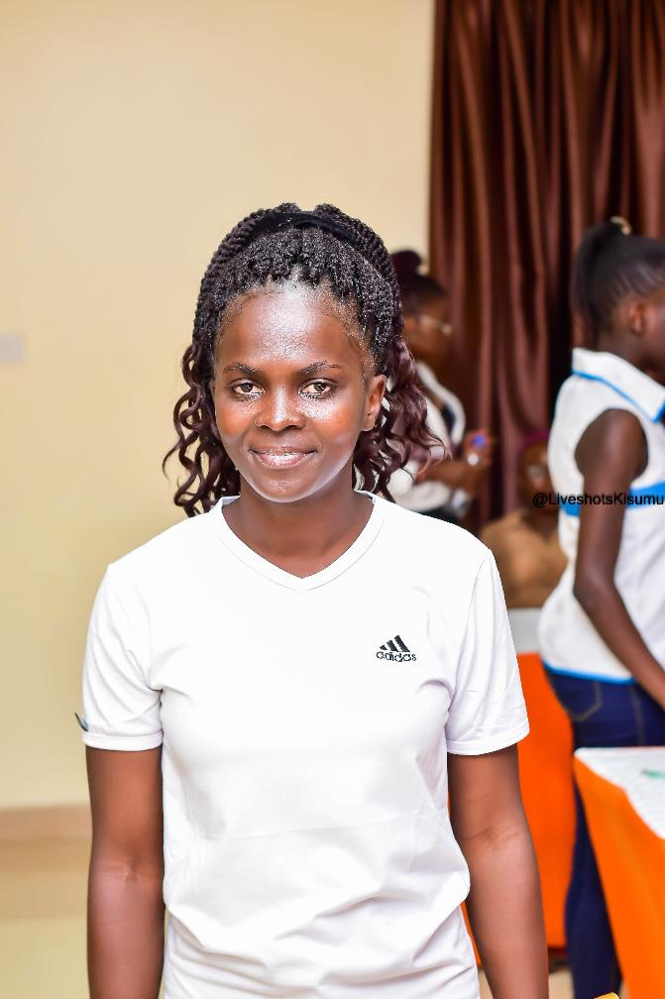
Legacy Featured Grants
Growth Through Learning
&
Children of Vietnam
In honor of Rise’s
20th anniversary and our co-founder Barb Collins
Notes:
Legacy Grants celebrate 20 years of giving and collaboration and thank Barb Collins, Together Women Rise co-founder, for her two decades of devoted service.
Over the years, Growth Through Learning and Children of Vietnam have made a significant impact on women and girls, and they have an ongoing relationship with Rise. This month, that work is honored and primed for the future with grants that continue their work.
In December, a legacy grant will fund Speak for the Poor, which received a featured grant in 2021, when maximum grant limits were reduced due to the pandemic.

Slide 3
Growth Through Learning
Funded in 2006, 2007, and 2008, Growth Through Learning provides full secondary education scholarships for girls and young women in Kenya, Uganda, and Tanzania
2023 Legacy Grant: $25,000
Notes:
Growth Through Learning (GTL) supports education and development in East Africa by providing full secondary education scholarships for exceptional young women in Kenya, Uganda, and Tanzania who would otherwise be unable to afford an education beyond primary school. GTL encourages cross-cultural exchange of information and ideas, especially promoting women’s empowerment in East Africa. Educate a girl and she will do the rest.

Slide 4
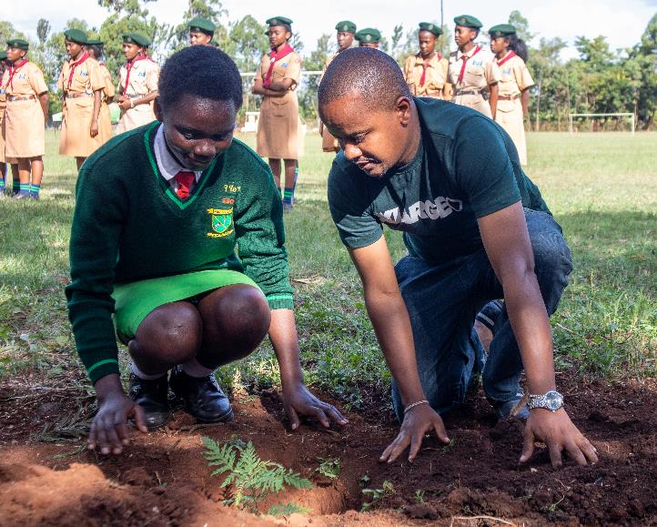
Life Challenges for Women Served
For the girls reached by GTL:
Virtually all come from families that are not in the cash economy
$700 a year to cover school costs is out of reach
Almost half live (48%) in single parent households or are orphans
Notes:
For the girls reached by GTL:
• Virtually all come from families that are not in the cash economy. Parents typically are either subsistence farmers, casual laborers, or jobless. There is little likelihood they would have been able to raise the $700 a year to cover school costs.
• Almost half (48 percent) of the GTL scholars either live in single parent households (43 percent) or are orphans (5 percent).
• GTL scholars come from large families. Half of the GTL scholars come from families that have six children. Half of the single parents (more than 80 percent of whom are mothers) have at least five children.
• Among the challenges faced by families are drought, cattle rustling, and debilitating chronic diseases. Families live on the edge, without health insurance, social security, or other support programs.

Slide 5
The Project
GTL provides educational scholarships (secondary and post-secondary) at an average cost of $700 per girl per year
Funds school fees, uniforms, food, books, and supplies
Girls learn to read and write in English and their native language
Girls obtain skills to teach their own children how to add and subtract, understand ideas, and strive for a better future
Sponsored girls learn empowerment and self-sufficiency through education
The Legacy Grant will enable GTL to pay annual high school fees for 30 scholars in 2024
Notes:
GTL provides educational scholarships (secondary and post-secondary) for girls and young women of East Africa. The average cost to provide a scholarship is $700 per girl per year. This amount keeps a young girl in school by funding school fees, uniforms, food, books, and supplies. A girl learns how to read and write in both English and her native language and obtains the skills necessary to teach her own children how to add and subtract, understand ideas, and strive for a better future.

Slide 6
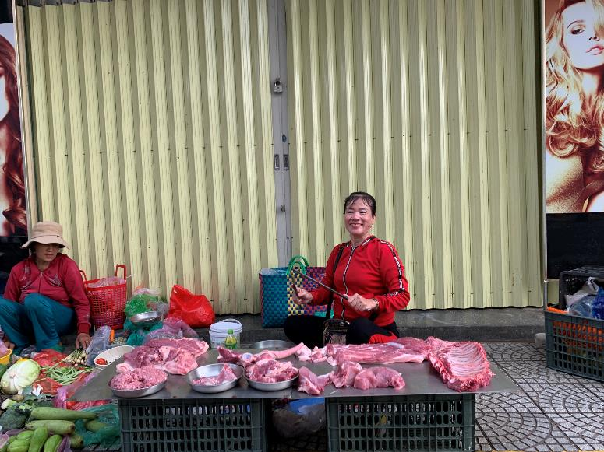
Children of Vietnam
Funded in 2009, 2012, and 2013, COV lifts children out of poverty by eliminating barriers to fulfilling their potential, through wrap around services that focus on one child, one family, one community at a time
2023 Legacy Grant $50,000
Notes:
Children of Vietnam (COV) lifts children out of poverty by eliminating barriers to fulfilling their potential through wraparound services that focus on one child, one family, one community at a time. COV works in Da Nang City and surrounding areas, in Quang Ngai Province, and in Quang Nam Province.

Slide 7
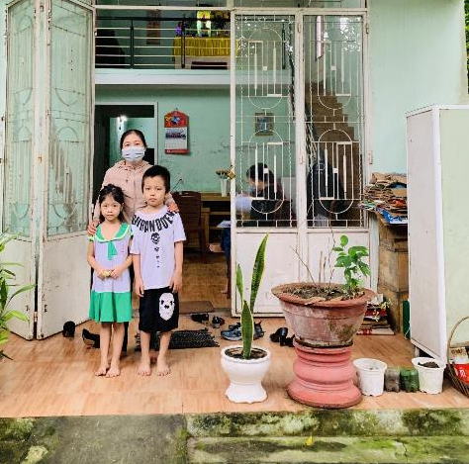
Life Challenges for Women Served
In Vietnam, children born into poverty have little hope for a better life, especially children of single mothers
Entire families can earn as little as $1 – $2 per day as rice farmers
Children in extreme poverty often must quit school and move far from home, exposing them to dangers
Notes:
In Vietnam, children who are born into poverty have little hope for the chance of a better life. More than 66 percent of the population lives in rural areas, where whole families earn as little as $1 – $2 per day as rice farmers.
Children growing up in extreme poverty often have no choice but to quit school and move far from home, exposing them to dangers such as trafficking, homelessness, sexual exploitation, drug abuse, and illness.
Because single mothers face unique challenges, their children become especially vulnerable.

Slide 8
The Project
Empowering Foundations for Women and Their Children (EFWC) provides comprehensive services tailored to meet single mothers’ immediate needs, helps develop lifelong skills that lead to self-sufficiency and self-reliance.
Goals achieved through EFWC:
Microloans and financial assistance to promote self-sufficiency
Training and workshops on micro-business management, self-protection, and nutrition
Medical exams and proper healthcare
Primary and secondary school scholarships and study aids for children
Notes:
To help break the cycle of poverty, COV works with single mothers who live at the bottom of the socioeconomic ladder. As COV collaborates with these mothers, their children have a better chance to grow up in a safe, stable, and healthy home and ultimately, overcome poverty.
The Empowering Foundations for Women and Their Children (EFWC) program provides comprehensive services tailored to meet single mothers’ immediate needs while helping them develop lifelong skills that lead to self-sufficiency and reliance.
EFWC achieves these goals through:
• microloans and financial assistance to promote self-sufficiency
• training and workshops on micro-business management, self-protection, and nutrition
• medical exams and proper healthcare
• primary and secondary school scholarships and study aids for their children.

Slide 9
Notes:
Voices
From Children of Vietnam:
“Since joining the Empowering Foundations for Women and Their Children (EFWC) program, I have received funds to repair my barns and start a chicken-raising project. I've also benefited from receiving general health check-ups, Tet gifts, and two scholarships for my child at the beginning of the year. Additionally, I have participated in business training sessions and celebrated Women's Day on March 8, 2023.
I am truly grateful for EFWC’s help as it has brought happiness into my life. I am now able to improve my livelihood and support my children while they continue their education. I want to express my heartfelt thanks to the Children of Vietnam for their care and for creating these favorable conditions for me. Participating in this program has brought me great joy.”
– Ngo Thi Ngoc Linh, Hoa Vang District, Danang City

