Slide 1
December 2023 Featured Project
Information, resources, and training girls need for health, safety, and well-being in Bangladesh

Slide 2
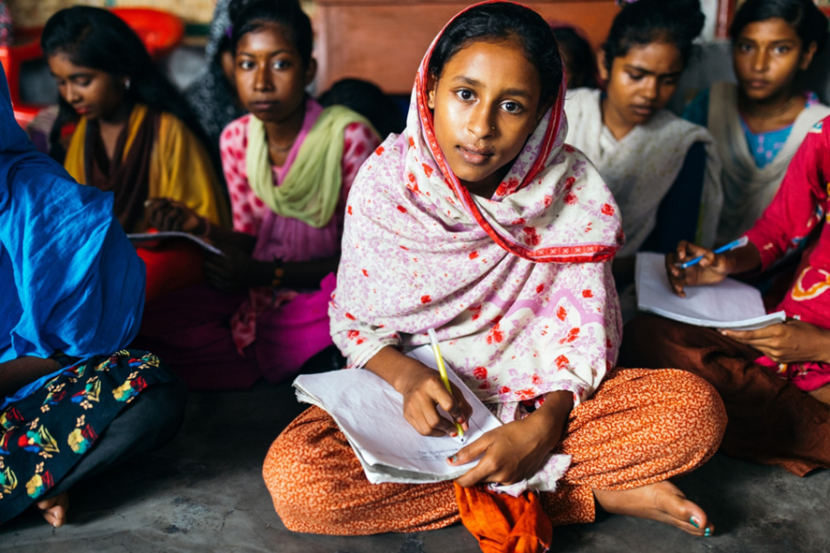
Introducing Speak Up for the Poor
Exists to transform the world on behalf of the poor and create a new reality for girls in poverty in Khulna Division, Bangladesh
Notes:
Speak Up for the Poor exists to transform the world on behalf of the poor and create a new reality for girls in poverty.

Slide 3
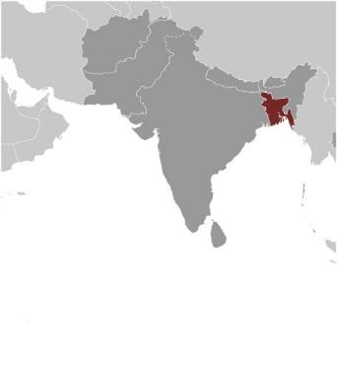
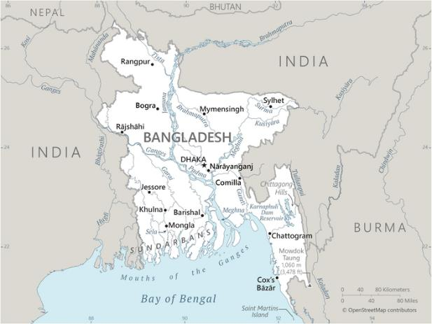
About Bangladesh
Population 173 million
In Southern Asia, bordering Bay of Bengal
98 percent ethnic Bengalis
One of the most densely populated countries on earth
High risk of infectious diseases
Highly agricultural = waterborne contamination and disease
Notes:
Bangladesh is located in Southern Asia, bordering the Bay of Bengal. Its climate is tropical, with monsoons from June to October. It is the eighth largest country in the world, with a population of 173 million people in 2023. But it is smaller in size than the U.S. state of Georgia, making Bangladesh one of the most densely populated countries on earth.
In 1971, Bangladesh gained independence from Pakistan and became a sovereign nation. It is one of the most ethnically homogenous countries on earth, with 98 percent of the population being ethnic Bengalis.
Seventy percent of the land is agricultural. Many people are landless and forced to live on and cultivate flood-prone land. Waterborne diseases are prevalent in surface water. Water pollution, especially of fishing areas, results from the use of commercial pesticides, and ground water is contaminated by naturally occurring arsenic.
The risk of major infectious diseases is high. Most prevalent are food or waterborne diseases. Dengue fever and malaria are high risks in some locations, as is rabies.

Slide 4
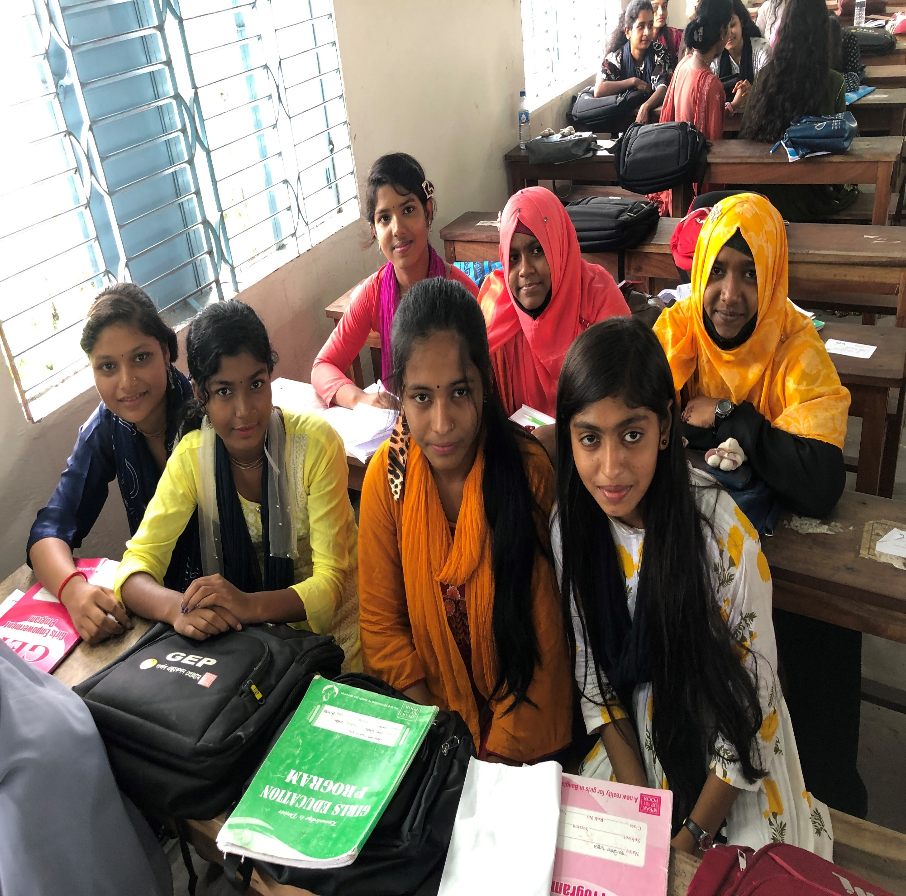
Life Challenges for Women Served
51 percent of girls in Bangladesh -forced into illegal child marriages before age 18
Vulnerable to being trafficked into prostitution
Often do not understand rights to bodily autonomy and safety
Lack of basic health information
Cultural taboos about menstruation and women’s health
Notes:
In February 2021, Together Women Rise supported Speak Up for the Poor’s Girls Education Program (GEP) with a grant of just over $26,000, during a time when maximum grants were reduced due to Covid. That grant had a profound impact and was particularly critical during the height of Covid. A look back at the results of that effort reinforces the need to continue the work.
In Bangladesh, girls in poverty are considered second-class citizens, destined only for child marriage and domestic servitude. This means hundreds of thousands of girls across Bangladesh drop out of school early and are forced into illegal child marriages, some as early as age 13. These girls are often uneducated about sanitation and hygiene issues. They tend not to have positive teaching about their body and feminine health issues, and they tend not to have an adequate sense of safe behaviors to avoid exploitation and abuse.
According to UNICEF, 51 percent of girls in Bangladesh are forced into illegal child marriages under the age of 18. Bangladesh is home to 38 million child brides, including currently married girls and women who were first married in childhood. Of these, 13 million married before age 15. It is among the top 10 countries in the world with the highest levels of child marriage.
.

Slide 5
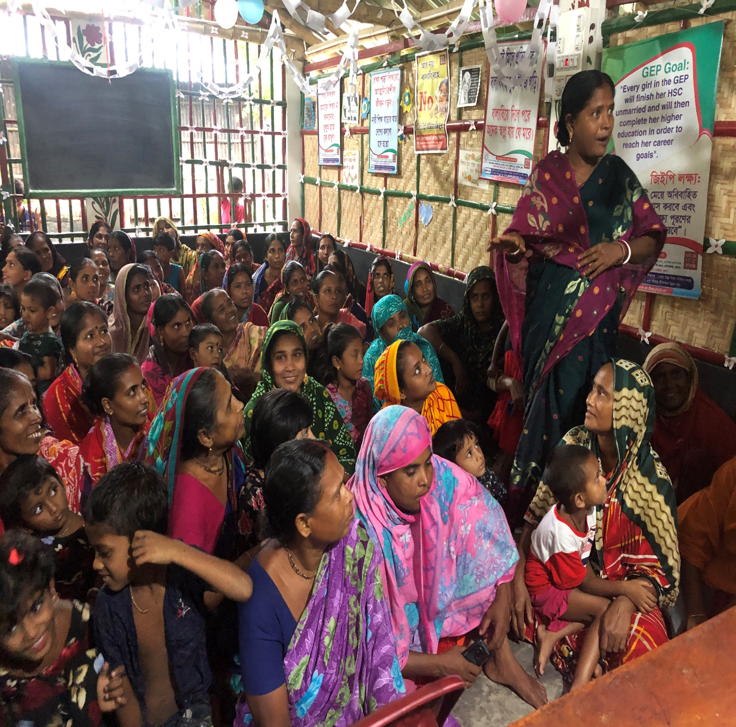
Girls Education Project (GEP)
Together Women Rise grantee – February 2021:
Socially distanced trainings – rare source of education about health and safety
Encouraged parents to keep daughters in school after long school closure
Notes:
Being able to educate girls and young women regarding these health and safety topics and practices made a substantial difference at a crucial time. Because schools were closed for almost a year and a half in Bangladesh due to Covid, the socially distanced trainings and materials were one of the few sources of formal education about matters of health and safety that many girls and their families in the working area received during that time period – the only source in many cases.
The fact that Speak Up for the Poor continued to provide socially-distanced learning opportunities (health and safety seminars, other life skills training, and academic tutoring and mentoring in small groups) throughout the time of formal school closures in Bangladesh encouraged many parents of girls to keep their daughters in school, rather than using the pretext of long school closures to rationalize giving their daughters in early marriage, as frequently happened in Bangladesh during the height of the pandemic.

Slide 6
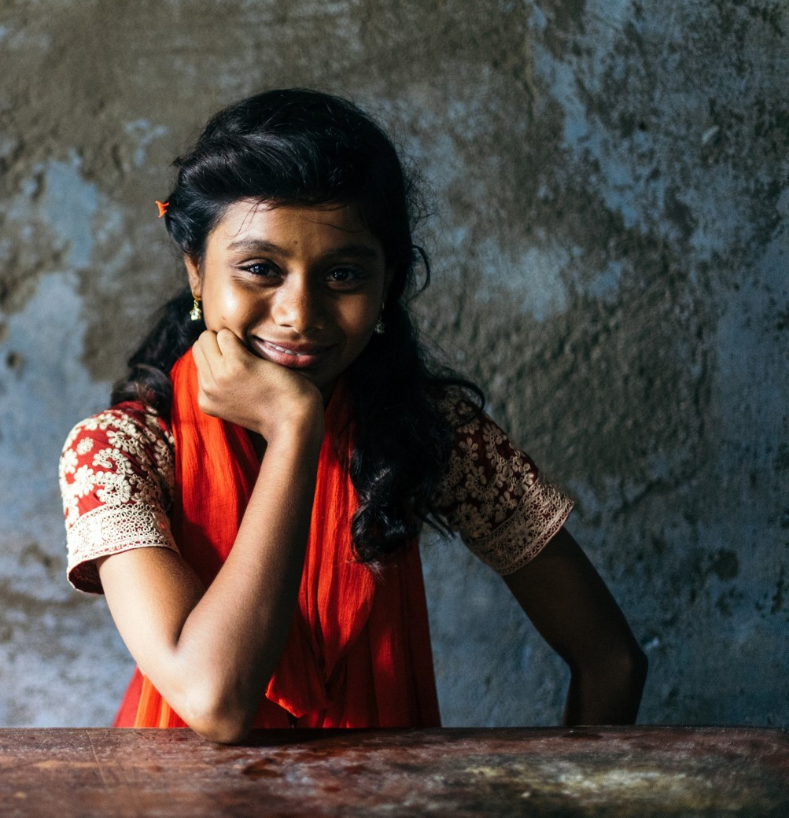
Girls Education Project (GEP)
December 2023:
At least 2 Health and Safety Seminars each month in 2024
More health training in College GEP
Hire nursing school graduate from GEP as full-time community health nurse
Notes:
Being able to educate girls and young women regarding these health and safety topics and practices made a substantial difference at a crucial time. Because schools were closed for almost a year and a half in Bangladesh due to Covid, the socially distanced trainings and materials were one of the few sources of formal education about matters of health and safety that many girls and their families in the working area received during that time period – the only source in many cases.
The fact that Speak Up for the Poor continued to provide socially-distanced learning opportunities (health and safety seminars, other life skills training, and academic tutoring and mentoring in small groups) throughout the time of formal school closures in Bangladesh encouraged many parents of girls to keep their daughters in school, rather than using the pretext of long school closures to rationalize giving their daughters in early marriage, as frequently happened in Bangladesh during the height of the pandemic.

Slide 7
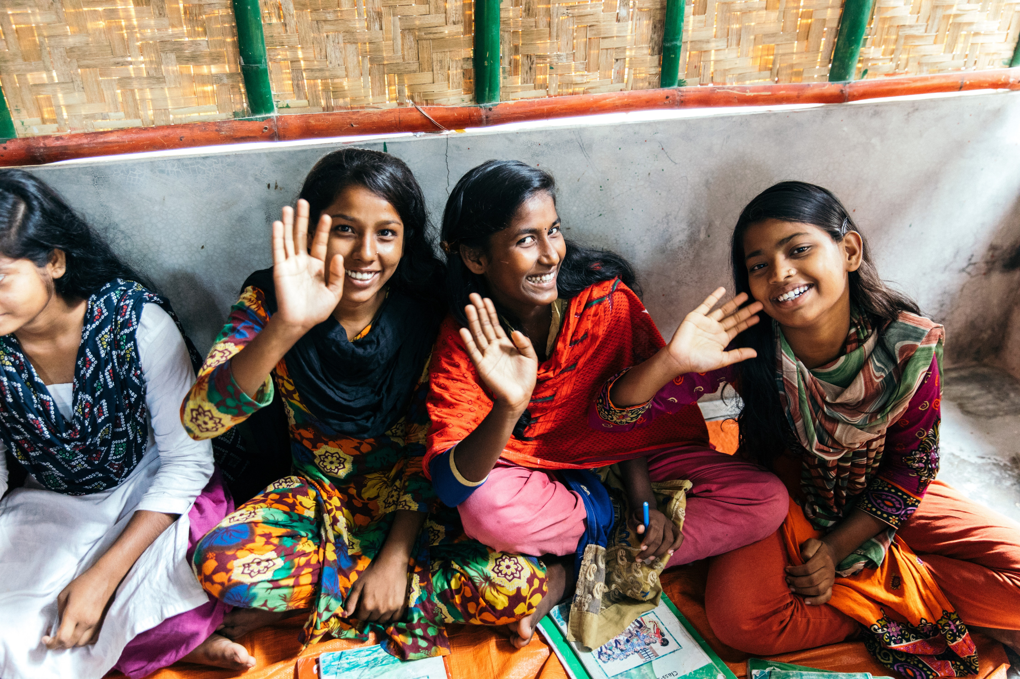
The Project
Health and Safety Training:
Basic hygiene, feminine hygiene
Infections and skin diseases
Water hygiene
Village youth club for local health and safety problems
Understanding of right to bodily autonomy and laws: child abuse, child marriage, sexual abuse, domestic abuse, spousal rape
Notes:
The main goal of Speak Up for the Poor’s Girls Health and Safety Training Project is to provide girls and women in the Girls Education Program (GEP) with the information and resources they need for optimal health, safety, and well-being in their context.
It includes basic hygiene, feminine hygiene, understanding and avoiding infections and skin diseases, water hygiene, a youth club to understand local health and safety problems, understanding the right to bodily autonomy and laws surrounding it.
At least 150 new girls join the GEP from a waiting list each year in January, so there are many younger girls who are new to the program since the 2021 grant. Ongoing health and safety trainings expose these new girls to these critically important concepts. This new grant from Together Women Rise will facilitate health seminars and continued health and safety trainings in the year ahead.

Slide 8
Budget
Item | Description | Cost
Village Health Seminars | For 36 seminars: health supplies (medicines), medical equipment (including first aid boxes), feminine hygiene products (for each girl), honorarium for visiting doctor or nurse at each event | $9,000
Large Group Training Meetings | For 16 training meetings : facility expenses (including rental, cleanup, etc.), food (snacks for girls), supplies (pens, notebooks, handouts, sanitation supplies), transportation for girls and staff attendees, media (sound system rental and materials) | $21,900
Nursing School | Student fees, nursing school training events | $11,900
Salaries | Nurse practitioner and nursing interns | $7,200
Total |  | $50,000

Slide 9
About Speak Up for the Poor
Founded in 2004 by Troy Anderson
Began operations in Bangkok, Thailand in 2008
In 2012, started Girls Education Program (GEP) in Khulna Division, Bangladesh
GEP grew from 20 girls in three villages in 2012 to 1,440 girls in 30 villages by 2020
Excellent record of keeping girls in school
Community meetings educate adults and children: importance of education for girls, detrimental consequences of child marriage
Notes:
Speak Up for the Poor was established in February 2004 by Troy Anderson. Since 2013, he has lived and worked in Thailand and Bangladesh. The organization officially began operations in Bangkok, Thailand in 2008. In 2012, Speak Up for the Poor initiated the Girls Education Program in Khulna Division, Bangladesh. GEP grew from 20 girls in three villages in 2012 to 1,440 girls in 30 villages by 2020.
Speak Up for the Poor’s primary service is the Girls Education Program in Khulna Division, Bangladesh. It provides after-school tutoring, school uniforms, books and materials, and school and exam fees to 1,440 girls from impoverished backgrounds who otherwise would be hindered from staying in school because of poverty and the high prevalence of child marriage, which almost always ends a girl’s education. The organization provides monthly community meetings in the 30 villages in which they work to educate thousands of adults and children regarding the importance of education for girls and the detrimental consequences of child marriage. Speak Up for the Poor also provides regular grade-level meetings for GEP girls to provide inspiration to continue in school, training in life skills and professional skills, and it operates a girls’ dormitory for 90 girls and young women who need a safe living environment to attend school or college in Khulna city.

Slide 10
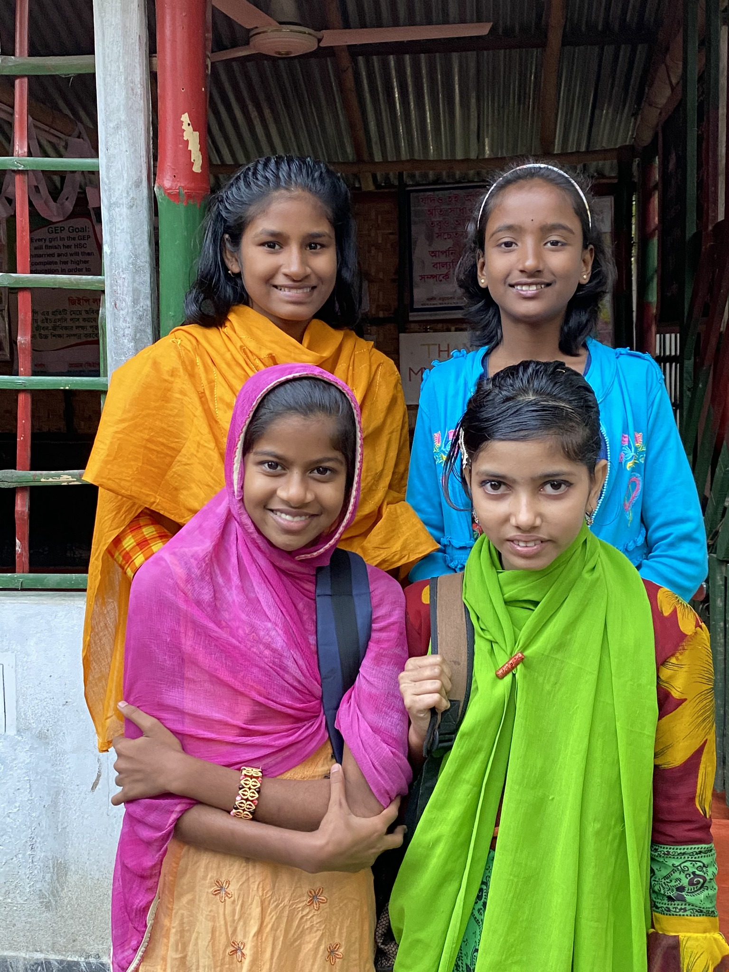
Discussion: Share Your Thoughts
1. Why do you think the participation of nursing students in local seminars has been so impactful?
2. The impact of continuing socially distanced programs during Covid reached far beyond the knowledge imparted during the trainings. Why do you think it was so important to those whose daughters participated?
3. How do you think removing the stigma around topics such as menstruation can change the life of a girl, her family, and her community?

Slide 11
Notes:
Voices
“I was very happy to inform the GEP girls about how to be a nurse. I am very happy to be a GEP student, and at the same time a trainer for this seminar. I am also happy to receive an honorarium from the seminar; it is the first time I have ever received an honorarium in my life. This program is very helpful for GEP girls and I think that every month in every village we need these seminars for girls and mothers.”
– Tumpa, a nursing student and trainer in the Health Seminars
“In the medical seminar I explained the importance of the nursing profession, and now many more girls are willing to study nursing. After participating in the medical seminar, many girls are also now able to take primary treatment at home. During their menstrual period they are now able to stay clean with the use of sanitary napkins.”
– Supriya, a nursing student and trainer in the Health Seminars
“The girls listened to me with a lot of enthusiasm, and they were very interested. The girls have been informed about many health issues which they were not aware of before. I like it that now many girls want to be a nurse.”
– Dipti, a nursing student and trainer in the Health Seminars

