Slide 1
March 2024 Featured Grant
Where War and Conflict Exist, Women and Girls Disproportionately Bear the Burden

Slide 2
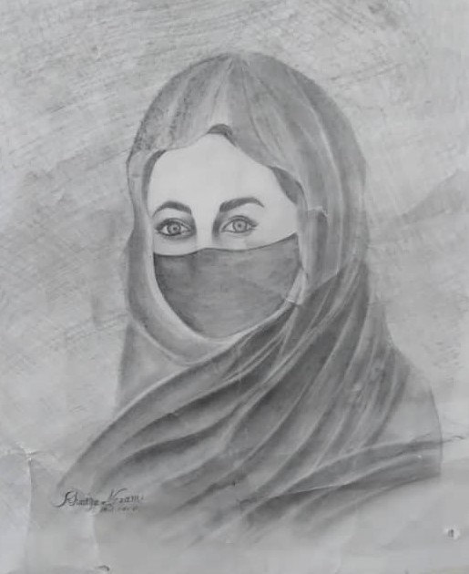
About Featured Grants
Featured Grants fund:
direct services
new projects
expansion of existing projects
general operations
capacity building
Notes:
Together Women Rise funds Featured Grants and Transformation Partnerships. Featured Grants fund projects, general operations, or capacity building. Project grants are awarded to fund a new or existing project. This month, our Featured Grant funds a project: IANGEL’s Powering Hope project.

Slide 3
The Global Issue
Women and girls bear the burden of war and conflict including:
hunger
illness and injury
assault
displacement
trauma
sexual and gender-based violence
Notes:
.

Slide 4
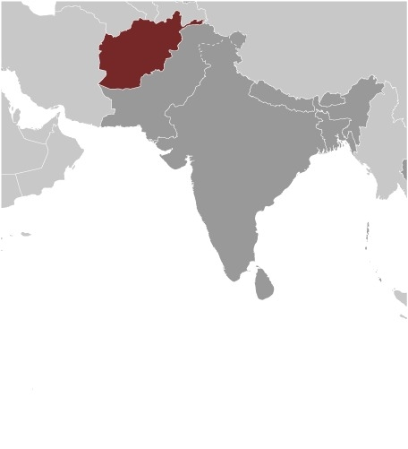
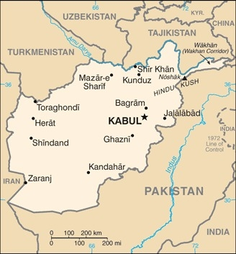
Life Challenges of Afghan Women & Girls
Impact of Taliban is considered gender apartheid
Women are isolated, live in fear, and lack access to:
Education
Employment
Public spaces
Other basic freedoms

Slide 5
International Action Network for Gender Equity and Law (IANGEL)
International network of lawyers
Dedicated to gender equity and justice
Harnesses the power of pro bono legal assistance
Focus areas: reproductive justice, leadership and empowerment, and peace and security
Notes:
IANGEL is an international network of lawyers dedicated to gender equity and justice that harnesses the power of pro bono legal assistance, connecting it to the cause of women’s rights locally, nationally, and around the world. IANGEL’s work focuses on critical issues affecting women and girls in the areas of reproductive justice, leadership and empowerment, and peace and security.

Slide 6
Why We Love this Project
Addresses gender inequities in Afghanistan caused by the Taliban’s systematic oppression of women
Connects volunteer lawyers to advance gender justice locally, nationally, and globally.

Slide 7
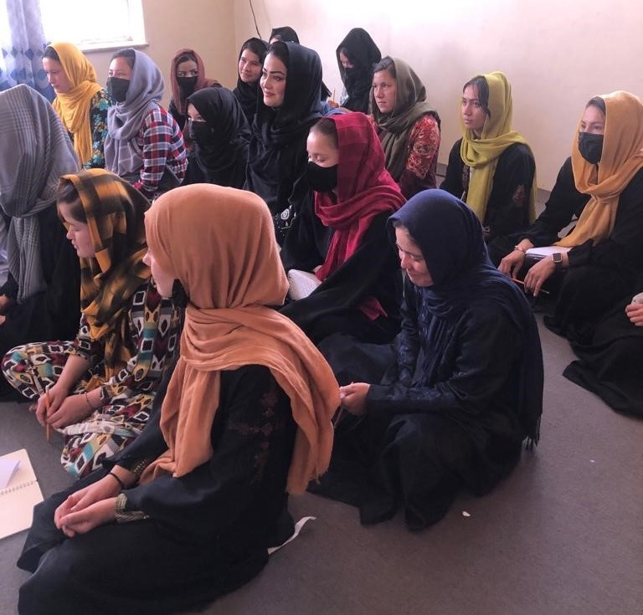
How Our Grant Will Be Used
$50,000 Project Grant to fund:
BRIDGE – Building Real Interactions Driving Gender Equality
Underground schools
International Legal Research and Advocacy Project
Notes:
To serve the women of Afghanistan, Together Women Rise is funding IANGEL’s Powering Hope project, which responds to the Taliban’s systematic oppression of its female population with multiple initiatives, including three primary, complementary components:
1. BRIDGE – Building Real Interactions Driving Gender Equality connects Afghan women lawyers inside and outside the country, directly benefitting the lawyers and advocates, their families, and the hundreds of women they will assist. They will be able to provide advice and assistance to women experiencing gender-based violence.
2. Underground schools – direct assistance and support to Afghan women who undertake the dangerous role of operate underground schools.
3/ International Legal Research and Advocacy Project – IANGEL is partnering with Afghan women’s rights defenders on international legal research to provide analysis, accountability, and advocacy in response to the crisis.

Slide 8
Budget
Item | Description | Cost
Project Facilitator | Daily oversight of the grant, monitor progress, and ensure achievement of periodic milestones | $5,640
Project Coordinator | Coordinate project services and activities, including training, communication, and information dissemination | $22,025
Project Data and Finance Lead | Provides support with information technology and finance services. | $5,800
Volunteer Coordinators (Afghanistan) | Stipends for Afghan for performing various tasks essential to project completion | $16,535
TOTAL |  | $50,000

Slide 9
Anticipated Impact
Direct impact = more than 2,240 women and girls, including:
lawyers and advocates
women served in the BRIDGE program
teachers and girls in underground schools.
Potential indirect impact = half the population of Afghanistan (approximately 20 million people)
Notes:
Together Women Rise’s funding of this project has a direct impact on more than 2,240 women and girls, including lawyers and advocates, women served in the BRIDGE program, and teachers and girls in underground schools.
As new ideas are generated for global policy makers to drive change in Afghanistan, the potential indirect impact is half the population of the country, or approximately 20 million people.

