Slide 1
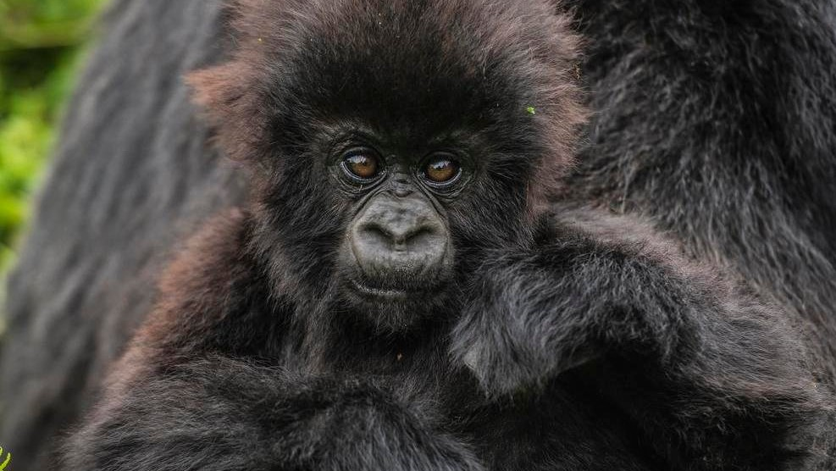
April 2024 Featured Grant
Educating Girls is Good for the Planet

Slide 2
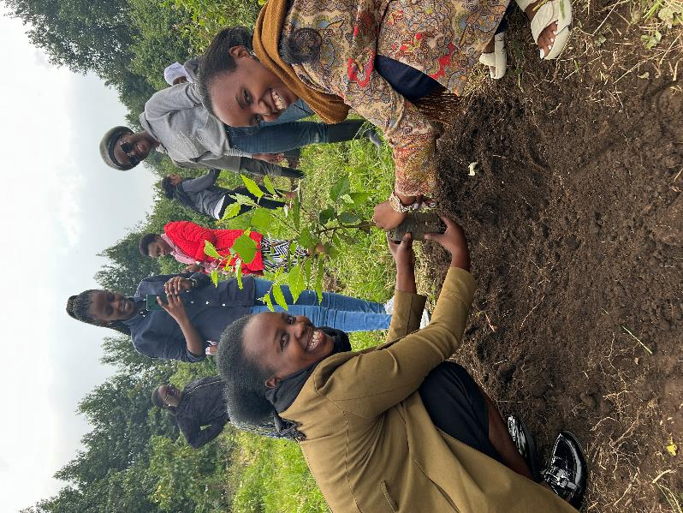
About Featured Grants
Featured Grants fund:
direct services
new projects
expansion of existing projects
general operations
capacity building
Notes:
Together Women Rise funds Featured Grants and Transformation Partnerships. Featured Grants fund projects, general operations, or capacity building. Project grants are awarded to fund a new or existing project. This month, our Featured Grant funds a project: the Dian Fossey Gorilla Fund’s Girls in Conservation project.

Slide 3
The Global Issue
Women are vulnerable to climate change and critical to solving the issues:
often dependent on natural resources
primary caretakers of water, land, and forests
engaged in farming, collecting water and firewood
Notes:
Women are disproportionately affected by environmental degradation and climate change in the Global South because they are often dependent on natural resources. They are the primary caretakers of water, land, and forests, engaging in activities like farming, collecting water and firewood, and managing household energy needs. They play essential roles in agricultural production, particularly in smallholder farming systems. Yet, women face barriers to accessing resources, land rights, and decision-making processes that limit their ability to be effective stewards of their environment.
Educating girls can have positive conservation outcomes by reducing greenhouse gas emissions and enhancing climate resilience. According to UNESCO data, educating girls could result in a massive reduction in emissions of 51.48 gigatons by 2050. This is because educating girls has an impact beyond the individual, cascading into her family and her community.
Women are disproportionately affected by environmental degradation and climate change in the Global South because they are often dependent on natural resources. They are the primary caretakers of water, land, and forests, engaging in activities like farming, collecting water and firewood, and managing household energy needs. They play essential roles in agricultural production, particularly in smallholder farming systems. Yet, women face barriers to accessing resources, land rights, and decision-making processes that limit their ability to be effective stewards of their environment.
Educating girls can have positive conservation outcomes by reducing greenhouse gas emissions and enhancing climate resilience. According to UNESCO data, educating girls could result in a massive reduction in emissions of 51.48 gigatons by 2050. This is because educating girls has an impact beyond the individual, cascading into her family and her community.

Slide 4
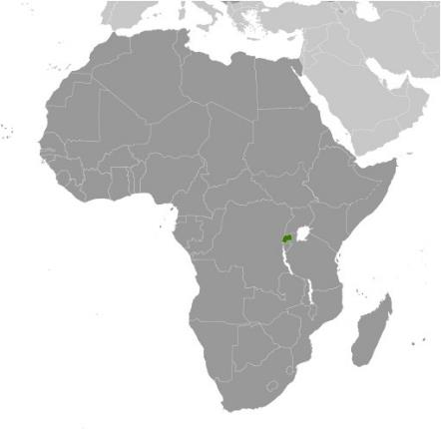
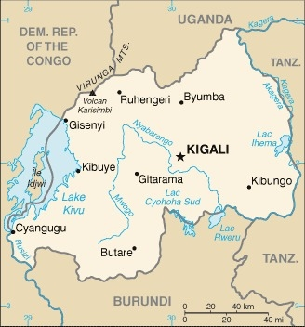
Life Challenges of Rwandan Women & Girls
Systemic discrimination and marginalization
Limited economic power and access to healthcare & education
Gender-based violence
Political underrepresentation
Notes:
Rwandan society has traditionally been patriarchal, with deep-seated cultural norms and stereotypes that shape gender roles and expectations. As a result, women face systemic discrimination and marginalization in nearly all spheres of life, including education, gender-based violence, economic empowerment, politics, and health. Around Volcanoes National Park (VNP) where the Dian Fossey Gorilla Fund works, communities are extremely poor and vulnerable to economic, social, and environmental shocks. Most are subsistence farmers growing Irish potatoes. Many have little or no formal education. The communities also include historically marginalized people who used to live in and rely on the forest and its products. The most vulnerable members of these households are women and girls.

Slide 5
Our April Featured Grantee: Dian Fossey Gorilla Fund
Founded by legendary female environmental scientist
Dedicated to region’s biodiversity: gorillas are iconic flagship species
55+ years of successful conservation work saving gorillas
Holistic model includes training conservationists
Notes:
The Dian Fossey Gorilla Fund is dedicated to the conservation, protection, and study of endangered mountain gorillas and critically endangered Grauer’s gorillas and their habitats in Africa. Founded by legendary conservation scientist Dian Fossey, it is the longest-running and largest organization dedicated to safeguarding the region’s biodiversity, with gorillas serving as an iconic flagship species because of where and how they live.
Gorillas live in the second largest tropical rainforest left on earth, an area that serves as he “lungs of the planet,” cleaning the air of the carbon dioxide that leads to climate change In addition, gorillas act as an “umbrella species” for their habitat. When they are protected, other species – many of which are endangered – are protected as well.
More than 55 years of successful conservation work in saving gorillas is based on a holistic model with four key pillars:
• Gorilla Protection
• Scientific Research
• Training Conservationists
• Helping Communities
The Dian Fossey Gorilla Fund is dedicated to the conservation, protection, and study of endangered mountain gorillas and critically endangered Grauer’s gorillas and their habitats in Africa. Founded by legendary conservation scientist Dian Fossey, it is the longest-running and largest organization dedicated to safeguarding the region’s biodiversity, with gorillas serving as an iconic flagship species because of where and how they live. Gorillas live in the second largest tropical rainforest left on earth, an area that serves as the “lungs of the planet,” cleaning the air of the carbon dioxide that leads to climate change In addition, gorillas act as an “umbrella species” for their habitat. When they are protected, other species – many of which are endangered – are protected as well.
More than 55 years of successful conservation work in saving gorillas is based on a holistic model with four key pillars:
• Gorilla Protection
• Scientific Research
• Training Conservationists
• Helping Communities

Slide 6
Why We Love This Project
Addresses education inequalities in Rwanda
Gives girls opportunities outside the classroom
Promotes careers in conservation
Sustainable: creates perpetual group of women to mentor others
Notes:
We love this direct approach to combating girls’ lack of access to education with a sustainable approach that creates a perpetual group of women who, after attaining their educational goals, can then mentor others.

Slide 7
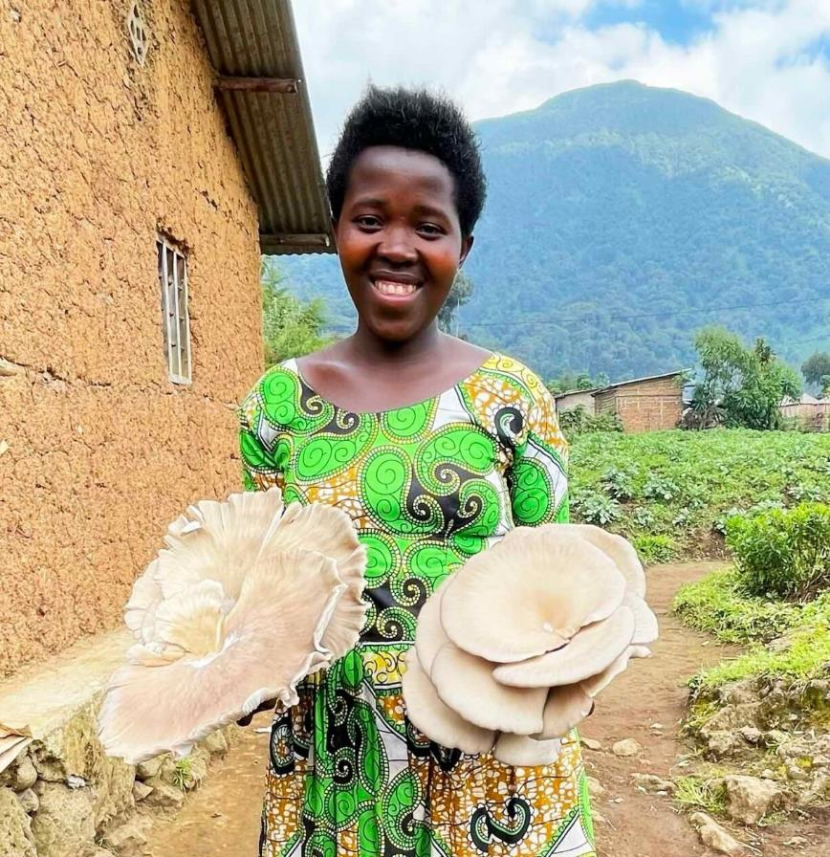
How Our Grant Will Be Used
$50,000 Project Grant to fund:
Training teachers in Girls in Conservation curriculum
Lesson delivery
Mentorship training & Shadow Day
Poster presentation workshop
Scholarships
Notes:
Together Women Rise is providing a $50,000 Featured Grant to the Dian Fossey Gorilla Fund. With this grant, we will fund a new Girls in Conservation project that tackles education inequalities in Rwanda, gives girls opportunities outside the classroom, and promotes careers in conservation.
As part of the new Girls in Conservation project, the Fossey Fund partners with local secondary schools to provide female students with life skills and practical conservation lessons, a female mentor, and a scholarship to continue their advanced level education in government funded boarding schools. The goal of this program is to increase school attendance, education attainment, and paid opportunities after secondary school.
The program has five phases:
Training of Trainers
Lesson Delivery to students
Mentorship Training and Shadow Day
Poster Presentation Workshop
Scholarship Awards
As part of the new Girls in Conservation project, the Fossey Fund partners with local secondary schools to provide female students with life skills and practical conservation lessons, a female mentor, and a scholarship to continue their advanced level education in government funded boarding schools. The goal of this program is to increase school attendance, education attainment, and paid opportunities after secondary school.
The program also benefits the female mentors by providing them with leadership and improved communications skills and helping to build their confidence and stature in the community. It will also build capacity of local teachers and invest in their passion to build gender equity in their classrooms. The project has five phases:
Training teachers in Girls in Conservation curriculum
Lesson delivery
Mentorship training & Shadow Day
Poster presentation workshop
Scholarships

Slide 8
Notes:
Mentorship training

Slide 9
Budget
Item | Description | Cost
Scholarships, Supplies, and Equipment | Computers, software and antivirus software for students Refreshments/ lunch for participants at workshops Accommodations at the Fossey Fund Student Housing for Conservation Workshop Course materials, school supplies Permits to enter the VNP to see golden monkeys (many of the students have never seen the animals in their natural habitat) Stipend for educators and mentors Travel for students to Ellen Campus Scholarships awarded to girls for private schools Cell plans for staff and educators to stay connected | $35,000
Project Personnel Costs | Community Manager (30% of her time devoted to project) Interns (2 Rwandan interns to assist on a temporary basis) Program Manager (50% of her time devoted to project) | $15,000
TOTAL |  | $50,000
Notes:
Together Women Rise is funding $50,000 of the $154,937 total cost of this two-year project, with the remaining $104,937 funded through donations and additional grants secured by the Fossey Fund.

Slide 10
Anticipated Impact
Direct impact = 290+ people
20 teachers, principals and professional educators
20 female mentors
250 students – including 50 girls in the mentorship program and 15 to 20 scholarship recipients.
Notes:
Together Women Rise’s grant will directly impact teachers and students in five schools per cohort (10 teachers, five principals, five professional educators), 250 students, more than 20 female mentors, 50 girls in the mentorship program, and 15 – 25 scholarship recipients. The resulting conservation and economic impact aims to reverberate for generations.

Slide 11
Notes:
Girls in Conservation – first workshop, Aug. 2023

