Slide 1
July 2024 Featured Grant
Investing in Girls’ Education

Slide 2
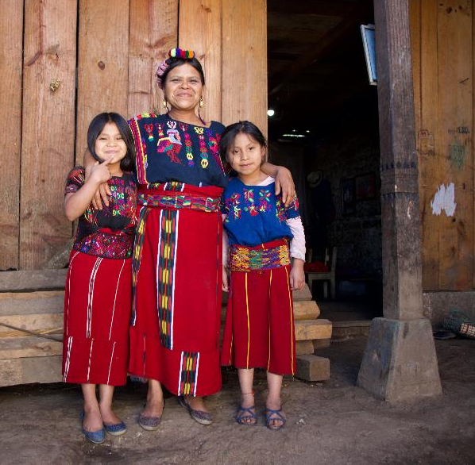
About Featured Grants
Featured Grants fund:
direct services
new projects
expansion of existing projects
general operations
capacity building
Notes:
Together Women Rise funds Featured Grants and Transformation Partnerships. Featured Grants fund projects, general operations, or capacity building. Project grants are awarded to fund a new or existing project. This month, our Featured Grant funds a General Operations grant to Limitless Horizons Ixil.

Slide 3
The Global Issue
The value of investing in girls’ education: A smart investment with far-reaching benefits
Increased Income and Economic Growth
Reduced Child Marriage, Early Pregnancy and Fertility
Improved Health Outcomes
Enhanced Female Empowerment and Civic Engagement
Notes:
Investing in girls’ education is a smart investment with far-reaching benefits for all. Benefits include:
Increased Income and Economic Growth – Because of the large gender gap in education, increasing education for girls has a stronger impact on a country’s educational attainment than simply increasing education for all.
Reduced Child Marriage, Early Pregnancy and Fertility – Educating girls tends to delay the age at which girls marry and have children, helping break the cycle of poverty. It also tends to reduce total fertility and population growth, which can be an economic impediment in the Global South.
Improved Health Outcomes – Educating girls tends to improve the health outcomes of girls and their families, especially if they are informed about nutrition, healthcare, and family planning. Because it delays the age at which girls have children, it also leads to healthier pregnancies and lower rates of infant and maternal mortality.
Enhanced Female Empowerment and Civic Engagement – By educating girls, they gain the knowledge, skills, and confidence to make informed decisions about their lives, health, and future. They are better equipped to challenge gender norms and advocate for their rights. They are more likely to participate in civic and political life, leading to more inclusive and representative governance.
Investing in girls’ education is a moral imperative and a smart investment with far-reaching benefits for all. Benefits include:
Increased Income and Economic Growth – Because of the large gender gap in education, increasing education for girls has a stronger impact on a country’s educational attainment than simply increasing education for all.
Reduced Child Marriage, Early Pregnancy and Fertility – Educating girls tends to delay the age at which girls marry and have children, helping break the cycle of poverty. It also tends to reduce total fertility and population growth, which can be an economic impediment in the Global South.
Improved Health Outcomes – Educating girls tends to improve the health outcomes of girls and their families, especially if they are informed about nutrition, healthcare, and family planning. Because it delays the age at which girls have children, it also leads to healthier pregnancies and lower rates of infant and maternal mortality.
Enhanced Female Empowerment and Civic Engagement – By educating girls, they gain the knowledge, skills, and confidence to make informed decisions about their lives, health, and future. They are better equipped to challenge gender norms and advocate for their rights. They are more likely to participate in civic and political life, leading to more inclusive and representative governance.

Slide 4
July Featured Grantee: Limitless Horizons Ixil
2017 Featured Grantee
Creates opportunities for the Indigenous youth, women, and families of Chajul, Guatemala
Girls develop academic and professional skills
Previous grant exceeded goals and expected outcomes
Notes:
LHI has deep connections to Together Women Rise. In 2017, LHI received a $50,000 project grant from Together Women Rise to enable a team of local female staff to educate and empower 110 Indigenous girls and women living in extreme poverty through LHI’s Youth Development Program. (The YDP is now a part of the Colegio Horizontes (Horizons School). The project provided access to education and academic support, career training, life skills workshops, mentorship, and income-generating opportunities, including a community-led artisan program. By the end of the grant period, LHI had met or exceeded all of its goals and proposed outcomes, directly benefitting 125 women and girls and indirectly benefitting 180 female family members. Katie Morrow, LHI’s Founder and Executive Director, is a member of Together Women Rise and her mother is a chapter leader. Katie spoke at Together Women Rise’s 20th anniversary celebration and LHI has welcomed Together Women Rise members to its campus, most recently in April 2024.
LHI has deep connections to Together Women Rise. In 2017, LHI received a $50,000 project grant from Together Women Rise to enable a team of local female staff to educate and empower 110 Indigenous girls and women living in extreme poverty through LHI’s Youth Development Program. (The YDP is now a part of the Colegio Horizontes (Horizons School). The project provided access to education and academic support, career training, life skills workshops, mentorship, and income-generating opportunities, including a community-led artisan program. By the end of the grant period, LHI had met or exceeded all of its goals and proposed outcomes, directly benefitting 125 women and girls and indirectly benefitting 180 female family members. Katie Morrow, LHI’s Founder and Executive Director, is a member of Together Women Rise and her mother is a chapter leader. Katie spoke at Together Women Rise’s 20th anniversary celebration and LHI has welcomed Together Women Rise members to its campus, most recently in April 2024.

Slide 5
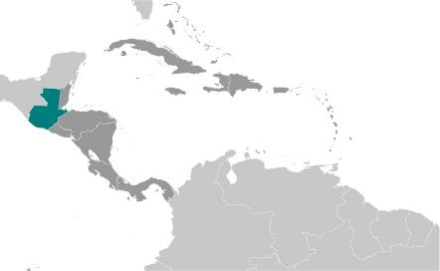
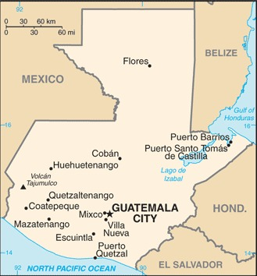
Life Challenges of Women: Guatemala
Patriarchy: Women face systemic discrimination & marginalization
Continued impact of genocidal violence from civil war
High rates of child marriage, early pregnancy
Notes:
Guatemalan society has a patriarchal or “machista” structure, with deep-seated cultural norms and stereotypes that shape gender roles and expectations. As a result, women face systemic discrimination and marginalization in nearly all spheres of life, including education, marriage and childbearing, gender-based violence, economic empowerment, and political representation.
The devastating violence of the Guatemalan Civil War against the indigenous Ixil population resulted in 70 – 90 percent of Ixil villages being razed. Post-traumatic stress disorder and alcoholism have contributed to elevated rates of violence against women. Residents continue to struggle to make a living. Two out of three people are faced with food insecurity and 93 percent live in poverty. During the war, few had access to education – adults have completed just 3.3 years of formal education on average.

Slide 6
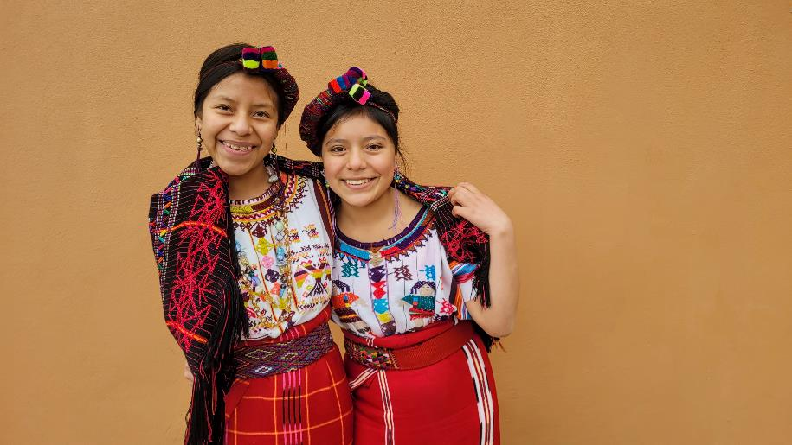
How Our Grant Will Be Used
$50,000 General Operations Grant
Supports Colegio Horizontes (Horizons School):
Indigenous girl-centered school
Holistic educational program
Notes:
Together Women Rise’s $50,000 Featured Grant to LHI supports general operations, with a focus on Colegio Horizontes (Horizons School), the organization’s Indigenous girl-centered school – a holistic educational program, including engaging academics, mentoring, nutritious meals, and family services that allows Maya Ixil girls to thrive. Graduates become champions for gender equality and women’s rights, leading their community to a brighter future and their families to better income, health, wellbeing. The school is building a pipeline of educated professionals in the community now and in the future in the hopes of bringing much-needed talent and economic stimulation to Chajul and while preserving the Maya heritage, language, and culture.
Together Women Rise’s $50,000 Featured Grant to LHI supports general operations, with a focus on Colegio Horizontes (Horizons School), the organization’s Indigenous girl-centered school – a holistic educational program, including engaging academics, mentoring, nutritious meals, and family services that allows Maya Ixil girls to thrive. Graduates become champions for gender equality and women’s rights, leading their community to a brighter future and their families to better income, health, wellbeing. The school is building a pipeline of educated professionals in the community now and in the future in the hopes of bringing much-needed talent and economic stimulation to Chajul and while preserving the Maya heritage, language, and culture.

