Slide 1
October 2024 Featured Grants
Unstoppable: Building Girls' Agency & Power

Slide 2
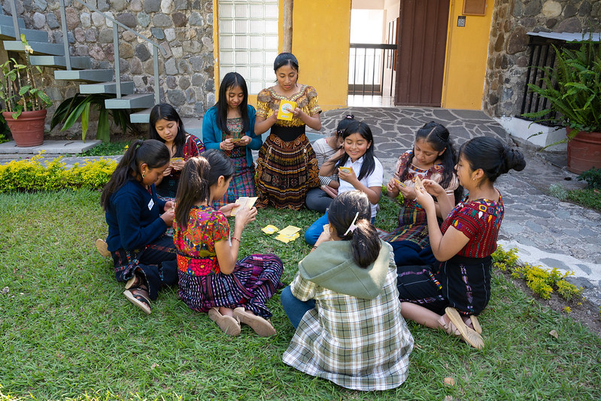
About Featured Grants
Featured Grants fund:
direct services
new projects
expansion of existing projects
general operations
capacity building
Notes:
Together Women Rise funds Featured Grants and Transformation Partnerships. Featured Grants fund projects, general operations, or capacity building. Project grants are awarded to fund a new or existing project. This month, our Featured Grant funds a general operations grant of $50,000 for She’s the First.

Slide 3
The Global Issue
Unstoppable: Building Girls' Agency & Power
Girls face barriers to basic human rights:
Gender-based violence (GBV)
Female genital mutilation/cutting (FGM/C)
Child marriage
Lack access to formal schooling
Economic insecurity
Notes:
In West and Central Africa specifically, adolescent girls face multiple challenges that overlap and put their rights and well-being, including health and education, at risk. But this scene is repeated in many countries, even in those that have legal protections against gender-based violence (GBV), female genital mutilation/cutting (FGM/C), and child marriage. If girls do not know their rights and if they are not empowered to assert them, the law often makes little difference.
The facts are brutal: 12 million girls were married in 2022, and as a result of the pandemic’s continuing effects, as many as 10 million more worldwide are at risk of child marriage in the next 10 years. And though the tide is turning, millions of girls remain at risk for female genital mutilation/cutting. Worldwide, 80% of girls complete primary school but only 40% complete upper secondary school. Global progress has been significant, but it remains uneven and faced many setbacks during the pandemic.

Slide 4
October Featured Grantee: She’s the First
Girl-centered design – “nothing about us without us”
Invests in mentorship programs & trains mentors
Teams with grassroots leaders, evidence-based toolkits
Founding partner Michelle Obama’s Girls Opportunity Alliance
Co-organizer of The Global Girls’ Bill of Rights
Notes:
She’s the First teams up with grassroots leaders to make sure girls everywhere are educated, respected, and heard. It uses girl-centered design – “nothing about us without us” – to build girls’ power.
Despite the geographic diversity of the 10 countries served by She’s the First partners (Guatemala, Peru, The Gambia, Sierra Leone, Kenya, South Sudan, Tanzania, Uganda, India, and Nepal), women and girls face many of the same challenges: high poverty rates, cultural norms that prioritize boys' education, early marriage, high rates of teen pregnancy, gender-based violence, and prevalence of traditional gender roles.

Slide 5
Impact & Success: She’s the First
Directly impacts nearly 160,000 girls each year
Transformational outcomes for 563,741 girls with 685 community organizations in 42 countries
Girls become the first – never the last - in their families to reach milestones
Notes:
Equipping women-led organizations in sub-Saharan Africa, Latin America, and Southeast Asia with the resources to ensure girls worldwide can freely and safely exercise their rights, She’s the First directly impacts nearly 160,000 girls each year. She’s the First’s toolkits were downloaded nearly 90,000 times in 2023.
Over the past 14 years, She’s the First has created transformational outcomes for 563,741 girls by working alongside 685 community organizations in 42 countries. Girls become the first in their families to reach amazing milestones, knowing they are never the last.
.

Slide 6
How Our Grant Will Be Used
$50,000 General Operations Grant
Funding focus: partner coalition of 15 organizations in 10 countries
Serves girls in East and West Africa, Latin America, & South-Eastern Asia
Notes:
Together Women Rise’s $50,000 Featured Grant to She’s the First will support the organization’s general operations, with a focus on its Partner Coalition, which is made up of 15 community-based organizations* (including MAIA, a past Together Women Rise grantee) in 10 countries.
The value of the Partner Coalition is that grassroots leaders get to learn and grow alongside each other, while each organization also receives a grant and hands-on support from She's the First. At these organizations, She’s the First attends in-person site visits, provides regular 1:1 office hours on feminist program development, sustainability, and evaluation, and hosts group online training sessions as well as in-person training. The coalition members share knowledge and work together on deciding goals and outcomes.

Slide 7
Notes:
Coming in October - Together Women Rise will recognize International Day of the Girl Child. Learn more here.

