Slide 1
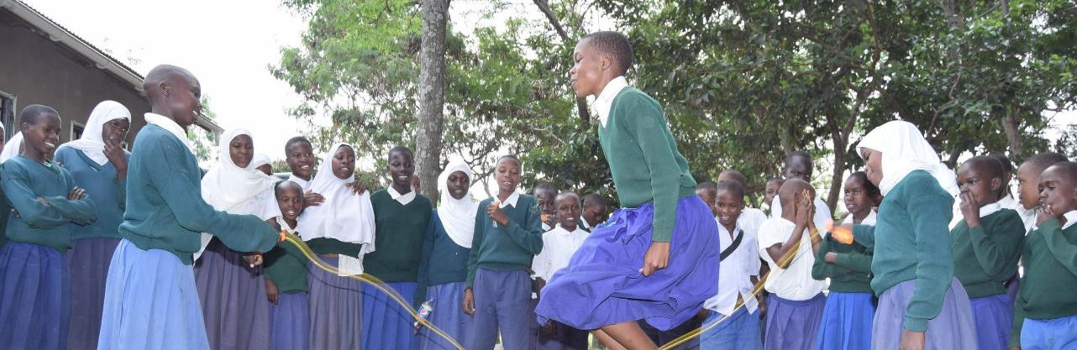
November 2024 Featured Grants
Changing the Culture & the Future: Preventing Violence Against Girls

Slide 2
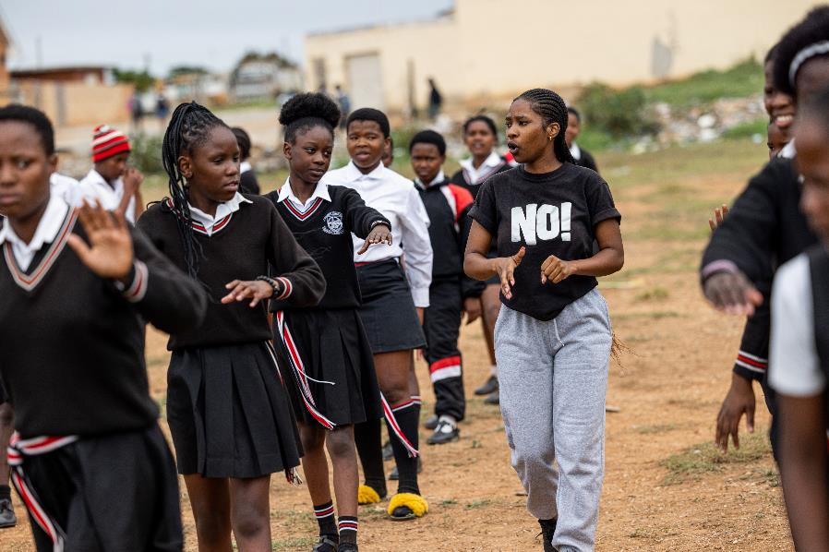
About Featured Grants
Featured Grants fund:
direct services
new projects
expansion of existing projects
general operations
capacity building
Notes:
Together Women Rise funds Featured Grants and Transformation Partnerships. Featured Grants fund projects, general operations, or capacity building. Project grants are awarded to fund a new or existing project. This month, Together Women Rise is funding two grants of $50,000 each: No Means No South Africa (general operations) and Project Zawadi (project/program).

Slide 3
The Global Issue
Changing the Culture & the Future: Preventing Violence Against Girls
30% of women experienced intimate partner violence (IPV) or non-partner sexual violence
89,000 women & girls killed intentionally in 2022 – highest in 20 years
16% of young women 15 to 24 subjected to IPV in the last year
Notes:
Violence against women and girls across the globe happens at a staggering rate. Intimate Partner Violence (IPV) includes psychological, sexual, and physical violence committed by a current or former intimate partner/husband. The statistics are alarming.
30% of women have experienced intimate partner violence (IPV) or non-partner sexual violence. That is 736 million women around the world.
The number of women and girls killed intentionally in 2022 – nearly 89,000 – is the highest yearly number recorded in the past 20 years.
More than 1 in 4 women (26%) ages 15 years or older have suffered violence at the hands of their partners at least once since the age of 15.
16% of adolescent girls and young women ages 15 to 24 have been subjected to IPV within the last year.
IPV among teenage girls is most prevalent in Sub-Saharan Africa and South Asia: one in five teenagers there has experienced IPV in the last 12 months. Africa, with an estimated 20,000 victims, recorded the largest number of female intimate partner/family related killings in 2022.

Slide 4
November Featured Grantee: No Means No South Africa
Mission to end sexual & gender-based violence against women & children
Country-based hub for South Africa programming & research
Sexual violence prevention, survivor support
Notes:
No Means No is an international nonprofit on a mission to end sexual and gender-based violence against women and children globally. No Means No South Africa is the country-based hub for programming and research in South Africa.
No Means No South Africa (NMNSA) was founded in 2020 and became a registered entity in South Africa in July 2021. NMNSA delivers the evidence-based No Means No sexual violence prevention program to young people in Nelson Mandela Bay in the Eastern Cape of South Africa. The program teaches adolescents of all genders mental, verbal, and physical skills and strategies to avoid and escape from sexual assault and other forms of sexual violence, as well as skills to safely intervene when anticipating or witnessing violence. NMNSA provides help for young people who are survivors of sexual abuse to disclose safely and access aftercare support.
In addition to providing important sexual violence prevention programming and survivor support to young people in a region with exceptionally high rates of sexual violence, the NMNSA team is focused on innovation and management of longitudinal research that examines the long-term impact and cost-effectiveness of No Means No to inform ongoing improvements to the program.
No Means No is an international nonprofit on a mission to end sexual and gender-based violence against women and children globally. No Means No South Africa is the country-based hub for programming and research in South Africa.
No Means No South Africa (NMNSA) was founded in 2020 and became a registered entity in South Africa in July 2021. NMNSA delivers the evidence-based No Means No sexual violence prevention program to young people in Nelson Mandela Bay in the Eastern Cape of South Africa. The program teaches adolescents of all genders mental, verbal, and physical skills and strategies to avoid and escape from sexual assault and other forms of sexual violence, as well as skills to safely intervene when anticipating or witnessing violence. NMNSA provides help for young people who are survivors of sexual abuse to disclose safely and access aftercare support.
In addition to providing important sexual violence prevention programming and survivor support to young people in a region with exceptionally high rates of sexual violence, the NMNSA team is focused on innovation and management of longitudinal research that examines the long-term impact and cost-effectiveness of No Means No to inform ongoing improvements to the program.

Slide 5
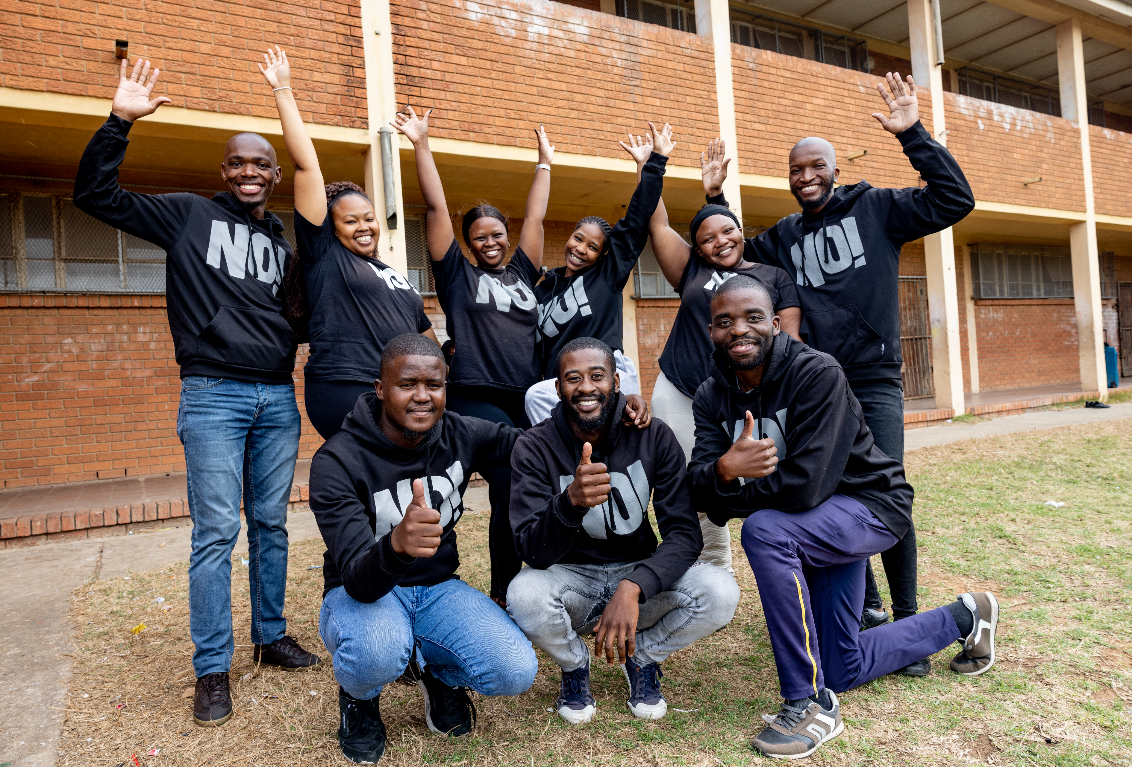
How Our Grant Will Be Used
$50,000 General Operations Grant
Supports No Means No - teaches young people to identify all forms of assault and realize these behaviors are not OK
Develops module to equip youth to defend themselves against cyber-based sexual violence
Notes:
Together Women Rise’s $50,000 Featured Grant to No Means No South Africa funds the organization’s general operations, which includes the No Means No program.
Gender-based violence reporting in South Africa is generally very poor. First, the justice system is not always supportive of the victim/survivor and puts the burden to prove the crime squarely on the victim. Second, the mechanisms to report and get the necessary support and intervention are not always readily available for victims. But the No Means No program teaches young people how to identify all forms of assault and to realize that none of these behaviors are normal or acceptable. The program clearly defines sexual violence and equips young people with the language and skill to articulate and communicate if and/or when they have been violated.
Includes Network Referral System to connect survivors to support and appropriate local services such as medical, legal, or shelter services
New focus on developing module to equip youth to defend themselves against cyber-based sexual violence (also known as technology-facilitated sexual and gender-based violence).
Together Women Rise’s $50,000 Featured Grant to No Means No South Africa funds the organization’s general operations, which includes the No Means No program.
Gender-based violence reporting in South Africa is generally very poor. First, the justice system is not always supportive of the victim/survivor and puts the burden to prove the crime squarely on the victim. Second, the mechanisms to report and get the necessary support and intervention are not always readily available for victims. But the No Means No program teaches young people how to identify all forms of assault and to realize that none of these behaviors are normal or acceptable. The program clearly defines sexual violence and equips young people with the language and skill to articulate and communicate if and/or when they have been violated.
Includes Network Referral System to connect survivors to support and appropriate local services such as medical, legal, or shelter services
New focus on developing module to equip youth to defend themselves against cyber-based sexual violence (also known as technology-facilitated sexual and gender-based violence).

Slide 6
November Featured Grantee: Project Zawadi
Mission to ensure Tanzanian children & youth can access quality education
Core programs: student sponsorship, professional development for teachers, model schools
Concentrated effort focusing on school safety – girls free from physical & emotional harm
Notes:
The mission of Project Zawadi is to ensure Tanzanian children and youth have access to a quality education.
Project Zawadi has been serving vulnerable students in the Nyamuswa area in Mara Region, Tanzania for over 20 years. Its core programs include:
• Student Sponsorship: a program that ensures equitable access to education by providing school fees, uniforms, supplies, and mental health and academic counseling to vulnerable students
• Tenda Teachers: a comprehensive teacher professional development program that encourages evidence-based teaching and learning strategies, and
• Model Schools: a program that focuses on creating a positive and productive school environment by improving school infrastructure, delivering enrichment activities, reducing student hunger, enforcing safety, and providing school and community leadership development.
The mission of Project Zawadi is to ensure Tanzanian children and youth have access to a quality education.
Project Zawadi has been serving vulnerable students in the Nyamuswa area in Mara Region, Tanzania for over 20 years. Its core programs include:
• Student Sponsorship: a program that ensures equitable access to education by providing school fees, uniforms, supplies, and mental health and academic counseling to vulnerable students
• Tenda Teachers: a comprehensive teacher professional development program that encourages evidence-based teaching and learning strategies, and
• Model Schools: a program that focuses on creating a positive and productive school environment by improving school infrastructure, delivering enrichment activities, reducing student hunger, enforcing safety, and providing school and community leadership development.

Slide 7
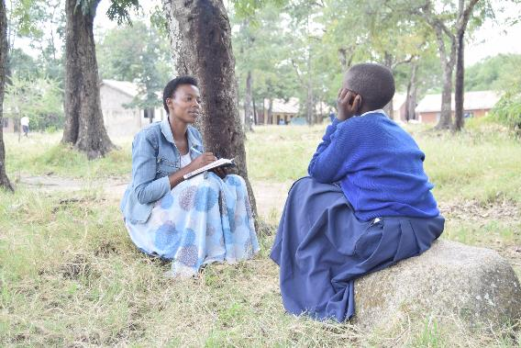
How Our Grant Will Be Used
$50,000 Project Grant
Funds Girls’ Safety in School and Communities Project
Girls’ Empowerment Clubs
Student councils
Entrepreneurial training for girls
Psychological, academic, & career counseling
Notes:
Together Women Rise’s $50,000 Featured Grant funds the Girls’ Safety in School and Communities (GSSC) program.
This project aims to build Project Zawadi’s school safety effort by piloting an initiative that includes a specific emphasis on girls’ empowerment and a reduction in gender-based violence (GBV) not only in schools, but also in families and in communities. As such, GSSC will work with girls and key stakeholders including students, teachers, families, community members, school administration, village leaders, law enforcement officers, and local government officials to change knowledge of, attitudes toward, and responses to GBV.
GSSC’s primary participants are the 2,132 school-age girls at 16 schools in the Nyamuswa area in Mara Region. GSSC includes existing, expanded, and new initiatives. Empowerment clubs exist at four schools and will expand to 16 schools. Project Zawadi delivers teacher professional development focusing on teaching methods, but this will expand to training on GBV. One-on-one counseling sessions are currently provided to sponsored students, but counseling will be expanded to include all students as needed. Project Zawadi works with local governments, but has not provided formal trainings until now.

Slide 8
Budget
Item | Description | Cost
Salaries | Includes portion of costs for school safety coordinator, sponsorship program manager, country manager, counselor, Empowerment Club and counseling interns, apprenticeship coordinator, M & E officer, sponsorship office support and data clerk | $38,400
Travel Expenses | Staff transport to multiple sites daily at 16 schools across 11 villages - transportation budget includes fuel, vehicle maintenance, part of the driver salary, boda boda fees, and safety gear as necessary (for staff taking boda boda) | $7,000
Professional Development | Teacher professional development and fast-track training for new teachers | $2,300
Project Evaluation | Baseline study, ongoing monitoring, summative evaluation | $1,500
Communication | Phone expenses (for calls and texts with teachers, parents, and local officials regarding GBV cases as well as coaching and follow up) | $800
Total |  | $50,000

