Slide 1
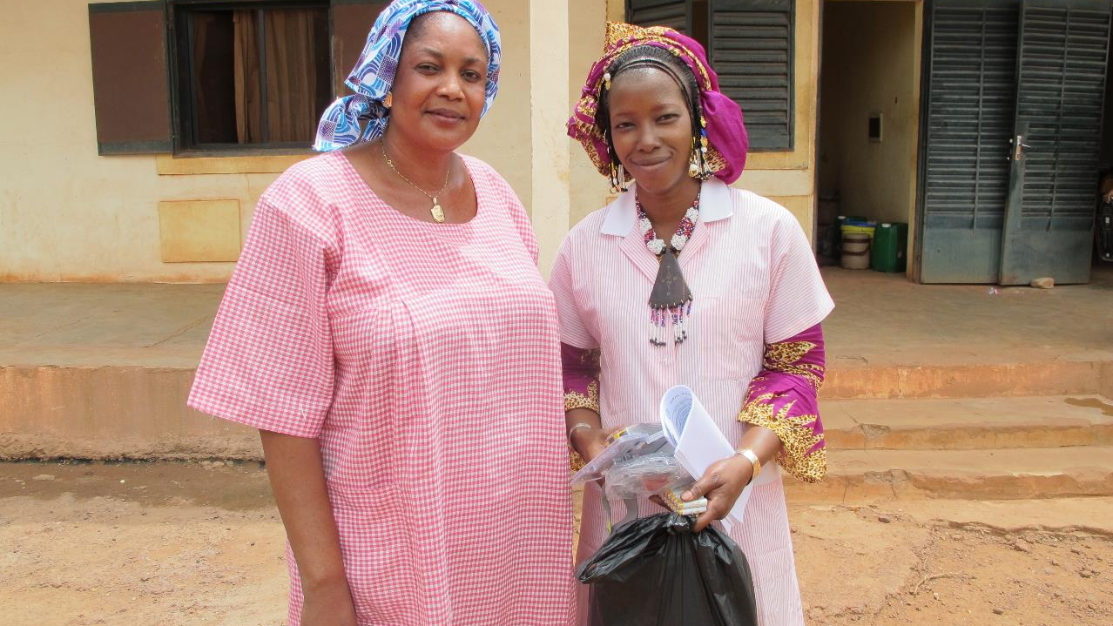
December 2024 Featured Grant
Using Storytelling Cloths to Champion the HPV Vaccine

Slide 2
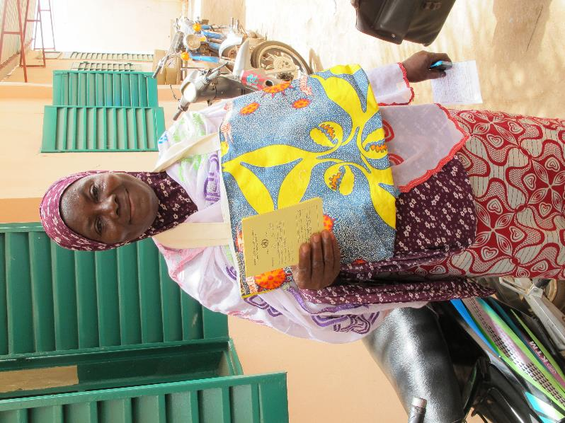
About Featured Grants
Featured Grants fund:
direct services
new projects
expansion of existing projects
general operations
capacity building
Notes:
Together Women Rise funds Featured Grants and Transformation Partnerships. Featured Grants fund projects, general operations, or capacity building. Project grants are awarded to fund a new or existing project. This month, Together Women Rise is funding a $48,522 Featured Grant to GAIA Vaccine Foundation. This will be a project grant. Together Women Rise previously funded GAIA Vaccine Foundation in 2020.

Slide 3
The Global Issue: Preventing Cervical Cancer
2nd most common cancer in women in West Africa
Nearly all caused by human papillomavirus (HPV)
90% of deaths from cervical cancer caused by HPV are in low & middle-income countries
HPV vaccines are safe & highly effective
Survival rate – when diagnosed early – is 91%
Notes:
Cervical cancer is the fourth most common cancer in women worldwide and the second most common cause of cancer in women in West Africa.
Nearly all cervical cancer is caused by persistent infection with the human papillomavirus (HPV).
Ninety percent of deaths from cervical cancer caused by HPV occur in low and middle-income countries, where knowledge about cervical cancer, HPV, and access to preventative measures is low or nonexistent.
Cervical cancer prevention in West Africa is often limited to visual inspection of the cervix and surgical intervention.
Prophylactic vaccination against HPV and screening and treatment of pre-cancer lesions are effective strategies to prevent cervical cancer and are very cost-effective. Vaccines against HPV are considered safe and highly effective.
Cervical cancer can be cured if diagnosed at an early stage and treated promptly. When cervical cancer is diagnosed at an early stage, the 5-year relative survival rate is 91%.
Cervical cancer rates in the U.S. declined 11% each year from 2012 to 2019 for women ages 20-24, likely reflecting the first signs of cancer prevention from the HPV vaccine.

Slide 4
December Featured Grantee: ​ GAIA Vaccine Foundation
GAIA’s mission = to reduce infectious diseases that disproportionately affect the underserved
Cervical cancer screenings & HPV vaccines
Preventing mother-to-child HIV transmission
HIV testing & community care
Nutrition & support program
Teen peer education
Notes:
GAIA partners with community clinics in Sikoro, Bamako, Mali to reduce the incidence of infectious diseases that disproportionately affect the underserved and to promote the development of globally relevant, globally accessible vaccines that can be distributed on a not-for-profit basis in low income countries. GAIA focuses on education, prevention, access to care, and vaccination. Their programs include:
Mother-to-Child HIV Transmission Prevention (MTCTP) – offers free HIV and maternity care to women to ensure that HIV is not transmitted from mothers to newborns.
Nutrition & Support Program – created by women who participated in the MTCTP program to ensure that all HIV+ women have peer support and proper nutrition.
Teen Peer Education – offers sex education to girls in the community and encourages them to stay in school. These programs take place weekly to ensure that women and girls in Sikoro have access not only to quality care, but also the necessary education and support to make these services sustainable.
HIV Testing & Community Care – offers anonymous, free HIV testing and is a model for community-level HIV care.
HPV and Cervical Cancer – provides cervical cancer screenings and vaccinates girls against HPV.
Together Women Rise funded a project of GAIA Vaccine Foundation in 2020 to develop a COVID-19 storytelling cloth and train female community educators to lead information sessions on how to prevent the spread of COVID-19 through mask wearing, social distancing, and hand washing.

Slide 5
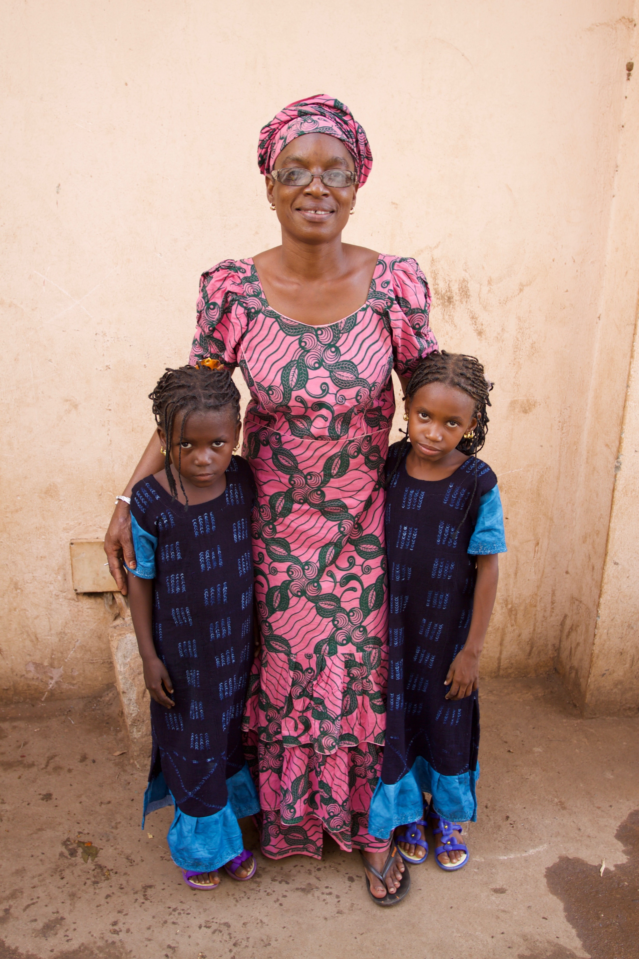
Life Challenges of Women in Mali
Cervical cancer is major killer
Women have limited education
Traditional family structure may include 1 man and multiple wives
Access to healthcare is extremely limited
Women have little power to pay for healthcare
Mali is ranked 179 out of 188 countries for gender equality
Notes:
Cervical cancer is a major killer of women in Mali. Most women in Mali are unaware of the link between HPV and cervical cancer. Screening for cervical cancer does not typically occur until women are symptomatic.
The traditional family structure may include one man and several wives, which increases the risk of HPV infection and transmission.
Women in Mali have extremely limited education, with 60% having no formal schooling and an additional 28% having only a primary school education. Many health campaigns come with posters and pamphlets, but those resources are not helpful to women who cannot read them.
Mali is a traditionally patriarchal and hierarchical society, so women typically lack decision-making power even in their own homes.
Mali is a difficult place to be a woman and a mother. One in eight children die before their fifth birthday and one in 26 women die in childbirth.
Mali is ranked 179 out of 188 countries for gender equality, according to the United Nations Development Program’s Gender Development Index, a measure which considers the Human Development Index from a women’s empowerment perspective.
Mali is ranked the 4th worst place in the world to be a mother or a child under 5, according to Save the Children’s annual State of the World’s Mothers Report that documents the condition of maternal health and wellbeing.
Access to healthcare is extremely limited, primarily due to the decentralized Malian health system that leaves each community clinic faced with the challenge of raising revenue through a fee-for-service system. This places the burden of payment on poor families. These communities lack the training, financial resources, and education to manage clinics effectively, so both people and clinics struggle.
Women have little power to pay for healthcare or anything else because of their traditional exclusion from financial management in their families. As a result, clinic utilization is low, leaving clinics under-resourced, under-staffed, and thus unable to provide high-quality health care.

Slide 6
How Our Grant Will Be Used
$48,522 Project Grant
Year-long educational community outreach campaign to assist in the introduction of the HPV vaccine in Mali
Storytelling cloth teaches “test, treat, vaccinate”
Partnering with community women’s associations to provide training
Also includes cervical cancer screenings
Notes:
Together Women Rise’s $50,000 Featured Grant to No Means No South Africa funds the organization’s general operations, which includes the No Means No program.
Gender-based violence reporting in South Africa is generally very poor. First, the justice system is not always supportive of the victim/survivor and puts the burden to prove the crime squarely on the victim. Second, the mechanisms to report and get the necessary support and intervention are not always readily available for victims. But the No Means No program teaches young people how to identify all forms of assault and to realize that none of these behaviors are normal or acceptable. The program clearly defines sexual violence and equips young people with the language and skill to articulate and communicate if and/or when they have been violated.
Includes Network Referral System to connect survivors to support and appropriate local services such as medical, legal, or shelter services
New focus on developing module to equip youth to defend themselves against cyber-based sexual violence (also known as technology-facilitated sexual and gender-based violence).
In preparation for the arrival of the HPV vaccine in Mali, GAIA’s educational outreach will encourage people to get their daughters vaccinated. The campaign will be centered around a “storytelling cloth” designed for HPV outreach. As only 22% of Malian women are literate, communicating information through forms other than writing is extremely important. GAIA’s newest HPV and cervical cancer storytelling cloth shows the importance of a three-pronged approach: “tester, traiter, vacciner” or “test, treat, vaccinate.”
The logo for the program depicts a woman and girl’s profile encircled with the Malian proverb, “It is better to prevent than to cure” and the French slogan, “Screened Mothers and Vaccinated Daughters.”
GAIA has proven that the storytelling cloth method is very effective, and that this education helps motivate women to seek care.
GAIA will partner with community women’s associations to provide their groups with training on HPV, cervical cancer, screening, and the vaccine. Local women’s associations know their communities best and how to spread information.
Part of the project includes offering cervical cancer screenings at local clinics.

Slide 7
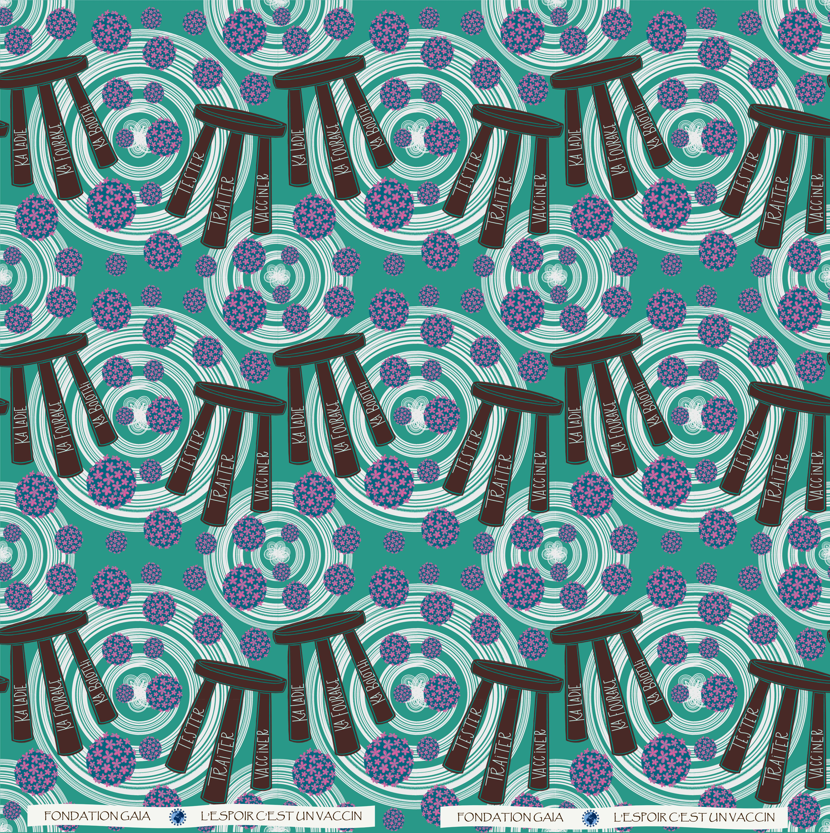
Notes:
Storytelling cloth for HPV vaccine and screening, by Adeline LeDoux

Slide 8
Budget
Item | Description | Cost
Stipends | Provided to community organizations that act as community health care workers to do educational outreach using the storytelling cloth as a teaching tool | $22,500
Storytelling Cloths | Sufficient amount for community organizations to conduct outreach | $8,333
Project Management |  | $4,555
Training | Training for women’s associations that are participating in the project | $4,167
Screening Supplies | Cervical cancer screening supplies | $4,000
Clinic fees | Services provided by partner clinics | $2,500
Interviews | Interviews of women’s associations after 3 months and at the end of the project to gather their opinions on program success and any recommended adjustments | $1,667
Transport |  | $800
Total |  | $48,522
Notes:
We love this project because of the innovative way it is using a teaching cloth to provide vaccine education. This program also focuses on the fact that cervical cancer is a major killer of women in Mali, and this is a logical step in reducing the number of cases. As a previous grantee, GAIA has a proven record of creative, innovative, and successful work.

Slide 9
Notes:
Training

