Slide 1
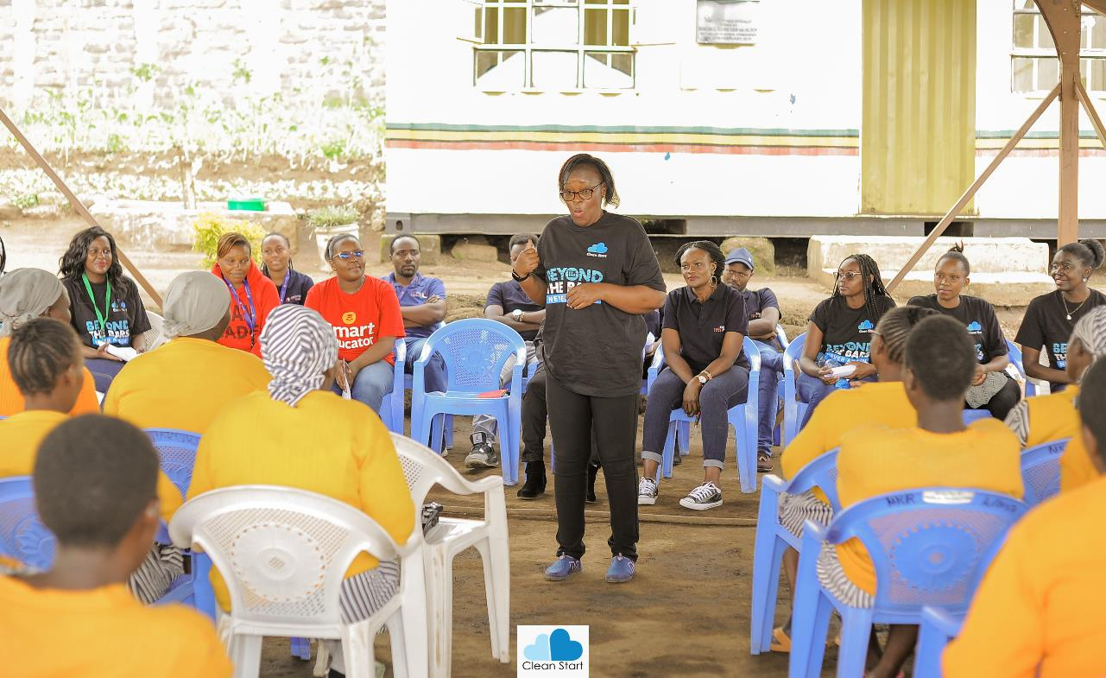
January 2025 Featured Grant
Restoring Dignity & Hope After Incarceration

Slide 2
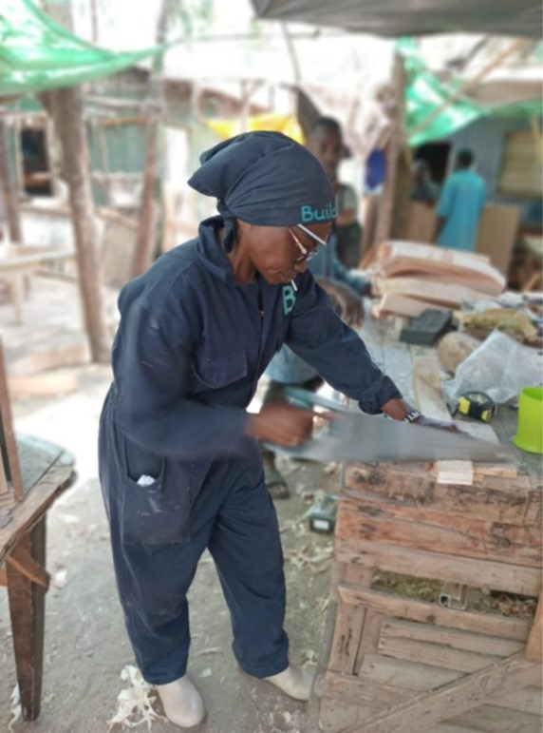
About Featured Grants
Featured Grants fund:
direct services
new projects
expansion of existing projects
capacity building
Notes:
The Together Women Rise Grants Program has two key components that support our overall mission to achieve global gender equality. Featured Grants are largely focused on delivering direct services by funding grassroots organizations that empower and support women and girls in low-income and marginalized communities in the Global South. Our Transformation Partnerships are designed to invest in areas where we can make the biggest impact on achieving global gender equality by addressing the root causes of gender inequality.
Through our Featured Grants Program, we highlight a different organization/project each month, providing a variety of learning materials on the issue and how the grant will be used. Through the Featured Grants program, we support capacity building, new programs, or expansion of existing programs. The following is information on the grant we are featuring for January 2025.

Slide 3
The Global Issue: Poverty, Incarceration, and Reintegration of Women
740,000+ women & girls in prison globally – 60% increase since 2000
Often poor, may have mental illness and/or history of sexual and physical abuse
Poverty & incarceration linked
Poverty after release = stigma, recidivism
Notes:
More than 740,000 women and girls are in prison globally – up 17 percent since 2010 – and the number is growing. Since 2000, the number of women and girls imprisoned has grown by approximately 60 percent, while the male prison population has increased by around 22 percent. Most female prisoners are profoundly vulnerable. They are typically poor, may have mental illness, and/or have endured sexual and physical abuse. Sadly, incarceration does not just affect the women themselves. Their children and communities also suffer.
Poverty and incarceration are inextricably linked. Impoverished women may commit offenses such as low-level drug activities as a means of survival for their families. These women can neither pay fines for petty crimes nor afford to pay bail. In addition, some countries imprison women for “status offenses” such as adultery, prostitution, or other behavior considered unseemly. According to the World Health Organization, up to 80 percent of women in prison have an identifiable mental illness and they are more likely than men to harm themselves or die by suicide. After incarceration, women experience high rates of economic hardship, parenting challenges, mental health issues, social stigma, community rejection, limited access to housing, and higher rates of recidivism.

Slide 4
January Featured Grantee: ​ Clean Start Africa
Works with women, girls, and children impacted by the criminal justice system
Founder & 3-month-old baby served 1 year for crime she didn’t commit
Positive impact on 4,000+ women
Notes:
Clean Start Africa works with women, girls, and children impacted by the criminal justice system to restore their dignity and hope for a successful reintegration.
In 2009, Teresa Njoroge and her three-month old baby began a one-year sentence in Nairobi, Kenya, for a crime she did not commit. This experience inspired Teresa to devote her life to helping imprisoned and formerly imprisoned women to reintegrate back into society. As a result, she founded Clean Start Africa. Today, 80 percent of the organization’s staff are women who were formerly imprisoned. Teresa is a TED Speaker and she and Clean Start Africa have received numerous awards.
To date, Clean Start Africa has had a positive impact on over 4,000 women entangled in the criminal justice system, fostering resilience and hope amid adversity. Programs are offered in Kenya, Uganda, and Malawi.

Slide 5
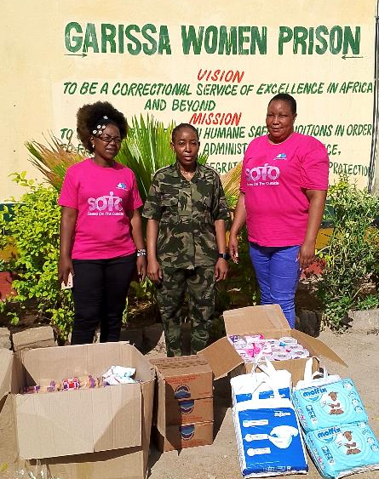
Life Challenges of Women in Kenya
In population served:
74% of women were imprisoned for petty survival-related offenses
90% mothers & single parents
Stigma & isolation = cycle of poverty
70% imprisoned under The Liquor Act (selling illicit brews), often for survival
39% of women in prison in Kenya don’t know whereabouts of children
Notes:
Clean Start Africa serves women, girls, and children in peri-urban (areas on the outskirts of cities or large urban areas) and rural areas where economic hardship and social marginalization are prevalent.
Within this community, 74% of these women have been imprisoned for petty, survival-related offenses, such as selling illicit home brews or shoplifting, underscoring their low-income status and vulnerability.
Notably, 90% of these women are mothers and single parents, bearing the sole responsibility of providing for their families alone.
Upon release, these women often turn to small-scale ventures such as hawking (street vending) and selling groceries to make ends meet. Many belong to minority groups, including refugees and internally displaced persons, which further compounds their challenges.
The stigma and isolation after release too often leaves women trapped in a cycle of poverty and marginalization which is then passed down to their children.
Snapshot of imprisoned Kenyan women:
81% had no legal representation
22% will be reincarcerated, often within three years
60% of their children are under 10 years old
39% do not know the whereabouts of their children
90% are single parents and breadwinners
69% are 20 to 39 years old
70% were imprisoned under one act alone: The Liquor Act, for selling illicit brews, which is often driven by their need to earn an income
74% of imprisoned and formerly imprisoned women live on about US $2.30 per day
Half a million formerly imprisoned women need support.

Slide 6
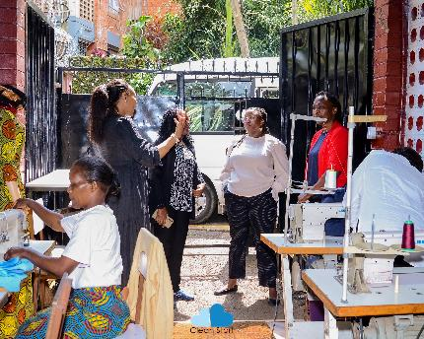
How Our Grant Will Be Used
$45,000 Project Grant
Beyond The Bars: Sustainable Livelihoods for Women Leaving Prison in Kenya
Provides sustainable economic opportunities & dignity to women transitioning out of prison
Addresses systemic socio-economic injustices & inequalities that contribute to incarceration & recidivism
Includes business options & vocational training
Notes:
Together Women Rise’s $50,000 Featured Grant to No Means No South Africa funds the organization’s general operations, which includes the No Means No program.
Gender-based violence reporting in South Africa is generally very poor. First, the justice system is not always supportive of the victim/survivor and puts the burden to prove the crime squarely on the victim. Second, the mechanisms to report and get the necessary support and intervention are not always readily available for victims. But the No Means No program teaches young people how to identify all forms of assault and to realize that none of these behaviors are normal or acceptable. The program clearly defines sexual violence and equips young people with the language and skill to articulate and communicate if and/or when they have been violated.
Includes Network Referral System to connect survivors to support and appropriate local services such as medical, legal, or shelter services
New focus on developing module to equip youth to defend themselves against cyber-based sexual violence (also known as technology-facilitated sexual and gender-based violence).
Together Women Rise’s $45,000 Featured Grant to Clean Start Africa funds Beyond The Bars: Sustainable Livelihoods for Women Leaving Prison, an economic empowerment program designed to provide sustainable economic opportunities and dignity to women transitioning out of prison in Kenya. The program addresses systemic socio-economic injustices and inequalities that contribute to the incarceration and recidivism of these vulnerable women.
This project aims to equip formerly imprisoned women with skills and foster economic independence. It includes business options and vocational training in six business tracks: interior design, African cuisines, beauty and hairdressing, green energy, blue economy (sustainable use of ocean resources for economic growth), and fashion design.

Slide 7
How Our Grant Will Be Used
Skill-building: 500 entrepreneurship starter kits & 150 vocational training sessions (beauty & hairdressing, culinary, textile/fashion, & briquette making)
Two-year project: employment/small business opportunities
Individual & group therapy support
Continuous mentorship & advocacy supports reintegration
Direct impact: 600 women & girls; Indirect impact: 2,400 women & girls
Notes:
Together Women Rise’s $50,000 Featured Grant to No Means No South Africa funds the organization’s general operations, which includes the No Means No program.
Gender-based violence reporting in South Africa is generally very poor. First, the justice system is not always supportive of the victim/survivor and puts the burden to prove the crime squarely on the victim. Second, the mechanisms to report and get the necessary support and intervention are not always readily available for victims. But the No Means No program teaches young people how to identify all forms of assault and to realize that none of these behaviors are normal or acceptable. The program clearly defines sexual violence and equips young people with the language and skill to articulate and communicate if and/or when they have been violated.
Includes Network Referral System to connect survivors to support and appropriate local services such as medical, legal, or shelter services
New focus on developing module to equip youth to defend themselves against cyber-based sexual violence (also known as technology-facilitated sexual and gender-based violence).
Skill-building: This project will provide 500 entrepreneurship starter kits and 150 vocational training sessions across the following business tracks: beauty and hairdressing, culinary, textile/fashion, and briquette making (providing clean renewable fuel).
Starter kits include equipment, supplies, and setup for their new business, such as hair dryers, salon chairs, washing stations, and products for hairdressing/beauty, or appliances, furniture, and initial food stock for culinary work.
Each participant will receive training materials, toolkits, and resource guides to support their skill development. After the training, women are linked to job opportunities and supported in starting and running their own businesses.
In the first year of this two-year project, Clean Start Africa will recruit and train 400 women. In year two, the program will expand training, provide mentorship, and link the women to job opportunities and entrepreneurship. The project aims to equip the women to secure sustainable livelihoods upon reintegration. The programs offer a lifeline, helping women navigate the stigma and isolation they face post-release.
Psychological support: To address participants’ mental health needs, Clean Start Africa will offer 50 group therapy sessions and 100 individual counseling sessions.
Advocacy: Women receive continuous mentorship and Clean Start Africa advocates for policies supporting reintegration. This amplifies stories of resilience, hope, and change among formerly imprisoned women, pushing for policy changes and prison reforms. In addition, Clean Start Africa’s work towards gender equality ensures that women have the tools to overcome stigma, isolation, pain, abandonment, and other social challenges to live with dignity.
This program will have a direct impact on 600 women and girls and an indirect impact on 2,400 women and girls.
d an indirect impact on 2,400 women and girls.

Slide 8
Budget
Item | Description | Cost
Equipment & Setup | Salon: hairdryers, salon chairs, washing stations, tools, products, etc. Textile: sewing machines, cutting tables, fabric, materials Culinary: appliances, furniture, initial stock of food Charcoal Briquettes Manufacturing: press machines, material storage & handling, materials | $19,500
Rent & Utilities | Generally covering six month, until additional months are covered by revenue | $9,000
Training & Capacity Building | Training, as needed by business type: professional hairdressing & beauty, tailoring & design, culinary courses, technical training | $8,500
Marketing & Branding | Signage, branding, packaging, tags, etc. | $4,500
Miscellaneous | Contingencies for unexpected costs, transportation for raw materials & finished products | $3,500
Total |  | $45,000
Notes:
We love that this project works directly with women in prison or recently released, helping them obtain gainful employment and increased self-esteem. Notably, the incarceration of many women imprisoned in Kenya is directly related to poverty.

