Slide 1
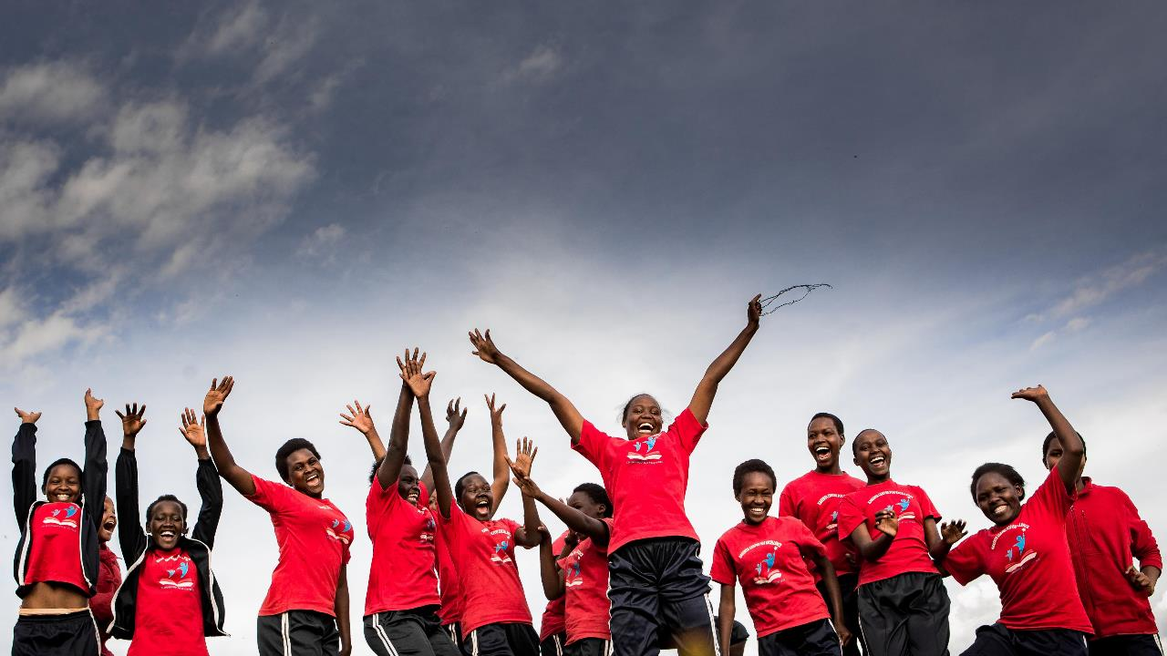
February 2025 Featured Grant
A Holistic Approach to Ending FGM/C
Notes:
February 2025: Kakenya’s Dream
A Holistic Approach to Ending FGM/C

Slide 2
About Featured Grants
Featured Grants fund:
direct services
new projects
expansion of existing projects
capacity building
Notes:
The Together Women Rise Grants Program has two key components that support our overall mission to achieve global gender equality. Featured Grants are largely focused on delivering direct services by funding grassroots organizations that empower and support women and girls in low-income and marginalized communities in the Global South. Our Transformation Partnerships are designed to invest in areas where we can make the biggest impact on achieving global gender equality by addressing the root causes of gender inequality.
Through our Featured Grants Program, we highlight a different organization/project each month, providing a variety of learning materials on the issue and how the grant will be used. Through the Featured Grants program, we support capacity building, new programs, or expansion of existing programs. The following is information on the grant we are featuring for February 2025.

Slide 3
The Global Issue: Education as an Antidote to FGM/C
230,000+ million women & girls worldwide have undergone female genital mutilation/cutting (FGM/C)
FGM/C has NO health benefits
Increased education = reduced FGM/C
Girls with primary education: 30% more likely to oppose, secondary education or higher = 70% oppose
Notes:
Over 230 million girls and women worldwide have undergone female genital mutilation/cutting (FGM/C) – defined by the World Health Organization as “all procedures that involve partial or total removal of the external female genitalia, or other injury to the female genital organs for non-medical reasons – with Africa accounting for the largest share of this total: 144 million. Asia follows with 80 million, with an additional 6 million in the Middle East. The practice is also found in pockets of Europe and in Australia and North America. The most frequently cited reasons for carrying out FGM/C are social acceptance, misconceptions about hygiene, a means of preserving a girl’s virginity, making the woman “marriageable,” and enhancing male sexual pleasure. The World Health Organization states unequivocally that FGM/C has no health benefits.
When a girl undergoes FGM/C, her childhood is essentially over. She typically drops out of school and is promptly married off at a young age to secure a bride price (a payment made by the groom to the family of the bride). Without education, she is then unable to secure livelihood, positioning herself and her family for a life of poverty, thereby perpetuating the cycle. FGM/C is condemned by international treaties and conventions, as well as by law in many countries – yet it continues.
The phrase “Information is Power” has no better place than in the fight against FGM/C. Opposition to FGM/C is highest among girls and women with more education. Girls and women with a primary education are 30% more likely than those with no education to oppose FGM/C. This rises to 70% among girls and women with a secondary education or higher. There are several factors that may affect this dynamic. One is that while in school, girls develop ties with peers and mentors who oppose FGM/C. Educational settings may also provide opportunities for discussion conducive to the formulation of new ideas. Educated girls and women have greater exposure to intervention programs, media messages, and local and international discourse that denounce the practice. It is clear that educating women and girls can decrease FGM/C. The challenge is to keep women and girls in school. Across the globe, 130 million girls ages 6-17 years are currently not in school.

Slide 4
February Featured Grantee: ​ Kakenya’s Dream
Founded by Dr. Kakenya Ntaiya – Maasai, first girl to leave village for college in U.S.
Dream: world where African women & girls are valued, respected as leaders, equals in every way
Two prior successful Together Women Rise grants
Notes:
Kakenya’s Dream started as a simple dream in 2008: a world where African women and girls are valued and respected as leaders and equals in every way. Its mission is to invest in girls from rural communities through education, health, and leadership initiatives to create agents of change, and its main purpose is to combat extreme gender inequality perpetuated by patriarchal societal norms and harmful traditional practices like FGM/C and child marriage that deprive girls of opportunity. Wraparound programs nurture and support the whole girl, from childhood to adulthood.
Kakenya’s Dream was founded by Dr. Kakenya Ntaiya. Engaged at age five, Dr. Kakenya Ntaiya experienced female genital mutilation (FGM) as a young teenager in preparation for marriage. Her life was set to follow the traditional Maasai path of ending school to become a wife and mother, but Ntaiya had a different dream. She negotiated with her father to return to school after surviving FGM. When she was accepted to college in the United States, she promised to use her education to help the village in exchange for their support. She went on to earn her PhD in education at the University of Pittsburgh, and returned to her community to fulfill her promise. You can hear more of Kakenya’s inspiring story by watching her TED talks here or by attending Together Women Rise’s webinar at 8 p.m. EST/5 p.m. PST on Feb. 6. Register here.
It began as a primary boarding school for girls, the Kakenya Center for Excellence, with a single class of 4th graders. Kakenya founded the organization as a way to uplift her rural community, having overcome adversity to become the first girl from her village to leave and attend college in the U.S.
The organization now includes two boarding schools, supports girls across Kenya with scholarships, teaches sexual and reproductive health (SRH) education in partner schools, leads extensive community outreach activities, and is preparing to open a youth-friendly health clinic.
Kakenya’s Dream has received two prior featured grants from Together Women Rise. A 2014 grant supported expansion of the Kakenya Center for Excellence Health and Leadership program to schools around the region. An additional grant in 2019 funded training of more youth in sexual and reproductive health and leadership skills, as well as continued expansion of the Health and Leadership Training program through a new peer-to-peer component. This ongoing partnership has increased enthusiasm and support in the community, leading to even more interest in programs than expected.

Slide 5
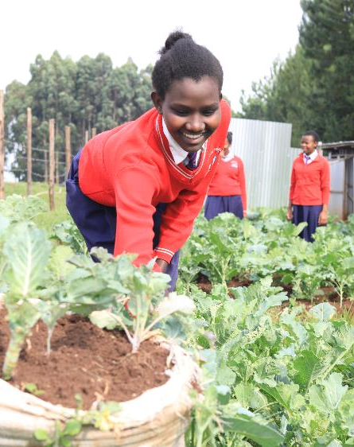
Life Challenges of Women in Rural Kenya
In population served:
Girls often seen as property & valued for bride price
FGM/C, arranged child marriage –generations-old practices
Pervasive poverty
Most vulnerable in rural areas
Poverty exacerbated by climate change
Notes:
Gender inequality and gender-based violence are a global problem, but especially pronounced in the Global South where women are often seen as property and valued for their bride price. In Kenya, women and adolescent girls are most vulnerable, particularly in rural areas. From insufficient financial resources to harmful cultural norms, the cycle of poverty and discrimination affects generations of women and girls.
Kakenya’s Dream operates in southwest rural Kenya, where harmful traditional practices like FGM/C and arranged child marriage are prevalent and generations old. Despite laws banning these practices, 66% of women in the communities have undergone FGM/C and half are married before the age of 19. Only 58% of the girls complete primary school and only 23% finish high school. These realities contribute to pervasive poverty and poor health outcomes.
In order to identify the girls who are most in need of Kakenya’s Dream’s holistic support, the organization prioritizes girls who face these life challenges most acutely – those whose families have never sent a girl to high school, those who are orphans, and those from single parent families with limited resources. Out of a cohort of 35 – 40 girls, 15 students are admitted based on academic merit, with the remainder admitted based on need. Because academic performance is often tied to economic hardship, girls who lack proper nutrition, have to walk long distances to elementary school, or miss school due to household chores are most likely to suffer poor performance.

Slide 6
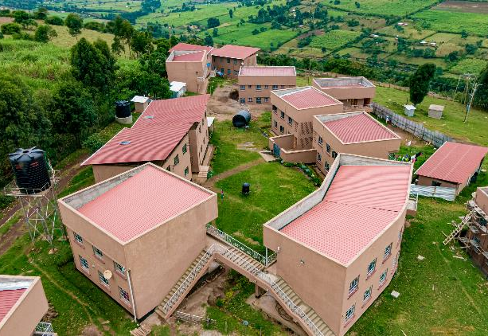
How Our Grant Will Be Used
$50,000 Grant
Kakenya Center for Excellence II (KCE II)
Supports student education & welfare programs, plus staffing for KCE II, full-support, all-girls boarding school, for grades 7 - 12 in remote Massai village
Notes:
Together Women Rise’s $50,000 Featured Grant to No Means No South Africa funds the organization’s general operations, which includes the No Means No program.
Gender-based violence reporting in South Africa is generally very poor. First, the justice system is not always supportive of the victim/survivor and puts the burden to prove the crime squarely on the victim. Second, the mechanisms to report and get the necessary support and intervention are not always readily available for victims. But the No Means No program teaches young people how to identify all forms of assault and to realize that none of these behaviors are normal or acceptable. The program clearly defines sexual violence and equips young people with the language and skill to articulate and communicate if and/or when they have been violated.
Includes Network Referral System to connect survivors to support and appropriate local services such as medical, legal, or shelter services
New focus on developing module to equip youth to defend themselves against cyber-based sexual violence (also known as technology-facilitated sexual and gender-based violence).
Together Women Rise will fund Empowering Marginalized Girls in Rural Kenya, a project to support continued expansion of student education and welfare programs and staffing for Kakenya Center for Excellence II (KCE II), a full-support, all-girls boarding school for grades 7 through 12 in a remote Massai village in Narok County, Kenya. This is a critical age for girls, as they face intense pressure to drop out, undergo FGM/C, and marry young. The program provides the opportunity to nurture and release the potential of young women and creates a space for gender equality in a community that has a long history of female suppression.
Built on land donated by the village elders, KCE campuses are beacons of hope in the community. The first classroom building on the KCE I campus opened in 2009. From 2010-2017, that first campus expanded to meet the needs of its growing student population, offering art and science facilities, safe dormitories, teacher housing, a multi-purpose hall, and a library. In 2017, Kakenya’s Dream broke ground on its second campus, KCE II. Indigenous trees and vegetable gardens bring life to the grounds, while still leaving plenty of room for students to play sports and learn outdoors.

Slide 7
How Our Grant Will Be Used
Primary goals of KCE II:
Improve students’ retention & educational achievement through high school
Remove social & cultural barriers to girls’ education
Empower students to become agents of change in addressing child rights violations (FGM/C, child marriage)
Empower & motivate students to achieve their first-choice destination after high school
Direct impact: 268 women & girls; Indirect impact: 1,609 women & girls
Notes:
Together Women Rise’s $50,000 Featured Grant to No Means No South Africa funds the organization’s general operations, which includes the No Means No program.
Gender-based violence reporting in South Africa is generally very poor. First, the justice system is not always supportive of the victim/survivor and puts the burden to prove the crime squarely on the victim. Second, the mechanisms to report and get the necessary support and intervention are not always readily available for victims. But the No Means No program teaches young people how to identify all forms of assault and to realize that none of these behaviors are normal or acceptable. The program clearly defines sexual violence and equips young people with the language and skill to articulate and communicate if and/or when they have been violated.
Includes Network Referral System to connect survivors to support and appropriate local services such as medical, legal, or shelter services
New focus on developing module to equip youth to defend themselves against cyber-based sexual violence (also known as technology-facilitated sexual and gender-based violence).
KCE II holistically addresses obstacles from harmful traditional practices, negative social norms, physical and mental health concerns, past trauma, nutrition, socioeconomic limitations, and more.
The primary goals of KCE II are to:
Improve students’ retention and educational achievement through high school
Remove the social and cultural barriers to girls’ education
Empower students to become agents of change in addressing child rights violations (FGM/C, child marriage)
Empower and motivate students to achieve their first-choice destination after high school.
These goals are achieved through differentiating elements to ensure that 100% of the students graduate from high school, free from FGM and child marriage. Together Women Rise's grant will fund various programs at the KCE II, including these elements:
Girls participate in extended learning activities in arts, sports, and STEM so they can explore diverse career paths and gain leadership skills.
Students are fed nutritious meals from campus gardens and receive medical and mental health check-ups, a rarity in rural schools.
They are taught comprehensive sexual and reproductive health education, which outside of Kakenya’s Dream’s programs, does not occur in the region.
Students are paired with peer mentors who are trained and recruited from KCE alumnae to help girls envision their own potential and encourage them to make healthy life decisions, including staying in school and delaying marriage. This peer-led approach empowers alumnae to be positive role models. Coming from the same community, mentors are able to identify with the challenges younger girls experience.
100% of alumnae have transitioned to tertiary education, receiving financial, academic, and social support alongside practical career skills development for their next life phase.
IMPACT – Direct: 268 women and girls; Indirect: 1,609 women and girls

Slide 8
Budget
Item | Description | Cost
Student Education & Welfare | Students receive high-quality instruction in five core areas: languages, math, science, technical skills, and humanities, plus peer mentorship opportunities and leadership and life-skills training, extracurricular activities, and instruction in traditional Maasai beadwork, farming techniques, music, and dance. They receive nutritious daily meals, multivitamins, medical check-ups, and counseling. | $40,000
Staffing | Schools are staffed with a 1:13 teacher to student ratio, the lowest teacher to student ratio in the region, ensuring girls receive the extra support and personalized attention they need to succeed in school. | $10,000
Total |  |  | $50,000
Notes:
Kakenya’s Dream, is an experienced organization with a strong local program and impressive results, as witnessed in the previous grants that Together Women Rise funded in 2014 and 2019. We love that the organization is run by a Maasai woman and that it offers a comprehensive program that empowers and educates at-risk girls.

