Slide 1
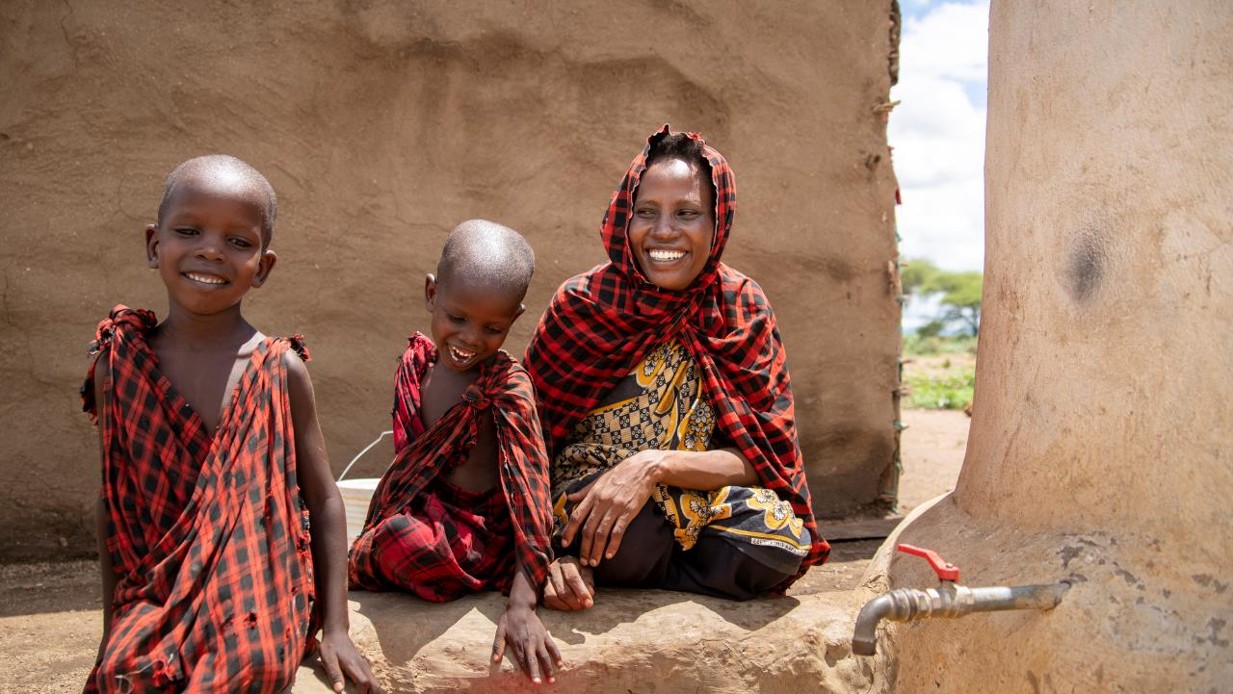
Water is a Women’s Empowerment Issue
March 2025 Featured Grant
Notes:
March 2025: Save the Rain
Water is a Women’s Empowerment Issue

Slide 2
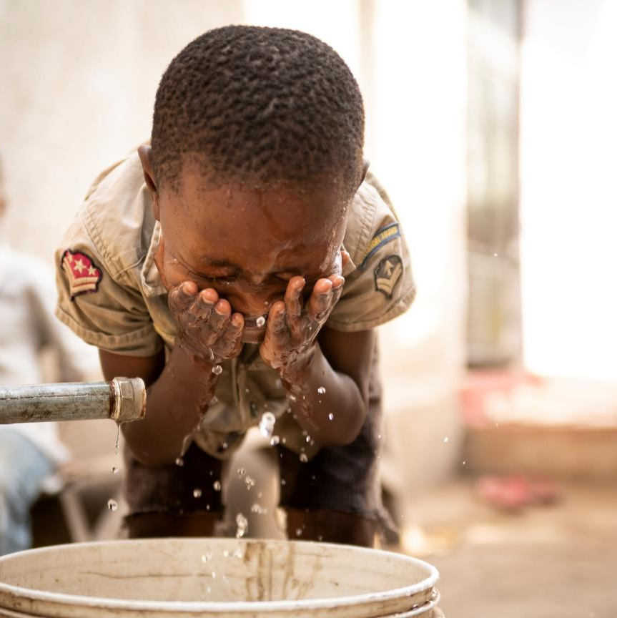
About Featured Grants
Featured Grants fund:
direct services
new projects
expansion of existing projects
capacity building
Notes:
The Together Women Rise Grants Program has two key components that support our overall mission to achieve global gender equality. Featured Grants are largely focused on delivering direct services by funding grassroots organizations that empower and support women and girls in low-income and marginalized communities in the Global South. Our Transformation Partnerships are designed to invest in areas where we can make the biggest impact on achieving global gender equality by addressing the root causes of gender inequality.
Through our Featured Grants Program, we highlight a different organization/project each month, providing a variety of learning materials on the issue and how the grant will be used. Through the Featured Grants program, we support capacity building, new programs, or expansion of existing programs. The following is information on the grant we are featuring for March 2025.

Slide 3
The Global Issue: The impact of water access and water scarcity on women
1 in 3 children, 1 in 4 people worldwide live in water scarcity
Increasing due to climate change, economic instability & population growth
Women & girls bear burden, usually responsible for water
Even when available, water quality may be poor
Notes:
Worldwide, one in three children, and one in four people total, live in water scarcity. And the numbers are increasing due to climate change, economic instability, and population growth. Sub-Saharan Africa is particularly vulnerable as it is affected by all three contributing factors.
According to the U.S. Mission to the United Nations, nearly half of the world’s population lacks a hygienic toilet at home, and one third of people are unable to wash their hands with soap and water at home. This burden is disproportionately felt by women and children, whose educational and economic opportunities suffer as a result, creating a cycle of poverty.
Water scarcity in Sub-Saharan Africa takes a great toll on women and girls because they are often the ones responsible for collecting it. They can spend a significant amount of time traveling long distances to collect water, and these walks are often risky. Many women report that they experience physical or sexual violence during their search for water. The girls involved in this work are spending less time at school, forfeiting their education to meet their families’ need for water.

Slide 4
March Featured Grantee: ​ Save the Rain
Founded in 2005 - first project: water tank at school
Transforms communities: sustainable rainwater collection
20 years: 6,500 rainwater harvesting systems
96% improvement in students’ health
Notes:
Save the Rain began in 2005 with one tank, one family, and one idea: harvesting rainwater. That first project was conceived of by Joseph Nyarianga, a farmer and mason in the Njeku community of northern Tanzania. He wanted to build a small rainwater tank at his children’s school. His family suffered from a lack of water, and his wife and daughter knew the threat of violence awaiting them when they searched for it. He thought building a rainwater tank could help his family and community. Save the Rain, a newly founded American nonprofit organization, agreed to help. Joseph is now the director of Save the Rain in Tanzania and his daughter, Violeth, works beside him.
Save the Rain transforms communities by constructing rainwater harvesting systems that provide clean water for homes and schools. Its sustainable practices empower women, improve health, enhance education, create economic opportunities, ensure food security, and cultivate a brighter future for all. Saving rain saves lives.
Since 2005, Save the Rain has built 6,500 rainwater harvesting systems. Instead of drilling wells, Save the Rain creates access to clean water for communities right at their doorsteps with no dependency on electricity or pumping. Having access to clean water is empowering women, improving health, enhancing education, creating economic opportunities, and cultivating a brighter future for all. The systems are meticulously designed to prevent contamination and ensure safe, clean drinking water. Save the Rain has seen a 96% improvement in students’ general health once these rainwater systems are in use. When clean water is present at home, 94% of families commit to their daughter’s education.

Slide 5
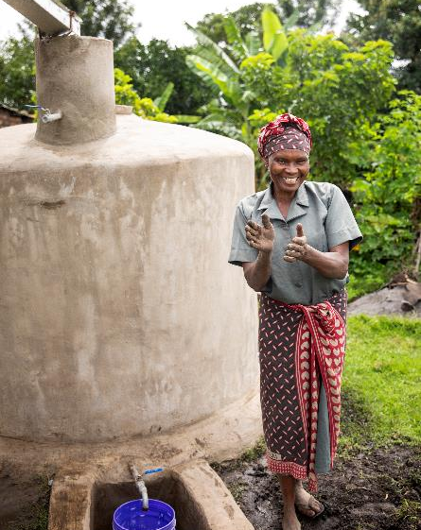
Life Challenges of Women in Tanzania
Women & girls can spend average of 8 hours a day walking for water
Economic inequality & limited opportunities
Gender-based violence, including FGM/C
Patriarchal roles: women have little say in decisions
Notes:
Save the Rain operates in northern Tanzania. Before receiving rainwater harvesting tanks of their own, the women who benefit from Save the Rain’s projects were walking an average of eight hours a day for water.
The women and girls of Tanzania face challenges that reflect broader national trends, while also being shaped by local factors.
Economic Inequality and Limited Opportunities: The area where Save the Rain works has suffered significant losses of life due to HIV/AIDS, leaving many widows to manage their families. The main source of income for families is sustenance farming, which women are largely responsible for, yet they have limited access to land ownership and control over resources. Formal employment opportunities are scarce, and the women who work for pay often find themselves in low-paying, informal sectors with little job security. Women also have less access to credit and financial services, limiting their ability to start a business.
Gender-Based Violence: Women and girls often face domestic violence, including physical and emotional abuse by their husbands or male family members. This violence is rooted in deeply entrenched patriarchal norms, where women’s roles are viewed primarily as caregivers, and their voices are marginalized. Although female genital mutilation/cutting (FGM/C) is illegal in Tanzania, it is still practiced in some communities. This harmful cultural practice can have serious physical and psychological consequences for girls and women.
Cultural and Patriarchal Norms: Women throughout Tanzania often have limited decision-making power within their households. Traditional gender roles dictate that men are the primary decision-makers, leaving women with little say in issues that affect their own lives and those of their children.

Slide 6
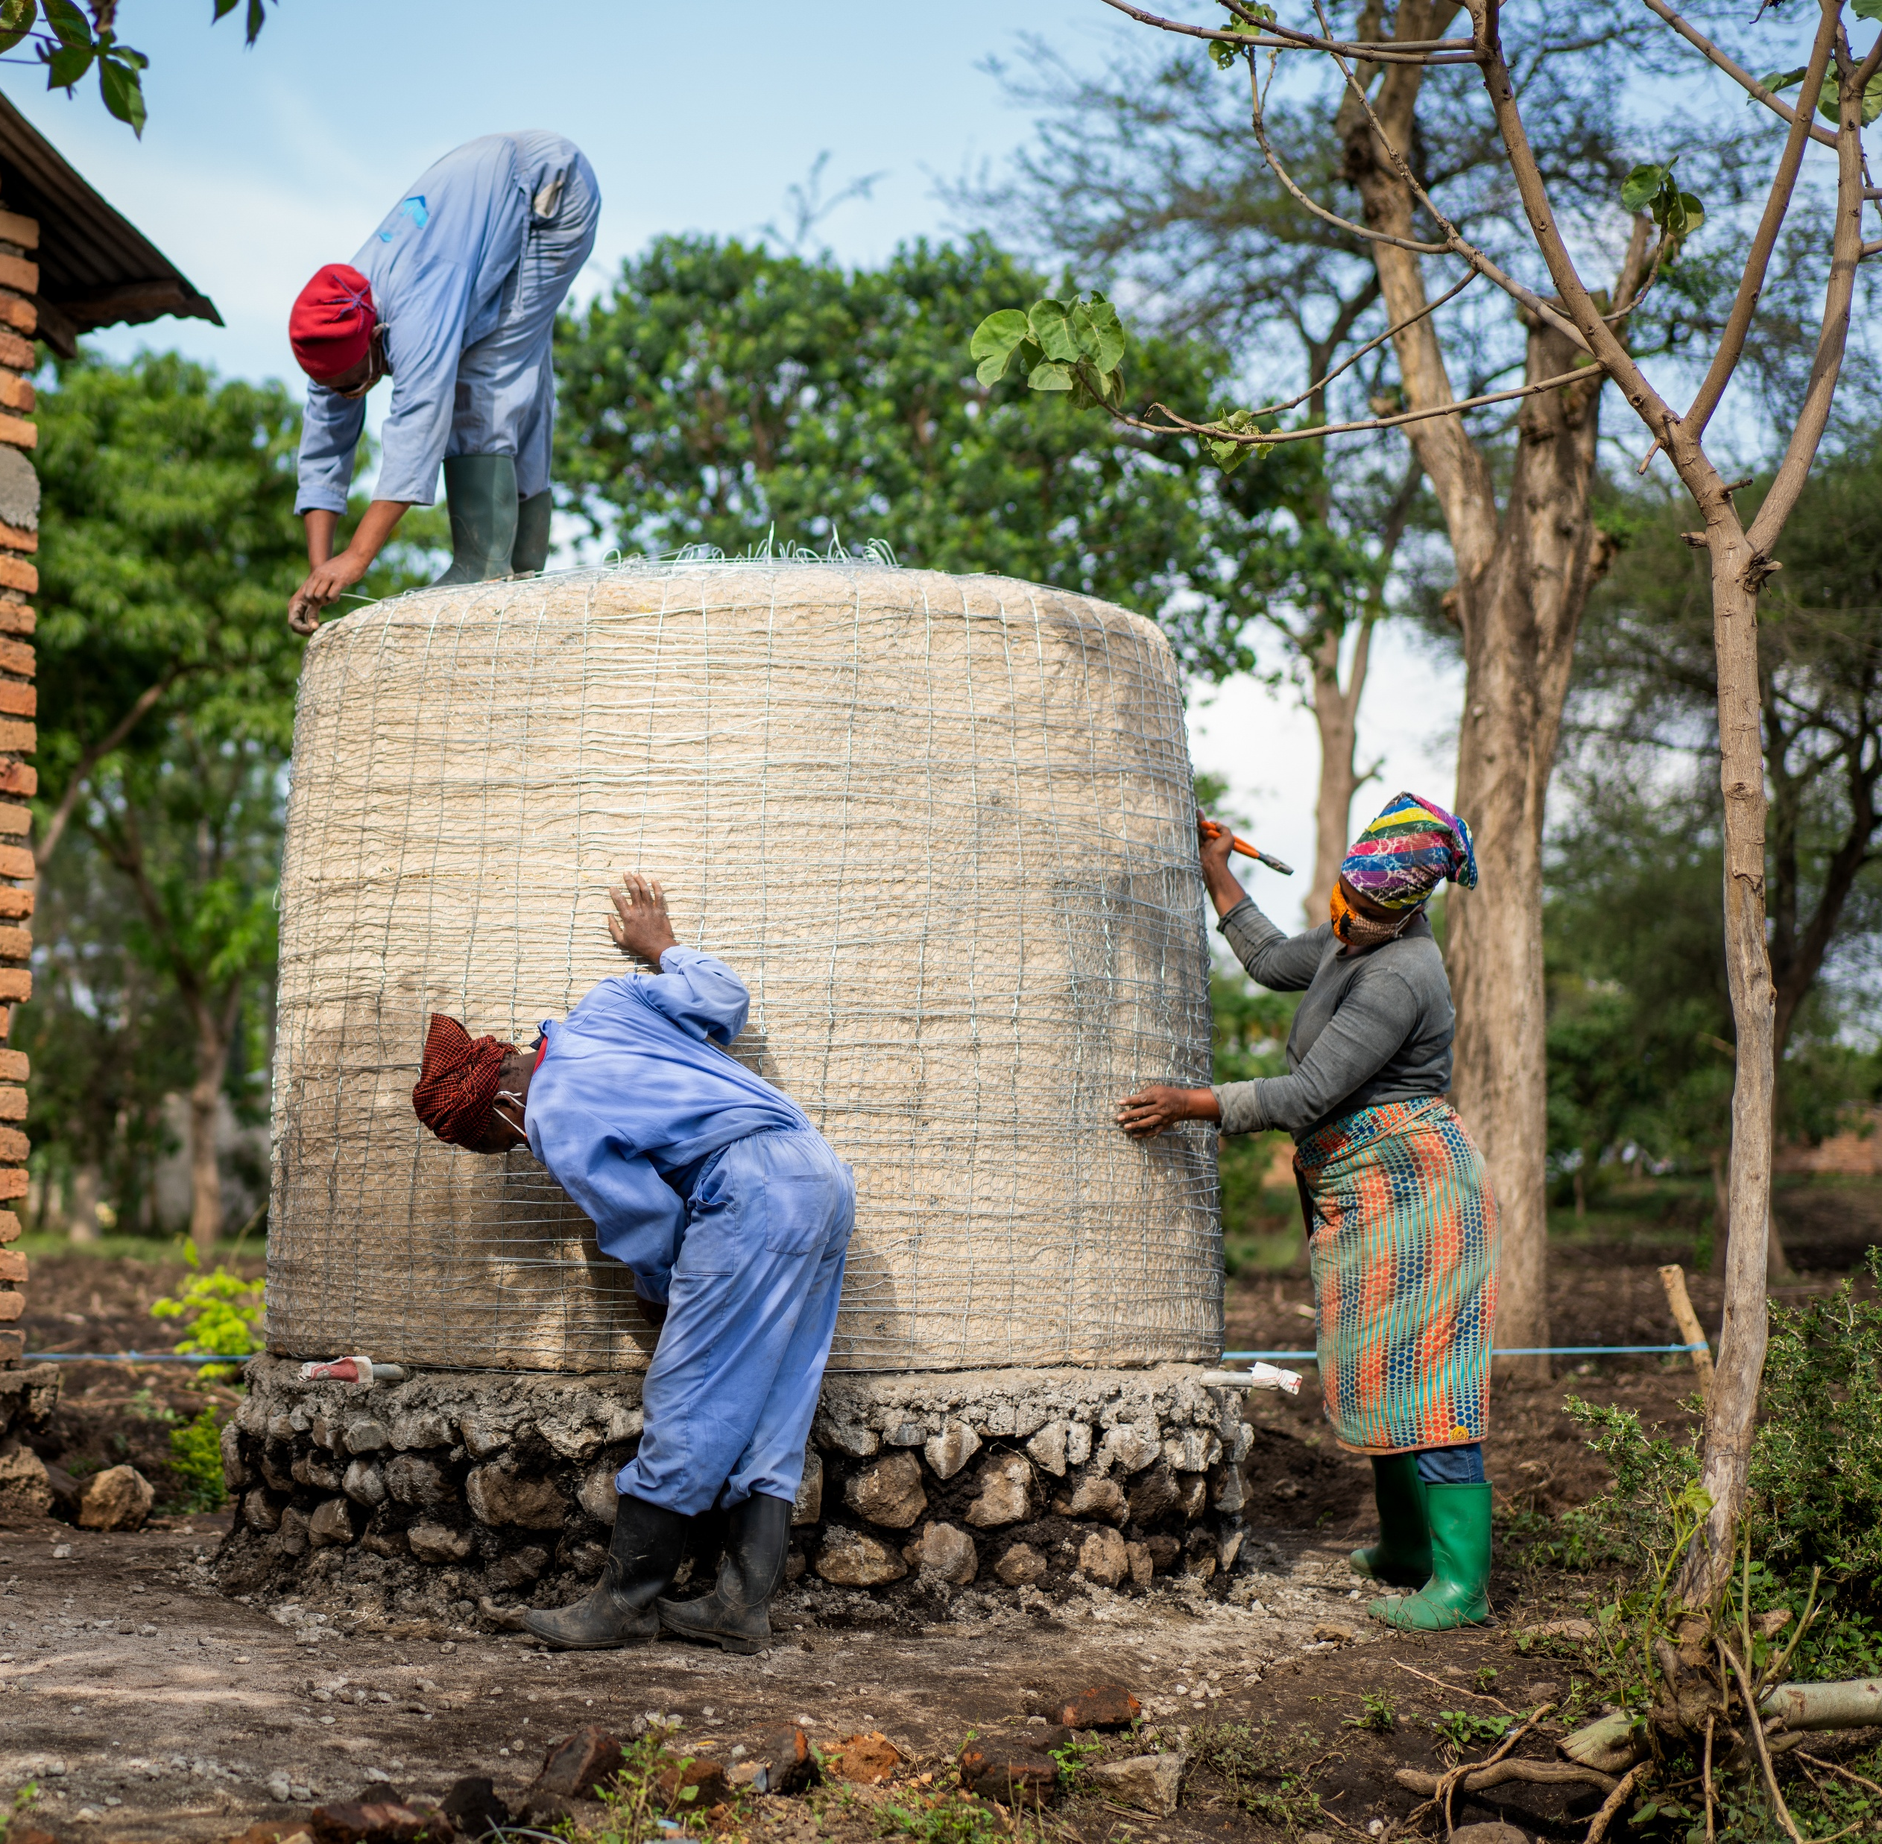
How Our Grant Will Be Used
$50,000 Project Grant
Women’s Water Initiative
100 female builders to construct
100 residential rainwater harvesting systems &
100 residential greenhouses for
100 families
Notes:
Together Women Rise’s $50,000 Featured Grant to No Means No South Africa funds the organization’s general operations, which includes the No Means No program.
Gender-based violence reporting in South Africa is generally very poor. First, the justice system is not always supportive of the victim/survivor and puts the burden to prove the crime squarely on the victim. Second, the mechanisms to report and get the necessary support and intervention are not always readily available for victims. But the No Means No program teaches young people how to identify all forms of assault and to realize that none of these behaviors are normal or acceptable. The program clearly defines sexual violence and equips young people with the language and skill to articulate and communicate if and/or when they have been violated.
Includes Network Referral System to connect survivors to support and appropriate local services such as medical, legal, or shelter services
New focus on developing module to equip youth to defend themselves against cyber-based sexual violence (also known as technology-facilitated sexual and gender-based violence).
Together Women Rise will fund the Women’s Water Initiative, a project to employ teams of 100 female builders to construct 100 residential rainwater harvesting systems and 100 residential greenhouses for 100 families.

Slide 7
How Our Grant Will Be Used
3,500-liter residential rainwater harvesting system for family: women never have to walk for water again
100 tanks sustain four different communities
Tanks have lifespan of 200 years, last for generations, require no electricity, pumping, or western additives for filtration
Employ 100 women to build tanks = future work opportunities to build for other communities
100 greenhouses = abundant and consistent food crops
Direct impact: 3,588 women & girls; Indirect impact: 36,000 women & girls
Notes:
Together Women Rise’s $50,000 Featured Grant to No Means No South Africa funds the organization’s general operations, which includes the No Means No program.
Gender-based violence reporting in South Africa is generally very poor. First, the justice system is not always supportive of the victim/survivor and puts the burden to prove the crime squarely on the victim. Second, the mechanisms to report and get the necessary support and intervention are not always readily available for victims. But the No Means No program teaches young people how to identify all forms of assault and to realize that none of these behaviors are normal or acceptable. The program clearly defines sexual violence and equips young people with the language and skill to articulate and communicate if and/or when they have been violated.
Includes Network Referral System to connect survivors to support and appropriate local services such as medical, legal, or shelter services
New focus on developing module to equip youth to defend themselves against cyber-based sexual violence (also known as technology-facilitated sexual and gender-based violence).
100 Rainwater Harvesting Systems:
Save the Rain continues to build rainwater harvesting systems at primary schools to ensure safe water for students, fostering a marked improvement in their health, attendance, and education. These tanks typically hold 150,000 liters of water, but Save the Rain also builds 3,500-liter residential rainwater harvesting systems for families, which will be the focus of this project. These systems mean that the women in these families never have to walk for water again.
Each residential system can sustain a family of eight between rainy seasons. The 100 tanks funded by this project will sustain four different communities with readily available clean water and end the need to walk for water. With a lifespan of 200 years, the tanks are built to last for generations, and require no electricity, pumping, or western additives for filtration.
100 Women Builders:
This project will also employ 100 women to build tanks and foster future work opportunities with Save the Rain to build for other communities. Each family is paired with four female builders. For each tank built, the teams train three women from the community to build alongside them, providing a new skill set and salaried work. Each domestic rainwater harvesting system takes six days to construct. Eliminating the need to walk for water costs only $500. This investment has a multigenerational impact, as clean water is shared with extended family and neighbors.
100 Greenhouses:
The residential greenhouses, made from local materials, are low-cost, effective, and sustainable, and they provide families with a consistent nutritious food supply. Save the Rain began implementing sustainable agriculture programs as part of every project nearly 15 years ago. It started with permaculture gardens at homes, schools and village centers, but following a locust infestation in East Africa, shifted first to large greenhouses and then to small, family-sized structures that protect nutritious leafy greens from insects, giving families abundant and consistent food crops along with their clean drinking water.

Slide 8
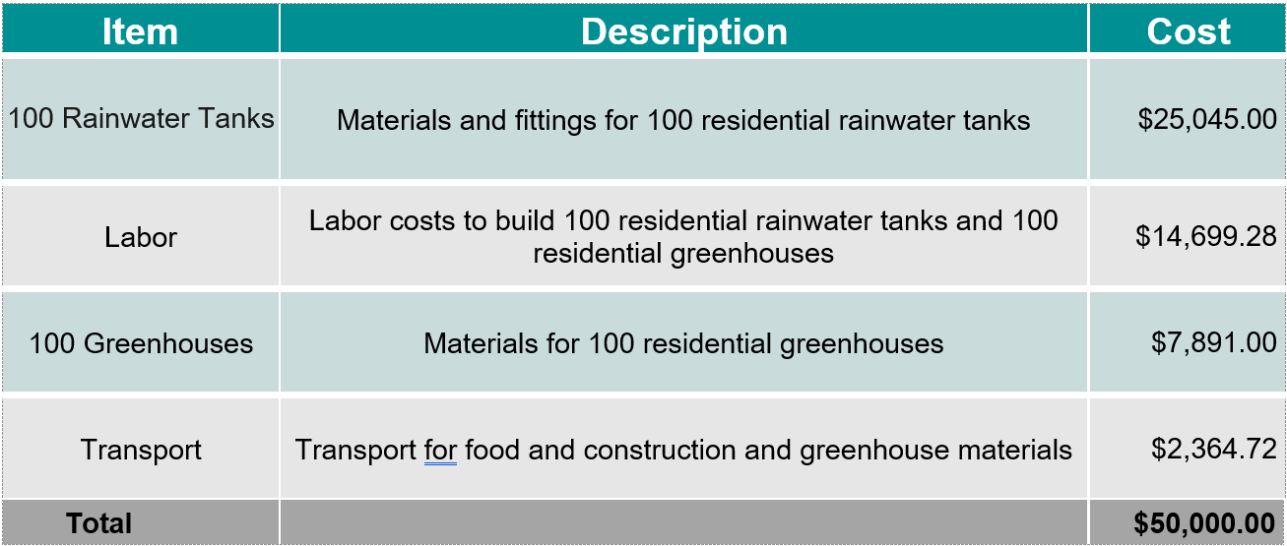
Budget
Notes:
This project looks simple but has huge ripple effects. Women and girls spend hours a day walking for water, which equals high risk of sexual assault. We love that this project is community-driven and community-led, with a commitment from Save the Rain for the long term. As women are trained to build rainwater collection systems, it increases their financial independence and their daughters can stay in school. The greenhouses also change the game nutritionally, providing access to healthy food.

