Slide 1
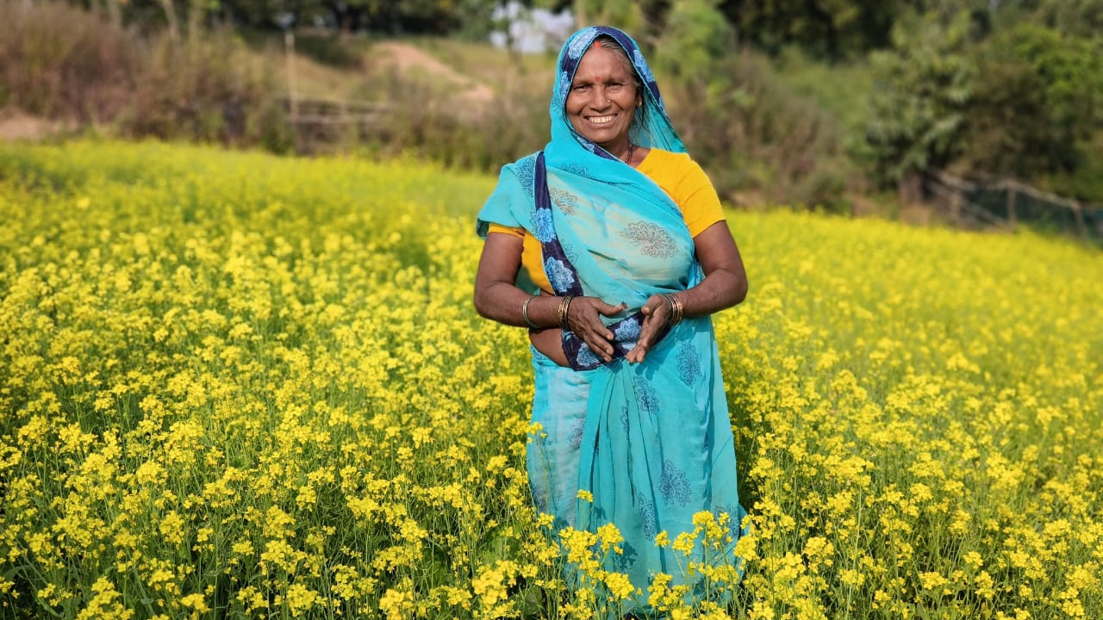
Cultivating Sustainable Health & Independence April 2025 Featured Grant
Notes:
April 2025: Asia Initiatives
Cultivating Sustainable Health & Independence

Slide 2
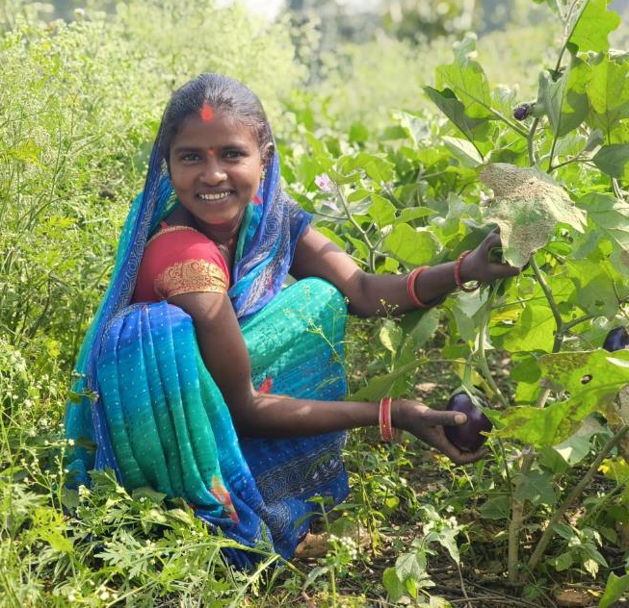
About Featured Grants
Featured Grants fund:
direct services
new projects
expansion of existing projects
capacity building
Notes:
The Together Women Rise Grants Program has two key components that support our overall mission to achieve global gender equality. Featured Grants are largely focused on delivering direct services by funding grassroots organizations that empower and support women and girls in low-income and marginalized communities in the Global South. Our Transformation Partnerships are designed to invest in areas where we can make the biggest impact on achieving global gender equality by addressing the root causes of gender inequality.
Through our Featured Grants Program, we highlight a different organization/project each month, providing a variety of learning materials on the issue and how the grant will be used. Through the Featured Grants program, we support capacity building, new programs, or expansion of existing programs. The following is information on the grant we are featuring for April 2025.

Slide 3
The Global Issue: Enhancing Women’s Health & Independence Using Sustainable, Climate-Friendly Practices
Malnutrition comes in many forms
Resulting health conditions: linked with poverty
Women: higher risk of food insecurity than men
Organic backyard gardens: improve livelihoods & health of women & families
Notes:
Although most of the world’s undernourished live in the Global South, malnutrition affects every country in the world and occurs in many forms. These include undernutrition (wasting, stunting, and underweight), inadequate vitamins or minerals, and overweight and obesity. Many of these conditions are inextricably linked with poverty and result in diet-related, noncommunicable diseases that have a developmental, economic, social, and medical impact on individuals, their families, and entire countries. Women are at higher risk of food insecurity than men in every area of the world. There are many factors in this, such as the local culture where this month’s grantee serves, which dictates that men eat first and receive larger helpings of nutritional food.
Micronutrient deficiencies are among the most common forms of malnutrition. These include calcium, iron, and vitamins C and E. Micronutrient deficiencies can have serious consequences, including adverse pregnancy outcomes, blindness, and greater susceptibility to infectious diseases.
Adding to the burden of food insecurity, climate change is hitting the world’s most vulnerable people hardest and erasing years of progress on child undernutrition.
Globally, there are 2.5 billion overweight adults and 890 million obese adults.
149 million children under 5 are stunted (too short). The incidence has declined from 40% in 1990 to 22% in 2022, but it has plateaued in the past several years.
45 million children under 5 are wasted (too thin).
50% of child deaths are linked to hunger, mostly in low and middle-income countries.
37 million children are overweight or obese.
50% of children under 5 suffer from vitamin and mineral deficiencies.
For many families, the solution is just outside their door. Many studies and projects around the world show that backyard gardens can help improve the livelihoods and health of women and their families, especially when they can sell their excess produce to others. A review of data on maternal and child undernutrition and survival from 36 countries has suggested dietary diversification, including home gardening, as an effective strategy to improve nutrition. When women can grow food at home, it can change the course of their lives and those of their children.

Slide 4
April Featured Grantee: ​ Asia Initiatives
Unique economic development focus:
Social Capital Credits (SoCCs): do good (care for community spaces, plant kitchen gardens, etc.) in exchange for goods and services
2018 Together Women Rise grantee
Empowers 50,000+ women & girls every year
Notes:
Asia Initiatives is focused on economic development and gender equity, especially for women and their families. Asia Initiatives uses Social Capital Credits (SoCCs), an innovative developmental platform, to incentivize acts of social good, such as caring for community spaces, planting kitchen gardens, etc., in exchange for goods and services, such as agricultural skill development, access to crops, and equipment.
Asia Initiatives empowers women to realize their full potential and become key stakeholders of their own success. Its work is based on co-founder Dr. Geeta Mehta’s reinterpretation of the Chinese proverb, “Give a man a fish and you feed him for a day; teach a man to fish and you feed him for a lifetime.” Asia Initiatives has worked in over 20 locations across India, Kenya, Ghana, and the United States. Its record of accomplishments demonstrates a strong commitment to promoting gender equality. Through targeted interventions in education, healthcare, and economic empowerment, Asia Initiatives empowers more than 50,000 women and girls across Asia every year.

Slide 5
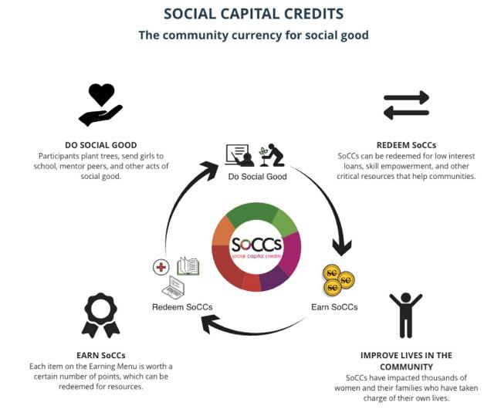
Asia Initiatives
Notes:
The Social Capital Credits (SoCCs) model encourages acts of social good without having to rely on money. It was developed by Asia Initiatives to tackle the endemic issue of poverty while simultaneously promoting the building of community spirit. SoCCs enable each development dollar to have a multiplier impact, since community members earn their personal good, such as education, by doing a social good such as planting trees. These good deeds are decided upon by the women themselves during SoCCratic Dialogues at the start of each project. SoCCs can be spent on items like education, upskilling, healthcare, microloans, or other types of support chosen by participants. SoCCs are based on an Earning Menu, which is a list of specific activities developed by the participants in the community. By doing them, a pre-determined number of credits can be earned through the Redemption Menu. Asia Initiatives’ SoCCs app and web platform record and analyze all SoCC transactions to ensure that the women are making progress toward the goals that they have set for themselves.
SoCCs received Fast Company’s “World Changing Idea Award” in 2020. Asia Initiatives has also won awards from MIT SOLVE, General Motors, Vodafone, Experian, and the Jacobs Foundation. United Nations Secretary-General Ban Ki-moon said, “I appreciate and commend the hard work of Asia Initiatives in prioritizing and enhancing the role of women in addressing the Global Development Agenda.”
Asia Initiatives was a Together Women Rise grantee in 2018. That project promoted sustainable development and a sense of independence and strong community among women in Shohratgarh, India. The women were trained in poultry farming, which improved nutrition for themselves and their families, and they received training in record keeping and financial literacy.

Slide 6
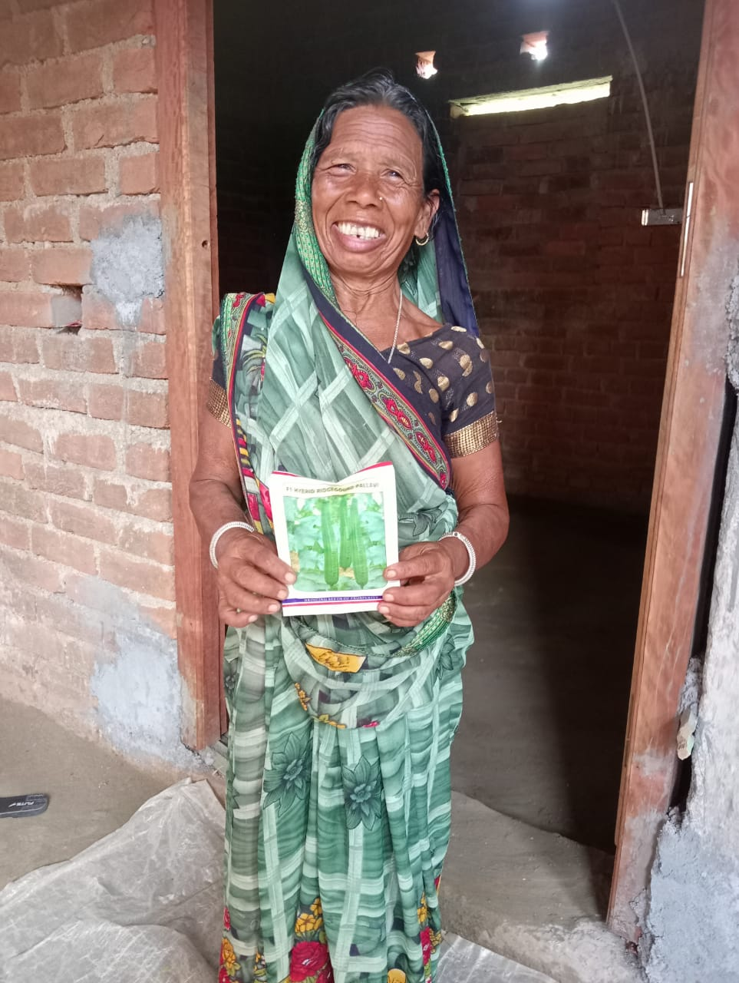
Life Challenges of Women in India
Most have micronutrient deficiencies
50% have anemia
Systemic marginalization
Seen as inferior to men
Deep poverty
Unequal pay
Gender-based violence
Sex trafficking risk
Notes:
Most women in India have access to food, but the majority suffer from micronutrient deficiencies. In the rural and tribal geographies of Northern India, most people eat a predominantly vegetarian diet of grains like rice, wheat, and lentils. This diet often lacks adequate protein, fruits, and vegetables. It also contributes to widespread deficiencies, with nearly 50% of the female population suffering from anemia. The resulting health issues affect the wellbeing of women and their families, contributing to a high rate of low birthweight babies and childhood health problems. Severe malnutrition can also lead to physical and mental stunting, perpetuating intergenerational poverty.
In addition to nutritional deficiencies, women in India face systemic marginalization throughout their lives. This mistreatment begins in childhood when they are considered less desirable than boys and continues relentlessly as they are consistently viewed as inferior to men. The issues faced by women and girls in India include:
Gender inequality – Discrimination and stereotyping against women and girls in India is rampant, thanks to a deeply entrenched patriarchal mindset.
Deep poverty – 360 million people – more than every U.S. man, woman, and child – live in squalid conditions and are among the most impoverished in the world.
Female feticide – Selective abortion of female fetuses kills approximately one million girls in India every year. This is a common practice due to economics, as parents see girls as burdens and cannot fathom the idea of having to pay a dowry to a future bridegroom.
Gender-based violence – Many frequent and severe incidents of sexual harassment and assault are reported each year in India. One out of four women report having experienced physical violence from a spouse. At least two women are sexually assaulted every hour, and every six hours a young married woman is beaten to death, burned, or commits suicide.
High incidence of non-communicable diseases (NCD) – The NCD crisis in India is one of the most significant health and development challenges of the century. NCDs, such as cardiovascular disease and diabetes, cause a financial burden for individuals and families due to the high cost of treatment and the loss of stable employment.
Unequal distribution of education – India has more than 35 million children without access to school, of which 53% are girls. These girls are at risk of early marriage, early pregnancy, trafficking, violence, and poverty. India also has a high drop-out rate for girls – as high as 57% in some areas.
Unequal pay – Men earn 82% of the labor income in India, leaving just 18% for women. The pay gap widens as women move up the career ladder.
Sex trafficking – This is an international human rights crisis and India is an epicenter of the problem, with an estimated 18 million of the world’s enslaved population.
Child marriage – One out of three girls in India is married before the age of 18. Child marriage interrupts schooling and limits a girl’s opportunities throughout her life. More than 7,200 children report rapes in India each year. Among these, victims who do report the assaults often suffer mistreatment and humiliation from the police.

Slide 7
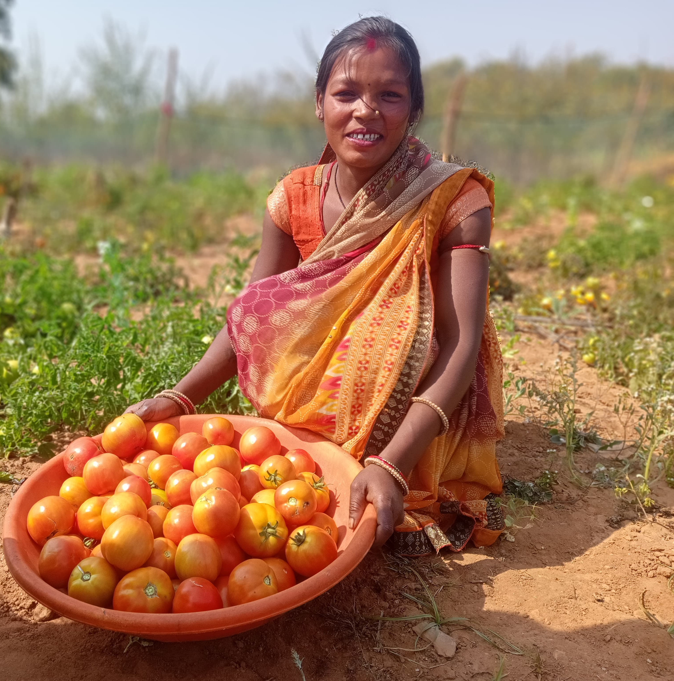
How Our Grant Will Be Used
$48,000 Project Grant
Organic Backyard Gardens
Supplies & training for organic backyard gardens for 450 women in remote villages
Improves nutrition & incomes for women, their families, & their communities.
Supplies earned through Social Capital Credits
Notes:
Together Women Rise will fund supplies and training for organic backyard gardens for 450 women in remote villages, improving nutrition and incomes for the women, their families, and their communities.
Asia Initiatives’ projects are conducted with local partners who know the local people, language, customs, and social hurdles for women. For this project, Asia Initiatives will work with Savera Foundation, a partner organization since 2021. This partnership includes training local SoCC managers and women participants, SoCCratic dialogues, data collection, and analysis of all SoCCs earning and redeeming activities.
To increasing health using sustainable, climate friendly gardens –
Participants receive:
vegetable seeds
kitchen garden tools
composting starter kits
workshops on organic kitchen garden planting and maintenance
composting workshops
training on building bamboo supports for garden protection
sessions on sorting, packaging and marketing vegetables locally, in wholesale markets, and connecting to larger supply chains.
All participating women are tribal forest-dwellers with rich Indigenous knowledge of cultivating wild vegetables. Asia Initiatives aims to leverage this Indigenous knowledge to both preserve and enhance it further to protect the native species and biodiversity in the area.
Training sessions are held during the first 25 days of the project, with refresher sessions scheduled quarterly thereafter. Training is organized in 15 groups of 30 women each. Resource persons will guide participants in preparing jeevamrut (natural liquid fertilizer), dasha parni arka (organic pest repellent), and in the techniques of seed planting and spacing, including optimal placement of vegetables based on available space.
Women will not only work directly in their gardens but also build bird perches and grow trees around their gardens to utilize birds as natural pest control and to increase biodiversity. They will also cultivate Moringa, the superfood that has helped cure anemia for many women in Asia Initiatives’ projects. Additionally, women will be able to sell their produce and Moringa powder to increase their income and help combat nutritional deficiencies throughout the community.

Slide 8
How Our Grant Will Be Used
Women earn SoCCs by
Attending government meetings to advocate for health & nutrition needs
Preparing & throwing seed balls in forests
Maintaining common areas, especially around water sources, to help prevent the spread of communicable diseases
Direct impact: 450 women; Indirect impact: 2,000 women & girls
Notes:
To increase economic independence through SoCCs activities –
Women earn SoCCs for the following activities, which they will redeem for all the supplies and training listed above, reinforcing the multiplier effect of the project:
Activating the Village Health and Nutrition Committee, a local body formed by the government that is inactive in most villages – Women will earn SoCCs for attending these local government meetings and advocating for their health and nutrition needs.
Preparing and throwing seed balls in forests – The seed balls have a dual purpose: regenerating forests and providing food for animals in the forest to prevent them from entering village areas and destroying kitchen gardens.
Maintaining cleanliness in common areas, especially around water sources, to help prevent the spread of communicable diseases.

Slide 9
Budget
Item | Description | Cost
Training | Organic kitchen garden training (includes preparation of jeevamrut, pest control) | $11,500
Marketing | Marketing of vegetables/produce (includes transport of vegetables to local market) | $10,500
Tools | Tools for planting and cultivating kitchen gardens | $9,000
Program Management | Includes SoCCs manager, community facilitator, and other personnel costs, as well as stationery, travel, etc. | $5,000
Seeds | Vegetable and other seeds | $4,500
Composting | Organic compost starter kits | $4,500
Training | Training in sorting, labeling, marketing etc. of produce to reflect organic and biodiversity friendly gardens – locally in wholesale markets and connecting to larger supply chains | $3,000
Total |  | $48,000
Notes:
We love the large impact and drastic increase in income for women who participate. Gardens support health and nutrition but also make an impact on the ecosystem. We also love the innovative use of Social Capital Credits as a means of community building and economic benefit.

