Slide 1
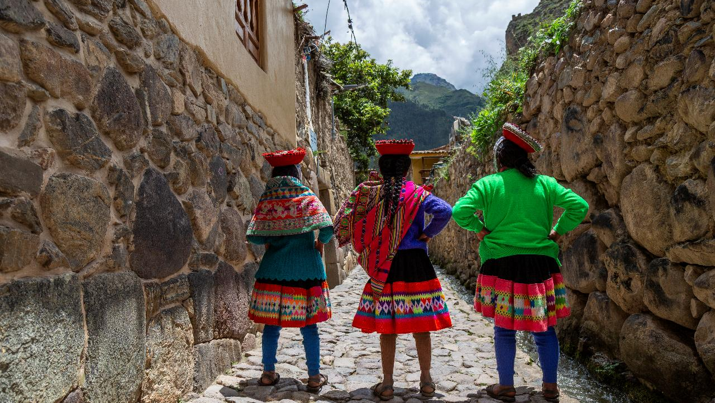
Culturally Sensitive & Empowering: Sexual & Reproductive Health
May 2025 Featured Grant
Notes:
May 2025: Sacred Valley Health
Culturally Sensitive & Empowering: Sexual & Reproductive Health for Girls

Slide 2
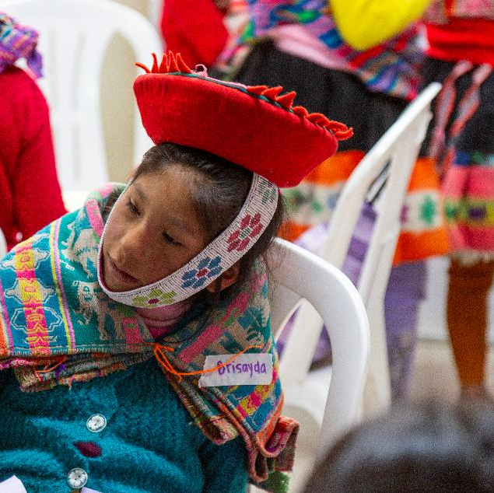
About Featured Grants
Featured Grants fund:
direct services
new projects
expansion of existing projects
capacity building
Notes:
The Together Women Rise Grants Program has two key components that support our overall mission to achieve global gender equality. Featured Grants are largely focused on delivering direct services by funding grassroots organizations that empower and support women and girls in low-income and marginalized communities in the Global South. Our Transformation Partnerships are designed to invest in areas where we can make the biggest impact on achieving global gender equality by addressing the root causes of gender inequality.
Through our Featured Grants Program, we highlight a different organization/project each month, providing a variety of learning materials on the issue and how the grant will be used. Through the Featured Grants program, we support capacity building, new programs, or expansion of existing programs. The following is information on the grant we are featuring for May 2025.

Slide 3
The Global Issue:
Sexual & Reproductive Health Education for Girls
Includes sensitive & often taboo topics:
consent
sexually transmitted infections (STIs)
early pregnancy
delaying marriage
Best success with culturally specific tools: storytelling, local history & literature
Notes:
Sexual and reproductive health (SRH) education addresses sensitive topics such as consent, sexually transmitted infections (STIs), early pregnancy, and delaying marriage – all critically important to girls’ long-term health and stability. Addressing cultural and linguistic practices unique to a community is vital for ensuring that SRH education is relevant and sensitive.
In many low- and middle-income countries, comprehensive sexuality education has become a key source of information for adolescents, especially those in school. Comprehensive sexuality education aims to provide an age-appropriate, culturally relevant program aimed at equipping students with sexual health information and skills to improve SRH outcomes. This type of education has many benefits, including delayed initiation of sexual activity and reduced rates of teenage pregnancy. By ensuring that educational content is inclusive and respectful of diverse cultural backgrounds, it can effectively address health disparities and support adolescents in making informed choices about their sexual and reproductive health, including decisions regarding marriage. Using culturally specific tools such as storytelling, local history and literature, curricula can be tailored to diverse communities with greater success.
Sacred Valley Health, this month’s Featured Grantee, makes local culture and practices the center of their health education curriculum. As a result, it is working to become the first nationally recognized certification program for Quechua-speaking trainers in Peru. It works with Quechua communities that have historically been marginalized and excluded from national economic development, but that possess an invaluable wealth of ancestral wisdom and culture.

Slide 4
May Featured Grantee: ​
Sacred Valley Health
Partners with Indigenous communities in Peru
Improves health & well-being of underserved, marginalized people
Programs: women’s health, nutrition, wilderness medicine, Community Health Workers, adolescent girls
Highly successful 2018 Together Women Rise grantee
Notes:
Founded in 2012, Sacred Valley Health is a community-based, public health nonprofit that partners with vibrant, Indigenous communities in the Andes of Peru. Its core purpose is to improve the health and well-being of these underserved, marginalized communities through a community health worker (CHW) program that empowers local women with education, resources, professional development, and economic opportunities. Its vision is to empower cohorts of women with health education and vocational training and provide women and girls with safe, supportive spaces to learn about their bodies, ask questions, and share experiences. Through these efforts, Sacred Valley Health aims to create generations of women who are empowered to make choices about their reproductive health, have greater access to education, and are advocates of gender equality – all of which can positively influence generations to come.
Sacred Valley Health’s programs include women’s health, nutrition, wilderness medicine, Community Health Worker training, a train-the-trainer CHW program, and more.
Sacred Valley Health received a previous project grant from Together Women Rise in 2018 supporting its nutrition-focused, train-the-trainer program to increase education about best practices in nutrition and combat child malnourishment. The project was extremely successful and very popular among participants, and information learned from that project formed the basis of this new effort.

Slide 5
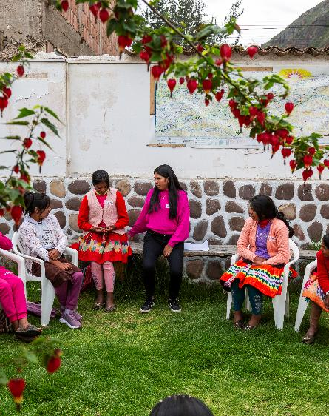
Life Challenges of Women in Peru
Poverty = biggest challenge
30%+ earn no income
Earn 30% less than men
Peru: world’s highest COVID death rates per capita
Political crisis, extreme drought, national economic woes
Additional marginalization for Indigenous Quechua-speaking women
Notes:
Poverty is the biggest challenge for women and girls in Peru. More than 30% of women in Peru make no personal income. Those who do earn income make 30% less per month than men.
Recent years have been extremely difficult ones for Peru and, subsequently, for Sacred Valley Health. Peru was one of the hardest hit countries during COVID, and the pandemic exacerbated pre-existing barriers to health. By the end of 2021, Peru had the highest COVID-related death rates per capita in the world. In December 2022, just as the country was recovering from the pandemic, Peru fell into the worst political crisis it had seen in decades.
The Cusco region, where Sacred Valley Health operates, was hit particularly hard. Coming on the heels of the worst drought the region has experienced in more than 50 years, deadly protests, regional roadblocks, and disrupted supply chains paralyzed the entire region for nearly three months. The economy, which relies heavily on agriculture and tourism, suffered significant setbacks once again.
Sacred Valley Health’s partner communities are 9,000 to 14,000 feet above sea level in the Peruvian Andes. Education about sexual and reproductive health is limited in the public school system and is often considered
taboo in a cultural context. Gender discrimination is heavily embedded in Andean society, which means girls and women, especially Indigenous girls and women, have fewer opportunities for both secondary and
vocational education. This limits their agency and participation in shaping circumstances that directly impact their well-being.

Slide 6
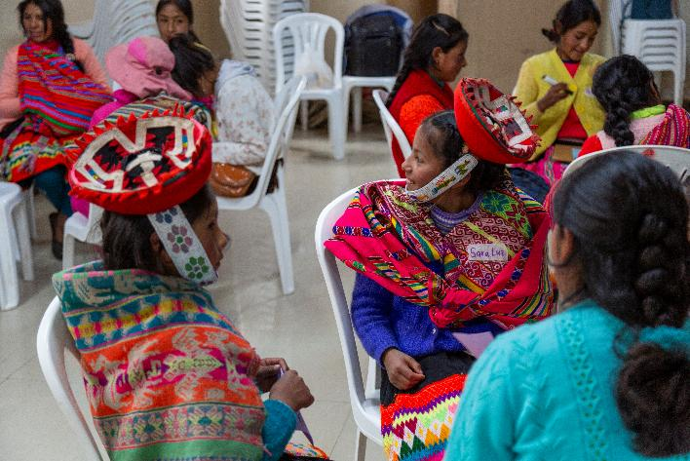
How Our Grant Will Be Used
$40,000 Project Grant
Adolescent Girls Empowerment Initiative
Train & empower Indigenous adolescent girls → leaders in healthy gender relationships & reproductive health
Notes:
Together Women Rise will fund the Adolescent Girls Empowerment Initiative, which aims to train and empower adolescent girls from Indigenous Peruvian communities to become leaders in the field of healthy gender relationships and reproductive health within their communities.
Indigenous adolescents in Peru report a lack of intercultural respect from staff who care for them in public health centers, reporting cases of mistreatment and mockery due to their way of communicating, their traditional clothing, and the use of traditional practices to prevent pregnancy. Recognizing the importance of addressing the specific health needs of Indigenous populations, this project seeks to promote a culturally sensitive and participatory approach to address barriers to sexual and reproductive healthcare, respecting cultural and religious patterns of the communities with the following primary program activities:
• Training workshops: Interactive and participatory workshops on sexual and reproductive health will be organized and adapted to the needs and cultural contexts of Indigenous communities. These workshops will address topics such as the prevention of unwanted pregnancies, the promotion of adolescent sexual and reproductive health, contraception, STIs, and the importance of maternal and child health services, as well as practical supplies like menstrual pads and cups.
• Leadership development sessions: Training sessions will be held to develop leadership, communication, and advocacy skills so these young women can advocate for equitable access to reproductive health services and become agents of change in their communities.
• Creating networks of young leaders: Groups of young Indigenous leaders will be established to facilitate the exchange of experiences, knowledge, and good practices in sexual and reproductive health. These networks will serve as platforms for collaboration and coordination of joint actions.
• Awareness and advocacy campaigns: Awareness campaigns will be organized in Indigenous communities to promote the importance of sexual and reproductive health and to advocate for equitable access to quality services. Young leaders will play an active role in the planning and execution of these campaigns

Slide 7
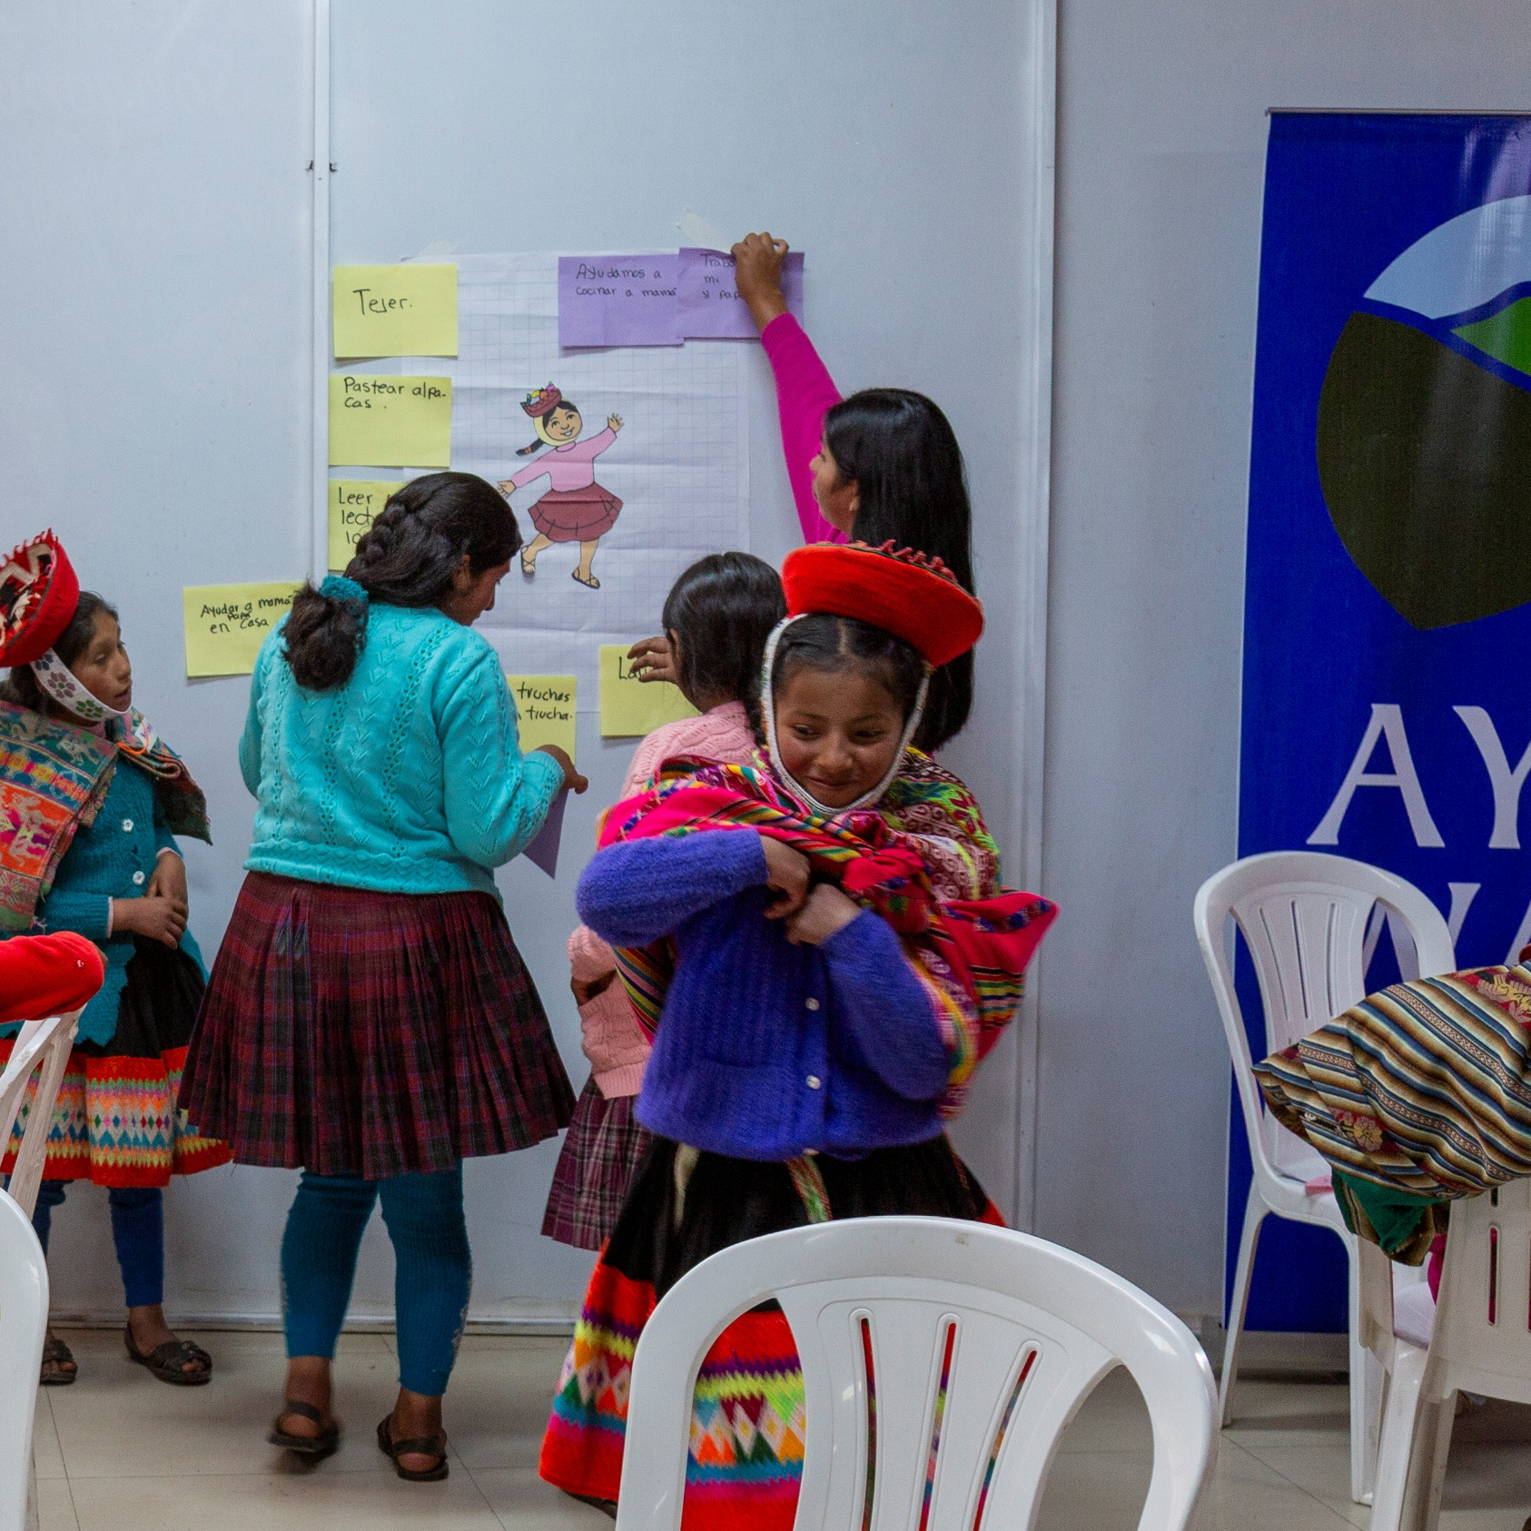
How Our Grant Will Be Used
Quechua-speaking staff
Effective, accessible teaching
Workshops
Leadership development
Networking young leaders
Awareness & advocacy campaigns
Direct impact: 50 women and girls;
Indirect impact: 800 women & girls
Notes:
Sacred Valley Health’s program is customized for and co-created by Indigenous, Quechua-speaking health workers. They collaborate with a local graphic designer to develop culturally competent images for the curriculum and use a curriculum guide created by Quechua-speaking staff to ensure teaching methodology for each topic is effective and accessible. Teaching activities focus on the use of storytelling (an important aspect of local learning culture) and discussion prompts to promote critical thinking and problem solving. In previous years, lessons focused specifically on individual behavior change with limited interventions. Now more materials and activities include the social determinants of health and how they affect entire communities. This has provided more room for problem-solving interventions that work best for each person and each community based on their specific context and condition.
Through community surveys and extensive conversations with Peruvian health workers, Sacred Valley Health found that one of the biggest barriers to contraception for women is not the lack of availability – most methods are available for free in government clinics – but it is a lack of understanding about what the different methods are, how they work, what the possible side effects are, and why they occur. This is an area where Sacred Valley Health has a significant impact.
Baseline data collected in 2023 for Sacred Valley Health’s Women’s Health Program showed major knowledge gaps in reproductive health education among women of all ages in the partner communities. In fact, many Sacred Valley Health’s Community Health Workers stated that the primary reason they wanted to train as a health worker was because they wanted to learn about women’s and reproductive health. There is myriad data showing both the need and desire for spaces where women and girls feel safe to learn about their bodies and their health so they can be empowered to make informed decisions about their life and their well-being. This project aims to create this space for young girls so they can be leaders for gender equality and reproductive rights among their peers.

Slide 8
Budget
Notes:
We love that this program for adolescent girls utilizes culturally sensitive practices to delay marriage. The program has been so successful that much of their staff is made up of alumnae who advanced through their professional development model.

Slide 9
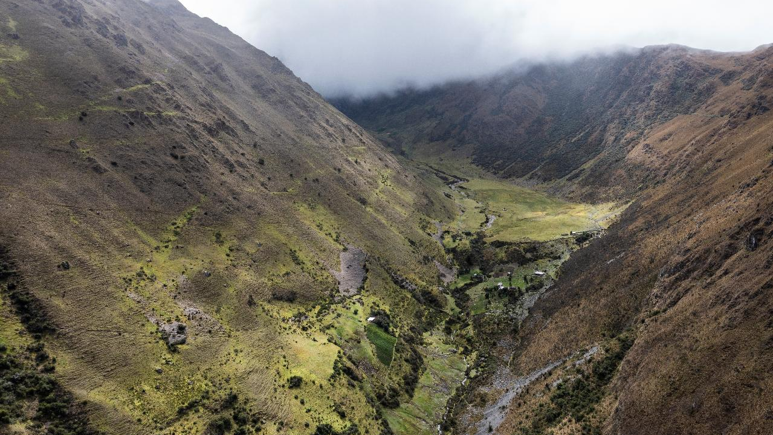
Notes:
Sacred Valley, Peru

